Slide 1

Tension Relievers or
Stress Management Tips
Miss.M.N Priyadarshanie
B.Sc. Nursing (Hons)

Slide 2
Learning Objectives
Student will be able to :
  Define stress
  Describe what is Stress Control
  Identify Stress Management Techniques
  Use Stress Management Tips
  Understand the Importance of Managing Stress
  Identify What is Time Management
  Describe Benefits of time Management
  Use Time Management Strategies

Slide 3
Out line
Definition of Stress
Stress Control
Stress Management Techniques
Stress Management Tips
The Importance of Managing Stress
Time Management
Time Management Strategies

Slide 4
Stress

Slide 5
WHAT IS STRESS ?
HELP ME!
Stress is the reaction people have to excessive pressures or other types of demand placed upon them. It arises when they worry that they can’t cope.

Slide 6
WHAT IS STRESS ?
I HATE YOU
Stress is the our minds and body’s experience as we attempt to cope with our continually changing environment

Slide 7
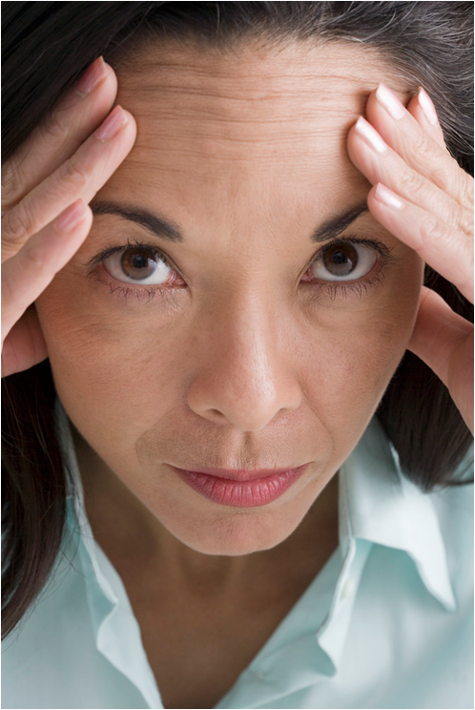
DEFINITION
S = P > R
Stress occurs when the pressure is greater than the resource

Slide 8
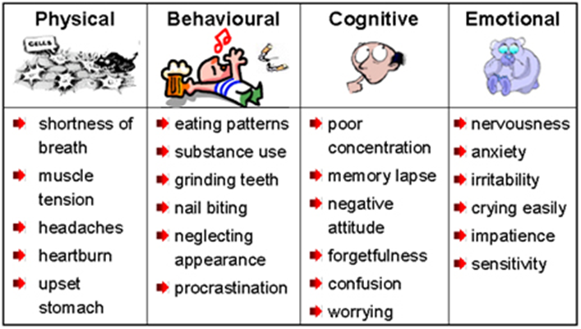
How do we know when we are feeling stress?

Slide 9
  Our goal is not to eliminate
  stress but to learn how to
  manage and use it
  to help us.

Slide 10
STRESS CONTROL
A B C STRATEGY

Slide 11
ABC STRATEGY
A = AWARENESS
What causes you stress?
How do you react?

Slide 12
ABC STRATEGY
B = BALANCE
There is a fine line between positive / negative stress
How much can you cope with before it becomes negative ?

Slide 13
ABC STRATEGY
C = CONTROL
What can you do to help yourself combat the negative effects of stress ?

Slide 14
Stress Management Techniques
Change your thinking
Change your behaviour
Change your lifestyle

Slide 15
Stress Management Tips

Slide 16


1. Try Physical Activity
Reduce your pressure through physical activity.
Physical activity
  Reduces pressure
  Refresh you.
  Energize you.
Examples:
  Walking, Running, Gardening, Cleaning etc.

Slide 17


Slide 18
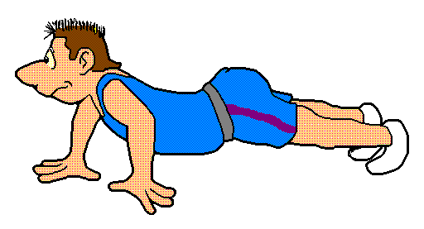

Slide 19
2. Shift Your Work
When we do the same work for a long time, we will get tired
Changing work/task reduces stress

Slide 20
3. Give a Break
Give a break to re-arrange the system
Give time to re-charge or repair your body.
Give your body a chance to heal itself
Give yourself a break to just relax
Temporarily remove yourself from stressful situation
Seek recovery every 90 to 120 minutes

Slide 21
Need for a Break
Increased stress produces increased performance, initially.
Once you pass a certain point (Disappointment), any more stress results in decreased performance.
Trying harder at this point is unproductive or even counter -productive.
The only sensible move is to take a break.

Slide 22
4. Focusing one at a time
Do not overwhelm yourself with entire workload
Pick out few things & deal with them
Concentrate on one activity
Finish one by one.

Slide 23
5. Take a Deep Breath
Inhale and exhale in an appropriate way to reduce stress.
  Deep breathing brings additional oxygen to body.
  It improves the functions of the body.
Poorly oxygenated blood brings anxiety, irritability, fatigue and depression.

Slide 24
6. Reduce your Workload
Cancel/avoid/give-up unnecessary and unwanted activities/tasks.
Postpone your activities.
Delegate some of your work.
Find alternative.
Change your method of doing the job.
Reduce your working hours.

Slide 25
7. Match work with Your Body Clock
Identify your Body Clock
Discover your peak performance time
- Morning, evening, night.
Assign the work to match your body clock.

Slide 26
8. Eliminate Distraction
Deliberately reduce all the distraction.
  Telephone calls.
  Visitors.
  Paper work.
  Unnecessary noise/lights.

Slide 27

9. Learn to Relax
Each of us have innate capacity to calm stress response
Only few of us regularly make use of it
Many of us don’t give enough time to use nature’s most guaranteed heal energizer
Learning to relax is like learning a new skill

Slide 28
10. Work-leisure Balance
Leisure time and levels of distress are inversely proportional
  the less leisure, the more stress.
Plan your leisure time

Slide 29

11. Muscular Relaxation
Muscular relaxation - tensing and relaxing various muscle groups can work wonders.
Try your neck and shoulders, your shoulder blades, your forehead and eyes, tensing these groups for a few seconds, then relaxing them.

Slide 30
12. Visualization
Visualization is another technique for relaxation
Steps:
  Cultivate & collect positive images of success & happy situations
  Move to peaceful & comfortable setting
  Imagine a scene, place or event that you remember peaceful, restful, beautiful and happy memory.
  You can bring all senses ie; Sound, Smell,Taste,Warmth etc

Slide 31
13. Learn to Accept
If a problem is beyond your control and cannot be changed, don’t fight.
Accept it at that moment and later you may change it.

Slide 32
14. Learn to Forget
Do not remember bad memories
Do not amplify hurts/worries
Imagine nothing happened
You can deceive your mind

Slide 33
15. Learn to Lose
Practice to take-up defeat.
Life is Game to Play
Allow others to win
Win-Win or Lose-Win

Slide 34
16. Laugh a Lot
Learn to Smile
Laugh a lot and make others laugh
With laughter stress will fade away
Wherever appropriate smile
Smile cost nothing
Humor is a wonderful stress reducer, an antidote to upsets. Laughter relieves tension.

Slide 35
17. Share your Feelings
Talk to someone about your worries.
Share your feelings with the person closer to you in a limited way
Develop support group

Slide 36
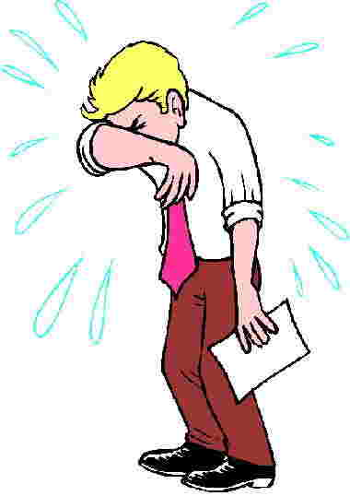
18. It is o.k. to Cry
A good cry can be a healthy way to bring relief.
It may prevent headache or other physical consequences.

Slide 37
19. Be Realistic
Be good to yourself
Do not fix un-achievable targets
Be more realistic

Slide 38
20. Not to become too
Perfectionist
We do not need to become a perfectionist
Give up the fallacious assumption that you have to be perfect

Slide 39
21. No Need to Become No #1
No need to become no.1 in everything
Settle with second or third best
  Purchasing
  Your partner
Reduce pressure of becoming first.
Happy with second/third best.

Slide 40
22. Non-Competitive
Life is not a contest
Never compete with others
Don’t compete unnecessarily
Compete with yourself

Slide 41
23. No need to React
No need to react to everything
No need to listen to all or watch all TV programs.
No need to read all the newspapers.
No need to have more friends.
Reduce material things and items.

Slide 42
24. No need to Control
Eliminate the temptation of control.
Lack of control is not a failure
You don’t need to control all the people, events, activities all the time.

Slide 43
25. Minimize External Pressures
Avoid or eliminate external pressures
Learn to say “no”

Slide 44
26. Reward yourself
Even for small successes, celebrate.
Promise yourself a reward for completing each task.
Indulging reward-
  Indulge yourself and reward
Review your success

Slide 45
27. Prioritize Things
Reduce the un-important and urgent from 80% to 20%.
Discriminate important and unimportant things
Allocate more time for important things and not urgent things

Slide 46
28. Check your Ego
Learn not to get angry
Admit Mistakes
Accept criticism

Slide 47
Learn not to get angry
When encounter problem,
Do not get angry
Take steps to solve the problem

Slide 48
Admit Mistakes
Do not defend
You have to learn to admit mistakes
Many people admire your honesty
Accepting your mistakes will give positive impact

Slide 49
Accept Criticism
Successful people know how to accept and learn from criticism in a way that earns you respect
They know how to deal with justified criticism and unjustified criticism

Slide 50
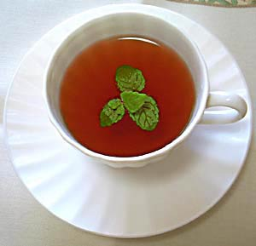
29. Avoid Bad Responses to Stress
Smoking
Coffee
Alcohol

Slide 51
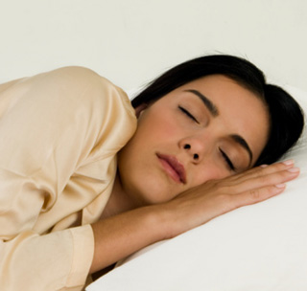

30. Get Enough Sleep
Lack of rest aggravates stress
Go to bed early and wake up early
Maintain Consistent bedtime and wake-up time

Slide 52
31. Developing Support Group
Find your mentor
Establish your network
People who keep things to themselves carry a considerable and unnecessary burden.

Slide 53
32. Right to Make Mistakes
You have the right to make mistakes as a human being.
No need to give excuses- Enjoy making mistakes.
You are taking the responsibility and meet the consequences.
When you want you can correct it.

Slide 54
33. Meditate
Meditate. Just ten to twenty minutes of quiet reflection may bring relief from chronic stress as well as increase your tolerance to it.
Use the time to listen to music, relax and try to think of pleasant things or nothing.

Slide 55
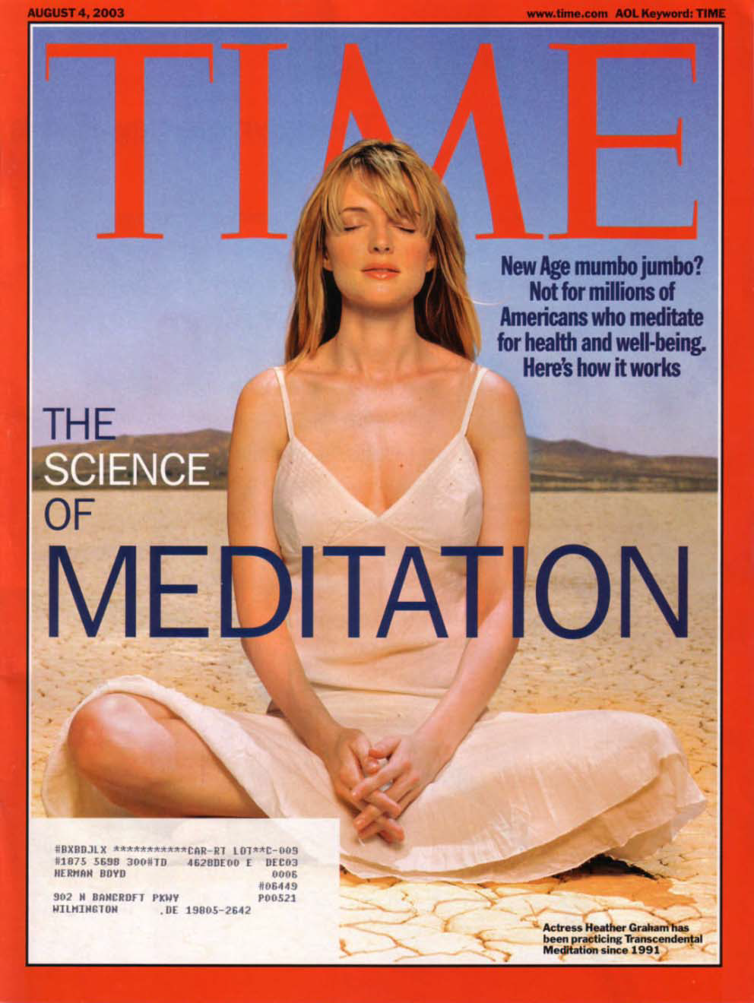

Slide 56
34. Develop Hobbies
Take a break from your worries by doing something you enjoy.
Whether it’s gardening or painting, schedule time to indulge your interest

Slide 57
Use the Method that Suit You
There is no universally accepted method to reduce stress.
All tips are not same and work well for different people.
Identify the best method that suits you and practice that.
By strictly practicing the above methods you might reduce your stress level by 15% to 20% immediately.

Slide 58
35. Seek Professional Help
If your stress level exceeds the control, go for professional help
If you find yourself in an unmanageable stage seek professional help

Slide 59
The importance of managing stress
People from all walks of life suffer from stress one way or another.
Stress can make you weak so if you do not take care of yourself you can get sick which can lead to more problems down the road.
When stress becomes excessive it can be very damaging. It can harm:
health, happiness, work performance, team spirit and co-operation, relationships and personal development
It is important to recognise and address the underlying causes of stress, or else the experience of stress will never go away.

Slide 60
The importance of managing stress contd..,
Stress is necessary in order to survive
Stress is necessary for development and growth
Stress helps us to achieve peak performance when required
Stress is manageable
Too much stress can wear us out “mentally and physically” and is a leading cause of illness

Slide 61
The importance of managing stress cond..,
Try to identify your own stress triggers
Adopt techniques which work for you - we all cope with stress differently
Be aware of your own symptoms of stress
Accept yourself and don't try to be perfect
Take action to tackle your problems
Look after yourself physically and mentally

Slide 62
Time Management

Slide 63
Benefits of time management
Reduce stress and frustrations
Improves performance and job satisfaction
More time to enjoy life
Have control over your life through planning
Get a sense of achievement

Slide 64
Time Management Strategies
80:20 Rule
Pareto’s Principle:
  80% of results are achieved with only 20% of the effort

Slide 65
Time Management Strategies cond..,
Goal Setting
Planning
Prioritized To-Do List
Urgent versus Important
Prioritization
Top Four
  Identify your top 4 tasks for the week and for each day

Slide 66
Time Management Strategies cond..,
Get organized
Utilize Time Gaps
Using your time Twice
Learn to say NO
Delegation

Slide 67
Summery….

Slide 68
Questions??

Slide 69
Thank You !

