Slide 1
Nutrition
M. Nirmala Priyadarshanie
B.Sc. Nursing (Hons)

Slide 2
Topics
3.1 Performing a Nutritional assessment.
3.2 Oral nutrition, Serving foods and assisting feeding.
3.3 Enteral nutrition- Feeding through a nasogastric tube.
3.4 Parenteral nutrition

Slide 3
Study questions
What is the importance of nutrition?
What are the major nutrients?
What you mean by a balance diet?
How to do a nutritional assessment?

Slide 4
Nutrition – the science of food and how the body uses food
Nutrients – substances in food
Calories – measures energy in food
Metabolism – chemical process in the body that keeps us alive and active

Slide 5
Six classes of nutrients
Carbohydrates
Fats
Proteins
Vitamins
Minerals
Water

Slide 6
Carbohydrates
Fruit
Milk
Cookies
Potato
Types of carbohydrates – simple (single or double sugar
molecule) and complex carbohydrates
Sugars
Glucose – single molecule sugar
Sucrose (table sugar) – double molecule sugar
Fructose – single molecule sugar found in fruits
Lactose – single molecule sugar found in milk

Slide 7
Starches
Are complex carbohydrates that are broken down by the body in
to sugars that can be used by the body.
Glycogen – stored carbohydrates
Excess carbohydrates are stored as fat
Fiber
Complex carbohydrate, provides little energy and can not be
digested. Increases the amount of fluid and bulk in the intestine.
Soluble fiber – oat bran, apples, beans and some vegetables
Insoluble fiber – fruits, vegetables and grains

Slide 8
Fats (lipids)
Fats is an
Essential nutrient
Adds to texture, flavor and aroma
Can cause weight gain, heart diseases and cancer
Large molecules made up of fatty acids and glycerol –triglycerides
Saturated fat made up of saturated fatty acids (this are solid at room temperature) ex. Meat, milk, coconut and palm oil
Unsaturated fat made up of unsaturated fatty acids (are liquid at room temperature) ex more common in plants
25-35 % of total calorie intake

Slide 9
Cholesterol found in human and animal tissues. Important to make vitamin D, cell membranes, certain hormones and bile
Low density lipoprotein LDL
High density lipoprotein HDL
Proteins
Proteins are amino acids that help build new cells and repair existing ones
Needed to form hormones, enzymes, antibodies and other important molecules
Excess protein is stored as fat
Essential amino acids
Nonessential amino acids
10-35 % of total calories

Slide 10
Vitamins
Needed in small amount to maintain health and allow growth
Fat-soluble vitamins – A, D, E and K
Water-soluble vitamins – B complex (eight) and C
Minerals
More than 20 minerals are essential in small amounts
Needed enzyme activity and bone formation
Water
60% of your body is water
Essential in every function
8 glasses per day

Slide 11
FUNCTIONS OF FOOD
Body needs certain essential ‘nutrients’ for its well-being.
Nutrients that are derived from food.
Energy-yielding,
Body-building, and
Protective foodstuffs
according to predominant role they play in sustaining life.

Slide 12
FUNCTIONS OF FOOD
Food provides energy to keep the body warm, the muscles active for work and play and the various organs alert to carry out the daily activities.
Food supplies body building nutrients needed for growth, while the fetus develops in the mother’s womb, new tissues are being continuously built. This proceeds right through infancy, childhood and adolescence.

Slide 13
Protective function.
Required in minute quantities.
Variety of these nutrients, each responsible for a specific task in the body. If the diet is deficient or lacking in one or more of these vital substances, it leads to derangement of the normal functioning of the different parts of the body, resulting in ill-health, stunted growth and imperfect development.

Slide 14
Energy-yielding foodstuffs
Foodstuffs form the great bulk of the ordinary diet.
They supply energy to keep the body warm and are hence known as ‘fuel-food.’
A few examples of energy-yielding foodstuffs are cereals starchy vegetables, pulses, nuts, sugars, and oils.

Slide 15
Body-building foodstuffs
Contain a satisfactory amount of the nutrients needs to build the body and replace the worn-out tissues.
Milk and its products, meat, fish, and eggs are the best representatives of this group of foodstuffs.
The other examples are legumes, dals, dried beans, peas and nuts.
Cereals also contain some body-building nutrients.

Slide 16
Protective foodstuffs
Provide large number of the protective substances needed by the body.
Almost all natural foodstuffs contain one or more of these protective nutrients.
There is no single foodstuff in which all the different protective substances are present in quantities sufficient to meet the daily needs of the body.
This is why a combination of different kinds of foodstuffs is essential in a diet.

Slide 17
Best examples of this group of foodstuffs are green vegetables, fresh fruits, milk, meat, fish, and eggs.
Protective foodstuffs contain sufficient amounts of one or more of the protective nutrients so that a combination of them yields enough to maintain life.

Slide 18
THE THREE FOOD GROUPS
Food groups serves as a general guide to chose a Balance Diet.
It also provides information as to which of the different foodstuffs can be substitute for one that may be temporarily unavailable.

Slide 19
ENERGY RICH FOODS
Major Nutrients | Other Nutrients
Carbohydrates and fats
Whole grain cereals, millets | Protein, fibre, minerals, calcium, iron, B-complex, vitamins
Vegetable oils, butter | Fat soluble vitamins, essential fatty acids
Nuts and oilseeds | Proteins, vitamins / minerals
Sugars | Nil

Slide 20
BODY BUILDING FOODS
Major Nutrients | Other Nutrients
Proteins
Pulses, nuts, & oilseeds | B-complex, vitamins, invisible fat, fiber
Milk and milk products | Calcium, vitamin A, riboflavin, vitamin B12
Meat, fish, poultry | B-complex, vitamins, iron, iodine, fat

Slide 21
PROTECTIVE FOODS
Major Nutrients | Other Nutrients
Vitamins and minerals
Green leafy vegetables | Antioxidants, fibre and other carotenoids
Other vegetables/fruits | Fibre, sugar, and antioxidants
Eggs, milk and milk products and flesh foods | Protein and fat

Slide 22
FOOD REQUIREMENTS
Vary according to age, sex, and activity of the individual.
Special demands are made during stress periods, such as pregnancy, lactation, infancy, and childhood, since during these periods, the individual needs increased amounts of Body-Building and Protective nutrients.

Slide 23
MICRONUTRIENTS
Play an essential role in the metabolic processes of the human body, but are only required in small quantities.
Because of their essential role, when micronutrients are not sufficient from food in the diet, significant health problems can result.

Slide 24
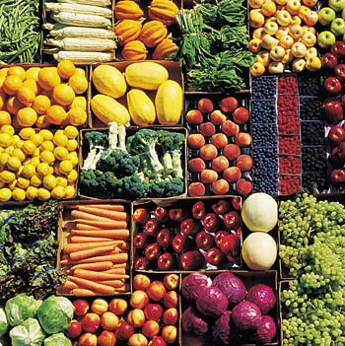
legumes

Slide 25
WHAT IS A BALANCE DIET?
A balance diet is one which provides all the nutrients in required amounts and proper proportions.
It can easily be achieved through a blend of four basic food groups.
The quantities of foods needed to meet the nutrient requirements vary with age, gender, physical activity and physiological status.
A balanced diet should provide around 60-70% of total calories from carbohydrates, preferably starch, about 10-12% from proteins and 20-25% from fat.

Slide 26
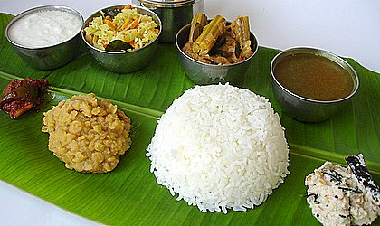

Slide 27
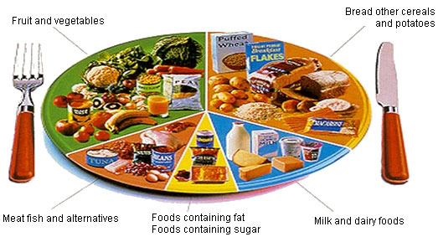

Slide 28
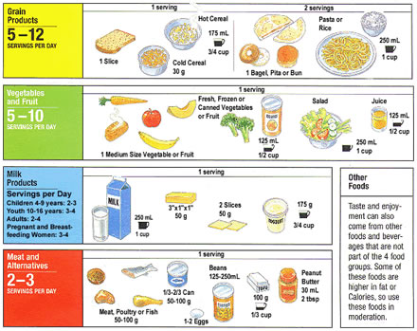

Slide 29
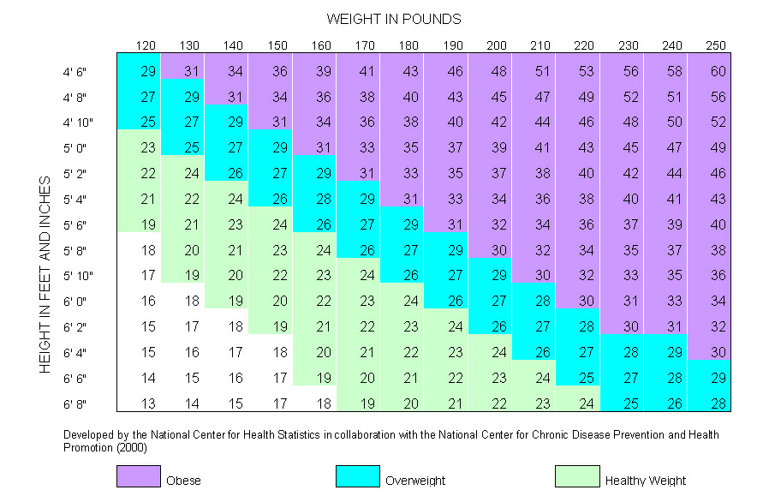
BMI
Body Mass
Index
Weight in Kilogram
==
Height in meters²

Slide 30
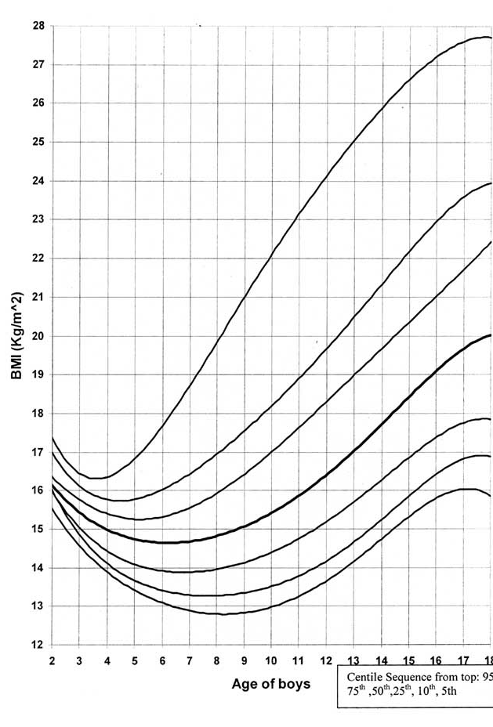
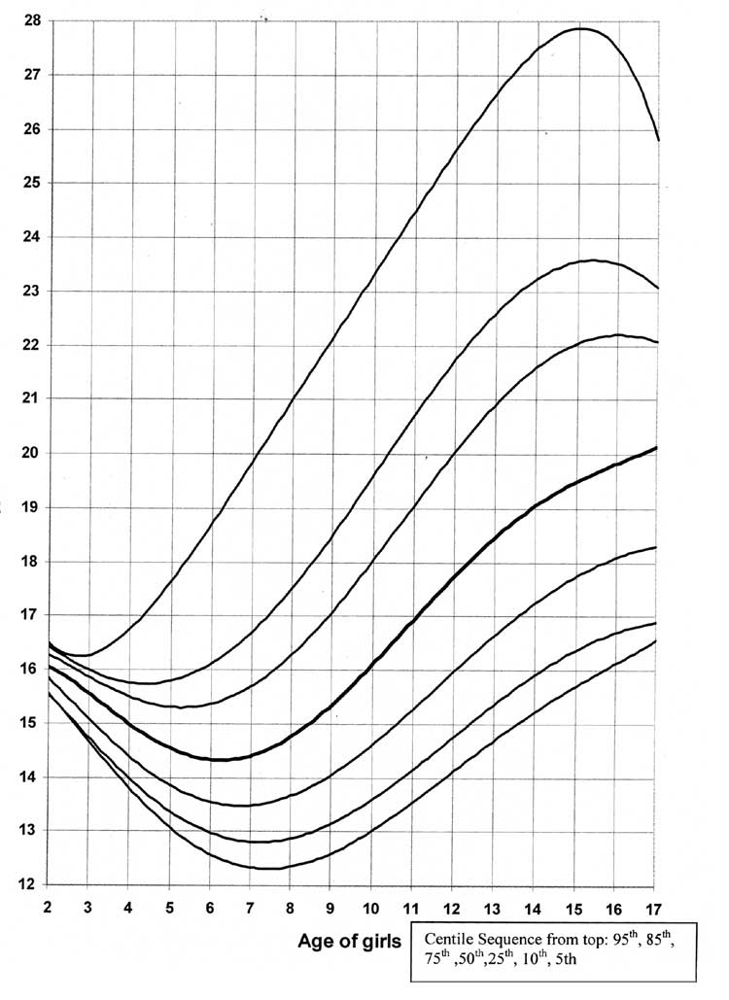

Slide 31
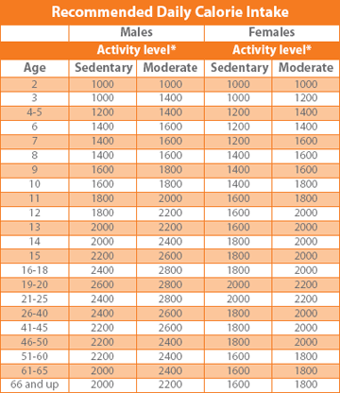

Slide 32
Tools for a Healthful Diet
My Pyramid
Provides an individualized approach to a healthy diet and physically active lifestyle

Slide 33
Tools for a Healthful Diet
MyPyramid
Divides food into six categories – grains, vegetables, fruits, milk, meat and beans, and oils
Should eat food from each category – including oil!
The width of the band indicates how much to consume – the wider the band, the more you should eat from that group (proportion)
Moderation is shown by the bands getting smaller at the top – bottom of the pyramid is the healthier options and the tip is for foods high in fat, sugar and sodium
Physical activity is shown by the person climbing the steps
The person in the pyramid indicates that each plan is individualized and will differ depending on the person’s needs

Slide 34
Tools for a Healthful Diet
MyPyramid
Food Groups
Helps you identify what foods are in each group, what counts as a portion, and how to make a healthy selection
Grains – foods made from wheat, rice, oats, cornmeal, barley, and other grains; half of the grains should be whole grains which include whole wheat flour, bulgur, oatmeal, brown rice, and whole cornmeal; refined grains include white bread, white rice, and other white flour products and should be consumed in moderation
Vegetables – provide a variety of nutrients and fiber; divided into five subgroups (Same as DGA); can be fresh, frozen or canned
Fruits – rich in nutrients and fiber; may be fresh, frozen, pureed, dried, or canned

Slide 35
Milk – high in protein and calcium; very little calcium is found in ice cream, cream cheese, butter so they are NOT included in this food group; consume 3 cups each day
Meat and Beans – provides a variety of nutrients including proteins, essential fatty acids, and vitamin E; includes meat, poultry, fish, dry beans and peas, seeds, nuts, and eggs; choose lean meats and poultry to avoid saturated fats and cholesterol ; beans and peas are also part of the vegetable group
Oils – fats that are liquid at room temperature; some are needed; high in calories

Slide 36
Nutritional Support

Slide 37
Nutritional Support may supplement normal feeding, or completely replace normal feeding into the gastrointestinal tract

Slide 38
Benefits of Nutritional Support
Preservation of nutritional status
Prevention of complications of protein malnutrition
↓ Post-operative complications

Slide 39
Who requires nutritional support?
Patients already with malnutrition - surgery/trauma/sepsis
Patients at risk of malnutrition

Slide 40
Patients at risk of malnutrition
Depleted reserves
Cannot eat for > 5 days
Impaired bowel function
Critical Illness
Need for prolonged bowel rest

Slide 41
How do we detect malnutrition?

Slide 42
Nutritional Assessment
History
Physical examination
Anthropometric measurements
Laboratory investigations

Slide 43
Nutritional Assessment
History
Dietary history
Significant weight loss within last 6 months
> 15% loss of body weight
compare with ideal weight
Beware the patient with ascites/ oedema

Slide 44
Nutritional Assessment
Physical Examination
Evidence of muscle wasting
Depletion of subcutaneous fat
Peripheral oedema, ascites
Features of Vitamin deficiency
eg nail and mucosal changes
Echymosis and easy bruising
Easy to detect >15% loss

Slide 45
Nutritional Assessment
Anthropometry
Weight for Height comparison
Body Mass Index (<19, or >10% decrease)
Triceps-skinfold
Mid arm muscle circumference
Bioelectric impedance
Hand grip dynamometry
Urinary creatinine / height index

Slide 46
Nutritional Assessment
Lab investigations
albumin < 30 mg/dl
pre-albumin <12 mg/dl
transferrin < 150 mmol/l
total lymphocyte count < 1800 / mm³
tests reflecting specific nutritional deficits
eg Prothrombin time

Slide 47
Types of Nutritional Support
Enteral Nutrition
Parenteral Nutrition

Slide 48
Enteral Feeding is best
More physiologic
Less complications
Gut mucosa preserved
No bacterial translocation
Cheaper

Slide 49
Enteral Feeding is indicated
When nutritional support is needed
Functioning gut present
No contra-indications
no ileus, no recent anastomosis, no fistula

Slide 50
Types of feeding tubes
Tubes inserted down the upper GIT, following normal anatomy
Naso-gastric tubes
Oro-gastric tubes
Naso-duodenal tubes
Naso-jejunal tubes

Slide 51
Types of feeding tubes
Tubes that require an invasive procedure for insertion
Gastrostomy tubes
Percutaneous Endoscopic Gastrostomy (PEG)
Open Gastrostomy
Jejunostomy tubes

Slide 52
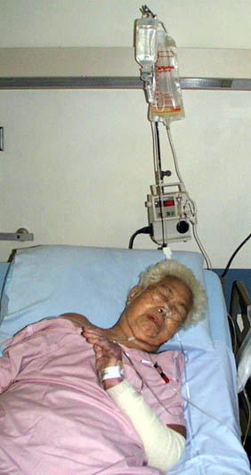
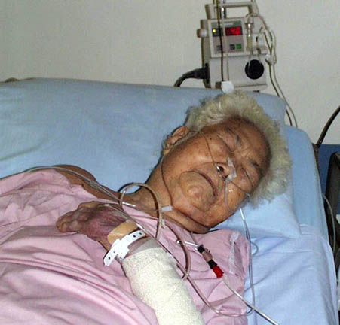

Slide 53
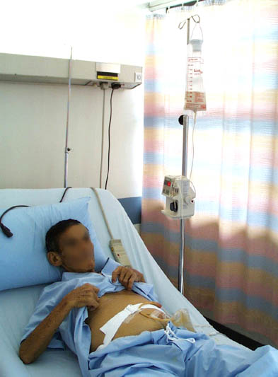

Slide 54
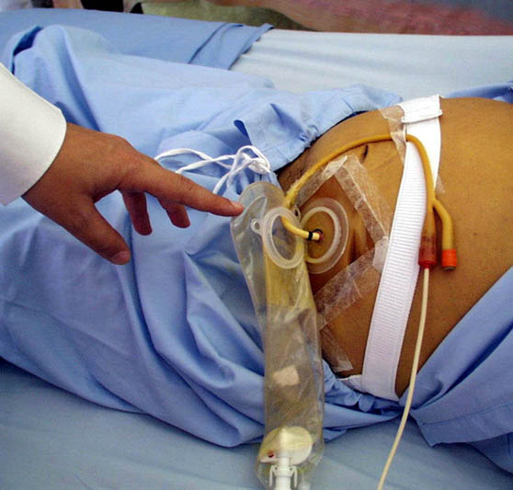

Slide 57
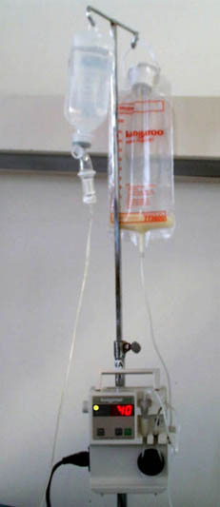
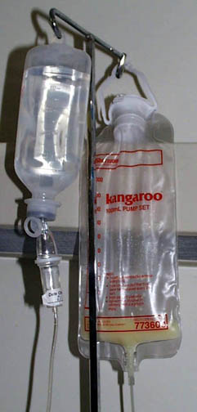

Slide 58
What can we give in tube feeding?
Blenderized feeds
Commercially prepared feeds

Slide 59
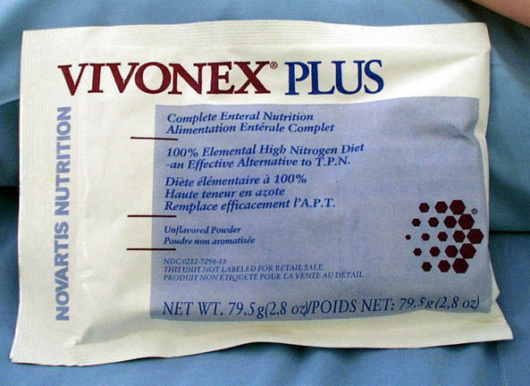

Slide 60
Complications of enteral feeding
12% overall complication rate
Gastrointestinal complications
Mechanical complications
Metabolic complications
Infectious complications

Slide 61
Complications of enteral feeding
Gastrointestinal
Distension
Nausea and vomiting
Diarrhoea
Constipation
Intestinal ischaemia

Slide 62
Complications of enteral feeding
Infectious
Aspiration Pneumonia
Bacterial contamination

Slide 63
Complications of enteral feeding
Mechanical
Malposition of feeding tube
Sinusitis
Ulcerations / erosions
Blockage of tubes

Slide 64
Parenteral Nutrition

Slide 65
Parenteral Nutrition
Allows greater caloric intake
BUT
Is more expensive
Has more complications
Needs more technical expertise

Slide 66
Who will benefit from parenteral nutrition?
Patients with/who
Abnormal Gut function
Cannot consume adequate amounts of nutrients by enteral feeding
Are anticipated to not be abe to eat orally by 5 days
Prognosis warrants aggressive nutritional support

Slide 67
Two main forms of parenteral nutrition
Peripheral Parenteral Nutrition
Central (Total) Parenteral Nutrition
Both differ in
composition of feed
primary caloric source
potential complications
method of administration

Slide 68
Peripheral Parenteral Nutrition
Given through peripheral vein
short term use
mildly stressed patients
low caloric requirements
needs large amounts of fluid
contraindications to central TPN

Slide 69
What to do before starting TPN
Nutritional Assessment
Venous access evaluation
Baseline weight
Baseline lab investigations

Slide 70
Venous Access for TPN
Need venous access to a “large” central line with fast flow to avoid thrombophlebitis
Long peripheral line
subclavian approach
internal jugular approach
external jugular approach
Superior Vena Cava

Slide 71
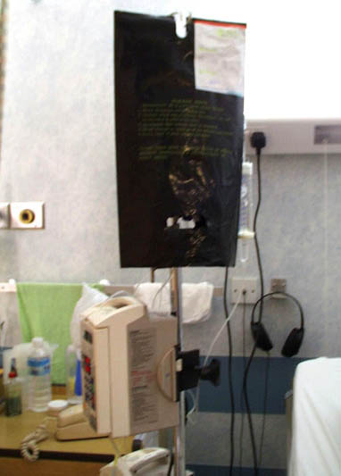

Slide 72
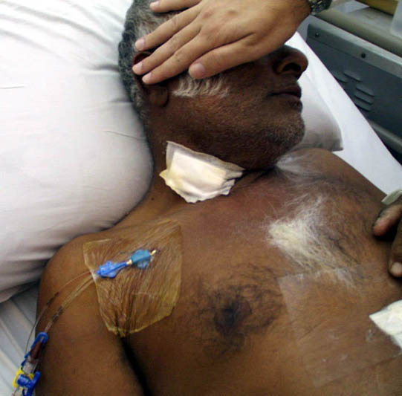

Slide 73
TPN Monitoring
Clinical Review
Lab investigations
Adjust TPN order accordingly

Slide 74
Clinical Review
clinical examination
vital signs
fluid balance
catheter care
sepsis review
blood sugar profile
Body weight

Slide 75
Lab investigations
Full Blood Count
Renal Panel
Ca⁺⁺, Mg⁺⁺, PO₄³⁻
Liver Function Test
Iron
Lipid Profile
Nitrogen Balance

Slide 76
Complications related to TPN
Mechanical Complications
Metabolic Complications
Infectious Complications

Slide 77
Mechanical Complications
Related to vascular access technique
pneumothorax
air embolism
arterial injury
bleeding
brachial plexus injury
catheter malplacement
catheter embolism
thoracic duct injury

Slide 78
Mechanical Complications
Related to catheter in situ
Venous thrombosis
catheter occlusion

Slide 79
Metabolic Complications
Abnormalities related to excessive or
inadequate administration
hyper / hypoglycaemia
electrolyte abnormalities
acid-base disorders
hyperlipidaemia

Slide 80
Metabolic Complications
Hepatic complications
Biochemical abnormalities
Cholestatic jaundice
too much calories (carbohydrate intake)
too much fat

Slide 81
Infectious Complications
Insertion site contamination
Catheter contamination
improper insertion technique
use of catheter for non-feeding purposes
contaminated TPN solution
contaminated tubing
Secondary contamination
septicaemia

Slide 82
Stopping TPN
Stop TPN when enteral feeding can restart
Wean slowly to avoid hypoglycaemia
Monitor hypocounts during wean
Give IV Dextrose 10% solution at previous infusion rate for at least 4 to 6h
Alternatively, wean TPN while introducing enteral feeding and stop when enteral intake meets TEE

Slide 83
Summery……..!

Slide 84
Questions??

Slide 85
Thank You !

