Slide 1
Nursing as a Developing Profession
Miss.M.N Priyadarshanie
B.Sc. Nursing (Hons)

Slide 2
Learning Objectives
Student will be able to :
Define Nursing
Describe Foundation of Nursing
Define Discipline
Describe Nursing as a Discipline
Define Professionalism
Identify Criteria for a Profession
Describe Nursing as a Profession
Describe Professional Nursing Education

Slide 3
Learning Objectives cond..,
Understand Professional Nursing Practice
Identify Standards of Professional Practice
Understand Professional Socialization
Identify Professions vs. Occupations
Describe Evolution of a Profession Professionalization
Understand Barriers to Professionalism
Describe Does Nursing qualify as a Profession?
Identify Key Principles of Nursing

Slide 4
Learning Objectives cond..,
Identify Standards of Clinical Practice
Describe Characteristics of Expert Clinical Practice
Define Level of Proficiency
Understand Dimensions of Nursing
Identify Roles and Functions of the Nurse
Identify Career Roles
Understand Nursing’s Future Challenges
Describe Challenges in Nursing Education
Understand Future Trends in Nursing
Describe New Concepts to Explore

Slide 5
Out line
Definition of Nursing
Nursing as a Discipline
Criteria for a Profession
Definition of Professionalism
Professional Nursing Education
Standards of Professional Practice
Professions vs. Occupations
Barriers to Professionalism
Key Principles of Nursing

Slide 6
Out line cond..,
Standards of Clinical Practice
Characteristics of Expert Clinical Practice
Level of Proficiency
Dimensions of Nursing
Roles and Functions of the Nurse
Career Roles
Nursing’s Future Challenges
Future Trends in Nursing
New Concepts to Explore

Slide 7
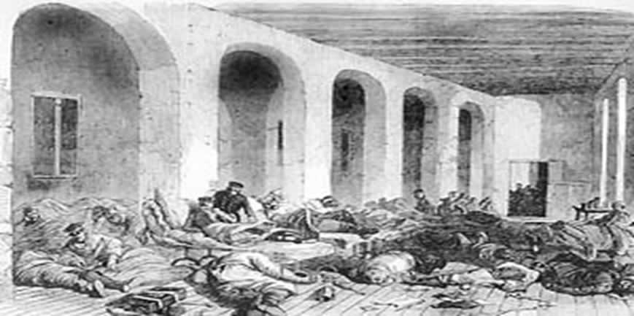
Barrack Hospital, Istanbul.
Florence Nightingale's big opportunity came when the Secretary at War, who knew the family, asked her to go to the Crimea to take charge of the hospital at Scutari in Turkey.

Slide 8
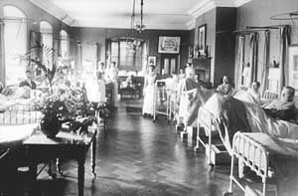
A Nightingale Ward

Slide 9
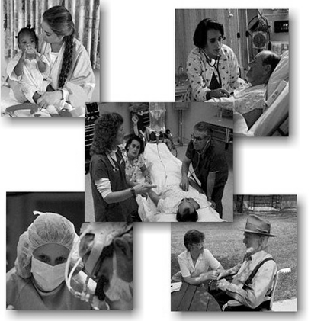
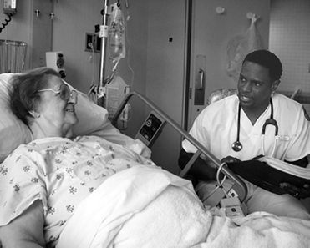
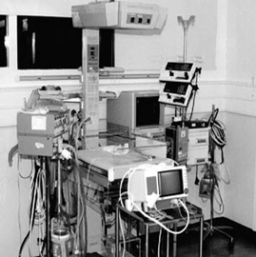
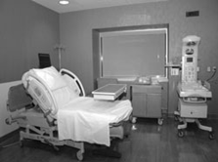
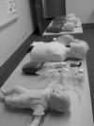
TODAY……

Slide 10
Definition of Nursing
Nurses’ unique function is to help individuals, both sick and well, perform activities that contribute to their health or recovery (or facilitate a peaceful death) that they would perform unaided if they had the necessary strength, will, or knowledge, and to accomplish this function in such a way as to help individuals gain independence.
V. Henderson, 1960

Slide 11
ANA Definition of Nursing
Nursing is the protection, promotion, and optimization of health and abilities, prevention of illness and injury, alleviation of suffering though the diagnosis and treatment of human response, and advocacy in the care of individuals, families, communities and populations.
ANA, 2003

Slide 12
Foundation of Nursing
Theories of nursing
Scientific knowledge
Relevance to basic social values
Professional autonomy
A sense of commitment
A sense of community
A code of ethics

Slide 13
Disciplines
Professional and Academic
Academic disciplines focus on research and education
Professional disciplines add component of clinical practice

Slide 14
Nursing as a Discipline
Discipline-
A unique perspective or way of viewing something
It is a body of knowledge, practice , and system of rules
It defines the boundaries in which we practice
“Nursing is an evolving discipline”

Slide 15
Nursing as a Discipline cond..,
Nursing falls under professional disciplines
Nursing is an Art – It is the creative use of knowledge in service to others
Nursing is a Science – It is a body of knowledge based on scientific research and analysis

Slide 16
Definition of Professionalism
A profession is any job where you need specialized knowledge and training. Nursing combines science and technology with people skills like: communication, problem solving, teaching, and compassion. ( affection)

Slide 17
Criteria for a Profession
Specialized education
Code of ethics
Research of orientation
Autonomy
Body of knowledge
Service orientation
Professional Organization

Slide 18
Criteria for a Profession cond..,
Complex occupation
Self-employed
Person-oriented
Competence tested
Licensed
High income & prestige

Slide 19
Nursing as a Profession
Profession
Body of knowledge that describes phenomena
Members add to the body of knowledge and remain current
Members are educated in institutions of higher education
Application of knowledge in practical service to society; older members shape the skills of new members
Autonomous formation of professional policy and in monitoring of its practice and practitioners

Slide 20
Autonomy
The quality or state of being self-governing; especially: the right of self-government
Self-directing freedom and especially moral independence

Slide 21
Nursing as a Profession cond..,
Guided by a code of ethics that regulates relationships between professional and client
Common culture, norms and values between members
Clear standard of educational preparation for entry into practice
Members value service above personal gain
Compensation for members

Slide 22
CODE OF ETHICS American Nurses Association
1. The nurse provides services with respect for human dignity and the uniqueness of the client unrestricted by considerations of social or economic status, personal attributes, or the nature of health problems.
2. The nurse safeguards the client’s right to privacy by judiciously protecting information of a confidential nature.
3. The nurse acts to safeguard the client and the public when health care and safety are affected by the incompetent, unethical, or illegal practice of any person.
4. The nurse assumes responsibility and accountability for individual nursing judgments and actions.
5. The nurse maintains competence in nursing.

Slide 23
CODE OF ETHICS cond.., American Nurses Association
6. The nurse exercises informed judgment and uses individual competence and qualifications as criteria in seeking consultation, accepting responsibilities, and delegating nursing activities to others.
7. The nurse participates in activities that contribute to the ongoing development of the profession’s body of knowledge.
8. The nurse participates in the profession’s efforts to implement and improve standards of nursing.
9. The nurse participates in the profession’s efforts to establish and maintain conditions of employment conducive to high-quality nursing care.
10. The nurse participates in the profession’s effort to protect the public from misinformation and misrepresentation and to maintain the integrity of nursing.
11. The nurse collaborates with members of the health professions and other citizens in promoting community and national efforts to meet the health needs of the public.

Slide 24
Professional Nursing Education
Entry-level education
Diploma programs
Associate’s degree programs
Baccalaureate degree programs
Graduate degree entry programs
Advanced practice education
Master’s degree programs
Doctoral degree programs
Continuing education
In-service Education

Slide 25
Levels of Entry Into Nursing
Diploma programs
Nursing education took place in hospital based training schools, diploma was awarded at completion of program
A 2-3 year experience was more common
prepares students for work in a hospital or other inpatient facility.

Slide 26
Levels of Entry Into Nursing cond..,
Associate’s Degree programs
3 - 4 years Associate Degree focuses more on technical skills than theory and is often a stepping stone to the BSN.
It allows a student to become a Registered Nurse and earn money more quickly than a 4 - year BSN program, so it works better for many students.

Slide 27
Levels of Entry into Nursing cond..,
Baccalaureate degree programs (BSN)
Provides broader education in sciences and liberal arts than other programs
Prepares graduate for greater variety of roles
Community Nursing
Leadership roles

Slide 28
Levels of Entry into Nursing cond..,
4 - years BSN is preferred by most nursing leaders and provides the best opportunities in today's job market.
If you look in the classifieds, you'll find that a BSN is a requirement for many positions.

Slide 29
Advanced practice education
Master’s degree programs (MSc)- 1-2 years
Nursing Education
Nurse Practitioner
Clinical Nurse Specialist
Nurse Anesthetist
Nurse Midwife
Nursing Administration
Doctoral degree programs (PhD) – 4 - 8 years

Slide 30
Professional Nursing Practice
Standards of professional nursing
Professional nursing organizations
Professional nursing roles
– Caregiver – Communicator
– Advocate – Manager
– Critical thinker – Researcher
– Teacher – Rehabilitator
Challenges

Slide 31
Standards of Professional Practice
Describe the competence level of professionals
Used to help “measure” competence in:
Licensure
Certification
Accreditation

Slide 32
ANA Standards of Professional Practice
Include:
Quality of care
Performance appraisal
Education
Collegiality
Ethics
Collaboration
Research
Resource utilization
Notes:
Collegiality: having consideration and respect among colleagues; colleague: a fellow worker in the same profession

Slide 33
Licensure
NCLEX – RN
Required of all nursing students who wish to practice as a registered nurse
Being a “registered” nurse indicates to the public that you have the minimal competencies to provide safe nursing care
Minimum standard

Slide 34
Certification
Voluntary process
Agency or an association grants recognition to a person who has met specified qualifications
Signifies competency in a specialty area
Advanced practice

Slide 35
Accreditation
“Granting of approval to an institution of learning by an official review board after the school has met specific requirements.”

Slide 36
Professional Socialization
Gaining an identity in nursing
Internalizing the values and norms of the profession
Becoming equipped with a process for continued learning
Gaining a process for accommodation to changing ideas and knowledge

Slide 37
Socialization of the Student
Role development or socialization involves exposure to new ideas about nursing, health, wellness, illness, and caring for clients and challenging of old ideas
-Fact VS Myth –
Notes:
Cracking your knuckles gives you arthritis. Fact or Myth? (myth)
Handling a toad will give you warts. Fact or Myth?
Watching too much TV will make you fat. FAct

Slide 38
Socialization of the Student cond..,
A lifelong process shaped by;
Curriculum
Faculty
Nursing program attended
Process of gaining knowledge, skills, and behaviors
Involves a change in attitudes and values

Slide 39
Professions vs. Occupations
Professions
College or University
Prolonged education
Mental creativity
Decisions based on science or theoretical constructs
Values, beliefs & ethics integral part of preparation
Strong commitment
Autonomous
Unlikely to change professions
Commitment > reward
Individual accountability
Occupations
On the job training
Length varies
Largely manual work
Guided decision making
Values, beliefs & ethics not part of preparation
Commitment may vary
Supervised
Often change jobs
Motivated by reward
Employer is primarily accountable

Slide 40
Evolution of a Profession Professionalization
Practitioners perform full-time work in the discipline
Determine work standards, identify a body of knowledge and establish educational programs
Promote organization into effective occupational associations (licensure/certification)
Establish codes of ethics

Slide 41
Barriers to Professionalism
Variability in educational preparation
Gender issues
Historical influences
External conflicts
Internal conflicts

Slide 42
What about Nursing???
Profession
or
Occupation

Slide 43
Does Nursing qualify as a Profession?
Multiple levels of entry into Nursing
A discipline that does not require at least a baccalaureate degree to be licensed
Practice of Nursing is not viewed as a career by some nurses
Nurses have the lowest educational requirements among professional health care providers

Slide 44
Key Principles of Nursing
Nursing is in transition, and the nurse must remain current to meet tomorrow’s demands.
Nursing is client focused.
Nursing involves prevention of illness, promotion of health, maintenance of health, and comfort in dying.
Nursing is team focused to give a holistic approach to the management of individualized clients.
Nursing is an autonomous practice of research-based expertise that uses scientific principles to guide daily practice.
Nurses gather data daily to contribute to research to further advance the profession.

Slide 45
Key Principles of Nursing cond..,
Nursing values the highest standard of care possible and is based on standards that guide the profession.
Nurses hold other nurses responsible and should mentor them as needed.
Roles of nurses are varied, complex, and evolving with new technologies and research advances.
The client is a multidimensional individual who has unique needs that affect health care outcomes.

Slide 46
Key Principles of Nursing cond..,
Health is the maximization of the potential improvements possible within the limitations that the individual possess and includes a balance of spiritual, physical, and mental aspects.
All registered nurses take the same licensing examination (NCLEX-RN) no matter what level of education they use for entry-level practice.
Professional organizations assist in the development and maintenance of the standards of practice.
Ongoing education is valued, expected, and required for continued licensure.

Slide 47
Standards of Clinical Practice
Describes the responsibilities for which nurses are accountable
Established and implemented by professional organizations – ANA,CNA,NANDA,ICN,SLNA, SLNC,GNFSL
Reflect the values and priorities of the nursing profession
Provide direction for professional nursing practice
Provide a framework for the evaluation of nursing practice

Slide 48
Standards of Clinical Practice cond..,
Define the profession’s accountability to the public and the client outcomes for which nurses are responsible
Generic in nature
Provide for the practice of nursing regardless of area of specialty

Slide 49
Characteristics of Expert Clinical Practice
Application of knowledge and clinical expertise
Expertise to interpret clinical situations and make complex decisions
Critical thinking is essential and on going
Life long learning is essential due to the continuing changes in nursing knowledge
Experts practice evidence based nursing care.

Slide 50
Level of Proficiency
1. Novice – student nurse entering a clinical setting where he/she has no experience at all.
2. Advance – nurse who demonstrates a marginally acceptable performance: depends on rules and maxims.

Slide 51
Level of Proficiency cond..,
3. Competent- 2-3 years experience demonstrates organizational ability but lacks speed and flexibility of a proficient nurse.
4. Proficient – concerned with long term goals, performance is fluid and flexible compared to competent nurse
has a wholistic view of the client.

Slide 52
Level of Proficiency cond..,
5. Expert–no longer relies on maxims, performance is highly proficient, fluid flexible and has a wholistic view.
Has high perceptual acuity or a clinical eye.

Slide 53
Dimensions of Nursing
1. Nursing Practice
2. Nursing Education
3. Nursing Research

Slide 54
Roles and Functions of the Nurse
1. Nurse Educator
3 domains of learning
a. Cognitive - knowledge aspect
b. Psychomotor – skills
c. Affective – interest/emotion
2. Caregiver
Attends to physical/emotional (mostly physical) needs of the client.

Slide 55
Roles and Functions of the Nurse cond..,
3.Nurses as Leader
Process of influencing people to work towards the attainment of goals.
4. Manager
Organizational goals/works within an organization.
5. Clinical Decision Maker
6. Patient Advocate

Slide 56
Roles and Functions of the Nurse cond..,
7. Rehabilitator
8. Comforter
9. Communicator

Slide 57
Career Roles
Nurse Educator
Advanced Practice Nurse
Clinical Nurse Specialist
Nurse Practitioner
Certified Nurse Midwife
Nurse Anesthetist
Nurse Administrator/Manager
Nurse Researcher
Nurse Scientist

Slide 58
Nursing’s Future Challenges
Societal Challenges
Demographics: study of vital statistics and social trends
Birthrates
Morbidity rates (illness)
Mortality rates (deaths)
Marriages
Ages of various populations
Migration patterns
Aging Population
End of life care/palliative care

Slide 59
Nursing’s Future Challenges cond..,
Poverty
Government with limited resources must look at more strategies for health care for these vulnerable populations
Cultural diversity: people from different racial, ethnic, religious, social, & geographic backgrounds
Nurses need to take cultural beliefs, values and practices into consideration when planning and implementing nursing care

Slide 60
Nursing’s Future Challenges cond..,
Urbanization: move from rural areas to cities
Homelessness, drugs, gangs, single-parent households, mental illness, violence, and crime
Environment: gradual deterioration of the world’s air, water, and plant and animal life
Disasters: an event or situation that is of greater magnitude than an emergency. Disaster; can be natural of man-made
Bioterrorism: refers to use of biological or chemical agent as a weapon.

Slide 61
Nursing’s Future Challenges cond..,
Unhealthy life styles: obesity, tobacco use, lack of exercise, eating disorders, stress, HIV/AIDs and drug use
Cost Containment: must do more with less
Regulation of Health Care: costs rise with aging, increased use of advanced practice nurses for primary health care
Differentiated Practice Levels:
ADN/BSN, MSc +

Slide 62
Nursing’s Future Challenges cond..,
Cost Containment: managed care, capitation
Nurses will need resource management skills
Autonomy & Accountability
Practice in Community Settings:
Cultural Competence

Slide 63
Nursing’s Future Challenges cond..,
Maintaining Health Work Environment: needle sticks, latex allergy, shift work, risk of violence in workplace, bloodborne diseases, back injuries.

Slide 64
Challenges in Nursing Education
Outcome-based Education: student competency and evidence-based education required to maintain accreditation
Diversity:

Slide 65
Challenges in Nursing Education cond..,
Technology & Nursing Informatics’ Impact
Computer competence
Internet utilization
Faculty required to actively practice to keep up with changes
Lifelong learning a requirement
NCLEX changes
New grad internships

Slide 66
Challenges in Nursing Education cond..,
Collaboration: Nurses with more education equal footing with physicians & others, interdisciplinary
Reforms in Health Care & Higher Education

Slide 67
Future Trends in Nursing
Expansion of nursing opportunities
Public perception of nursing
Nursing’s impact on politics and health policy
Basic nursing education in community colleges and universities.

Slide 68
Future Trends in Nursing cond..,
A growing variety of employment settings.
Growing emphasis on the aspects of nursing that characterize it as a profession.
Increasing political influence of nursing.
Nursing influences on health care policy and practice.

Slide 69
New Concepts to Explore
Safety in the workplace
Collaboration
Staff participation
Technology
Meaningful recognition and benefits

Slide 70
New Concepts to Explore cond..,
nursing should have a powerful voice and presence at every table where substantive health care issues are discussed.
Use of Collective Power to resolve issues, but only 10% of all nurses belong to their professional association

Slide 71
Summery….

Slide 72
Questions??

Slide 73
Thank You !

Slide 74
Assignment 1 : Discuss the influences of nursing organizations on the profession of nursing.
ANA
ICN
NANDA
CAN
SLNA
etc..,

