Slide 1
Restraints

Slide 2
Medical restraints are designed to restrain patients with the minimum of discomfort and pain and to prevent patients injuring themselves or others. These are physical restraints used during certain medical procedures.
There are many kinds of mild, safety-oriented medical restraints which are widely used.

Slide 3
Medical restraints are generally used to prevent people with severe physical or mental disorders from harming themselves or others.
A major goal of most medical restraints is to prevent injuries due to falls.
Other medical restraints are intended to prevent a harmful behavior.

Slide 4
Types of medical restraints
There are many types of medical restraint:
Four-point restraints, fabric body holders, straitjackets are typically only used temporarily during psychiatric emergencies.
Lap and wheelchair belts, or trays that clip across the front of a wheelchair so that the user can't fall out easily, may be used regularly by patients with neurological disorders which affect balance and movement.
All four side rails being in the upright position on a bed can be consider a restraint.

Slide 5
Safety vests and jackets can be placed on a patient like any other vest garment. They typically have a long strap at each end that can be tied behind a chair in order to prevent the patient from getting out of the chair, or to the sides of a bed to keep the patient in bed. Posey vests are commonly used with elderly patients who are at risk of serious injury from falling.

Slide 6
Limb restraints are used to prevent activity in various limbs. They are wrapped around the wrists or ankles, and tied to the side of a bed, to prevent patients from harming themselves or others by preventing the patients from using their arms or legs.
Mittens to prevent scratching are common for new-borns, but may also be used on psychiatric patients or patients who manage to use their hands to undo limb restraints.

Slide 7
A Papoose board can be used for babies and young children.
Chemical restraints are drugs that are administered to restrict the freedom of movement or to sedate a patient. Their use is heavily restricted.
A number of private national and regional companies teach physical (non-mechanical) restraint techniques for companies and agencies that care for or have custody of people who might become aggressive. The strategies vary widely, with many based on police or martial art pain-compliance techniques, with others using only pain-free techniques. Most also emphasize verbal de-escalation and defusing skills before using any physical skills.

Slide 8
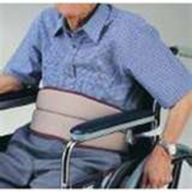
Types of Restraints
Belt Restraints
Belt restraints are threaded at the back and are used to prevent the patient from falling out of the bed or chair.
The belt is fastened around the patient’s waist, and the ties are fastened to the bed or wheelchair frame. Disposable belt restraints also are available.

Slide 9
Vest Restraints
These canvas or mesh vests have long ties that are secured to the bed frame. The ties may cross at the front back, depending on the design of the vest.
Vest restraints are used when the patient needs more support or a stronger reminder than a simple belt provides.

Slide 10
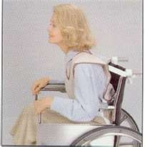
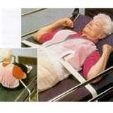
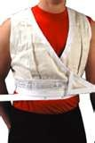
Attach the ties to the nonmovable part of the bed. Some vest restraints have shoulder loops. If the patient is unable to maintain an erect posture, short straps can be passed through the loops and slipped over the wheelchair handles to prevent leaning forward.

Slide 11
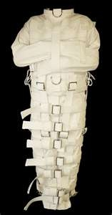
Jacket Restraints
Jacket restraints fit over the patient’s head. The neck opening is secured with a zipper or Velcro closure. There are secure ties fixed to the waist of the jacket. These ties may then be tied to the bed or wheelchair frame.

Slide 12
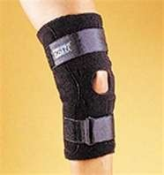
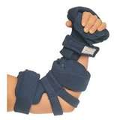
Elbow or Knee Restraints
These are canvas or mesh wraparound ties that have lengthwise rigid stays to prevent joint flexion. They are used most often to prevent the pediatric or confused patient from disturbing a tube or dressing or from scratching a rash.

Slide 13
Wrist or Ankle Restraints
Usually used to restrict motion of a limb for therapeutic reasons, such as to maintain an IV or prevent the patient from pulling out a tube.
Slip the device on the patient’s wrist or ankle, thread it, and tie it to the bed frame; never tie it to a side rail because if the rails were suddenly lowered, the patient could be injured.
Attach wrist and ankle ties to the movable portion of the bed frame so that if the head or foot of the bed is raised, the ties will not be pulled.

Slide 14
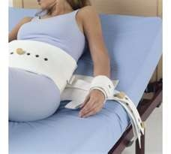
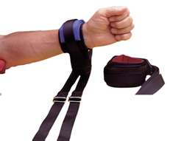

Slide 15
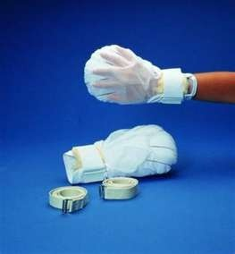
Mitt Restraints
Mitt restraints are used for patients who absentmindedly pull at tubes or appliances or who may injure themselves by scratching a rash or picking at a wound. T
hey restrict only the hand and fingers and allow the arm to move freely.
Secure the wrapping with paper tape to prevent skin irritation and allow easy removal. Remove the mitts periodically, as you would other devices, to clean and exercise the hands and fingers.

Slide 16
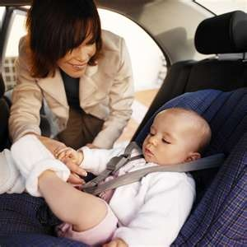

Slide 17
Chemical Restraints
Using medication to sedate patients or make them more cooperative is a form of chemical restraint.
This type of restraint is most often use to calm out of control patients when they pose a physical risk to themselves or others.
Any drug that is not part of the patient's normal medicine regimen is considered a restraint when used for the purpose of stopping an undesirable behavior. Ativan, Versed and Haldol are commonly used.

Slide 18
Bed Rails
Raised bed rails are also considered a form of restraint because they can make it difficult or impossible for a patient to get out of their bed.
Patients may also attempt to climb over the rail and suffer falling injuries.
In some circumstances, bed rails can be beneficial because patients can use them for support in turning and sitting. Doctors will commonly order one side raised for this reason.
Bed rails are not considered a restraint when the patient requests that they be raised.

Slide 19
Restraint Alternatives
Support Pillows
One of the softer alternatives to using either physical or chemical restraints on seniors is to have them use support pillows. For example, rather than using bed rails to keep a senior from rolling out of bed in the middle of the night, some nursing homes will give them full-length body pillows.
These pillows stop the seniors from rolling out of bed in his or her sleep, but they can easily be moved in the event that the senior needs to get out of bed.
Similar pillows are used to help support a senior who's in a wheelchair rather than using a belt to tie them into the chair.

Slide 20
Therapy and Restorative Care
Another method that many nursing homes prefer to restraints is to offer nursing home residents restorative care and therapy.
The goal of this approach is to help seniors maintain their abilities to walk, stand and to generally take care of themselves for as long as possible by maintaining their muscles and coordination.
This is more expensive and time-consuming than simply using restraints, but it is better for the residents' bodies as well as for their confidence.

Slide 21
Adaptive Safety Measures
There are individualized alternatives that can be taken to help ensure the safety of many seniors. An article on restraint alternatives in "McKnight's Long-Term Care News and Assisted Living," highlights the approach taken with a senior suffering from dementia who, as a retired circus acrobat, was still very physically fit and active. Rather than restraining him to a wheelchair, which would have had many negative effects on his body and his sense of well being, the staff members simply gave him good walking shoes, a bicycle helmet and training in how to use a walker. Whenever possible, adapting safety measures to each resident's abilities and needs, rather than restraining them, is a much better alternative.

Slide 22
How to apply restraints?
Instructions
1. Obtain an order from a physician before applying wrist restraints.
2. Explain to the patient's family why the patient needs wrist restraints. Answer any questions or concerns that the family has. If the patient is coherent, explain to him what you'll be doing and why he needs wrist restraints.
3. Wash the patient's wrists and hands using mild soap and warm water. Rinse and dry them thoroughly before applying wrist restraints.

Slide 23
4. Wrap the padded portion of the wrist restraint around the wrist of the patient. Pass the strap through the slot at the other end of the restraint, and attach it according to the manufacturer's instructions. Verify that you can slip three fingers between the patient's wrist and the restraint to maintain adequate circulation. Repeat with the other wrist.
5. Tie each restraint to a portion of the bed that moves when the bed is adjusted up or down.
6. Record what time you applied the wrist restraints and why they were needed.

Slide 24
Assess a patient wearing wrist restraints at least every hour, or more often if ordered by the doctor. Check the circulation to the patient's hands, and evaluate her mental state. Document your findings in the patient's chart, and report any signs of discomfort to the doctor.
Know how to remove wrist restraints quickly in the event of an emergency.
Don't apply wrist restraints to an arm with an intravenous line or where the skin is not healthy.

Slide 25
How to Fix a Hospital Restraint Bed With 4 Point Restraint
Instructions
Determine the need for restraints and only use them when they are appropriate. The risk of the patient interfering with treatment must outweigh the risks associated with their use.
Obtain a physician's order and follow your particular facility's policy dealing with physical restraints. Discuss with the family the reasons that you are using restraints and leave them on only as long as necessary.
Anchor the restraints to the bed frame. Place two at the head and two at the foot. They should be easy to unclasp from the wrist cuff straps if it becomes necessary to remove them in a hurry.
Gather three other people to help subdue the patient and carefully position him on the hospital bed. You are less likely to cause harm or become harmed yourself during the procedure if you have someone positioned at each arm and leg.

Slide 26
5.Hold the patient's extremities as someone else applies and adjusts each cuff. Leave enough space to fit two fingers between the patient's wrist and the cuff. Pulling it tighter may interfere with circulation.
6. Hold the patient's extremities as someone else applies and adjusts each cuff. Leave enough space to fit two fingers between the patient's wrist and the cuff. Pulling it tighter may interfere with circulation.
7. Connect the strap leading from the cuff to the anchor you attached to the bed frame, leaving an inch of slack. Depending on the level of agitation of the patient, the restraints may need frequent adjustments if they loosen.

Slide 27
Use of Restraints in Nursing Homes
Types of Restraints
Soft belts or safety vests are used to tie a patient to a bed or wheelchair by restricting the torso. A safety bar is a bar placed across the lap of the wheelchair to prevent a patient from falling or sliding out. Wrist or mitt restraints prevent the patient from removing IV tubing or dressings. Bed rails are considered a restraint, and policies vary as to how and when they can be raised.
There are also medications that are considered chemical restraints. These are administered by a nurse or physician, generally as a case of last resort when a patient becomes violent.

Slide 28
Effects of Restraints
Restraints should only be used to protect the patient. Patients may be restrained if they are violent or are in danger of falling, wandering or harming himself or others.
Restricting movement with a restraint may result in:
Loss of personal dignity and self esteem Increased confusion Anxiety Increased Anger Frustration Decreased communication
Physically, restraints can result in:
Skin breakdown Muscle weakness Blood clots Pneumonia Constipation

Slide 29
Alternatives to Restraints
Restraints are generally considered to be a last-resort measure. Before using a restraint try to:
Use bed or door alarms to designate confused patients. Distract the resident with another activity or television. Play calming music. Transport the patient to another area. Use padding, stuffed animals and other soft items for support. Speak to the patient in a calm, firm voice.

Slide 30
Restraint Procedure
Use the alternative techniques first. 2. Get a doctor's order in writing. 3. Use the least restrictive restraint when possible (that is, use a wrist restraint instead of a vest etc.). 4. Use the correct size restraint. 5. Explain to the resident about the restraint and why it is being applied. 6. Apply the restraint securely and correctly. 7. Allow the patient as much movement as possible; keep the call light within the patient's reach. 8. Check wrist restraints every 15 minutes. 9. Check patient safety every 30 minutes, including checking for skin breakdown, body alignment and toileting needs, and address those needs as needed. 10. Remove the restraints every 2 hours. 11. Exercise the restricted limb. 12. Document the application, checks and removal of the restraints.

Slide 31
Reassure the restrained patient frequently. Remove the restraint as soon as you feel the patient's safety risk is gone.
Physical restraints can bruise delicate skin, especially in the elderly. Apply the restraint so that it is secure but does not damage skin.
When attempting to restrain a violent patient, do not grab him. This can be considered assault and charges can be filed against you.

