Slide 1
Burn Management
Anuradha Perera (B.Sc.N)special

Slide 2
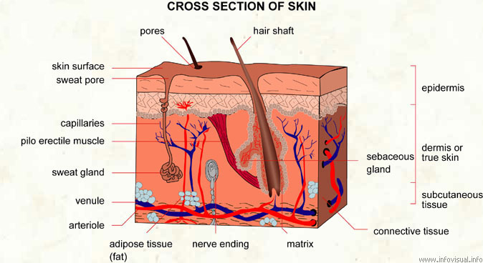

Slide 3
Burn Classification
Superficial (1°): epidermis (sunburn)
Partial-thickness (2°):
Superficial partial-thickness: papillary dermis
Blisters with fluid collection at the interface of the epidermis and dermis. Tissue pink & wet. Hair follicles intact
Deep partial-thickness: reticular dermis
Blisters. Tissue molted, dry, decreased sensation.
Full-thickness (3°): dermis
Leathery, firm, insensate.
4th degree: skin, subcutaneous fat, muscle, bone
Notes:
Superficial: Over 2 to 3 days the erythema and pain subside. By about the fourth day, the injured epithelium desquamates in the phenomenon of peeling, which is well known after sunburn.
Superficial partial-thickness: Heal spontaneously in less than 3weeks, and do so without functional impairment. They rarely cause hypertrophic scarring, but in pigmented individuals the healed burn may never completely match the color of the surrounding normal skin.
Deep partial-thickness: Heal in 3 to 9 weeks, but invariably do so with considerable scar formation. Unless active physical therapy is continued throughout the healing process, joint function can be impaired, and hypertrophic scarring is common.
Full-thickness: Do not blanch with pressure. Full-thickness burns develop a classic burn eschar, a structurally intact but dead and denatured dermis that if left in situ over days and weeks, separates from the underlying viable tissue. Full-thickness burns involve all layers of the dermis and can heal only by wound contracture, epithelialization from the wound margin, or skin grafting.

Slide 4
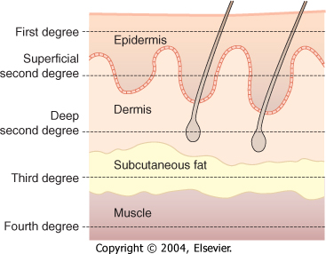
Classification of Burn Depth

Slide 5
Types of Burns
Heat/flame/contact- scald burns most common
Electrical – look for entry and exit wound
Cardiac monitoring, watch for rhabdo/cmpt synd
Acid/alkali – irrigate with water
Hydrofluoric acid – topical calcium powder
Powder – wipe away, then irrigate

Slide 6
Initial Assessment
Airway
Breathing
Circulation
Disability
Exposure
Initial burn treatment: remove burn source
Notes:
Airway
Breathing: PE
Circulation: pulses, IV, LR
Disability: rapid neurologic exam
Exposure: remove clothing, brush off dry chemicals

Slide 7
Assessment: Airway
Airway at risk secondary to:
Direct injury/trauma
Fluid resuscitation
Edema from inflammatory response
Clues to airway injury: history (closed spaces), facial burn, carbonaceous sputum, hoarseness, stridor, wheezing
Intubate based on respiratory and mental status
Notes:
The patient's history is an important part of assessing the extent of their injuries. Inhalation injury should be suspected in anyone with a flame burn, and assumed until proven otherwise in anyone burned in an enclosed space.
Nasotracheal intubation should be avoided if possible because of the risks of sinusitis and erosion of the nasal columella, especially if the nose is burned. Intubated patients with inhalation injuries should have the head of their bed elevated to at least 45 degrees to reduce swelling and to prevent aspiration.

Slide 8
Inhalation Injury
Carbon monoxide poisoning – tx 100% O₂
Upper airway thermal injury
Lower airway burn injury
Evaluate with bronchoscopy if uncertain
Notes:
CO: Dx: carboxyhemaglobin level. CO toxicity is easily treated with 100% inhaled oxygen, which rapidly accelerates CO dissociation from hemoglobin, +/- HBO
Upper airway thermal injury: 2/2 hot air or chemical toxins. Dx: direct visualization of the posterior pharynx. The decision to intubate should be based on visual evidence of posterior pharyngeal swelling, mucosal sloughing, or carbonaceous sputum coming from below the level of the vocal cords. The heat absorptive capacity of the oropharynx is sufficiently efficient that thermal burns to the lower airway are rare; however, steam can cause a lower airway thermal burn.
Lower airway burn injury: 2/2 smoke > steam.
ARDS

Slide 9
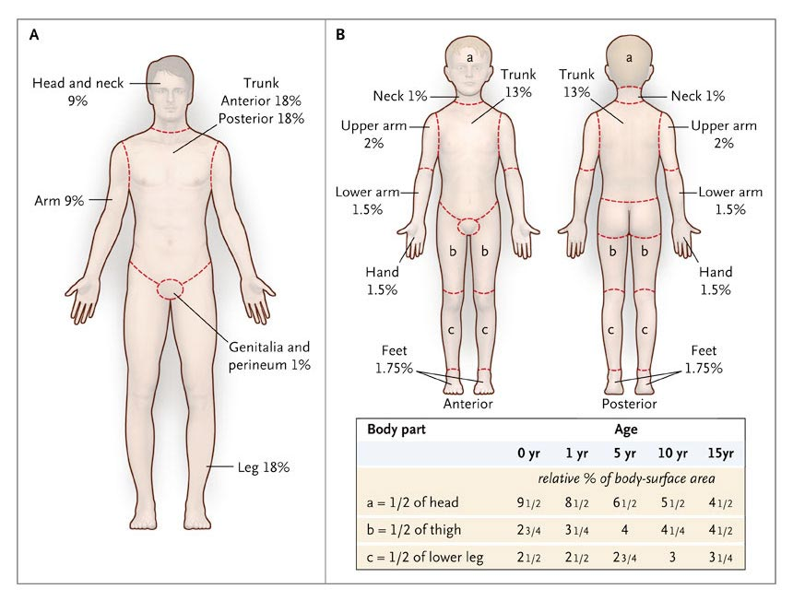
The Rule of Nines and Lund–Browder Charts
Orgill D. N Engl J Med 2009;360:893-901
Notes:
Arm = 9%
Leg = 18%
Ant trunk = 18%
Post trunk = 18%
Head = 9%
Palmar surface of hand = 1% TBSA
1st degree burns are not included
The size and depth of the burn is the basis for fluid resuscitation and care plans
Note: the burn evolves over 72 hours, so the initial calculation may be wrong

Slide 10
Burn Pathophysiology
Severe inflammatory reaction
Capillary leak
Intravascular fluid loss
High fevers
Organ Malperfusion
MSOF

Slide 11
Fluid Resuscitation
Resuscitation based on burn size (2nd & 3rd degree only)
LR in 1st 24 hrs
Parkland formula (burn >20% TBSA)
4 x Wt(kg) x %TBSA = mL/24 hours
Deliver 1/2 volume over 1st 8hrs
Deliver 2nd half over next 16 hours
Other formulas exist
Titrate to urine output
Notes:
Fluid resuscitation: start with Parkland, then titrate to UOP. Adults 0.5-1.0 mL/kg/hr, children >1.5 mL/kg/hr.
Lactated Ringer's solution is the primary resuscitative fluid because of the risk for metabolic hyperchloremic acidosis and hypernatremia in patients who receive large volumes of 0.9% normal saline solution. Albumin increases complications
The resuscitative fluid solution should not contain glucose because hyperglycemia and osmotic diuresis may confound resuscitation. However, pediatric patients who weigh less than 20 kg do not have large glycogen stores in their liver and should receive 0.45% half normal saline with 5% dextrose at a maintenance rate. Colloid administration (albumin or fresh frozen plasma) after the capillary leak has closed (12 to 48 hours post-injury) may restore intravascular volume in patients with persistent low urine output and hypotension despite adequate crystalloid administration. In such cases, 5% albumin (0.3 to 0.5 ml/kg/% TBSA burn) can be administered over 24 hours.

Slide 12
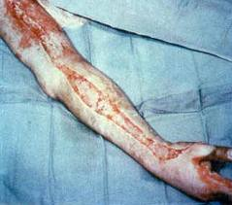
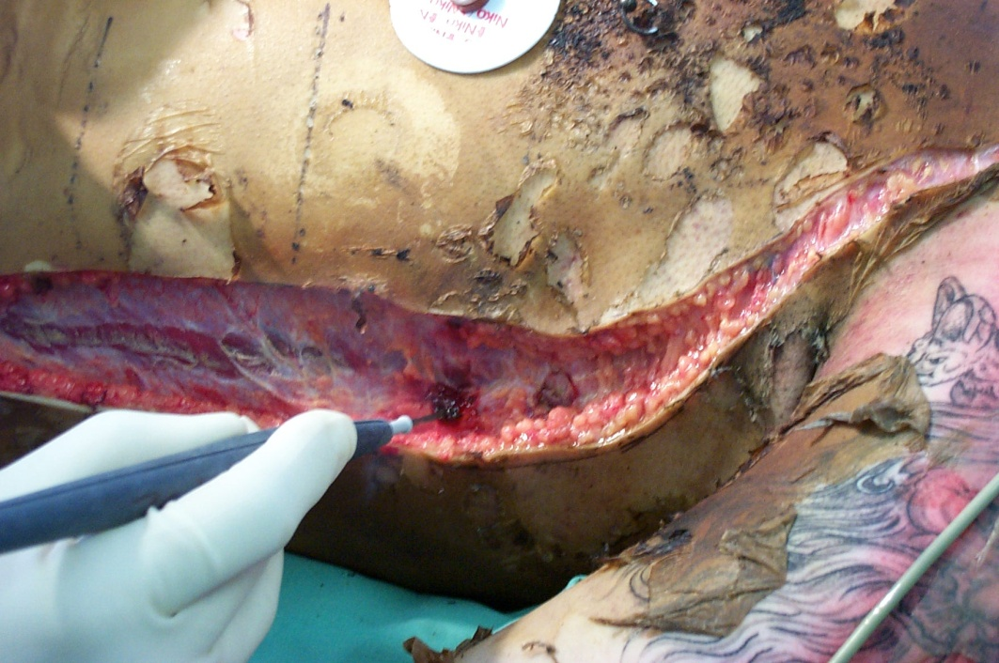
Escharotomy Indications
Circumferential burns
Cool extremity, weak pulse, decreased capillary refill, decreased pain
Difficulty with ventilation in chest burns
Notes:
Overresuscitation causes: poor tissue perfusion, abdominal or extremity compartment syndrome, pulmonary edema, and pleural effusion.
Burned extremities should be elevated and hourly neurovascular examinations should be performed; tight bands of eschar are often evident before vascular inflow is compromised and indicate need for escharotomies. Decreased chest compliance with circumferential burns can also improve with thoracic escharotomies, especially in children. An effective thoracic escharotomy must extend along each anterior axillary line and connect at the infraclavicular and subcostal lines (Fig. 11-5A). Extremity escharotomies should extend through the skin only and should not violate the fascia; the arm must be in anatomic position when medial and lateral incisions are made extending across the wrist (see Fig. 11-5B). Eschar on the dorsal hand must often be released to restore vascular signals in the palmar arch (see Fig. 11-5C); there is no benefit to digital escharotomies and risk of injury to the digital arteries and nerves is significant.
Increased abdominal pressure decreases lung compliance and impedes lung expansion, resulting in elevated airway pressures and hypoventilation Abdominal compartment syndrome also classically has decreased venous return, oliguria, and intraabdominal pressures exceeding 25 mm Hg. Bedside decompressive laparotomy through burn wounds, if necessary (Fig. 11-6), can alleviate abdominal compartment syndrome, in patients with hemodynamic instability, hypoventilation with hypoxemia, and elevated abdominal pressures.
Composition of the resuscitation fluid is important to prevent electrolyte imbalance and acidosis.

Slide 13
Wound Management: General
Clean & debride wound
Prophylactic IV abx unnecessary
Topical abx delay wound colonization and infection
>10⁵ for a wound infection-need quantitative counts
Excise burns in < 72 hrs

Slide 14
Wound Management: Topical Antibiotics
Mafenide acetate (Sulfamylon) for cartilage
Good at penetrating eschar but is painful
Broad spectrum
Side effect: metabolic acidosis via carbonic anhydrase inhibition
Bacitracin for face
Gram-positive bacteria
Silver sulfadiazine (Silvadene) for trunk & extremities
Broad spectrum
Does not penetrate eschar very well
Avoid if sulfa allergy
Side effects: neutropenia/thrombocytopenia

Slide 15
Wound Management: Burn Excision & Grafting
Autograft
Full-thickness skin grafts (FTSG)
Split-thickness skin grafts (STSG) – epidermis/pt dermis, more likely to survive
Meshed vs. Sheet
Allograft- temporary, replaced aft 2 weeks
Porcine xenograft – Deep partial thickness
Dermal substitutes: Integra, expensive

Slide 16
Electrical Burns
Categories: high voltage (>1000 volts), low voltage, lightning
High voltage: requires trauma evaluation
Local injury, deep injury, fractures, blunt injuries
Risk of rhabdomyolysis, compartment syndrome, cardiac injury
Low voltage: common in children
Local injury
Late complications: cataracts, progressive demyelinating neurologic loss

Slide 17
Chemical Burns
Empirical treatment
End the exposure
ABCDE
Alkalis generally cause worse damage
Initial treatment for acid or alkali: irrigation with water
Dry powder should be brushed off
Hydrofluoric acid: can cause severe hypoCa
Notes:
Empirical treatment of the casualties of an acute chemical emergency is of paramount importance. Treatment begins with ending the exposure, which can be accomplished by evacuating or extricating the affected persons and then by thorough decontamination. Persons who suspect that they have sustained an exposure to a chemical contaminant should remove and bag their clothing and shower thoroughly with soap and water as soon as possible.
Removing contaminated clothing can eliminate 85 to 90 percent of trapped chemical substances. After their clothing has been removed, injured persons should be irrigated with water, and then washed with soap and water.
The clinical signs of severe chemical injury include altered mental status, respiratory insufficiency, cardiovascular instability, and a period of unconsciousness or convulsions. Initial supportive therapy should be focused on airway patency, ventilation, and circulation, at the same time that patients are examined for burns, trauma, and other injuries.

Slide 18
Take Home
Always start with ABCDE for trauma/burns
The airway is at risk in burn patients
Parkland formula for initial resuscitation
Rule of Nines
Keep burns clean with soap & topical abx
Early burn excision & grafting saves lives

