Slide 1
Epidemiology of Cancer

Slide 2
Classically speaking
Epi = upon
Demos = people
Ology = science
Epidemiology = the science which deals with what falls upon people…..
Bridge between biomedical, social and behavioral sciences

Slide 3
A Modern Definition
Study of the occurrence and distribution of health-related diseases or events in specified populations, including the study of the determinants influencing such states, and the application of this knowledge to control the health problem
(Porta M, Last J, Greenland S. A Dictionary of Epidemiology, 2008)

Slide 4
Cancer….. Is a major source of disease burden in Sri Lanka.
Is the second leading cause for death. Number of cases are expected to increase. Growth of aging population

Slide 5
The pattern of cancer incidence in Sri Lanka is totally different to that of Western countries.
No Set National Screening Programme available in all over Sri Lanka.
At present Hospital based Cancer Registry is available.
Study of cancer incidence in Sri Lanka will help to set up our own prevention and screening guidelines to control the cancer burden.

Slide 6
Burden of cancer
Burden in South East Asia region
1.6 m new case and 1 million death due to cancer
In men lung followed by oral and pharynx were commonest incident and fatal cancer
In women cervix and breast cancer incident and fatal cancer

Slide 7
Burden of Cancer
One in eight deaths worldwide is due to cancer.
Worldwide, cancer causes more deaths than AIDS, tuberculosis, and malaria combined
12.4 million incidence of cancer was estimated and 7.6 million deaths estimated due to cancer in 2008 worldwide

Slide 8
Burden of cancer
Notes:
Reason for increase in cancer burden are
First of all, the increase in the world’s population which is 7 billion now, anticipated to attain 8.3 billion by 2030 that will lead to an increase in the cancer burden even if the age-specific rates remain constant
Secondly, ageing of population with increase in life expectancy, As cancer risk increases with age, if the population size and the age-specific rates remain constant, thus the burden will increase Aging is a major issue for the future cancer burden. Aging has proceeded more gradually in more developed countries than in less developed countries, affording these nations time to adjust to this structural change
The third element that can lead to an increase in the cancer burden, even when the population
size remains constant and the age distribution remains unchanged, is an underlying increase in
the incidence rates.

Slide 9
Contd
the greatest effect of this increase will fall on low-resource and medium-resource countries
Likewise, 70% of death due to cancer that means 5.5 million are occurring in developing countries which is forecasted to grow to 6.7 million in2015 and 8.9 million in 2030.
Notes:
Evidently, the greatest effect of this increase will fall on low-resource and medium-resource countries due to population ageing, rapid unplanned urbanization, and the globalization of unhealthy lifestyles
The proportion of cases diagnosed in less developed countries is 56 % which is estimated to increase to to more
than 60% in 2030 in developing countries
According to the latest WHO statistics, cancer causes around 7.9 million deaths worldwide each year. Of these deaths, around 70%, that means 5.5 million, are now occurring in the developing world
f no action is taken, deaths from cancer in the developing world are forecast to grow to 6.7 million in 2015 and 8.9 million in 2030. In contrast, cancer deaths in wealthy countries are expected to remain fairly stable over the next twenty years.
Thus the developing countries like ours where we are still fighting against the infection is going to face emense burden of cancer and other non communicable diseases.

Slide 10
Incidence and Mortality: World
Notes:
Gender wise top cancer in terms of incidence and mortality.
The gender wise variability is not that being certain gender increase risk for particular cancer but due variation in exposure to certain type risk factor. For example, the incidence of the lung cancer are increasing recently among female due to increase in smoking among female.

Slide 11
Incidence Developed Vs Developing
Developed
Developing
Notes:
Currently, two of the three leading cancers in men (stomach and liver) and women (cervix and stomach) in developing countries are related to infection. Stomach cancer continues to be the most common infection-related cancer worldwide, followed closely by liver and cervix

Slide 12
Notes:
In general, smoking, dietary patterns, and reproductive behaviors have been known to be the major risk factors for cancer in western (host) countries, and infectious agents in economically developing countries. However, these patterns are changing rapidly. While smoking prevalence is declining in economically developed countries, it is increasing in some developing countries in South America, Asia, and Africa
-Cancers that once were rare and considered the diseases of western countries, such as colon, breast, and lung cancers, are now frequently diagnosed in less developed or economically transitioning countries and their rates are on the rise

Slide 13
Mortality Developed vs Developing
Notes:
In developing world, leading cause of death among female is cervix uteri which is not top five leading cause of death in economically developed world. This is due to.
Cervical cancer reflects striking global health inequities, in terms of availability and use of medical practices such as cancer screening, availability and quality of treatment, resulting in deaths of women in their most productive years, resulting in devastating effects on the society at large. It is the largest single cause of years of life lost to cancer in the developing world. The major barrier to prevention of cervical cancer is failure to be screened at all.

Slide 14
Geographical variation
Notes:
Factors that contribute to regional differences in the types or burden of cancer include regional variations in the prevalence of major risk factors, completeness of reporting, and age structure.
-The frequency of commonly diagnosed cancer cases or deaths also varies by geographic areas (Table 3), and counties and parishes within countries. For example, the most commonly diagnosed cancer is cervix uteri in
Eastern and Southern Africa, Kaposi sarcoma in Middle Africa, and breast cancer in Northern and Western
Africa.
2).

Slide 16
Burden in South East Asia region
1.6 m new case and 1 million death due to cancer
In men lung followed by oral and pharynx were commonest incident and fatal cancer
In women cervix and breast cancer incident and fatal cancer
Notes:
there were 1 589 000 incident cases of cancer in 2008 (758 000 in men and 831 000 in women) and 1 072 000 deaths from cancer (approximately 557 000 in men and 515 000 in women) (Figure 1.1.4b). In men, the commonest cancer was lung cancer, followed by oral cancer, pharyngeal cancer, oesophagus cancer, stomach cancer, colorectal cancer, liver cancer and larynx cancer (Figure 1.1.4b). Lung cancer was the commonest form of cancer deaths in men (Figure 1.1.4b). If oral cavity and pharynx are combined, then this site is the predominant site of incident cancer and cancer death in men. In women, cervix cancer and breast cancer were the commonest incident and fatal forms of cancer by a considerable margin (Figure 1.1.4b). The different case mix between men and women results in more deaths in men than in women, based on fewer incident cases.

Slide 17
Nepal
SN | Male | Female
1 | Lung | Cervix
2 | Oral | Breast
3 | Stomach | lung
Notes:
Overall the most common site in males was the lung, followed by the oral cavity and stomach, while the first three in females were cervix uteri, breast and lung.

Slide 18
Estimated Cancer Deaths in the US in 2013
Notes:
Lung cancer is by far the most common cancer in men (28%), followed by prostate (10%), and colon & rectum (9%). In women, lung (26%), breast (14%), and colon & rectum (9%) are the leading sites of cancer death.

Slide 19
Cancer Death Rates* Among Women, US,1930-2009
Notes:
The lung cancer death rate in women began declining in the early 2000s after increasing for the previous 70 years. The lag in the decline in lung cancer in women compared to men reflects differences in smoking patterns; smoking rates peaked about two decades later in women than in men and women lagged behind men in quitting smoking in large numbers. In comparison, breast cancer death rates changed little between 1930 and 1990, but decreased 33% between the peak year (1989) and 2009. Since 1930, the death rate for stomach cancer has decreased by more than 90%. The death rate for uterine cancer, which was the leading cause of cancer death in the early 20th century, declined from 1930 to 1997, but has since been fairly stable. Colorectal cancer death rates have been decreasing for more than 50 years.

Slide 20
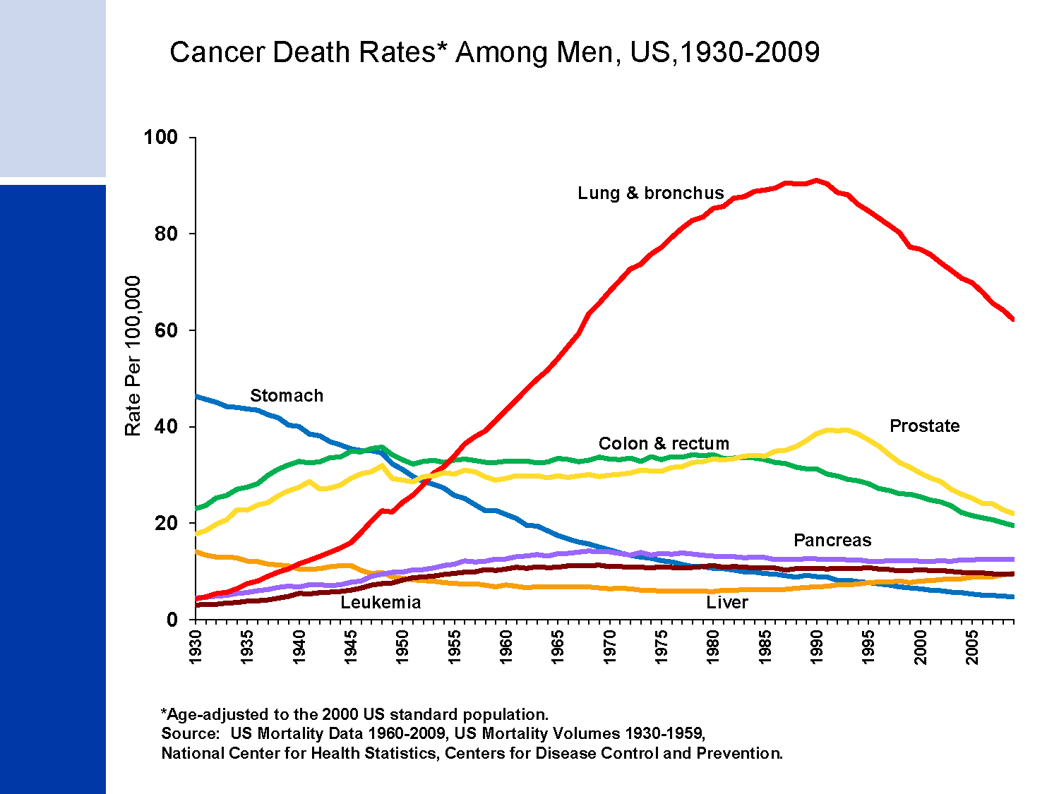
Cancer Death Rates* Among Men, US,1930-2009
Notes:
Most of the increase in overall cancer death rates for men prior to 1990 was attributable to the rapid increase in lung cancer deaths due to the tobacco epidemic. However, since 1990, the lung cancer death rate in men has been decreasing; this decline has accounted for nearly 40% of the overall decrease in cancer death rates in men. The death rate for stomach cancer, which was the leading cause of cancer death among men early in the 20th century, has decreased by 90% since 1930. Death rates for prostate and colorectal cancers have been declining since the early 1990s and 1980s, respectively.

Slide 21
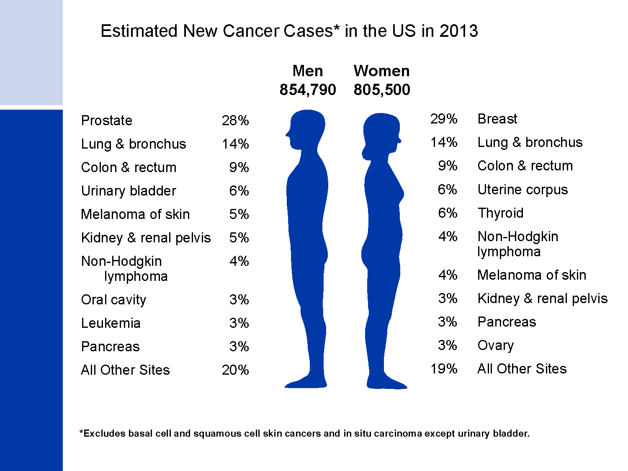
Estimated New Cancer Cases* in the US in 2013
Notes:
Now we will turn our attention to the number of new cancers projected for the US this year. It is estimated that more than 1.6 million new cases of cancer will be diagnosed in 2013. The most common cancers are prostate in men and breast in women; lung and colorectal cancers are the second and third most common cancers in both men and in women.

Slide 22
The Lifetime Probability of Developing Cancer for Men, 2007-2009*
Notes:
The next four slides look at the lifetime probability of developing cancer and relative survival rates of cancer.
Presently, the risk of an American man developing cancer over his lifetime is a little less than one in two.

Slide 23
The Lifetime Probability of Developing Cancer for Women, 2007-2009*
Notes:
The risk of an American woman developing cancer over her lifetime is a little more than one in three.

Slide 24
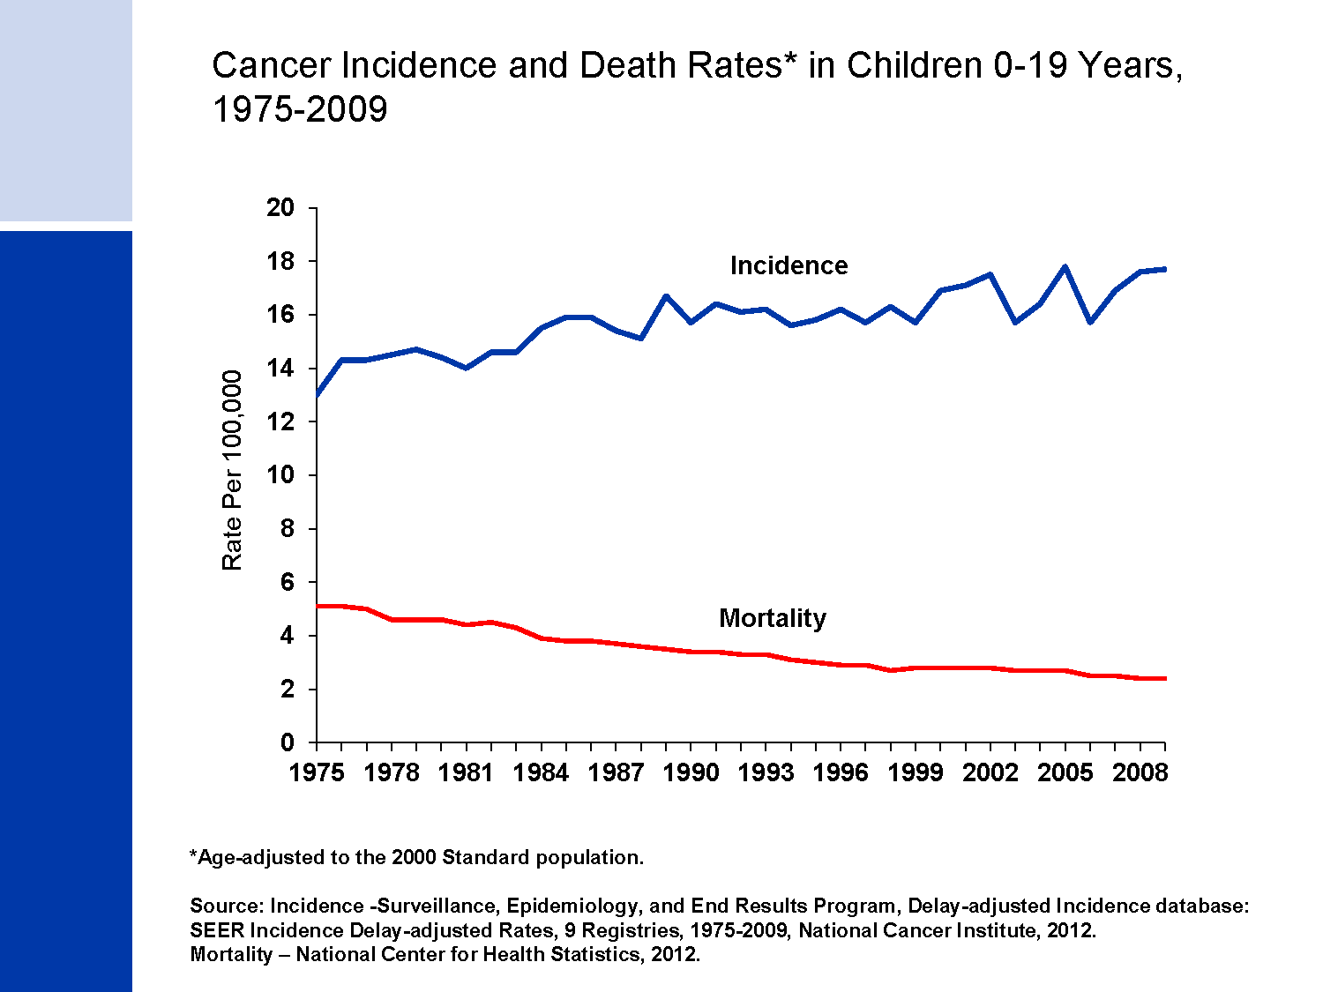
Cancer Incidence and Death Rates* in Children 0-19 Years, 1975-2009
Notes:
The next series of slides present the burden of cancer among our nation's children. Since 1975, cancer incidence rates among children have been increasing slightly (by about 0.6% per year), while cancer death rates have decreased by more than half (from 5.1 to 2.4 per 100,000 children younger than 20 years).

Slide 25
Cancer Death Rates* in Children, 2005-2009
Notes:
Leukemia also accounts for the most cancer deaths in children, comprising almost one-third of cancer deaths among boys and girls 0-14 years. Cancers of the brain and other nervous system are the second leading cause of cancer death in children.

Slide 26
EPIDEMIOLOGY OF COMMON CANCER

Slide 27
Lung cancer
Estimated 1.5 million new cases of cancer in year, account 12% of all cancer
Leading cause of cancer mortality in men and second cause in women
Cigarette smoking most imp risk factor- risk related to No of cigarette, age of starting and habits, no of puff and nicotine & tar content as well length of cigarette
Others occupational & environmental exposures, radiation, as well genetic susceptibility among younger cancer pt
Notes:
-Trends in lung cancer incidence and mortality rates over time reflect historical patterns of smoking, albeit with a 20- to 30-year lag time variations in temporal trends in lung cancer rates between countries reflect differences in the stage of the tobacco epidemic
-Cigarette smoking is the most important risk factor for lung cancer, accounting for about 80% of lung cancer cases in men and 50% in women worldwide. Other risk factors include secondhand smoke, occupational or environmental exposures to radon and asbestos (particularly among smokers), certain metals (chromium, cadmium, arsenic), some organic chemicals, radiation, air pollution, coal smoke, and indoor emissions from burning other fuels. Genetic susceptibility contributes to risk, especially in those who develop the disease at a younger age

Slide 28
Prevention stratigies
Tobacco control
Policy based intervention :
Non policy Intervention: Pharmolocigal( NRT, bupripion, vareniciline), Non Pharmacological (counselling)
Early diagnosis with screening
Notes:
FCTC- Framework Convention on Tobacco Control
First public healh treaty among various nation in the world under WHO
international law on 27 February 2005,
Of the 38 articles, articles 6 to 14 cover Core demand reduction provisions
policy interventions directed at preventing tobacco use, decreasing consumption, reducing toxicity, protecting non-smokers and diminishing tobacco use initiation. Articles 15 to 17 relate to measures controlling the availability of tobacco
Its’ goal is to protect the current and the future generations from the harm caused by tobacco to health, economy and the environment
On April 11th, 2011 Tobacco control bill was passed by the Constituent Assembly of Nepal and its being implemented from August 7th, 2011. Although ratification took place in November, 2006 only

Slide 29
Oral Cancer
One of the tenth most common cancer in world. High frequency in central and east Asia
It is 2nd common cancer in male in Nepal
Risk factor: Tobacco, Excessive alcohol, cultural patterns
Prevention: intensive public education and motivation for changing life styles supported by legislative
- Secondary prevention by early detection of precancerous lesion(leucoplacia, erythroplacia) and treatment
Notes:
Tobacco-apprx 90%, in any form eg chewing, smoking and others as bettle

Slide 30
Cervical cancer
the second most commonly diagnosed cancer and the third leading cause of cancer death in women worldwide
Risk factors: HPV-16, 18 , early marriage, OCP, Low socio economic status, single divorce with multiple sex partner
Notes:
Cervical cancer is the second most commonly diagnosed cancer in women. More than 80% of these cases will occur in developing countries is mainly due to lack of screening
Cervical cancer is the third leading cause of cancer death in women worldwide. Cervical cancer kills more women in the developing world than any other cance
Cervical cancer incidence and mortality rates have been declining since the 1960s in many developed countries due to widespread screening and intervention but prevalent in central and south america, africa, asia.
Nearly 100% of women with cervical cancer have evidence of cervical infection with HPV, the main cause of cervical cancer. HPV 16, 18- 70%

Slide 31
Contd….
Prevention and control strategies
Primary: HPV Vaccination
Secondary: early case detection with cervical screening
Notes:
Merck’s Gardasil ( HPV 6, 11, 16, and 18), GlaxoSmithKline( HPV 16, 18)
two currently available HPV vaccines [9,10] include HPV16 and 18(account 70%) and are based on L1 virus-like particles (VLPs), i.e. empty viral capsids. aged 9–26 years. at least 90% effective in preventing persistent HPV infection and 95% effective in preventing type-specific precancerous lesions. Available vaccines did not, however, prevent development of CIN2 and 3 in women who had been infected by HPV16 and 18 before immunisation, or CIN2 and 3 caused by other HPV types in clinical trials.
-Up to 80% of cervical cancer could be prevented if comprehensive Papanicolaou (Pap) test screening programs were made available Cost-effective screening methods that are gaining prominence in resource-poor settings include visual inspection using either acetic acid (VIA) or Lugol’s iodine (VILI) and DNA testing for human papilloma virus (HPV) in cervical cell samples. However, many low-resource countries do not have the technical and
public health infrastructure to support Pap testing for cervical cancer (

Slide 32
Breast Cancer
the most frequently diagnosed cancer and the leading cause of cancer death among women worldwide
Risk factors: gender, age, inheritance of genetic mutation high breast tissue density, high dose radiation, obesity after menopause, use postmenopausal HRT, physical inactivity, alcohol, smoking etc
Notes:
the most frequently diagnosed cancer in women
Breast cancer is the leading cause of cancer death among women worldwide
Aside from being female, age is the most important factor affecting breast cancer risk
Risk is also increased by inheritance of two genetic mutations (BRCA1 and BRCA2), a personal or family history of
breast cancer, high breast tissue density (a mammographic measure of the amount of glandular
tissue relative to fatty tissue in the breast), biopsy confirmed hyperplasia of breast tissue (especially
atypical hyperplasia), and high-dose radiation to the chest as a result of medical procedures
Some potentially modifiable factors that increase risk include being overweight or obese after menopause, use of postmenopausal hormone therapy (especially combined estrogen and progestin therapy), physical inactivity, and consumption of one or more alcoholic beverages per day
Breast feeding, moderate or vigorous physical activity, and maintaining a healthy body weight are all associated with lower risk of breast cancer
to reduce known risk factors as much as possible by maintaining a healthy body weight, increasing physical
activity, and minimizing alcohol intake

Slide 33
Prevention strategies
Reduce the risk factors by maintaining the body weight, rigorous physical activity, decrease alcohol intake
Early diagnosis include screening by mammography, clinical breast examination (CBE), and breast self-examination (BSE).
Notes:
Mammography is especially valuable as an early detection tool because it can identify breast cancer at a stage when treatment may be more effective. But mammography screening programs may be cost prohibitive in many developing countries.
Tamoxifen, an anti-oestrogen drug used in chemotherapy, has shown a chemopreventive action against breast cancer, although the magnitude of the protection is uncertain

Slide 34
Stomach Cancer
fourth most common malignancy in the world in 2007, with an estimated one million new cases
second leading cause of cancer death in men and the fourth among women
Risk factors: H. Pylori infection( 60%), Diet rich in smoked foods, slated meat or fish or pickled vegetables and low fresh vegetables, smoking
Prevention strategy to reduce intake of preserved food, smoking, prevalence of H. pylori increase consumption of fruits and vegetables,
Notes:
fourth most common malignancy in the world in 2007, with an estimated one million new cases. Nearly 70% of
new cases will occur in developing countries
Stomach cancer is the second leading cause of cancer death in men and the fourth among women
A steady decline in stomach cancer rates has been observed in most developed countries Factors that have
contributed to these remarkable decreases are thought to include increased availability of fresh fruits and
vegetables, decreased reliance on salted and preserved foods, reduction in chronic H. pylori infection due to
sanitation and antibiotics,1 and increased screening
primary
prevention strategy for stomach cancer is to reduce the intake of foods preserved by salting, pickling, or smoking; to increase consumption of fresh fruits andvegetables; and to reduce the prevalence of H. pylori infection by improving hygienic conditions and increased use of antibiotics.
An estimated 59% of cases in developing countries and 63% of cases in developed countries can be attributed to H. pylori infection
Diets rich in smoked foods, salted meat or fish, and pickled vegetables and low in fresh vegetables have also been
associated with an increased risk of stomach cancer

Slide 35
Aetiology
.

Slide 36
Aetiology is the study of causes of a disease

Slide 37
Cancer is neither contagious nor hereditary disease.
It is suggested that every living organism has some inactive cancer-causing genes called proto-oncogenes.
A number of physical, chemical or biological agents are known to mutate and activate these proto-oncogenes into active and cancer causing oncogenes.
Due to altered gene activity, normal control mechanism is lost and the abnormal cell growth and cell division take place.
The physical and chemical agents, which induce cancer growth, are called carcinogens.

Slide 38
Risk Factors
Non Modifiable
Age
Sex
Genetic factor
Modifiable
Tobacco
Chronic infection
Alcohol drinking
Occupational exposure
Dietary factors
Obesity and physical exercise
Radiation
Medical drugs

Slide 39
Tobacco Consumption
Main single cause of human cancer worldwide
Accounts for 30% approx of all human cancer in developed countries
Responsible for 13 types of cancer: lung, oral cavity, nasal cavity and nasal sinuses, pharynx, larynx, esophagus, stomach, pancreas, liver, urinary bladder, kidney, uterine cervix and myeloid leukemia
Any form of tobacco are risk( smoking, chewing)
Benefit of quitting tobacco in adulthood for all kind of major cancer
Notes:
-burden of tobacco related cancer is lower given relatively recent start of the epidemics of smoking, however I will result in greater burden in future

Slide 40
Chronic infection
Approx 15- 20% of cancer worldwide: 26% in developing countries, 8% in developed countries
Common cancer associated with chronic infection: -Cervical cancer and other malignancy- HPV, Lymphoma- Leukemia- Gastric cancer- H. Pylori,
Notes:
-Approximately >> 15–20% of cancers worldwide have been attributed to infectious agents. However, this proportion is higher in low-resource countries (26%) than in the developed world (8%)
->>HPV, EBV, HTL V1 and HHV8 play a direct role in carcinogenesis encoding oncoprotein
->>Other infectious agents, e.g. HBV, HCV and H. pylori, appear to have an indirect role, inducing a chronic inflammation with tissue necrosis and regeneration

Slide 41
Alcohol Drinking
- Global burden of cancer attributed to alcohol -3.6%
A causal association has been established between alcohol drinking and cancers of the oral cavity, pharynx, larynx, esophagus, liver, colon, rectum and, in women, breast
For all cancer sites, risk if the function of amount of alcohol consumption

Slide 42
Dietary Factors, Obesity and Physical activities
Responsible for 25% of human cancers in high income countries but exact role of dietary factors for causing cancer remains largely obscure
Increased weight gain is associated with cancer of colon, gall bladder, postmenopausal breast, endometrium, kidney and esophagus
Increasing physical activities decrease the risk of the breast and colon cancer
Notes:
Only for alcohol and aflatoxin sufficient evidence has been established for increased risk for cancer. Though high fat diet or other nutrients in determing breast and colorectal cancer has showen associated however risk has not been confirmed. As well limited evidence for protective role of the vegetable and fruits.
Which is also indirect benefit thru prevention of obesity that is known risk factor
-at least 30 minutes per day of more than moderate level of physical activity might be needed to see the greatest effect in risk reduction-colon cancer
- risk reduction begins at levels of 30–60 minutes per day of moderate-intensity to vigorous activity in addition to the usual levels of occupational and household activity of most women”- breast

Slide 43
Occupational exposures
Global burden of cancer: 2-3%
Approx 40 occupational agents, groups of agents and mixtures are classified as carcinogens(monographs)
Notes:
Unlike lifestyle factors, exposure is involuntary

Slide 44
Reproductive factor and exogenous hormone
Reproductive factors(age at first child, number of pregancy, age at last child, and age at menopause) strongly associated with cancer of breast, ovaries and endometrial
Exogenous estrogens and progestin's in combination as HRT in menopause and in steroid contraceptives increase the risk of breast and ovarian cancers
OCP exert long term protection for ovarian and endometrial cancer but increase risk for cervical and liver cancer
Notes:
Long-term exposure to high levels of endogenous sex steroids has been considered as the risk of breast and endometrial cancers in post-menopausal women

Slide 45
Genetic Factor
Cancer susceptical genes may be oncogenes, tumor suppressor gene, risk modifier genes
oncogenes are genes where either over-expression or gain of function mutations contribute to tumorigenesis eg:RAS and MYC families
Tumour suppressor gene: genes where either under-expression or loss of function mutations contribute to tumorigenesis. RB and the melanoma predisposition gene CDKN2A (p16), BRCA1, TP53
risk modifier genes: genes whose normal function can modify the risk due to a carcinogenic exposure (either environmental or genetic). ADHs and ALDHs-hnc, RAD51-BRAC2
Notes:
With development of newer technologies and understanding about the genome of human being, the role of gene in carcinogenesis is growing
The unifying characteristic of oncogenes is that their normal function tends to drive a process required for tumour
initiation, progression, invasion, or metastasis forward.oncogenes are genes where either over-expression or gain of function mutations contribute to tumorigenesis eg:RAS and MYC families
Tumour suppressor genes are the opposite; their normal function tends to inhibit a process required for tumorigenesis. Thus, from a genetics point of view, tumour suppressors are genes where either under-expression or loss of function mutations contribute to tumorigenesis. Classic examples include the retinoblastoma predisposition gene RB and the melanoma predisposition gene CDKN2A (p16)
-Caretakers are involved in detection or repair of DNA damage, eg Li-Fraumeni susceptibility gene TP53 and the breast/ovarian cancer susceptibility gene BRCA1
-risk modifier genes are not main-effect oncogenes or tumour suppressors but rather genes whose normal function can modify the risk due to a carcinogenic exposure (either environmental or genetic). Examples include the alcohol dehydrogenases and acetaldehyde dehydrogenases (ADHs and ALDHs) that modify risk of head and neck cancer attributable to heavy alcohol consumption but have little effect on cancer risk in nondrinkers [1] and RAD51, which can modify the risk of breast cancer in BRCA2 carriers but has little effect on risk in non-carriers [2].
Genetic susceptibility focuses on inherited (constitutional or germline) genetic variation in cancer susceptibility genes, and the effects of that inherited variation on an individual’s lifetime cancer risk. In contrast, somatic cell genetics focuses on mutations that arise in an individual’s cells during their lifetime and the role that those mutations play during tumour initiation and progression.

Slide 46
Others
Ionizing and non ionizing radiation
Medical procedures and drugs
Sunlight
Notes:
Ionizing- ALL, CML, cancer of breast, lung, bone, brain, thyroid
Non Ionizing- UV radiation skin
Chemotherapy- leukaemia, NHL- immunosupressive drugs, Phenacetin- renal pelvis

Slide 47
True or False?
Smoking causes lung cancer
causes lung cancer
Smoking causes lung cancer?
Smoking causes lung cancer
cancer
causes lung cancer
Smoking causes lung cancer

Slide 48
Smoking causes lung cancer
Smoking causes lung cancer
False
From epidemiological point of view, there is a good association between smoking and lung cancer. This does not mean causation. Many people who smoke never develop lung cancer

Slide 49
True or False?
Large percentage of cancers are preventable
Large percentage of cancers are preventable?

Slide 50
True

Slide 51
True or False?
In the past 20 years tremendous improvements in the treatment of all cancers have been achieved?

Slide 52
False
We have seen improvement in detection, monitoring, and treatment for some cancers. However, there is large number of cancers, where we have seen little improvement, such as pancreatic and ovarian.

Slide 53
True or False?
Preventing cancer is easier than treating cancer?

Slide 54
True

Slide 55
True or False?
Screening tests are available for most cancer?

Slide 56
False
Screening tests are available for some cancers, such as prostate, colorectal, and breast.
There are many cancers for which we do not have screening tests yet, such as pancreatic, brain, etc.

Slide 57
Thank you

Slide 58
Prevention

Slide 59
Cancer Prevention and control
Four Strategies: WHO
Primary Prevention
Early Detection and Secondary Prevention
Diagnosis and Treatment
Palliative Care

Slide 60
Primary Prevention
Goal: to reduce or eliminate exposure to cancer-causing factors
Approaches :
- Immunization against, or treatment of, infectious agents that cause certain cancers- HBV and HPV vaccine, eradication treatment of H. pylori
- application of effective tobacco control measures
- reduction of excessive alcohol consumption
- maintenance of healthy body weight and physically active lifestyles
- reduction in occupational exposure to carcinogens
- pharmacological intervention
Notes:
-The goal of primary prevention is to reduce or eliminate exposure to cancer-causing factors, which include modifiable factors related to tobacco use, nutrition, physical inactivity, occupational exposures, and chronic infections
-two currently available HPV vaccines [9,10] include HPV16 and 18(account 70%) and are based on L1 virus-like particles (VLPs), i.e. empty viral capsids. aged 9–26 years. at least 90% effective in preventing persistent HPV infection and 95% effective in preventing type-specific precancerous lesions. Available vaccines did not, however, prevent development of CIN2 and 3 in women who had been infected by HPV16 and 18 before immunisation, or CIN2 and 3 caused by other HPV types in clinical trials.
-HBV vaccines are predominantly produced by recombinant DNA technology. The vaccine is administered in a three-dose series and has resulted in high immunogenicity and efficacy,

Slide 61
Secondary Prevention
Cancer Registration
Provide base for assessing the magnitude of the problem and for planning necessary services
Two types: Hospital based Registries and Population based Registries
Notes:
Advantages of population based registries
(1) They describe the extent and nature of the cancer burden in the community and assist in the establishment of public health priorities.
(2) They may be used as a source of material for etiological studies.
(3) They help in monitoring and assessing the effectiveness of cancer control activities.
-In Nepal, a system of collection of cancer incidence data from 7 major hospitals(BPKIHS, BPCMH, TUTH, KANTI, BIR, MANIPAL TH, BHARATPUR) around the country was introduced in 2005, with the support of WHO.

Slide 62
Early Detection of Cases
Objective: to detect pre-cancerous changes or early stage cancer when they can be treated most effectively
Two strategies of cancer screening
Opportunistic Screening: Physician or individual
Organized screening: Mass screening or selective screening
Notes:
-Objective through screening to detect pre-cancerous changes or early stage cancers when they can be treated most effectively
-organized screening in which a defined population is contacted and invited to be screened at regular intervals
- Mass screening by comprehensive cancer detection examination or at the specific site

Slide 63
Contd…
Cancers that have proven early detection methods include cervix, colon and rectum, and breast.
Notes:
Cancers that have proven early detection methods include cervix, colon and rectum, and breast. However, wide implementation of screening for these cancers has not been fully achieved even in economically developed countries.
Early detection is only valuable if it leads to timely diagnostic follow up and effective treatment- so require mobilization of all available resources and development of a cancer infrastructure

Slide 64
Diagnosis and Treatment
Cancer diagnosis first step in cancer management
Cancer staging
Treatment- surgery, Radiotherapy, Chemotherapy , Hormonal therapy
Notes:
-Cancer diagnosis, including careful clinical and pathological assessments, is the first step to cancer management.
Once a diagnosis is confirmed, it is necessary to determine cancer stage, where the main goals are to aid in the choice of therapy, to determine prognosis, and to standardize the design of research treatment protocols
- primary modalities of cancer treatment are surgery, chemotherapy, and radiotherapy; these may be used alone or in combination

Slide 65
Palliative care
70% of cases presented in hospital at advance stage- RGMCH
Goal: To improve quality of life of the patients & relief of sufferings
To decrease the problems faced by the families psychologically
To prolong the life
Notes:
In our parts of the world, the majority of cancer patients present with advanced disease
For these patients, the only realistic treatment option is pain relief and palliative care
-To improve quality of life of the patients & relief of sufferings
- To decrease the problems faced by the families psychologically
- To prolong the life

Slide 66
References
World Cancer Report 2008, International agency for research on Cancer
Global Cancer Facts & Figures 2007, American Cancer Society
Park Text book of Preventive and Social Medicine, 21st Edition
Oxford Textbook of Public Health, 5th edition
Kishore K Pradhananga, Mina Baral, Bhakta Man Shrestha”Multi-institution Hospital-based Cancer Incidence Data for Nepal - An Initial Report” Asian Pacific J Cancer Prev, 10, 259-262
VS Binu, TS Chandrashekhar et al “Cancer Pattern in Western Nepal: A Hospital Based Retrospective Study” Asian Pacific J Cancer Prev, 8, 183-186

Slide 67
Contd….
National Cancer Registry Program, BPKIHS
Yen-Ching Chen, ScD; David J. Hunter, MD, ScD “Molecular Epidemiology of Cancer” CA Cancer J Clin 2005;55:45–54
Ahmedin Jemal, Melissa M. Center, Carol DeSantis, et al “Global Patterns of Cancer Incidence and Mortality Rates and Trends” Cancer Epidemiol Biomarkers Prev 2010;19:1893-1907
Martha S. Linet” Evolution of Cancer Epidemiology” Epidemiologic Reviews vol 22. No 1, 2000
Cancer Epidemiology: Principle and Methods, International Agency for Research on Cancer Lyon, France 1999

Slide 68
Thank you

