Slide 1
CHILDHOOD PSYCHIATRIC DISORDERS

Slide 2
Childhood psychiatric disorders basically deals with emotional and behavioural disturbances of children
Categories of psychiatric disorders.
Developmental
Autism spectrum disorders
Behavioural
Conduct disorders
Oppositional Defiant disorders
Emotional
Anxiety
Intellectual disability
Language and reading delay
Enuresis
Encorpresis
ADHD
Depression
Phobia
OCD
Somatization

Slide 3
Attachment
Attachment & Bonding
Separation anxiety
Healthy attachment
Sometimes to several figures

Slide 4
Detachment
Protest
Despair
Detachment

Slide 5
Aetiology
Vulnerability Factors in childhood
Multiple and Additive
adverse genetic , environmental
factors
poor coping skills

Slide 6
Protective Factors
Eg: available psycho-social support
Good family relationships, good coping abilities of the child
Good social skills , level of education etc

Slide 7
Studies indicate that 1 in 10 children and adolescents may have a diagnosable disorder.
Estimates of the number of children who have mental disorders range from 7.7 million to 12.8 million.

Slide 8
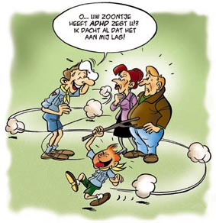
Attention Deficit Hyperactivity Disorder (ADHD)
ADHD is a condition that becomes apparent in some children in the preschool and early school years. It is hard for these children to control their behavior and/or pay attention.
It is estimated that between 3 – 5%
of children have ADHD, approximately 2 million children in US.
1% in UK
Hyperactive disorder - 1 / 200 children
Boys > Girls 3: 1

Slide 9
Conduct disorder
Also known as disruptive behavior disorder, is a disorder that involves chronic behavior problems during childhood and adolescence including stealing, fighting, or bullying others.
Conduct disorder affects 1 - 4%
of 9 to 17-year-olds,
More common in boys.

Slide 10
Oppositional Defiant Disorder
(ODD)
ODD is a persistent pattern of disobedient, hostile, and defiant behavior towards various authority figures.
Studies have shown that 1 to 6 % of
the school-age population is affected.
More common in boys prior to puberty
but after puberty, both genders are equal.

Slide 11
Eating Disorders
Are severe disturbances in eating behavior. There are two main types of eating disorders:
- Anorexia nervosa
- Bulimia nervosa
Common in adolescent and
young females.
Anorexia nervosa 1%
Bulimia nervosa 1 - 3%
Approximately 5 - 15 % of individuals diagnosed with anorexia or bulimia are male.

Slide 12
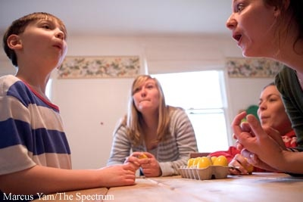
Autism Spectrum Disorder
Also known as Pervasive Developmental Disorders (PDDs), cause severe and pervasive impairment in thinking, feeling, language, and the ability to relate to others.
A recent study estimated that 3.4 of every 1,000 children 3-10 years old had autism.
Boys > Girls
3 : 1

Slide 13
Learning disability
Arrested or incomplete development of the mind.
According to an American study, estimated prevalence
3:1000 - IQ < 70
But true prevalence – Higher
Some studies – 20:1000
Learning disability in Sri Lanka
12 % in children of primary school

Slide 14
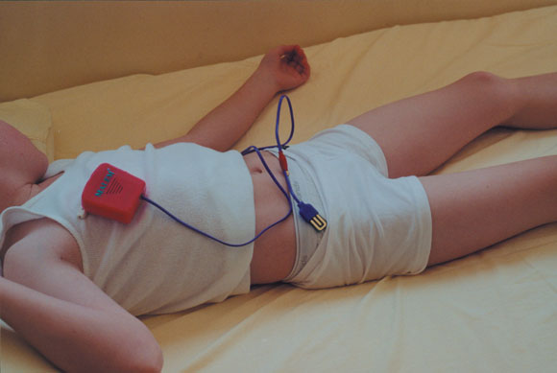
Enuresis
Repeated involuntary voiding of urine occurring after an age at which continence is usual.
Prevalence varies by country
U.K. 10% at 5 yrs
5% at 10 yrs
1% at 18yrs

Slide 15
Anxiety
Apprehension, tension, or uneasiness that stems from the anticipation of danger or an inability to cope, which may be internal or external.
Overall prevalence 8 - 10%
Separation anxiety disorders 3.5 – 5.4%
Selective mutism 0.08 – 0.7 %

Slide 16
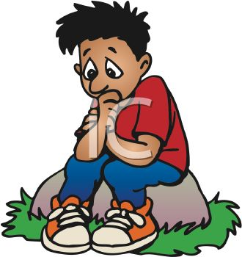
Depression
Major depression is more than a sad mood, depression affects a young person’s ability to think, feel, and behave in a normal manner.
At any point in time, 1 in every 10
children and adolescents are affected
by serious emotional disturbances.
Prevalence of depression 2 – 4%
More commoner after puberty rising to 4 – 8%
In adolescents F > M

Slide 17
Reference
www.who.int
www.nimh.nih.gov

Slide 18
Thank you

