Slide 1
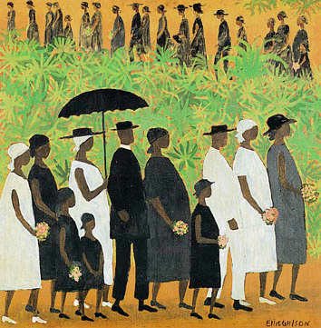
Death, Dying and Grieving

Slide 2
The Death System
In most societies, death is not viewed as the end of existence because the spiritual body is believed to live on
Changing Historical Circumstances:
The age group in which death most often strikes
Life expectancy has increased from 47 to 78 years
Location of death

Slide 3
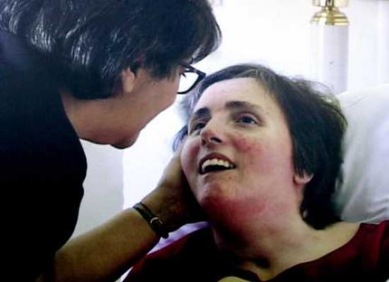
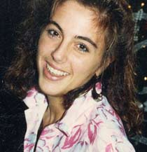
Issues in Determining Death
Brain Death: a person is brain dead when all electrical activity of the brain has ceased for a specified period of time
Includes both the higher cortical functions and the lower brain-stem functions

Slide 4
Life, Death, and Health Care
Advance directive & living wills are designed to be filled in while the individual can still think clearly
Designed for situations in which the individual is in a coma and cannot express his or her desires
Many countries have natural death legislation
People engaged in end-of-life planning are more likely to:
Have been hospitalized in the year prior
Believe that patients rather than physicians should make health-care decisions
Have less death anxiety
Have survived the painful death of a loved one

Slide 5
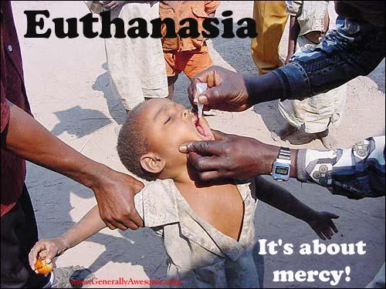
Life, Death, and Health Care
Euthanasia:
the act of painlessly ending the lives of individuals who are suffering from an incurable disease or severe disability
Passive euthanasia: treatment is withheld
Active euthanasia: death deliberately induced
Trend is toward acceptance of passive euthanasia in the case of terminally ill patients

Slide 6
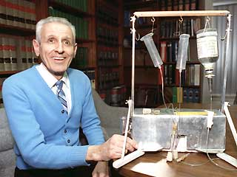
Active euthanasia was made famous by Dr. Jack Kevorkian in the U.S. as “assisted suicide”
Active euthanasia is a crime in most countries
Patients who have a desire for euthanasia are often:
Less religious
Have been diagnosed with depression
Have a lower functional living status

Slide 7
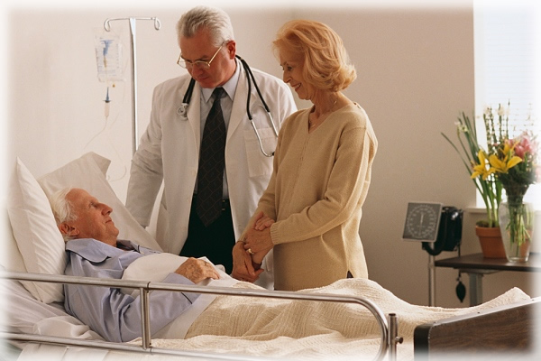
Life, Death, and Health Care
Hospice:
A program committed to making the end of life as free from pain, anxiety, and depression as possible
Palliative care: reducing pain and suffering, helping individuals die with dignity
Makes every effort to include the dying patient’s family members
Includes home-based programs today, supplemented with care for medical needs and staff
Family members report better psychological adjustment to the death of a loved one when hospice care is used

Slide 8
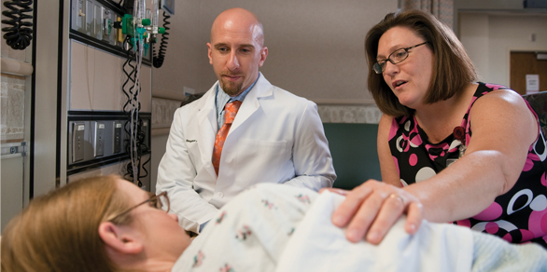
A “good death” involves:
physical comfort
support from loved ones
Acceptance
appropriate medical care.

Slide 9
Causes of Death
Causes of death vary across the life span:
Prenatal death through miscarriage
Death during birth or shortly afterwards
Accidents or illness cause most childhood deaths
Most adolescent and young adult deaths result from suicide, homicide, or motor vehicle accidents
Middle-age and older adult deaths usually result from chronic disease

Slide 10
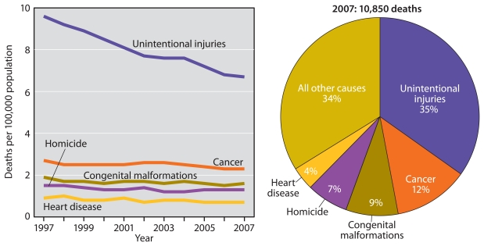

Slide 11
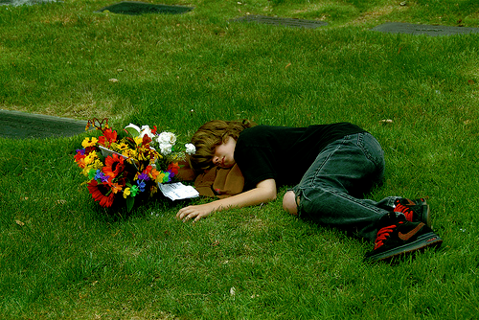
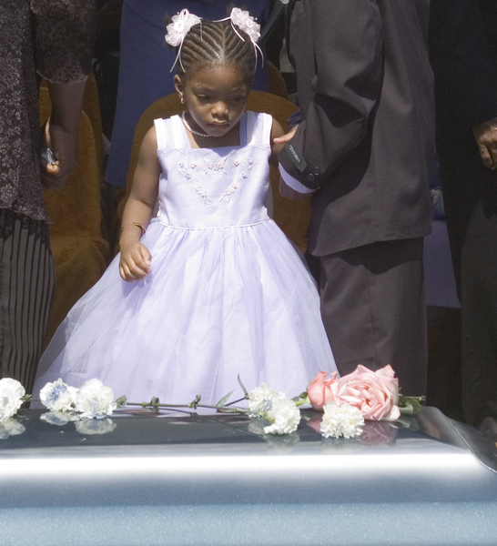
Attitudes Toward Death
Death of a parent is especially difficult for children
Most psychologists believe that honesty is the best strategy in discussing death with children
Depends on the child’s maturity level
Terminally ill children may distance themselves from their parents as death approaches
Most adolescents:
Avoid the subject of death until a loved one or close friend dies
Describe death in abstract terms and have religious or philosophical views about it
Often think that they are somehow immune to death

Slide 12
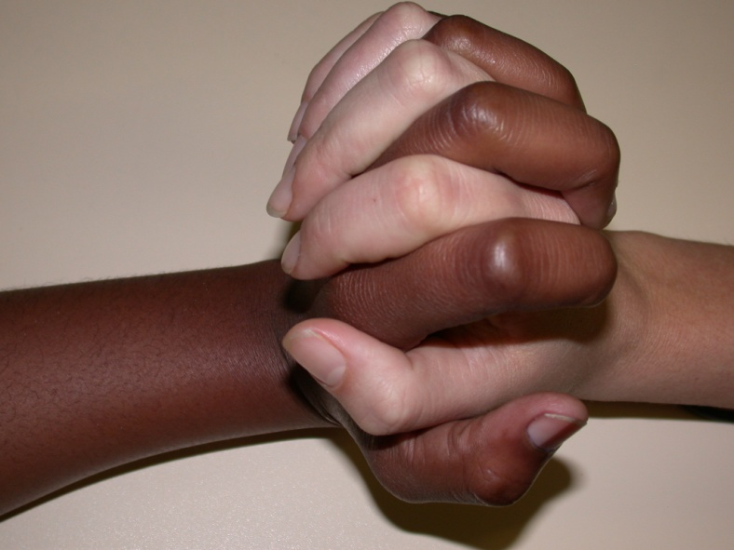
Attitudes Toward Death
Concerns about death increase as one ages:
Awareness usually intensifies in middle age
Middle-aged adults often fear death more than young adults or older adults
Older adults are more often preoccupied by it and want to talk about it more
One’s own death usually seems more appropriate in old age, possibly a welcomed event, and there is an increased sense of urgency to attend to unfinished business

Slide 13
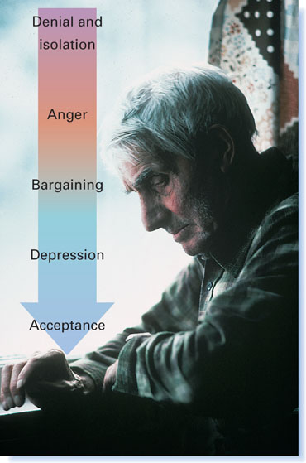
KÜBLER-ROSS’S STAGES OF DYING
Denial and Isolation: “It can’t be!”
Anger: “Why me?”
Bargaining: “Just let me do this first!”
Depression: withdrawal, crying, and grieving
Acceptance: a sense of peace comes

Slide 14
Perceived Control and Denial
Perceived control may be an adaptive strategy for remaining alert and cheerful
Denial insulates and allows one to avoid coping with intense feelings of anger and hurt
Can be maladaptive depending on extent

Slide 15
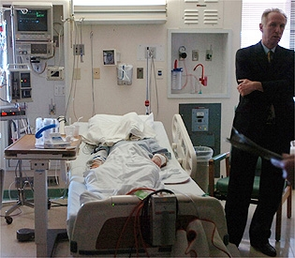
Contexts in Which People Die
More than 50% of Americans die in hospitals
Nearly 20% die in nursing homes
Hospitals offer many important advantages:
Professional staff members
Technology may prolong life
Most individuals say they would rather die at home

Slide 16
Grieving
Grief:
emotional numbness, disbelief, separation anxiety, despair, sadness, and loneliness that accompany the loss of someone we love
Grief is a complex, evolving process with multiple dimensions
More like a roller-coaster ride than an orderly progression of stages
Cognitive factors are involved in the severity of grief
Good family communications and grief counselors can help grievers cope with feelings of separation and loss
Prolonged Grief: approximately 10%–20% of survivors have difficulty moving on with their life after 6 months have passed
Disenfranchised Grief: an individual’s grief involving a deceased person that is a socially unclear loss that can’t be openly mourned or supported
Examples: ex-spouse, abortion, stigmatized death (such as AIDS)

Slide 17
Grieving
Dual-Process Model:
Loss-oriented stressors: focus on the deceased individual
Can include grief work and both positive and negative reappraisal of the loss
Restoration-oriented stressors: secondary stressors that emerge as indirect outcomes of bereavement
Changing identity and mastering new skills
Effective coping involves cycling between coping with loss and coping with restoration

Slide 18
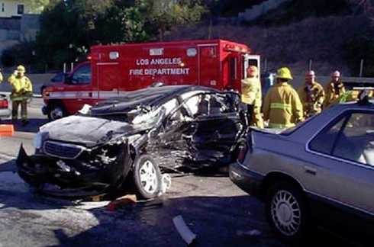
Grieving
Impact of death on surviving individuals is strongly influenced by the circumstances under which the death occurs
Traumatic, violent, or sudden deaths are likely to have more intense and prolonged effects
Can be accompanied by PTSD-like symptoms

Slide 19
Grieving
Cultural Diversity:
Some cultures emphasize the importance of breaking bonds with the deceased and returning quickly to autonomous lifestyles
Beliefs about continuing bonds with the deceased vary extensively
There is no one right, ideal way to grieve

Slide 20
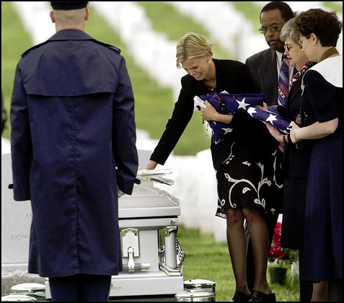
Losing a Life Partner
Women live longer than men
A widowed man is more likely to remarry
Widows usually marry older men
Widowed women are probably the poorest group in America
Women tend to do better than men because women typically have better networks of friends and relatives
Older women do better than younger women
Religiosity and coping skills are related to well-being following the loss of a spouse in late adulthood

Slide 21
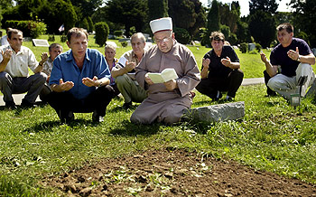
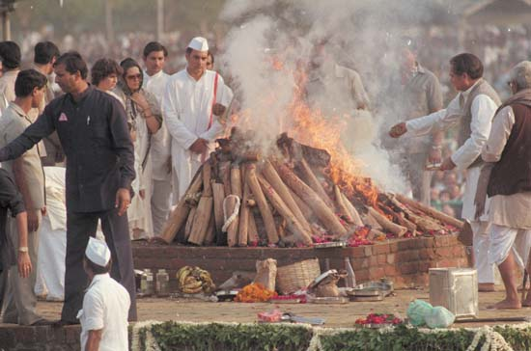
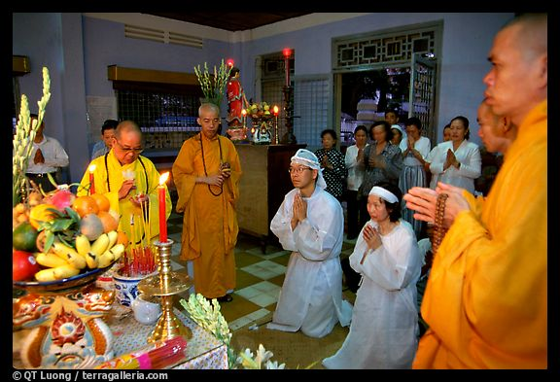
Forms of Mourning
Approximately 80% are buried; 20% are cremated
Funerals are an important aspect of mourning in many cultures
Cultures vary in how they practice mourning

Slide 22
THANK YOU…

