Slide 1
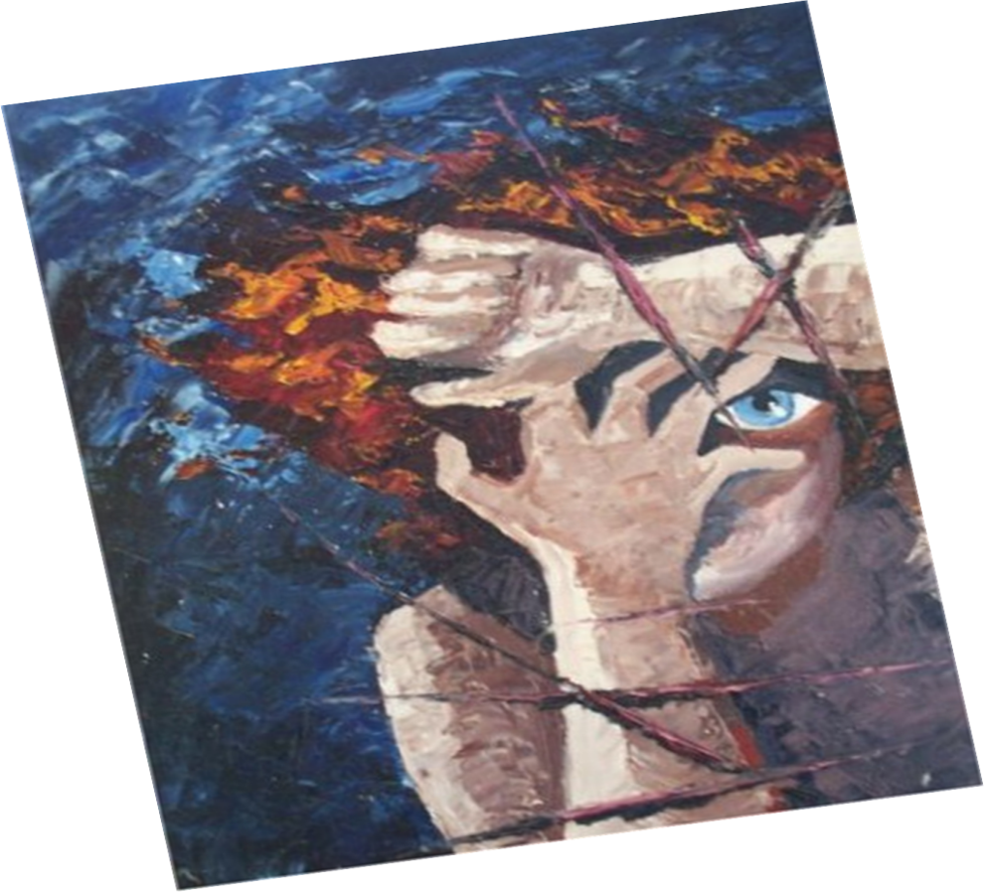
Deliberate Self Harm & Suicide
Dr. Vidumini De Silva

Slide 2
Deliberate self-harm ( WHO Definition )
- deliberate and direct destruction or alteration of body tissue
- without conscious suicidal intent,
- but resulting in injury severe enough for tissue damage to occur.
- Basically, deliberate self-harm means doing something to cause immediate physical harm to yourself
- but not for the purpose of ending your life.
-

Slide 3
Female:Male ratio - 2:1
15-21 largest age group
At risk:
Female
Isolated
Negative life events
Pre-existing psychiatric conditions
Familial history
Intolerable stress
Impulsive, immature, aggressive personality

Slide 4
4% of English hospital admissions (Carroll 2006)
Fifth biggest cause of admissions

Slide 5
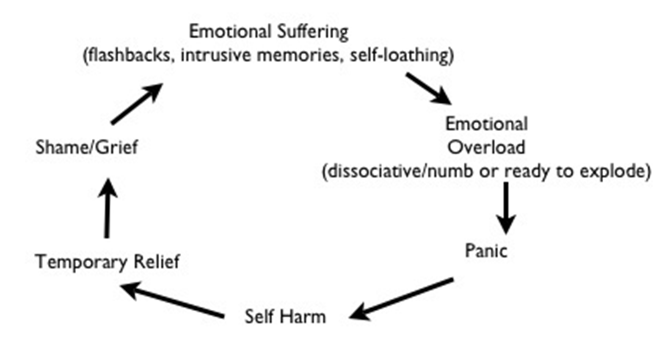
DSH

Slide 6
Why?

Slide 7
Cry for help
Attention seeking
Coping strategy
Destruction
Control & Mastery
Punish others
- Loved ones
- Family
- Failing relationships

Slide 8
Negative self-esteem
Hypersensitivity to rejection
Suppressed anger and sadness
Chronic Anxiety
Relationship problems
Poor functioning in school, home or work
- More common in females than males
- Typical onset is at puberty
- History of physical and/or sexual abuse
- Average to high intelligence
- Middle to upper-class background

Slide 9
Feels "empty" and isolated
Drug or alcohol abuse
Early history of medical illness or surgical procedures requiring hospitalization
Imprisonment or institutionalization in drug treatment centres
Inability to express or tolerate negative feelings
Poor academic performance or truancy
Has a background of emotional neglect

Slide 10
Self-harm acts
Cutting
Burning with heat, chemicals or cigarettes
Needle-sticking
Banging head
Ingestion of toxic substances
Carving on skin
Severe scratching
Punching
Biting
Cutting is often considered one of the most common methods of self-harm.

Slide 11
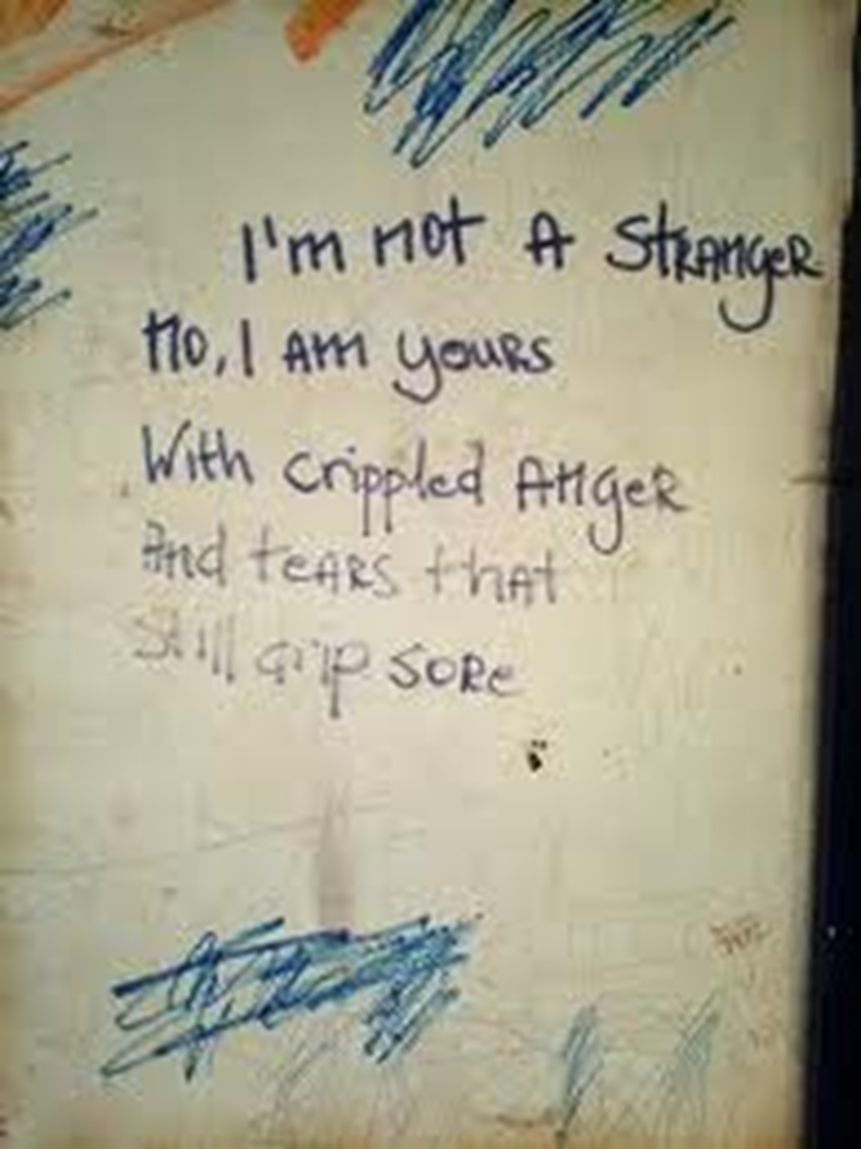
Art form

Slide 12
Use of an rubbers or friction to burn skin
Bruising
Pulling fingernails and toenails
Refusing to take needed medications
Hitting self
Banging one's head
Ingesting sharp or toxic objects
Picking scabs / keeping wounds from healing

Slide 13
Deep scratching
Inserting objects into body openings
Inserting needles or sharp objects under the skin
Some forms of hair-pulling
Tooth-pulling
Bone-breaking
Carving symbols, names or images

Slide 14
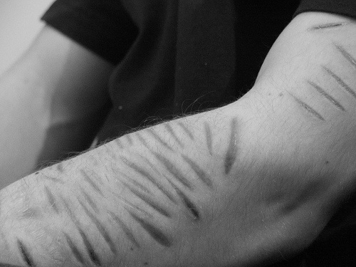

Slide 15
Suicide

Slide 16
Suicide
Suicide is the human act that is self inflicted, self intentioned cessation of life.

Slide 17
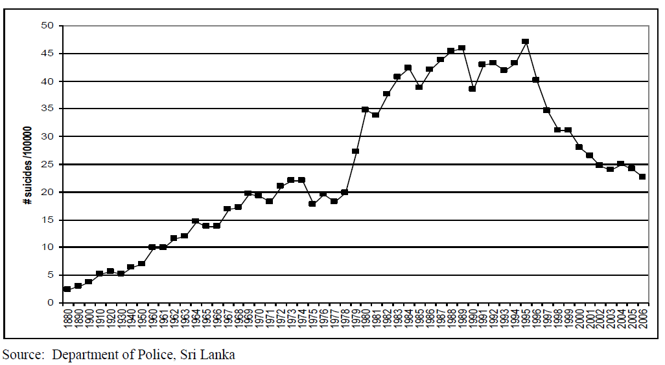
Figure : Overall suicide rates in Sri Lanka since 1880 - 2006

Slide 18
Gender differentials are discernible as suicide is seen as an easy way out of a problem by more men than women, at any particular time interval of the lifespan.
Age
Older persons, those 60 years and above, shared the largest suicide burden through out the period.

Slide 19
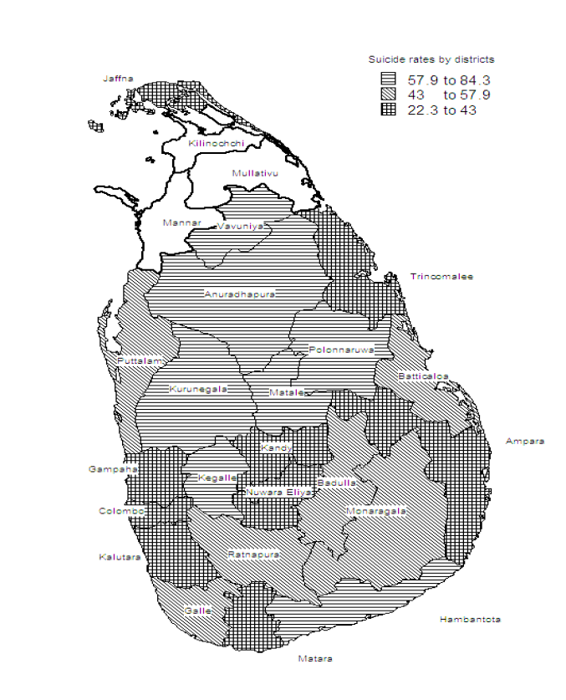
The rural agricultural districts reported
higher rates than rest of the country.

Slide 20
Nearly 70% of those who have committed suicide in 1999, have ended their lives by
Poisoning after the use of pesticides or unspecified substances.
Another 14% have been subjected to strangulation or suffocation due to hanging themselves.
Other methods of committing suicide include burning themselves, jumping in front of a moving train and getting drowned.

Slide 21
Signs and symptoms
Depression
Anxiety
Low self esteem
Isolation
Verbal/non verbal clues
Anger towards himself/others
Previous attempts
Hx of psychiatric illness
Family hx

Slide 22
Assessment
Hx, MSE, physical Ex
Suicidal Assessment

Slide 23
Suicidal Assessment
why, when, place, how?
Time, place – isolated/not
Prior planned/ sudden thought
Any clues given prior
Access to info about suicidal methods – lethal doses etc
Intention – scare others/kill yourself
Left a note, message, phone call etc?
Door locked inside/not
Still wants to kill yourself?

Slide 24
SAD PERSONS scale
S: Male sex
A: Age
D: Depression
P: Previous attempt
E: Excess alcohol or substance use
R: Rational thinking loss
S: Social supports lacking
O: Organized plan
N: No spouse
S: Sickness

Slide 25
Risk assessment scale,
0–4: Low
5–6: Medium
7–10: High

Slide 26
Exercise 01
List 10 nursing diagnoses for a patient with a suicidal intent.

Slide 27
Exercise 02
Discuss therapeutic nursing management for this patient.

Slide 28
Exercise 03
Discuss on following theories
Psycological theories
Sociological theories
Biological theories

Slide 29
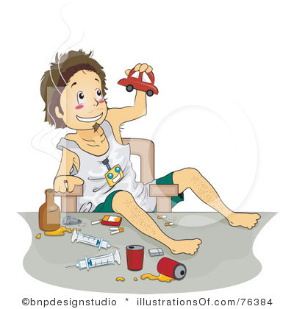
Substance Abuse
By Dr. Vidumini De Silva

Slide 30
Terminology
  Substance Abuse
  Dependence (Addiction)
  Tolerance
  Intoxication

Slide 31
1. What is a “Substance” ?
Drugs of abuse are any chemical agents (natural or artificial) that affect the mind and are known to be used in an abusive manner.
Alcohol
Illegal street drugs (cannabis, cocaine or amphetamine)
Addictive prescription drugs (like tramadol, pethidine)
Over the counter drugs (like corex D or even mouthwash)
Other mind altering substances (like glue, UHU, opioids)

Slide 32
Substance Abuse
Use of substances is causing problems in life (failure to fulfill major role obligations at work, school, or home)
If diagnosed with substance abuse is not considered to be addicted or dependent (otherwise the diagnosis would be substance dependence)

Slide 33
2. Substance Dependence
Certain changes in the way the person relates to the substance. Shows all the signs of abuse plus some additional problems.

Slide 34
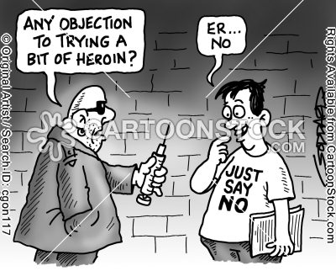

Slide 35
Dependency features
Withdrawal signs when not using
lacking the control of the onset, amount and termination of the substance usage.
Devotes a lot of time and energy to getting and using
Needs more and more to get the same effect (tolerance)
Gives up things that used to be important in order to use
Compulsions or cravings to keep using

Slide 36
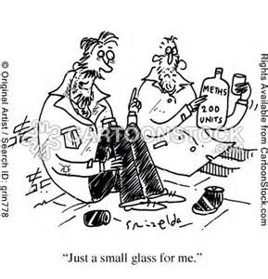

Slide 37
3. Tolerance
Needs more and more of the drug to get the same effect as before.
E.g.: initially one glass of liquor to get the buzz, later needs 6-7 glasses to get the same buzz.

Slide 38
4. Intoxication
Transient syndrome
due to recent substance ingestion which produces
physical or
psychological impairment

Slide 39
Withdrawal
Symptoms and signs specific for specific drug abused.
Impairment in social, occupational etc

Slide 40
Risk factors
Biological
Genetic
Biochemical – substance make them addicted
Psychological
Developmental influences – disturbance of sense of self, ego
Personality – pessimism, impulsivity

Slide 41
Socio-cultural
socio-learning – children likely to use substances if parents do so
Conditioning – pleasurable effects ->positive reinforcement to use the substance
Culture and ethnicity
Mental illness – BAD, depression, schizophrenia, anxiety

Slide 42
ICD 10 Guidelines on Dependence
a strong desire
(b) difficulties in controlling substance-taking
(c) withdrawal state when substance use has ceased or been reduced.
(d) tolerance.
(e) progressive neglect of alternative pleasures or interests
(f) persisting with substance use despite clear evidence harmful consequences .
Any of 3 or more present sometime during the last 12 month period

Slide 43
Characteristics of Dependence
Chronic
Primary
Progressive
Relapsing
.

Slide 44
Alcohol

Slide 45
Is there a lion in you ?

Slide 46
Spectrum of alcohol use /abuse
1. Social drinker
2. Heavy drinker
3. Binge drinker
4. Alcohol abuser
5. Dependent or addicted drinker

Slide 47


Social drinker
Occasional drinker
Regular but moderate

Slide 48

Heavy drinker
regular and heavy drinker

Slide 49

Binge drinker
irregular and heavy drinker

Slide 50

Alcohol abuser
physical, psychological and social problems

Slide 51
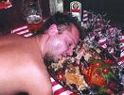
Dependent or addicted drinker
tolerant
obvious physical, psychological and social problems

Slide 52
SAFE LEVELS
Males – 21 Units / week
Females – 14 Units / week

Slide 53
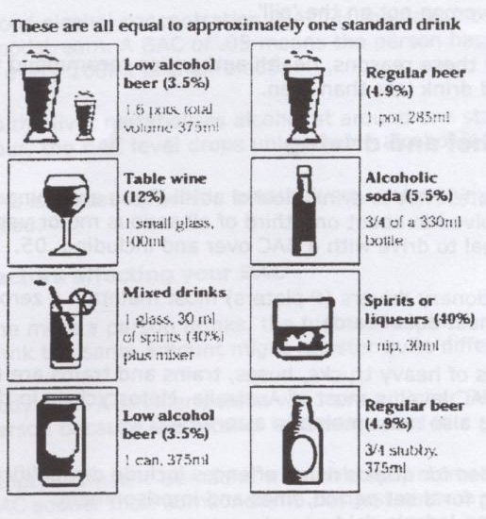

Slide 54
Alcohol dependence
( 3 or more needed for diagnosis )
Tolerance
Physiological withdrawal state
Compulsion to drink
Difficulty in controlling
Neglect of alternative pleasures
Persisting despite clear evidence of harmful effects

Slide 55
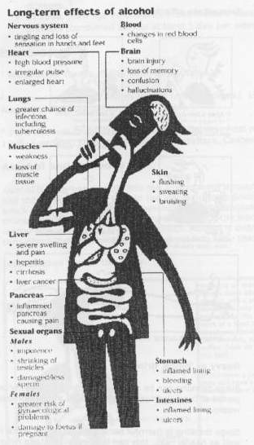

Slide 56
ALCOHOL WITHDRAWAL
Tremulousness - “the shakes”
Agitation - easily startled
Nausea, retching & sweating
Illusions
Hallucinations
Seizures ( rum fits )
Delirium tremens

Slide 57
Toxic / Nutritional conditions
Wernicke’s encephalopathy
Korsakov’s psychosis
Alcoholic dementia

Slide 58
WERNICKE’S ENCEPHALOPATHY
Memory defect
Disorientation
Impairment of consciousness
Ataxia
Ophthalmoplegia
ACUTE
SYNDROME

Slide 59
Korsakov’s Psychosis
CHRONIC SYNDROME
Impairment of memory and learning
Confabulation

Slide 60
OTHER PSYCHIATRIC DISORDERS
Personality deterioration
Self centredness
Responsibilities evaded
Decline in standards of conduct
Dishonest and deceitful

Slide 61
depression
B. Mood disorders
C. Suicidal behaviour
D. Impaired psychosexual function
Erectile impotence
Delayed ejaculation

Slide 62
E. Morbid jealousy

Slide 63
SOCIAL DAMAGE
MARITAL/FAMILY
PROBLEMS
CRIME
UNEMPLOYMENT
CHILDREN –
BEHAVIOUR PROBLEMS

Slide 64
A man
...or a mouse

Slide 65

CANNABINOIDS

Slide 66
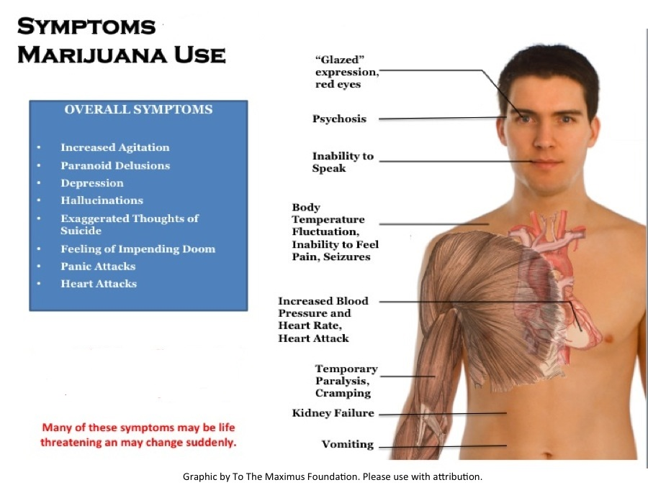

Slide 67
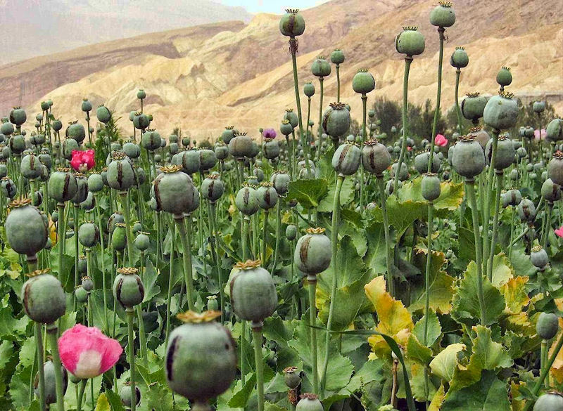
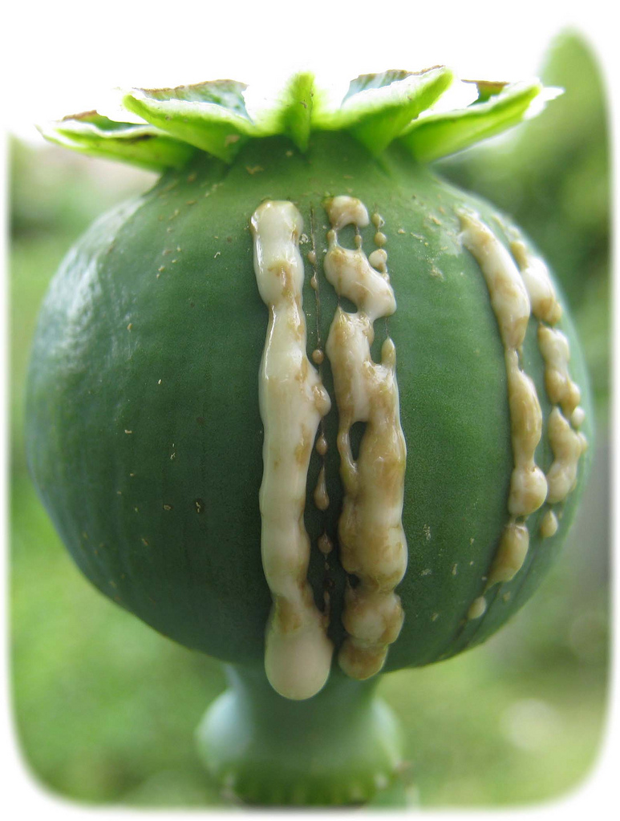
Opiates

Slide 68
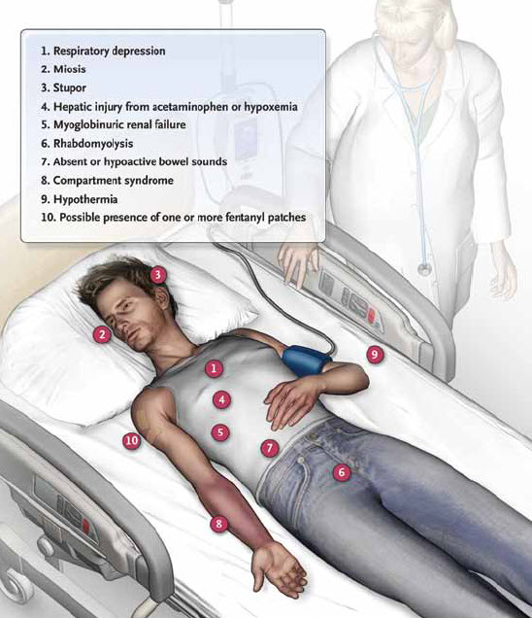

Slide 69
MCQ session

Slide 70
Thank you!

