Slide 1
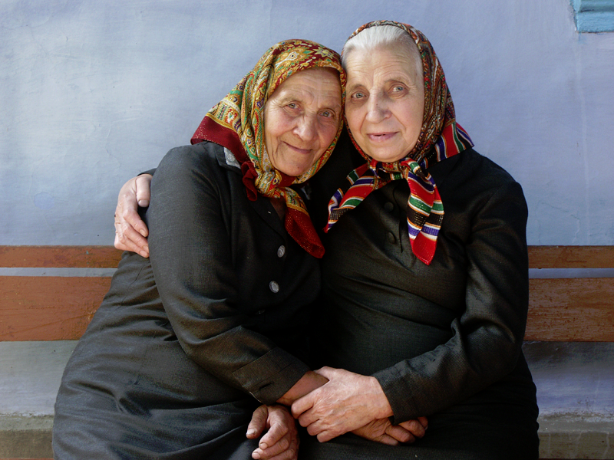
Development in Late Adulthood

Slide 2
Physical Development in Late Adulthood

Slide 3
Life Expectancy and Life Span
Life Span: the maximum number of years an individual can live; has remained between 120–125 years
Life Expectancy: the number of years that the average person born in a particular year will probably live
Has increased an average of 30 years since 1900
Average life expectancy today is 77.6 years

Slide 4
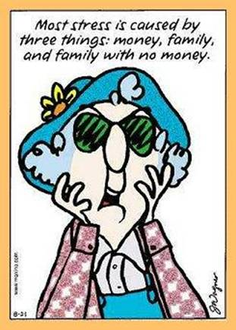
Life Expectancy and Life Span
Number of centenarians is increasing by approximately 7% each year
Getting older may not mean getting sicker
Many centenarians are women
Among centenarians, men are more likely to be healthier than women
Ability to cope successfully with stress seems to be important to survival
Other important factors:
Genes and family history
Health, education, personality, and lifestyle
Some developmentalists divide late adulthood:
Young-old are aged 65 to 74
Old-old are aged 75 or more
Oldest-old are aged 85 or more

Slide 5
Biological Theories of Aging
Cellular Clock Theory: cells can divide a maximum of 75-80 times; this places the maximum human life span at 120–125 years of age
Telomeres become shorter each time a cell divides
Free-Radical Theory: people age because when cells metabolize energy, the by-products include unstable oxygen molecules, or free radicals
Free radicals damage DNA and other cellular structures

Slide 6
Biological Theories of Aging
Mitochondrial Theory: aging is due to the decay of mitochondria
Mitochondria: supply essential energy for function, growth, and repair
Hormonal Stress Theory: aging in the body’s hormonal system can lower resistance to stress and increase the likelihood of disease
Prolonged, elevated levels of stress hormones are associated with increased risks for many diseases

Slide 7
The Aging Brain
On average, the brain shrinks 5% to 10% between the ages of 20 and 90
May result from a decrease in dendrites, damage to myelin sheath, or the death of brain cells
Some areas of the brain shrink more than others
Shrinkage of the prefrontal cortex is linked with a decrease in working memory and other cognitive activities
A general slowing of function in the brain and spinal cord begins in middle adulthood and accelerates in late adulthood
Aging has been linked to a reduction in the production of certain neurotransmitters

Slide 8
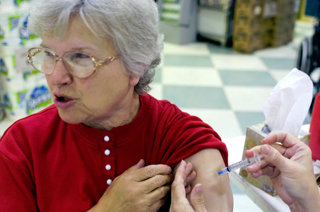
The Immune System
The immune system declines in functioning with age
Extended duration of stress; diminished restorative processes
Malnutrition involving low levels of protein
Exercise improves the immune system, and influenza vaccination is very important for older adults

Slide 9
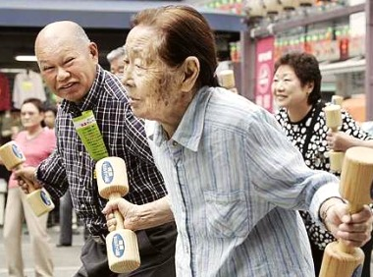
Physical Appearance and Movement
Wrinkles and age spots become more noticeable
People get shorter with aging due to bone loss in their vertebrae
Weight typically drops after we reach age 60; likely because we lose muscle
Older adults move more slowly than young adults
Exercise and appropriate weight lifting can help reduce these declines

Slide 10
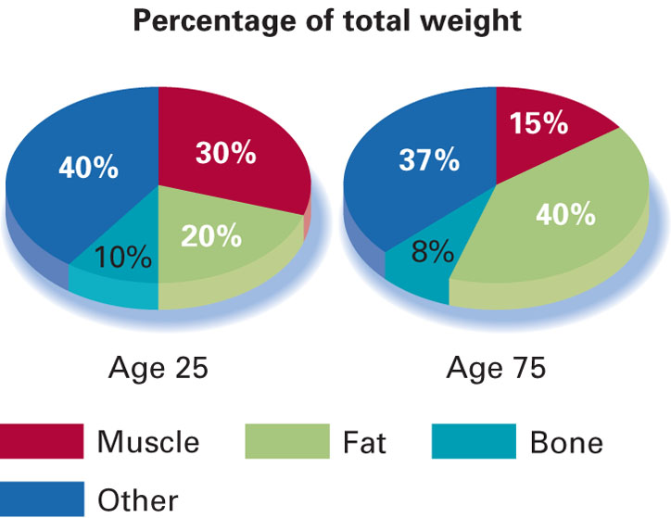
Physical Appearance and Movement

Slide 11
Sensory Development
Vision:
Decline in vision becomes more pronounced
Adaptation to dark and driving at night becomes especially difficult
Decline may be the result of a reduction in the quality or intensity of light reaching the retina
Color vision may decline as a result of the yellowing of the lens of the eye
Depth acuity declines in late adulthood

Slide 12
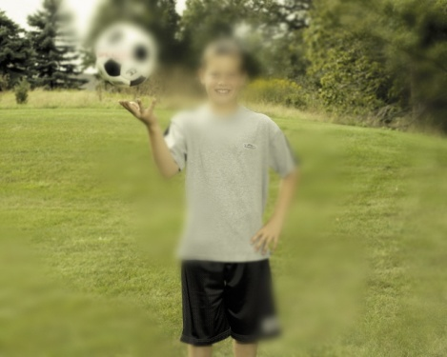
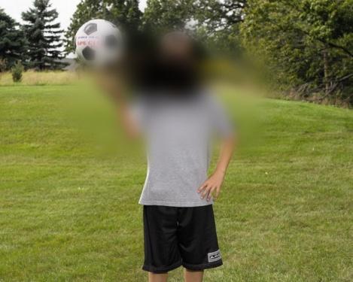
Sensory Development
Diseases of the Eye:
Cataracts: a thickening of the lens of the eye that causes vision to become cloudy, opaque, and distorted
Glaucoma: damage to the optic nerve because of the pressure created by a buildup of fluid in the eye
Macular Degeneration: deterioration of the macula of the retina, which corresponds to the focal center of the visual field

Slide 13
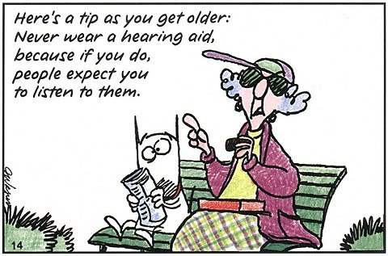
Sensory Development
Hearing:
Hearing impairments are typical in late adulthood
15% of the population over age 65 is legally deaf
Usually due to degeneration of the cochlea
Some (but not all) hearing problems can be corrected by hearing aids
Smell and Taste:
Smell and taste losses typically begin about age 60
Less decline in healthy older adults
Touch and Pain:
Slight decline in touch sensitivity with age
Older adults are less sensitive to pain

Slide 14
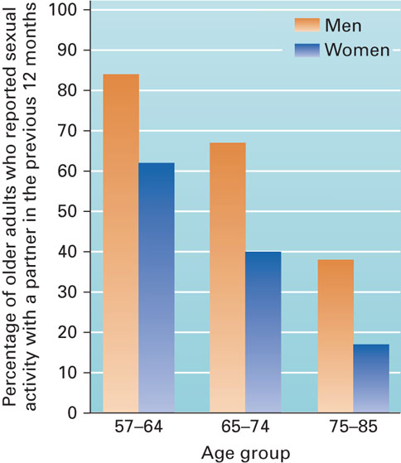
Sexuality
Orgasm becomes less frequent in males with age
Many older adults are sexually active as long as they are healthy
Older adults who do not have a partner are far less likely to be sexually active than those who have a partner
Various therapies have been effective for older adults who report sexual difficulties

Slide 15
Health Problems
Probability of having some disease or illness increases with age
Arthritis is the most common
Hypertension is the second most common
Older women have a higher incidence of arthritis, hypertension, and visual problems than older men
Nearly 75% of older adults die from heart disease, cancer, or cerebrovascular disease (stroke)
Lifestyle and social and psychological factors are linked to health in older adults

Slide 16
Health Problems
Osteoporosis: extensive loss of bone tissue
Affects women more often than men
Can be prevented by:
Eating calcium-rich foods and vegetables
Having a regular exercise program
Medication
Accidents: 7th leading cause of death in older adults
Healing and recuperation are slower in older adults
Exercise programs can reduce risks

Slide 17
Substance Abuse
Medications can increase the risks associated with consuming alcohol or other drugs
Substance abuse among older adults may be an “invisible epidemic”
Late-Onset Alcoholism: onset of alcoholism after the age of 65
Often related to loneliness, loss of a spouse, or a disabling condition
Moderate drinking of red wine is linked to better health and increased longevity

Slide 18
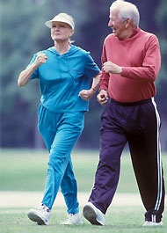
Exercise, Nutrition, and Weight
Exercise:
Active adults are healthier and happier
Benefits:
Linked to increased longevity
Related to prevention of common chronic diseases
Associated with improvement in the treatment of many diseases
Can optimize body composition and reduce the decline in motor skills as aging occurs
Reduces the likelihood that older adults will develop mental health problems
Linked to improved brain and cognitive functioning

Slide 19
Exercise, Nutrition, and Weight
Nutrition and Weight:
Some older adults restrict their dietary intake in a way that may be harmful to their health
Decreased snacking between meals may contribute to harmful weight loss
Calorie restriction has been proven to extend the life span of certain animals, but it is not known if this works in humans
New research suggests that antioxidants may help slow the aging process and possibly prevent some diseases

Slide 20
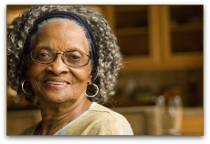
Cognitive Development in Late Adulthood

Slide 21
Multidimensionality
Cognitive mechanics:
the “hardware” of the mind
Speed and accuracy of processes involved in sensory input, attention, visual and motor memory, discrimination, comparison, and categorization
Tends to decline with age
Cognitive pragmatics:
culture-based “software” programs of the mind
Reading, writing, and educational qualifications
Professional skills and language comprehension
Knowledge of self and life skills
May improve with age

Slide 22
Multidimensionality
Speed of Processing:
Speed of processing information declines in late adulthood
Considerable individual variation
Often due to a decline in brain and CNS functioning
Attention:
Selective attention: focusing on a specific aspect of experience that is relevant while ignoring others that are irrelevant
Older adults are generally less adept at this
Divided attention: concentrating on more than one activity at the same time
When tasks are easy, age differences are minimal
The more difficult the tasks, the less effectively older adults divide attention
Sustained attention: readiness to detect and respond to small changes occurring at random times in the environment
Older adults perform just as well on simple tasks; but performance drops on complex tasks

Slide 23
Multidimensionality
Memory: Memory changes during aging but not all in the same way
Episodic memory: younger adults have better episodic memory
the memory of autobiographical events (times, places, associated emotions, and other contextual knowledge)
Semantic memory: does not decline as drastically as episodic memory
the memory of meanings, understandings, and other concept-based knowledge
Working memory : decline during the late adulthood years
the system which actively holds information in the mind to do verbal and nonverbal tasks

Slide 24
Multidimensionality
Explicit memory: the conscious, intentional recollection of previous experiences and information
Implicit memory: memory without conscious recollection; skills and routines that are automatically performed
Implicit memory shows less aging declines than explicit memory
Source memory: the ability to remember where one learned something
Decreases with age during late adulthood

Slide 25
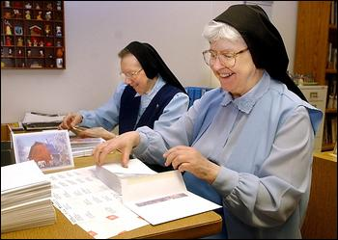
Use It or lose it
Changes in cognitive activity patterns can result in disuse and lead to atrophy of skills
Certain mental activities can benefit the maintenance of cognitive skills
Reading books, doing crossword puzzles, going to lectures and concerts
Research suggests that mental exercise may reduce cognitive decline and lower the likelihood of developing Alzheimer disease

Slide 26
Retirement
Retirement is a process, not an event
Older adults who adjust best to retirement:
Have an adequate income
Are better educated
Are healthy and active
Have extended social networks and family
Were satisfied with their lives before retiring

Slide 27
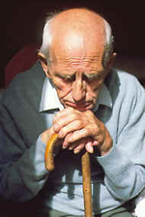
Mental Health: Depression
Major depression:
mood disorder in which the individual is deeply unhappy, demoralized, self-derogatory, and bored
Depressive symptoms increase in the oldest-old
Higher percentage of women
More physical disability
More cognitive impairment
Lower socioeconomic status
Women show more depression at 50 and 60 years of age, but depression in men increases from 60 to 80

Slide 28
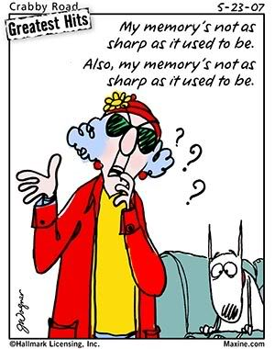
Dementia and Alzheimer Disease
Dementia:
any neurological disorder in which the primary symptoms involve a deterioration of mental functioning
20% of individuals over the age of 80 have dementia
Alzheimer Disease:
a common form of dementia that is characterized by a gradual deterioration of memory, reasoning, language, and eventually, physical function
Rates could triple within the next 50 years as people live longer
Divided into early-onset (younger than 65) or late-onset (later than 65)

Slide 29
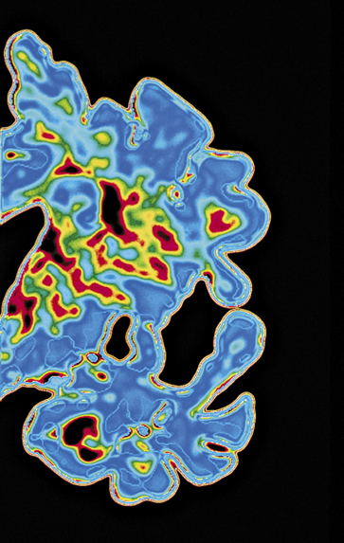
Dementia and Alzheimer Disease
Alzheimer Disease (continued):
Alzheimer involves a deficiency in the brain messenger chemical acetylcholine
Brain shrinks and deteriorates as memory ability decreases
Formation of amyloid plaques and neurofibrillary tangles
Age is an important risk factor, and genes also play an important role
Healthy lifestyle factors may lower the risk

Slide 30
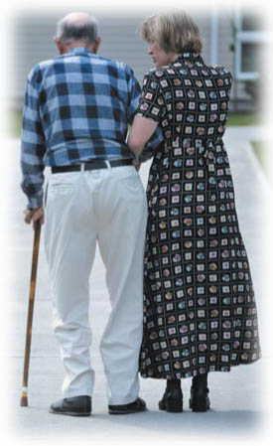
Dementia and Alzheimer Disease
Caring for people with Alzheimer is a major concern
Support is often emotionally and physically draining for the family
50% of family caregivers report depression
Female caregivers report more caregiving hours, higher levels of burden and depression, and lower levels of well-being and physical health than male caregivers

Slide 31
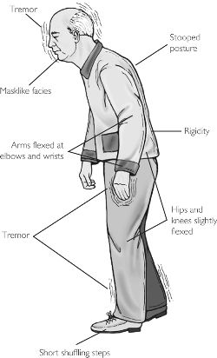
Dementia and Parkinson Disease
Multi-Infarct Dementia:
a sporadic and progressive loss of intellectual functioning caused by repeated temporary obstruction of blood flow in cerebral arteries
More common among men with a history of high blood pressure
Recovery is possible
Parkinson Disease:
a chronic, progressive disease characterized by muscle tremors, slowing of movement, and facial paralysis
Triggered by the degeneration of dopamine-producing neurons in the brain
Several treatments are available

Slide 32
Religion
Religion is:
More significant in older adults’ lives
Related to a sense of meaning in life
Related to higher levels of life satisfaction, hopefulness, and self-esteem
Associated with better health
Perhaps associated with living longer

Slide 33
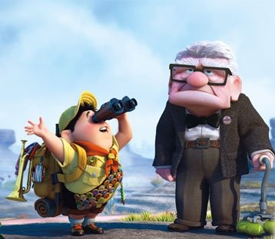
Socioemotional Development in Late Adulthood

Slide 34
THEORIES OF SOCIOEMOTIONAL DEVELOPMENT
Erikson’s Theory:
Integrity vs. Despair: involves reflecting on the past and either piecing together a positive review or concluding that one’s life has not been well spent
Life review: looking back at one’s life experiences, evaluating them, and interpreting/reinterpreting them
Life review is set in motion by looking forward to death
Can include sociocultural dimensions, interpersonal/relationship dimensions, and personal dimensions

Slide 35
THEORIES OF SOCIOEMOTIONAL DEVELOPMENT
Activity Theory: the more active and involved older adults are, the more likely they are to be satisfied with their lives
Suggests that individuals will achieve greater life satisfaction if they continue their middle-adulthood roles into late adulthood

Slide 36
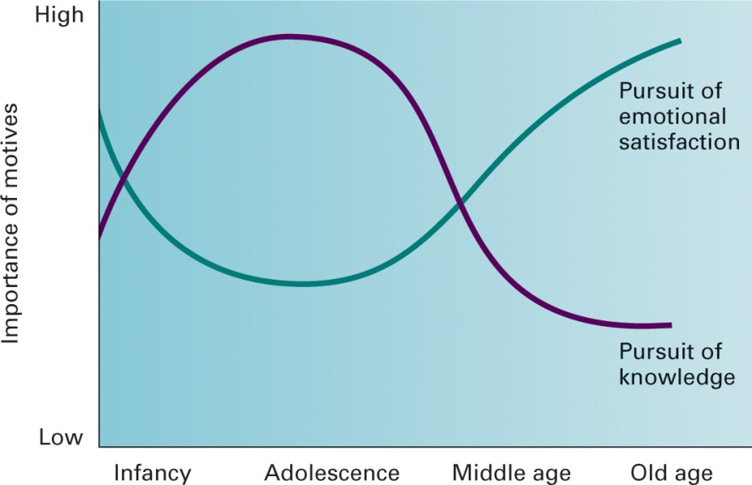
THEORIES OF SOCIOEMOTIONAL DEVELOPMENT
Socioemotional Selectivity Theory: older adults become more selective about their social networks, spending more time with individuals with whom they have had rewarding relationships
Two important classes of goals:
Knowledge-related
Emotional
Trajectory for each type of goal is different
When time is perceived as open-ended, knowledge-related goals are pursued more often
As older adults perceive that they have less time left, emotional goals become more important

Slide 37
THEORIES OF SOCIOEMOTIONAL DEVELOPMENT
Selective Optimization with Compensation Theory: successful aging is linked with three main factors:
Selection: older adults have a reduced capacity and loss of functioning, which require a reduction in performance in most life domains
Optimization: it is possible to maintain performance in some areas through continued practice and the use of new technologies
Compensation: older adults need to compensate when life tasks require a higher level of capacity

Slide 38
The Self and Society
Self-Esteem:
Tends to be higher for males than females; difference disappears in the 70’s and 80’s
Tends to decline significantly in the 70’s and 80’s
Deteriorating physical health
Negative societal attitudes toward older adults

Slide 39
Self-Acceptance: depends on whether the individual is describing their past, present, future
Self-Control: a majority of adults in their 60’s and 70’s report being in control of their lives

Slide 40
Older Adults in Society
Ageism: prejudice against others because of their age
Stereotypes against older adults are often negative
Most frequent form is disrespect, followed by weakness caused by age
Concern that the economy cannot bear the burden of so many older persons
Problems involving health care
Increasing health care costs
Medical system is based on a “cure” rather than “care” model

Slide 41
Older Adults in Society
Income:
Average income for retired individuals is about half what they earned when they were fully employed
Living Arrangements:
95% of older adults live in the community
Two-thirds live with family members, one-third alone
Half of older women 75 years and older live alone
Technology:
Older adults are less likely to have a computer in their home and less likely to use the Internet
Older adults spend more time on the Internet, visit more Web sites, and spend more money on the Internet than young adults

Slide 42
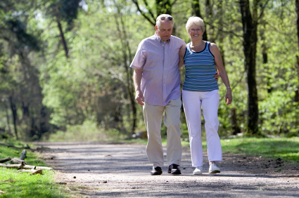
Lifestyle Diversity
Married Older Adults:
56% of U.S. adults over 65 are married; 45% of older adult women are widows
Marital satisfaction is greater in older adults than middle-aged adults
Retirement alters a couple’s lifestyle
Greatest changes occur in the traditional family
Older adults who are married or partnered are usually happier and live longer than those who are single
Marital satisfaction is often greater for men than women

Slide 43
Divorced and Separated Older Adults:
Represent only 8% of older adults
Social, financial, and physical consequences of divorce
Weakening of family ties
Less financial resources
Linked to more health problems
Remarriage is increasing due to rising divorce rates, increased longevity, and better health
Some older adults perceive negative social pressure about their decision to remarry
Majority of adult children support the decision of their older adult parents to remarry

Slide 44
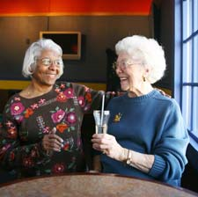
Friendship
Friendships have been found to be more important than family relationships in predicting mental health
Individuals with close ties to friends were less likely to die across a 7-year period
Unmarried older adults with a strong network of friends

Slide 45
Social Support and Social Integration
Convoy Model of Social Relations: individuals go through life embedded in a personal network of individuals from whom they give and receive social support
Social Support:
Improves physical and mental health
Reduces symptoms of disease
Increases one’s ability to meet health-care needs
Decreases risk of institutionalization
Associated with lower rates of depression
Social Integration:
Greater interest in spending time with a small circle of friends and family
Low level of social integration is linked with coronary heart disease
Being a part of a social network is linked with longevity, especially for men

Slide 46
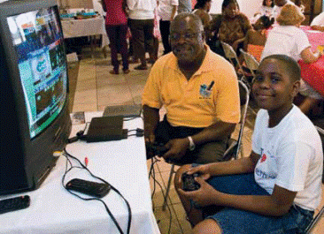
Altruism and Volunteerism
Older adults benefit from altruism ( concern for the welfare of others) and engaging in volunteer activities
Helping others may reduce stress hormones, which improves cardiovascular health and strengthens the immune system
Volunteering is associated with a number of positive outcomes
More satisfaction with life
Less depression and anxiety
Better physical health

Slide 47
Gender
Gender:
Some developmentalists believe that there is decreasing femininity in women and decreasing masculinity in men during late adulthood
Older men often become more feminine, but women do not necessarily become more masculine
Older adult females face ageism and sexism
Poverty rate for older adult females is almost double that of older adult males

Slide 48
Successful Aging
Being an older adult has many positive aspects
Older adults’ functioning is the result of better health habits such as:
Eating a proper diet
Having an active lifestyle
Engaging in mental stimulation and flexibility
Having positive coping skills
Having good social relationships and support
Avoiding disease
Successful aging involves having a sense of self-efficacy and a perceived control of environment.

Slide 49
THANK YOU…

