Slide 1
Eating Disorders
Dr. Vidumini De Silva

Slide 2
Objectives
Types of eating disorders
Clinical features
Aetiology
Management

Slide 3
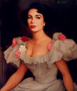

Slide 4
Types of Eating Disorders
Anorexia nervosa
Bulimia nervosa

Slide 5
Many famous people with eating disorders

Slide 6
Anorexia Nervosa
deliberate weight loss
Induced or sustained by the individual
In adolescent girls and young women
Rare – in adolescent boys and young men

Slide 7
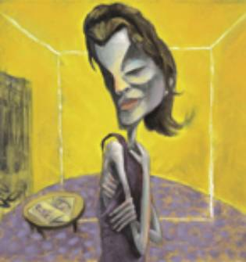

Slide 8
- Body weight 15% less than the expected weight
or
- Body Mass Index of less
than or equal to 17.5

Slide 9
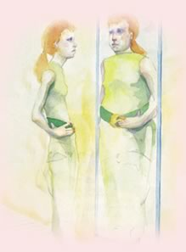
- Distorted body image
- Intense wish to be thin and a fear of being fat

Slide 10
Attempts to achieve an abnormally low body weight
Dieting
Avoidance of carbohydrates
Self induced vomiting
Self induced purging
Excessive exercise
Use of appetite suppressants
and / or diuretics

Slide 11
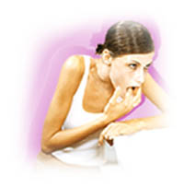

Slide 12
Amenorrhea
reduced sexual interest and potency in men
If onset is before puberty
delayed pubertal events
Sometimes episodes of binge eating / bulimia

Slide 13
Preoccupation with food
Depressive symptoms
low mood
social withdrawal

Slide 14
Examination
Consequences of starvation
sensitivity to cold
constipation
low blood pressure
bradycardia
hypothermia
lanugo hair

Slide 15
Consequences of repeated vomiting
potassium depletion – weakness
cardiac arrhythmias
renal impairment
pitted teeth
swollen parotid glands
calluses on the dorsum of the hand

Slide 16
Investigations
Haematological abnormalities
Leucopaenia
Relative leucocytosis
Anaemia

Slide 17
Metabolic abnormalities
Metabolic alkalosis
Hypokalaemia
Hypoglycaemia
Elevated plasma amylase
Hypercholesterolaemia
Hypercarotenaemia

Slide 18
Endocrine abnormalities
Elevated plasma growth hormone
Elevated plasma cortisol
Low plasma gonadotrophins
Low plasma gonadal steroids
Low plasma T3 with normal TSH & T4

Slide 19
Aetiology
Psychosocial factors
Social factors – middle and
upper social class
occupational groups
Individual psychological causes
Causes within the family
Genetics
Hypothalamic dysfunction

Slide 20
Differential Diagnosis
Depression
Obsessive Compulsive disorder
Personality disorders
Organic disorders
Intestinal disorders –
Malabsorption syndrome
Crohn’s disease
Malignancies
Chronic debilitating illnesses

Slide 21
Assessment
History - from patient
and other informants
Development of the disorder
Present pattern of eating and
weight control
Patient’s ideas about weight
Ask the patient to draw him/herself

Slide 22
Mental State Examination
overvalued ideas about distorted
body image
depressive symptoms
obsessive features
Physical examination
degree of emaciation
state of peripheral circulation
signs of nutritional deficiency
exclude other wasting disorders

Slide 23
Treatment
When to admit
Weight loss more than 25%
Metabolic abnormalities
Hypotension
Hypothermia
Suicidal intent
other complications

Slide 24
Treatment
Educate patient
Restore weight
set targets
supervise eating
reward weight gain
Treat depressive illness if present
Cognitive therapy to modify excessive concern about weight and shape
Supportive psychotherapy
Regular follow-up

Slide 25
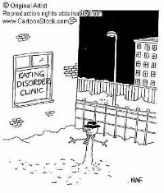

Slide 26
Bulimia Nervosa
Episodes of uncontrolled and excessive eating
- binge eating
Clinical Features
Recurrent episodes of overeating
Persistent preoccupation with eating and a strong desire to eat
Self perception of being too fat with a dread of being fat

Slide 27
Attempts to counteract fattening effects of food by
Self induced vomiting
Self induced purging
Alternate periods of starvation
Excessive exercise
Abuse of appetite suppressants
and diuretics

Slide 28
Normal menstruation
Consequences of repeated vomiting
potassium depletion – weakness
cardiac arrhythmias
renal impairment
pitted teeth
swollen parotid glands

Slide 29
Management
Similar to that of Anorexia Nervosa
but no need for weight restoration
Assessment of patient to identify depressive symptoms
Treatment of depression if present
Cognitive therapy to modify excessive concern about weight and shape

Slide 30
Summary
Anorexia Nervosa
Bulimia Nervosa
Clinical features
Differential diagnosis
Management – Assessment
Treatment

Slide 31
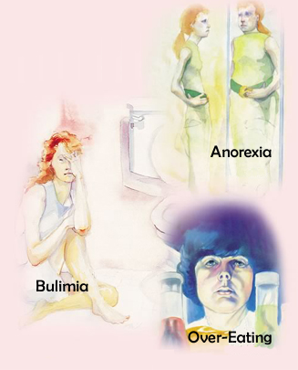

Slide 32
Thank you .

