Slide 1
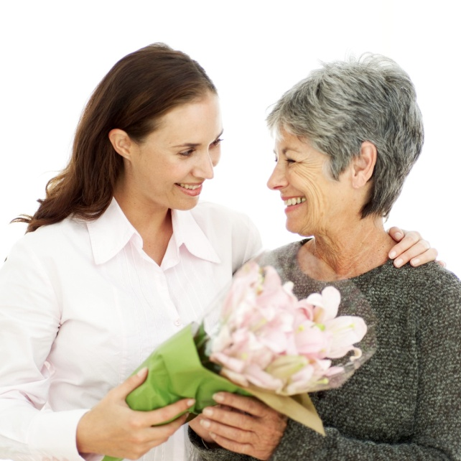
Gerontology
Aging
Ageism
Developmental tasks of Aging

Slide 2
Aging
Definition
Aging is a gradual process that begins at birth and is characterized by continued development and maturation.
Aging, like pregnancy, is not a disease, but a normal state.

Slide 3
When does Aging Start?
There are different opinions as to when Aging actually starts:
Middle adult years- 40 – 65
Older adult years – start at 65
Young old: 65 – 74
Middle old: 75 – 84
Old old: 85 and up
Using the Functional Age method to classify people is somewhat preferred

Slide 4
Functional Age Method
Age is related to health, physical independence, social and psychological functioning.
It emphasises that abilities and changes occur at different rates
All older adults of the same age don’t function at the same level
The changes that occur are influenced by 3 factors: Biological, Psychosocial & Environmental
These are described in the Theories of Aging.

Slide 5
Ageism
A concept in Gerontology
It’s the systematic stereotyping and discrimination against people because they are old.
The problem arises when becoming older is viewed is viewed in prejudicial terms of uselessness or functional incapability
As nurses we must assess our personal attitudes towards aging if we are to have a personal and positive influence on others

Slide 6
Nursing Care of the Older Client

Slide 7
Since aging is a normal evolutionary state, disability and dysfunction are normal or inevitable occurrences.
A nurse must be an autonomous health care professional who coordinates complex care of older clients and their families and who assumes a leadership role in the multidisciplinary health care team.
Gero. Nursing is a specialized area as the problems of the aged are associated with daily functioning and are therefore more responsive to nursing models, than medical models of care

Slide 8
Gero. Nursing Models
Principles:
Patients have the right to self- determination and independent decision making
Patients are holistic in nature, and their health and well-being are affected by the interaction of physiologic, pathologic, psychological, social, financial, and environmental factors.
Nursing has a role in assisting patients to optimize health, to improve the quality of life, to achieve comfort, and to facilitate personal growth (Phillips, 1990.)
Gero nursing is provided in acute care, skilled and assisted living, community, and home care settings.
Goal: promote and maintain functional status and helping older adults identify and use their strengths to achieve optimal independence.

Slide 9
Theories of Aging (Definitions)
Aging can also be defined as the sum of all changes that occur in humans with the passage of time that lead to functional impairment and death.
Alternately , it might be the decreasing ability to survive stress
Stress is any factor or process that tends to shift the internal environment away from its equilibrium, with the end point of homeostatic impairment in an internal environment incompatible with life.
Aging includes those changes that occur in any cell or organ system as a function of time , independent of any external or pathologic influences, such as disease.
Disease is a pathologic or abnormal state found in any cell, organ or organ system in a unit of time or extending over many units of time.

Slide 10
Biological Theories attempt to explain the physiologic processes and structural alterations in living organisms that determine mental developmental changes, longevity and death.
Psychological theories try to describe and explain aging behavior among and between persons, which can be affected by biological and environmental factors.
Sociologic theories focuses largely on ways that older adults adapt during later life and on their status as a group compared with other age groups in the society.

Slide 11
Importance of theories
Helps plan care in diversified and individualised ways.
There is consideration for the person’s functional and physical limitations, preferences, lifestyles and personality
They accentuate the influences of culture, family, education, community, roles and patterns of responses and disease states.
The nurse can use these theories as a basis to plan interventions in the care of the older adults

Slide 12
Developmental tasks of aging
These are tasks that can be achieved successfully by an aging adult or can cause problems if not adapted to successfully.

Slide 13
Some of these task are:
Adjusting to full or semi-retirement
Accepting help from others graciously and comfortably as dependency increases
Learning new affectionate roles with one’s children who are now mature adults
Establishing ongoing satisfying affectionate roles with grand children
Being a good companion to an aging spouse
Facing he loss of one’s spouse
Finding and preserving mutually satisfying friendships
Choosing and maintaining ongoing social activities and functions appropriate to health.

Slide 14
Maintaining a sense of moral integrity in the face of disappointments.
Making a good adjustment to failing powers as aging diminished strength and abilities
Adapting interests and activities to reserves of vitality and energy of the aging body
Mastering new awareness and methods of dealing with physical surroundings as a person with occasional or permanent disabilities
Keeping mentally alert and effective
Preparing for eventual and inevitable cessation of life by adopting a philosophy of life that allows one to live and die in peace

Slide 15
Promoting Communication In Older Adults
Does Communication abilities remain unchanged throughout one’s life?

Slide 16
Communication was once believed to remain essentially unchanged throughout one’s life. Now, however, observations reveal that communication skills do change throughout the life span.
Effective communication is essential to:
Independence
Compliance
Socialization
Feelings of satisfaction and well-being
When communication fails, the needs of the older client remain unmet and the stress on others increases

Slide 17
What can happen if there is a breakdown in communication?
First satisfying interpersonal relationships with family friends and caregivers are threatened
Broken relationships lead to further isolation and further Comm.Brkdwn
Hence effective communication with the older adult , whether patient, spouse, family member or colleague, is essential to Gero-nursing

Slide 18
Normal physiologic changes
These a relatively minor changes that require adjustment of family and friends of the older adult’s communication exchanges
Word retrieval difficulties
Inability to recall a name of someone they know well
Decreased fluency and flexibility
Fluency is the ability to think of and name a large number of different elements within a class. (name of animals in a zoo beginning with F)
Flexibility is the variability of the elements, for example, different ways to solve a problem, unique uses of an object
Overall slowing of rate
Manifested by a slower rate of speaking, response times and retrieval of words and thoughts

Slide 19
Changes in voice quality
Changes in pitch and frequency of voice and overall steadiness of pitch and volume (Perturbation)
Imprecise articulation
Poor coordination of the speech articulators (lips, tongue, lower jaw, soft palate, pharynx) makes speech sounds sound jumbled or mumbled to the listener.
Decrease in communication efficiency
A combination of the above makes communication laborious as the rate at which messages can be sent and received accurately is markedly reduced and uneven.

Slide 20
Abnormal changes
These are disturbances that can affect comprehension, memory and expression.
Poor recognition and comprehension
Decline in the ability to recognise familiar words and understand the meaning of spoken words .
Semantic-episodic memory problems
Empty speech. The word and utterances are grammatically correct but content is vague and limited
Decreased fluency
Reduced verbal out put as supposed to usual talkativeness

Slide 21
Overuse of pronouns without clear referents
A client might say “Someone came to see me” instead of “Mr. Jones came to see me”- hence its difficult for the listener to know who the client is referring to.
Frequent repetition
As the semantic memory declines, older people tend to rely on images, pictures and sounds to prompt conversation.. If environment remains constant, the will end up repeating the same thing over and over
Verbal disguise
Many patients use cover up behaviors to hide their difficulties such as making statement like “I haven’t seen you in a long time” when they have just met the person a few mins ago or “I don’t feel well” to avoid all conversation.

Slide 22
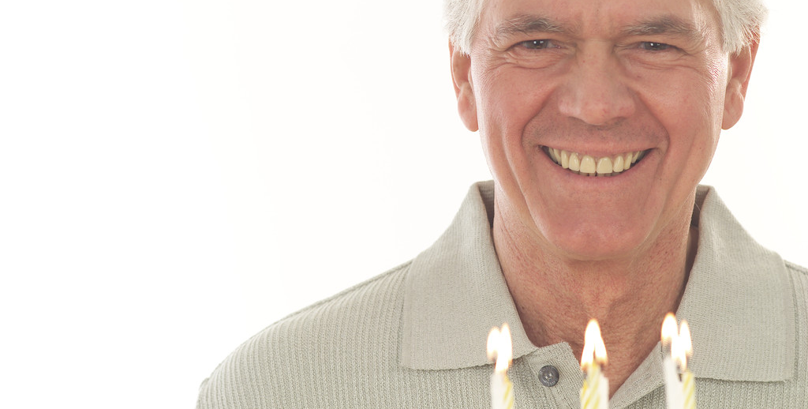
Normal Physiologic Changes Of Older Adulthood

Slide 23
General Status
Decreased efficiency of physiologic processes resulting in fragile balance and impaired homeostasis
They become more vulnerable to physical and emotional stress as their physiologic reserves are depleted
The older client will continue to engage themselves in regular activities but at a modified pace with more rest periods

Slide 24
Integumentary System
As a result of decreased skin elasticity, wrinkles and sagging of skin takes place.
Dryness and scaling is also common.
Both men and women experience hair loss to different extents (Balding), discoloration and thinning of hair also occurs. (___________MEDI TERM)
Skin pigmentation and moles are common, skin can become pale due to loss of melanocytes
Nails typically thicken and become brittle and yellowed

Slide 25
Musculoskeletal System
Weight and subcutaneous fat reduces
Muscle mass and strength decreases
Bone demineralisation occurs making bones porous
Joints tend to get stiffened and loose flexibility, decreasing range of motion
Overall mobility slows down and moves into a stooped posture.
Height decreases slightly

Slide 26
Neurologic system
CNS responds more slowly to multiple stimuli.
Hence cognition and behavioral responses are slower
Rate of reflex responses decreases
Temperature regulation becomes less efficient
Pain/pressure perception is less efficient
Difficulties with balance, coordination, fine movements and spatial orientation resulting in an increased risk for falls
Shortened sleep at night and are easily awakened
Cat-naps are more common.

Slide 27
Cardiopulmonary System
Blood vessels become less elastic, rigid and tortuous.
Venous return is less efficient
Fatty deposits continue to occur in the blood vessel linings
Lowered extremity edema and cooling can occur, esp. with decreased mobility
Cardiac out put and heart rate is less likely to increase with activity
Pulmonary activity and ciliary action decrease, hence less effective airway clearance
Resp. rate increases accompanied by diminished depth.

Slide 28
Gastrointestinal System
Digestive juices continue to diminish and less nutrients are absorbed
Malnutrition and anaemia are more common
Reduced muscle tone and peristalsis, results in constipation and indigestion
Dentition
Tooth loss and decay continue
Eating habits change due to loss of teeth and loose fitting dentures

Slide 29
Genitourinary System
Blood flow to kidney reduces due to reduced cardiac output
No. of functioning nephron units decreases, hence waste products are filtered out slower
Fluid and electrolyte balance becomes fragile although normal.
Bladder capacity decreases by 50%, voiding becomes more frequent, decreased bladder sphincter control resulting in stress incontinence or incomplete balder emptying
Males may experience prostate gland hypertrophy. (when is surgery required?)
There is atrophy, decrease of secretions and thinning of older women's genitals

Slide 30
Special Senses
Presbyopia and Presbyacusis occurs
Increased sesitivity to glare
Decreased ability to adjust to darkness.
Decreased accommodation, depth perception and colour discrimination.
Cataracts can further obscure vision
Difficulty reading small print and driving ability can be compromised
Hearing problems cause withdrawal from society
Senses of smell and taste also decrease, decreased sensitivity to odours can be problematic
Nutrition problems can arise.

