Slide 1
Health Promotion Project
Health Promotion Initiatives
Dhananjaya Perera

Slide 2
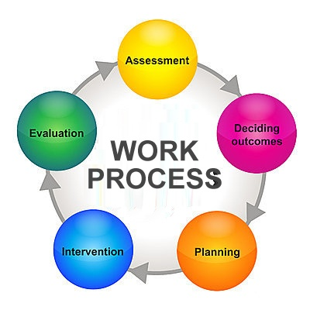
Step by step approach
Planning
Implementation
Monitoring and evaluation
Closing down / sustaining

Slide 3
Topic 1 ; Planning
Target community
b. Situational analysis
Identify the burring health issues – mental , physical , social , spiritual
Prioritize the problem
Study the problem
Analyze the main problem via problem tree - cause and effect diagram
Find the solutions for the problem via solution tree
c. Objectives of the project

Slide 4
d. Strategies for implementation of the project
Activity plan
Target group
Problem in concern
Method of delivery
Resources needed
Schedule
Budgets ( if any)

Slide 5
Topic 2 ; implementation
Implement the activities
Gather evidence
Gather feed back

Slide 6
Topic 3 : Evaluation
Regarding the program outcome
Recommendation
Sustainability

