Slide 1
HUMAN BEHAVIOUR
AND HEALTH PROMOTION LINKAGE
Dhananjaya Perera
B.Sc. (Sp) Health Promotion

Slide 2
HUMAN
HEALTH BEHAVIOUR

Slide 3
Human Health Behavior
Human behaviour, especially health behaviour, is complex and not always readily understandable
Health behaviour, like other behaviour, is motivated by stimuli in an individual’s environment
The response to such stimuli may or may not be directly related to health
Motivation for health behaviour is dynamic and not static

Slide 4
Types Of Health Behavior
Health-directed behavior
  Observable acts that are undertaken with a specific health outcome in mind
Health-related behavior
  Those actions that a person does that may have health implications, but are not undertaken with a specific health objective in mind

Slide 5
Types Of Health-related Behaviour
Preventive Health Behaviour
  action taken when a person wants to avoid being ill or having a problem e.g. a mother takes her child for immunisation
Illness Behaviour
  action taken when a person recognizes signs or symptoms that suggest a pending illness e.g. a mother gives her child cough medicine after hearing her wheeze

Slide 6
TYPES OF HEALTH-RELATED BEHAVIOUR
Sick-role Behavior
  action taken once an individual has been diagnosed (either self or medical diagnosis) e.g. an employee takes a vacation because he is ill, he takes treatment and obeys his doctor’s advice

Slide 7
BEHAVIOR IN
ILLNESS
Feeling symptoms
Do nothing
Self treatment
compliance
cure
Go to pharmacy
Go to doctor
No compliance
complication

Slide 8
Factors that affect illness behavior
Age, sex, level of education, culture, religion, past experience
Seriousness of symptoms/signs
If these symptoms affect the ordinary life
Persistence and frequency of symptoms
Personal tolerance to symptoms
Level of knowledge, cultural opinion about these symptoms
Severity of illness or being fatal.
Stigma : community opinion towards patients of that illness
Availability of medical services & treatment
Trusted services and health providers

Slide 9
KNOWLEDGE AND
BEHAVIOUR

Slide 10
PHASES BETWEEN
KNOWLEDGE & BEHAVIOUR
Knowledge
Putting the
of correct
Perception
Interpretation
Salience
knowledge
health action
into action

Slide 11
KNOWLEDGE AND BEHAVIOUR
In some cases, knowledge may be sufficient to elicit changes in behaviour, but in other cases it may be neither necessary nor sufficient
It should not be assumed that individuals are always knowledgeable about an appropriate health behaviour, but neither should it be assumed that knowledge will guarantee changes in behaviour

Slide 12
KNOWLEDGE AND BEHAVIOUR
Where knowledge is deemed important, this should be expressed in terms that are salient (most noticible) to the target audience
The transfer of knowledge into action is dependent on a wide range of other internal and external factors, including values, attitudes and beliefs

Slide 13
KNOWLEDGE AND BEHAVIOUR
For most individuals, the translation of knowledge into behaviour requires the development of specific skills (enabling factors) which may include interpersonal skills.

Slide 14
ATTITUDES, VALUES
AND BEHAVIOUR

Slide 15
ATTITUDES, VALUES AND BEHAVIOUR
An individual’s attitude to a specific action and their intention to adopt it is influenced by:
    beliefs, motivation which comes from the person’s values, attitudes and drives (instincts), and the influence from social norms

Slide 16
ATTITUDES, VALUES AND BEHAVIOUR
A belief represents the information a person has about an object or action. It links the object to some attribute.
Values are acquired through socialization and are those emotionally charged beliefs which make up what a person thinks is important.

Slide 17
ATTITUDES, VALUES AND BEHAVIOUR
Attitudes اتجاهare value-based social judgement which possess a strong evaluative component
Attitudes have different components - cognitive (belief), emotional (feeling) and behavioral (predispositions to act)

Slide 18
ATTITUDES, VALUES AND BEHAVIOUR
Values and attitudes help to explain the knowledge-action gap in many instances
Most people are at ease when their knowledge is consistent with their attitude and values
If discord arises, the facts are often interpreted (or misinterpreted) so that contradiction between knowledge is removed

Slide 19
ATTITUDES, VALUES AND BEHAVIOUR
There is no clear or linear progression from attitudes to behaviour
Often, attitude change precedes behavioural change
  Often assumed that changing attitudes to smoking will influence smokers to quit, yet a majority of smokers continue to smoke despite a negative attitude to smoking

Slide 20
ATTITUDES, VALUES AND BEHAVIOUR
But equally, behaviour change may precede and influence attitudes
  On the other hand, quitting smoking is often a stimulus for indifferent smoker to develop a negative attitude to smoking

Slide 21
MODELS OF
BEHAVIOUR CHANGE

Slide 22
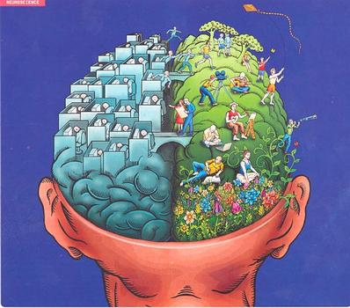
1. THE COGNITIVE DISSONANCE MODEL
(Festinger-1957) التنافر المعرفى

Slide 23
COGNITIVE DISSONANCE MODEL
The model holds that inconsistency is a painful or uncomfortable state
Since dissonance is psychologically uncomfortable, it will motivate an individual to reduce dissonance to achieve consonance
In addition, the individual will actively avoid situations and information that are likely to increase the dissonance

Slide 24
COGNITIVE DISSONANCE MODEL
The consequences of this are vital for anyone involved in the process of influence
For example, if a respected role model with whom an individual identifies makes a statement or declaration with which the individual disagrees, consonance is achieved by either:
  (a) changing the belief, or
  (b) changing attitudes to the respected person.

Slide 25
2. MASLOW’S HIERARCHY OF NEEDS
(Maslow - 1968)

Slide 26
MASLOW’S HIERARCHY OF NEEDS
Self-actualization needs - to find self-fulfilment and realise one’s own potential
Esteem needs - to achieve, be competent, and gain approval and recognition
Belongingness and love needs - to affiliate (follow) with others, be accepted
Safety needs - to feel secure and safe, out of danger
Basic physiological needs - hunger, thirst and related needs

Slide 27
MASLOW’S HIERACHY OF NEEDS
Behaviour is motivated by a hierarchy of human needs
Explains why not everybody responds to the obviously beneficial and well-meaning interventions
Health needs may be compromised for the sake of satisfaction of low-order needs

Slide 28

3. THE HEALTH BELIEF MODEL
(Rosenstock and Becker - 1974)

Slide 29
HEALTH BELIEF MODEL
“Two major factors influence the likelihood that a person will adopt a recommended preventive health action
First they must feel personally threatened by disease i.e. they must feel personally susceptible to a disease with serious or severe consequences
Second they must believe that the benefits of taking the preventive action outweigh the perceived barriers to (and/or cost of) preventive action”

Slide 30
HEALTH BELIEF MODEL

Slide 31
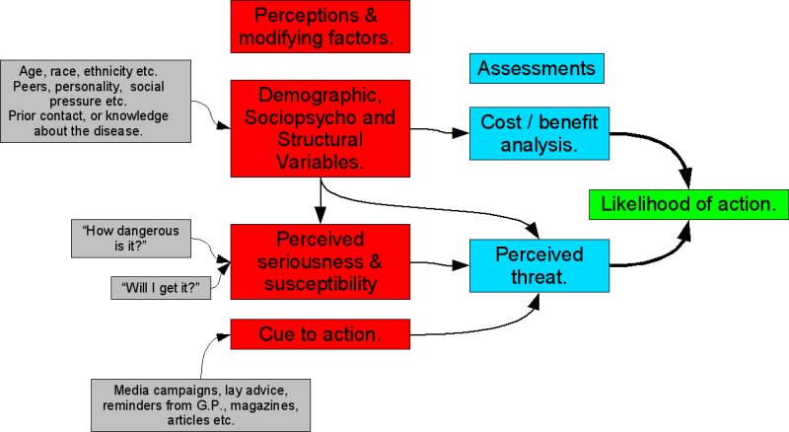

Slide 32
HEALTH BELIEF MODEL (Detailed)

Slide 33
MODIFIED HEALTH BELIEF MODEL AS APPLIED TO HIV/AIDS PROGRAMME

Slide 34
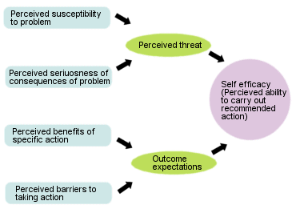

Slide 35

4. THE SOCIAL LEARNING OR SOCIAL COGNITIVE THEORY
(Bandura - 1977)

Slide 36
SOCIAL LEARNING THEORY
The first theory to introduce the idea of self-efficacy
Theory is based on the belief that behavior is determined by expectancies and incentives

Slide 37
SOCIAL LEARNING THEORY
Behaviour is influenced by expectancies about:
  environmental cues (i.e. beliefs about how events are linked and what leads to what)
  consequences of one’s actions (i.e. how behaviour is likely to influence outcomes)
  competency to perform the behaviour needed to influence outcomes (i.e. self-efficacy)

Slide 38
SOCIAL LEARING THEORY

Slide 39
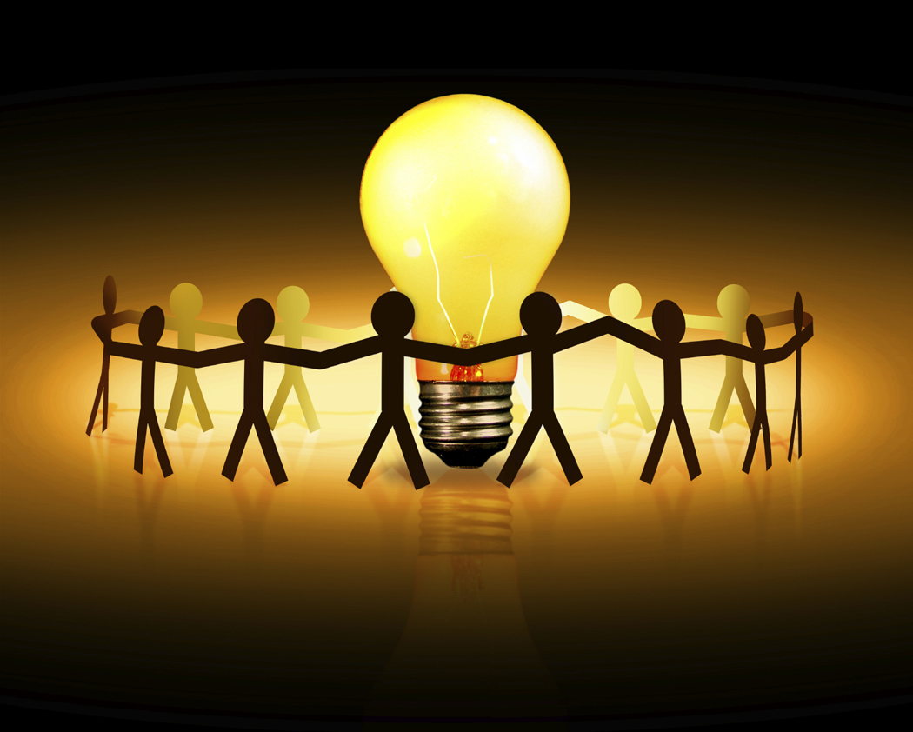
5. THEORY OF REASONED ACTION
(Fishbein and Atzen - 1975)

Slide 40
THE THEORY OF REASONED ACTION
Proposes that voluntary behaviour is predicted by one’s intention to perform the behaviour (e.g. how likely is it that you will take up a quit smoking programme?)
Intention, in turn, is a function of :
  attitude towards the impending behaviour (do you feel good or bad about quitting?), and
  subjective norms (do most people who are important to you think you should quit?)

Slide 41
THE THEORY OF REASONED ACTION
Attitude is a function of beliefs about the consequences of the behaviour (how important do you think it is to quit?) weighted by an evaluation of the importance of that outcome (how important is it to you to quit?)
Subjective norms are a function of expectations of significant others (does your spouse think you should quit?) weighted by the motivation to conform (how important is it to do what your spouse wants?)

Slide 42
THE THEORY OF REASONED ACTION
Unlike the Health Belief Model and the Social Learning Theory, this model is based on rationale and does not provide explicitly for emotional ‘fear-arousal’ elements such as the perceived susceptibility to illness
Basically more emphasis is put on intention rather than attitudes.

Slide 43
THEORY OF REASONED ACTION

Slide 44
THEORY OF REASONED ACTION AND PERSONAL BEHAVIOUR APPLIED TO HIV/AIDS PROGRAMME ACTION
(Adapted to key focus areas)

Slide 45
6. STAGES OF CHANGE MODEL
(Prochaska and DiClemente -1984)

Slide 46
STAGES OF CHANGE MODEL
(Prochaska J & DiClemente C, 1984)
Exit:
Maintaining
‘safer’ lifestyle
Action:
Making
changes
Maintenance:
Maintaining
change
Commitment:
Ready to
change
Relapse:
Relapsing
back
Contemplating:
Thinking
about change
Pre-contemplation
Not interested in
changing ‘risky’
lifestyle

Slide 47
STAGES OF CHANGE MODEL
The model identifies a number of stages which a person can go through during the process of behaviour change
It takes a holistic approach, integrating a range of factors such as the role of personal responsibility and choices, and the impact of social and environmental forces that set very real limits on the individual potential for behaviour change
It provides a framework for a wide range of potential interventions by health promoters

Slide 48
STAGES OF CHANGE MODEL
Pre-contemplation stage: The stage which precedes entry into the change cycle. At this stage the person has not considered changing their lifestyle or become aware of any potential risks in their health behaviour.
Contemplation stage: Although the individual is aware of the benefits of change, they are not yet ready and may be seeking information or help to make the decision. This stage may last a short while or several years.

Slide 49
STAGES OF CHANGE MODEL
Commitment stage: When the perceived benefits seem to outweigh the costs and when the change seems possible as well as worthwhile, the individual may be ready to change, perhaps seeking some extra support.
Action stage: The early days of change require positive decisions by the individual to do things differently. A clear goal, a realistic plan, support and rewards are features of this stage.

Slide 50
STAGES OF CHANGE MODEL
Maintenance stage: The new behaviour is sustained and the person moves into a healthier lifestyle
Relapse stage: Although individuals experience the satisfaction of a changed lifestyle for varying amounts of time, most of them cannot exit from the revolving door first time around. Typically, they relapse back. Of great importance, however, is that they do not stop there, but move back into the contemplation stage.

Slide 51
Stages Of Change Model As Applied To Hiv/Aids Programme
Contemplation
Young man
believes that he
and his friends
are at risk and
thinks that he should
do something.
Decision/
Determination
Young man is
ready & plans to
use condoms
so goes to a shop
to buy them.
Precontemplation
Young man has heard
about AIDS but
doesn’t think it is
relevant to his life.
Maintenance
Wearing condoms
has become a habit
and young man
regularly buys them.
Action
Young man buys
and uses condoms.

Slide 52
STAGES OF CHANGE MODEL

Slide 53

7. THE DIFFUSION OF INNOVATION THEORY
(Rogers - 1962)

Slide 54
DIFFUSION OF INNOVATION PROCESS
Late adopters
Cummulative number or % of adopters
Late majority
Early majority
Early adopters
Innovators
Time
Source: Green & MCAlister 1984.

Slide 55
DIFFUSION OF INNOVATION
The adoption of ideas in a community diffuses among individuals in that community at varying rates
Early in the introduction of a new idea, it is picked up by ‘innovators’ (between 2 and 3% of the target population) who are venturesome, independent, risky and daring. They want to be the first to do things and they may not be respected by others in the social system.

Slide 56
DIFFUSION OF INNOVATION
The second group of people, the ‘early adopters’ (about 14% of the target population) are very interested in the innovation but they are not the first to sign up. They wait until the innovators are already involved to make sure the innovation is useful. They are respected by others in the social system and looked at as opinion leaders.

Slide 57
DIFFUSION OF INNOVATION
The next group ‘early majority’ (about 34% of the target population) may be interested in the innovation but will need external motivation to become involved, They will deliberate for some time before making a decision.
The ‘late majority’ (also about 34% of the target population) are next and it will take more time to get them involved for they are skeptical and will not adopt an innovation until most people in the social system have done so.

Slide 58
DIFFUSION OF INNOVATION
The last group the‘laggards’ (about 16% of the target population are not very interested in innovation and would be the last to become involved. They are very traditional and are suspicious of innovations. Laggards tend to have limited communication networks, so they really do not know much about new things.
This situation calls for different strategies for different categories of people and at different stages of the adoption process.

Slide 59
DIFFUSION OF INNOVATION
Time Relapse between awareness, interest, trial and adoption
100
STAGES
Awareness
Interest
Trial
Adoption
Late adopters
Percentage of population
75
Early adopters
50
A
B
C
25
E
F
G
Time
Source: Green & MCAlister 1984.

Slide 60
DIFFUSION MODEL

Slide 61
PRECEDE PROCEED MODEL
(PRECEDE stands for) P=predisposing, R=reinforcing, E=enabling, C=construction, E=education, D=diagnosis, E=evaluation.
The predisposing factors are knowledge, attitude, cultural beliefs and readiness to change that give reasons for change.
Reinforcing factors are rewards or incentives that encourage repetition or persistence of good behavior as social support by family or peers, praise, symptom relief
Enabling factors includes the available resources and supportive policies that enable persons to act according to their suggestion.

Slide 62
(PROCEED stands for) P=policy, R=regulatory, O=organizational, C=constructs, E=education, E=environment, D=development.
All these factors are environmental factors related to policy, regulations, laws. The relation between different organizations that have role related to health as education, agriculture, commerce, industry. These factors can affect the health education program either by helping or obstructing it.

Slide 63
The PRECEDE-PROCEED model is a basic framework for planning process by breaking it into manageable smaller pieces.
It also allows taking account both internal and external factors.
The model recognizes that behavior is a complex of factors and need to be influenced by a combination of interventions.

Slide 64
PRECEDE
PRECEDE has four phases,
Phase 1 : Identifying the ultimate desired result
“Diagnosis”, a behavioural and contextual analysis is made and programme goals are established in line with policy objectives.
The roles of habitual and reasoned behaviour of the target groups are assessed.
Also the changeability of behaviour is analysed as it is advisable to start with behaviour which has the greatest impact and is easiest to change.

Slide 65
Phase 2 :
Identifying and setting priorities among health or community issues and their behavioral and environmental determinants that stand in the way of achieving that result,
or conditions that have to be attained to achieve that result; and identifying the behaviors, lifestyles, and/or environmental factors that affect those issues or conditions.

Slide 66
Phase 3: the instruments are chosen
Regulatory instruments (laws, regulations, permits, enforcement, covenants and agreements)
Economic instruments (subsidies, levies, taxes, tax differentiation and financial constructions)
Communicative instruments (information and promotion, training, personal advice, demonstrations and benchmarks)
Structural provisions (infrastructural provisions and technical interventions)
Often, a combination of instruments is used to influence people’s decisions.

Slide 67
Phase 4 :
Identifying the administrative and policy factors that influence what can be implemented

Slide 68
PROCEED
PROCEED has four phases
Phase 5 :
Implementation – the design and actual conducting of the intervention.
Phase 6 :
Process evaluation. Are you actually doing the things you planned to do?

Slide 69
Phase 7 :
Impact evaluation. Is the intervention having the desired impact on the target population?
Phase 8 :
Outcome evaluation. Is the intervention leading to the outcome (the desired result) that was envisioned in Phase 1

Slide 71
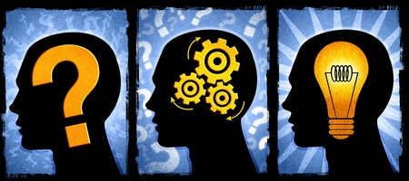
CONCLUSION
From all these models we can conclude that the most important variables underlying behavioral performance are:

Slide 72
VARIABLES UNDERLYING BEHAVIOURAL PERFORMANCE
1. The person must have formed a strong positive intention (or made a commitment) to perform the behaviour.
2. There are no environmental constraints that will make it impossible to perform the behaviour.
3. The person has the skills necessary to perform that behaviour.

Slide 73
VARIABLES UNDERLYING BEHAVIOURAL PERFORMANCE
4. The person believes that the advantages (benefits, anticipated positive outcomes) of performing the behaviour outweigh the disadvantages (costs, anticipated negative outcomes).
5. The person perceives more social (normative) pressure to perform the behaviour than to not perform the behaviour.

Slide 74
VARIABLES UNDERLYING BEHAVIOURAL PERFORMANCE
6. The person perceives that performance of the behaviour is more consistent than inconsistent with his or her self image, or that it’s performance does not violate personal standards that activate negative self-actions.
7. The persons emotional reaction to performing the behaviour is more positive than negative; and

Slide 75
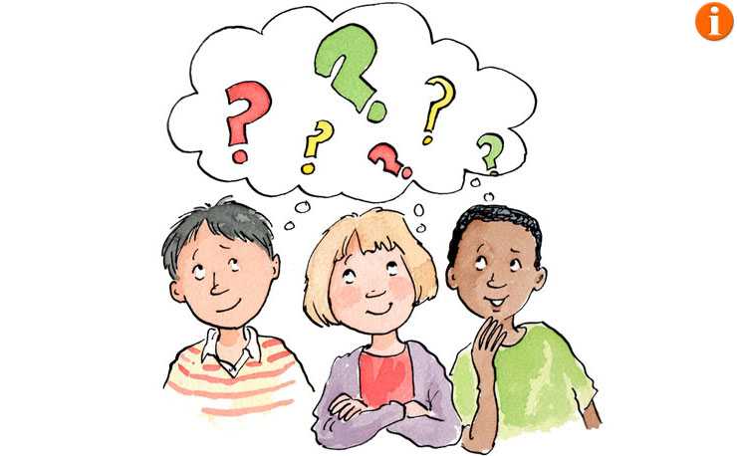
VARIABLES UNDERLYING BEHAVIOURAL PERFORMANCE
8. The person perceives that he or she has the capability to perform the behaviour under a number of different circumstances…”

Slide 76
End of Session

