Slide 1
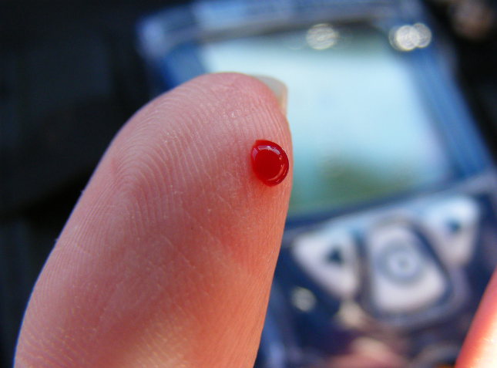
Blood Glucose Monitoring
Dilum Weliwita
B.sc. Nursing ( London )

Slide 2
What is blood glucose levels . . . ?
Literally the amount of glucose in the blood
Expressed as millimoles per liter
Ideally level 4-8 mmol/l
Spikes - after meals , lower in the early morning
When Diabetes blood sugar fluctuates widely
Blood Glucose Monitoring

Slide 3
Why Blood glucose level to be controlled. . . ?
High level of glucose in blood over a sustained period of time , end up damaging the blood vessels
Poorly control can increased diabetes complications
e.g. neuropathy
nephropathy
retinopathy
CVD
Blood Glucose Monitoring

Slide 4
What are the good blood glucose levels . . . ?
Pre- parandial ( before meal) – 4-7 mmol /l {70-130mg/dl}
Post- parandial( after meal) – below 9 mmol /l {180 mg/dl}
Fasting 8-10 hrs 5-7 mmol / l {90-130mg/dl}
Blood Glucose Monitoring

Slide 5
When should blood glucose level be measured . . . ?
Type 1 Diabetic :
Before every meal , often as 5 times per day
Type 2 Diabetic :
Several times a week if poorly control 2 times /day
Blood Glucose Monitoring

Slide 6
When should blood glucose level be measured . . . ?
Any time you feel unwell / infection –stimulate release of stress hormones including glucagon , also cause glucose imbalance
If reading too high should perform a urine test for ketones
Blood Glucose Monitoring

Slide 7
Hb A1c
Glycosylated haemoglobin
Percentage of HbA1c a number that corresponds to your average blood glucose for the previous 3 months. ( Increased in the body by high BGL)
Not for diagnosed DM
High levels indicate risk if complications
Blood Glucose Monitoring

Slide 8
Blood glucose Testing
Simple investigation
Rapid accurate reading
But there are significant risk of error (DoH 1996)
Detect Hyper or Hypo glycaemia
Indicate the patient’s ability to maintain Normoglycaemia
Blood Glucose Monitoring

Slide 9
Blood glucose Testing
Traditionally performed –blood from arteries, veins or capillaries
Currently - non-invasive approaches
e.g : capillary sampling & test at bedside
Blood Glucose Monitoring

Slide 10
Point- of – Care Testing (POCT)
Defined as any analytical test that is performed for a patient by a healthcare profession outside the conventional laboratory setting (MHRA 2002)
Blood Glucose Monitoring

Slide 11
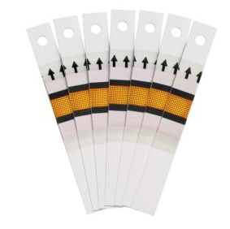
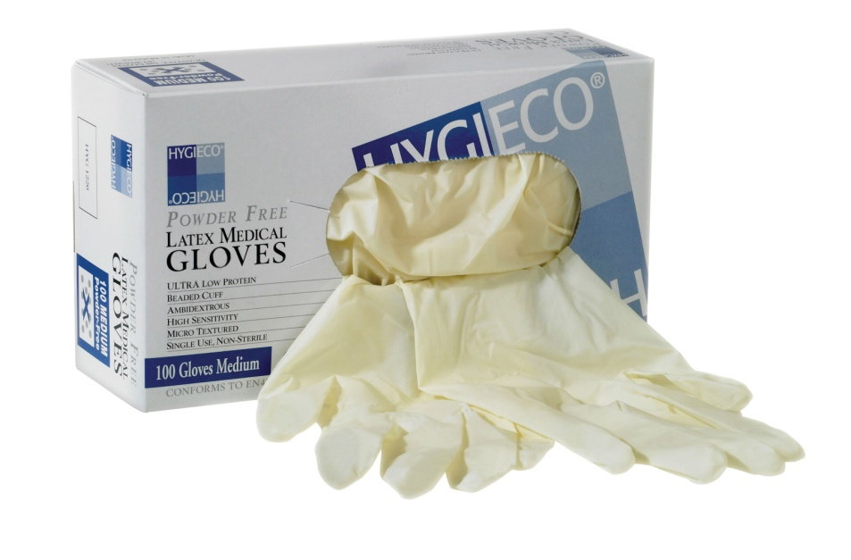
Procedure
Gather equipment required
Gloves, apron, disposable lancet device test strips , sharp bin etc.
Blood Glucose Monitoring

Slide 12
Procedure
Explain to the patient and obtain the consent
Check any manufacturer’s recommendations and expiry date
Ensure monitor and test strips have been calibrated together e.g. batch no
Ask the patient to wash had if possible with warm water before sampling
Advice pt to sit down & relax
Blood Glucose Monitoring

Slide 13
Procedure
Get ready the equipment before you ‘prick’ the finger
e.g. load the lancet as required, new test strip each time
Take the sample from side of the finger using the
lancet as directed
Ensure the site of piercing is rotated
Dispose lancet in sharp box
Apply the blood to test strip
make sure the blood that is large enough to cover the test pad
Blood Glucose Monitoring

Slide 14
Procedure
Proceed on device instruction
Dispose waste appropriately
Wash hands
Ensure punctured site has stop bleeding & assess pt for any adverse reaction such as further bleeding or bruising
Analyze the reading & document the result.
If needed get further advice
Blood Glucose Monitoring

Slide 15
Professional Responsibilities & Accountabilities
Should undertake & completed the appropriate training
Have enough experience to be deem competent
Must be in accordance with local policies & guidelines
Able to interpret the result
Blood Glucose Monitoring

Slide 16
Hypoglycemia vs Hyperglycemia
Hypoglycemia Hyperglycemia
Low blood sugar Elevated blood sugar
hyperinsulinemia Inadequate insulin
Blood Glucose Monitoring

Slide 17
Hypoglycaemia symptoms
Below 4.0 mmol/L
Can be sudden onset – appear drunk
Sweating/clammy
Tachycardia
Palpitations
Nervousness/shaking
Tremors
Weakness
Headache
confusion
Fatigue
Blood Glucose Monitoring

Slide 18
Hypoglycemia Treatment Protocol
Mild to moderate 2.8-3.9 mmol/l
Give ½ g=cup of juice (gliclazide drink) or glucose tablets 2-3 retest in 15 min
Severe unconscious < 2.8 Need IV glucose
Assess possible cause & discuss with Dr.
Blood Glucose Monitoring

Slide 19
How to care for yourself when you’re
hypoglycemic
Eat or drink 15 grams of fast-acting, low - fat carbohydrate right away
e.g. Quick energy sources
Blood Glucose Monitoring

Slide 20
How to care for yourself when you’re
hypoglycemic
Contain about 15 grams of CHO
½ Cup fruit of orange, apple, or grapefruit juice
1/3 Cup grape, prune, or cranberry juice
2 tbsp raisins
6 Crackers
1 Cup semi skim milk
1 Piece bread
3-4 Glucose tablets, or 1 tube glucose gel/hypostop
½ Cup regular soft drink (not diet)
Blood Glucose Monitoring

Slide 21
Hyperglycemia
High blood sugar > 10.0 mmol/L
Usual gradual onset
Fruity breath with ketosis
Slow & sluggish
Blood Glucose Monitoring

Slide 22
Hyperglycemia
Signs & Symptoms
Fatigue & Lethargy- unable to use glucose
Polyuria – kidneys
Irritable & pruritis
Glycosuria – as unable to reabsorb
Polyphagia (hunger) - sense of starvation
Polydipsia (thirst) - fluid loss
Ketosis – fat metabolism
Blood Glucose Monitoring

