Slide 1
DIABETES FOOT CARE
Dilum Weliwita
B.sc. Nursing ( UK )

Slide 2
Definition
Causes
Risk Factors
Symptoms
Diagnosis
Treatment
Prevention

Slide 3
Definition
Causes
Risk Factors
Symptoms
Diagnosis
Treatment
Prevention

Slide 4
DIABETES FOOT CARE
Definition
Diabetic foot ulcers are sores that occur on the feet of people with type 1 and type 2 diabetes .
Diabetic foot ulcers usually occur bottom of the foot.
The sooner diabetic foot ulcers are treated, the better the outcome.
If not treated leads to amputations.
1 out of 10 people with diabetes will affect

Slide 5
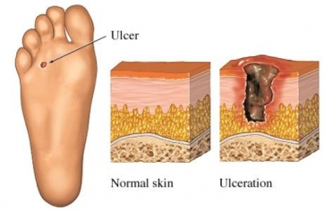
DIABETES FOOT CARE
Foot Ulcer

Slide 6
Definition
Causes
Risk Factors
Symptoms
Diagnosis
Treatment
Prevention

Slide 7
DIABETES FOOT CARE
Causes
Diabetes can damage nerves of legs and feet
May not feel a blister or sore when it begins to appear.
If undetected, become larger and infected.
This may lead to an amputation of a toe , a foot, or even a leg

Slide 8
DIABETES FOOT CARE
Then how are blood vessels affected ?
High blood sugar expedites artherosclerosis giving peripheral vascular disease (reduction of blood
supply to the foot).
The delivery of essential nutrients and oxygen to the foot is compromised leading to anaerobic infections and tissue necrosis.

Slide 9
Ischaemic toes due to artherosclerosis

Slide 10
Definition
Causes
Risk Factors
Symptoms
Diagnosis
Treatment
Prevention

Slide 11
DIABETES FOOT CARE
Risk Factors
Following factors increase chance of developing diabetic foot ulcers.
Neuropathy (numbness, tingling, or burning sensation
in your feet)
Peripheral vascular disease (poor circulation in your legs)
Improperly fitted shoes
A foot deformity
A history of smoking

Slide 12
Definition
Causes
Risk Factors
Symptoms
Diagnosis
Treatment
Prevention

Slide 13
DIABETES FOOT CARE
Symptoms
Sores, ulcers, or blisters on the foot or lower leg
Pain
Walking with difficulty
Discoloration in feet: black, blue, or red
Cold feet
Swollen foot or ankle
Fever, skin redness or swelling, or other signs of infection

Slide 14
Definition
Causes
Risk Factors
Symptoms
Diagnosis
Treatment
Prevention

Slide 15
Diagnosis
Symptoms and medical history,
Physical exam/ check pulses
Refer you to a foot specialist or podiatrist.

Slide 16
Tests may be included followings
Wound swab/culture -infection is present
X-ray —especially bones; to determine evidence of infection in the bones ( osteomyelitis )
CT scan/MRI scan —to evaluate a suspected pocket of pus called an abscess
Doppler studies —adequate blood flow to feet,
Blood glucose test
Full blood count- to determine an infection—high white blood cell count indicate an infection.

Slide 17
Definition
Causes
Risk Factors
Symptoms
Diagnosis
Treatment
Prevention

Slide 18
DIABETES FOOT CARE
Treatment
Medication
Regranex gel approved by the Food and Drug. Administration (FDA) -shown to speed wound healing.
No Weight-bearing
Keeping pressure off the foot, promotes healing.
Special casts or boots are placed on the foot to “off- load” pressure from the ulcer.
Wound Care
Cleanse regularly and change the dressings often to prevent infection.

Slide 19
DIABETES FOOT CARE
Treatment
Antibiotics
Prevent an infection.
May need for 4-6 weeks.
Blood Sugar Control
High blood sugar levels lower immune response and prevent wound healing.
Adjustments in diet or medications.
Insulin may needed in the short-term to achieve optimal blood sugar control.

Slide 20
Treatment
Skin Graft
Skin grafts have been shown to speed the healing process.
Surgery
Removal of dead tissue around the wound, or debridement
Bypass surgery - improve blood flow within the arteries of the legs , wound healing and spare amputations.
Amputation may be needed-to stop the spread of infection to the rest of the body.

Slide 21
Treatment
Hyperbaric Oxygen Therapy
Appears to help reduce amputations.
Nonhealing wounds are placed in a chamber.
Pure oxygen is pumped into the chamber.
This oxygen-rich blood helps form new blood vessels, and wound heal.

Slide 22
Definition
Causes
Risk Factors
Symptoms
Diagnosis
Treatment
Prevention

Slide 23
Prevention
Advice for healthy foot habits will reduce the chances of getting diabetic foot ulcers
Cleanse your feet daily and dry them thoroughly between the toes
Do not wear tight stockings / socks around the legs.
Use an unscented lotion to moisturize
Do not put lotion between the toes, - extra moisture may attract bacteria.

Slide 24
DIABETES FOOT CARE
Prevention
Advice for healthy foot habits will reduce the chances of getting diabetic foot ulcers
After cleansing your feet, inspect them daily- sores ,not be able to feel. Use a mirror ,or another person
Doctor should look your feet and test the feeling in them at least once a year , may be referred to a foot specialist or podiatrist
May have toenails that are brittle and difficult to cut without causing ingrown toenails.- Need podiatrist trim toenails regularly.
Use properly fitted shoes.

Slide 25
DIABETES FOOT CARE
Prevention
Advice for healthy foot habits will reduce the chances of getting diabetic foot ulcers
Avoid smoking.
Exercise daily, as per dr’s advice, to improve blood flow and blood sugar levels.
Calluses can increase the pressure in the foot and lead to foot ulcers. Podiatrist cut any callus once

Slide 26
DIABETES FOOT CARE
Remember ;
Diabetes-related foot problems can worsen very quickly and are difficult to treat,
so
Important to seek prompt medical attention.

Slide 27
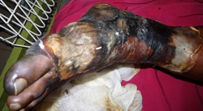
DIABETES FOOT CARE
Necrotic FOOT ulcer

Slide 28
Checking Pulses
Dorsal pedial pulse Posterior tibial pulse

Slide 29
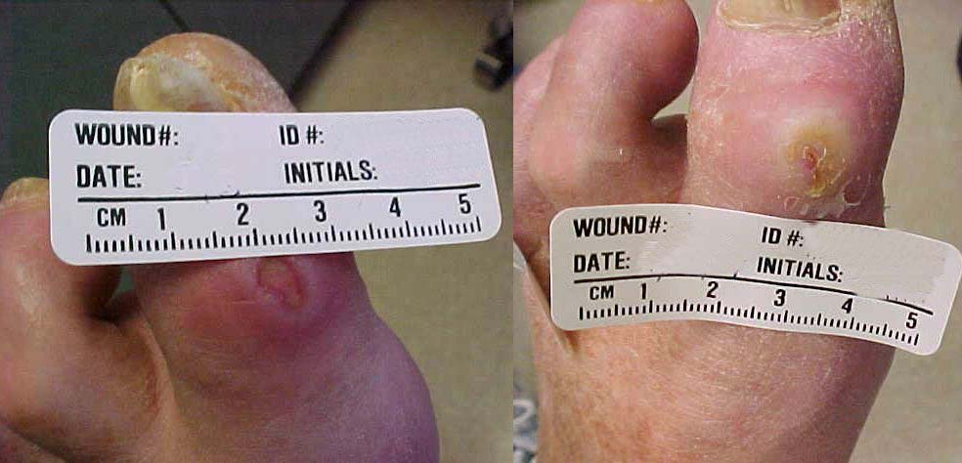
DIABETES FOOT CARE

Slide 30
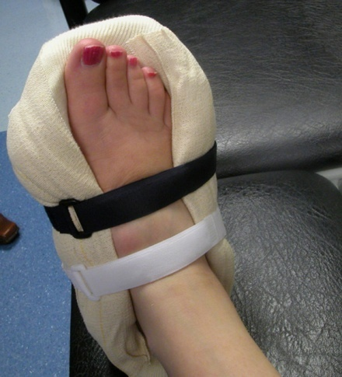
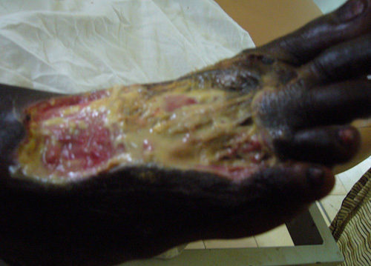
DIABETES FOOT CARE
Ascotch cast boot Infected ulcer

Slide 31
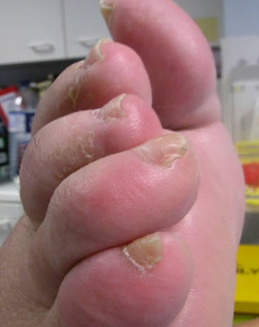
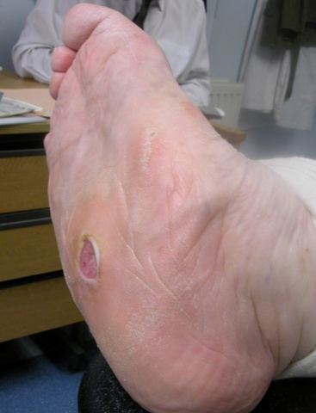
Clow toes Charcot deformity
Clow toes charcot deformity

Slide 32
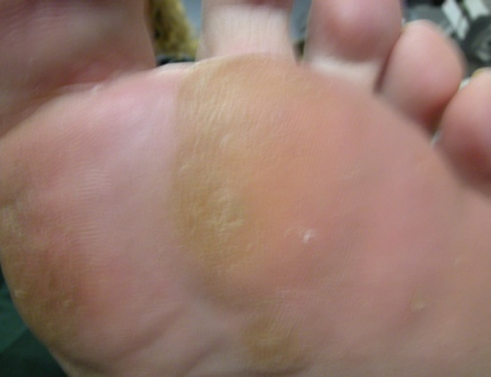
Nail deformity Calluse
Clow toes charcot deformity

Slide 33
DIABETES FOOT CARE
Extra Information
Maggots are available in 2 forms.
1. ‘Free Range’ maggots
Applied directly to the wound
Roam freely over the surface seeking out areas of slough or necrotic tissue
Generally left on wound for a maximum of 3 days.
2. BioFOAM Dressing
Maggots enclosed in net pouches containing pieces of hydrophilic
polyurethane foam
Dressing is placed directly upon the wound surface
Clow toes charcot deformity

Slide 34
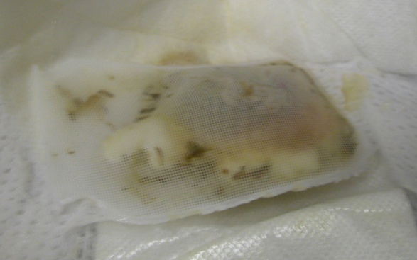
DIABETES FOOT CARE
BioFOAM dressing can be left for up to 5 days then the wound is reassessed.
Clow toes charcot deformity

