Slide 1
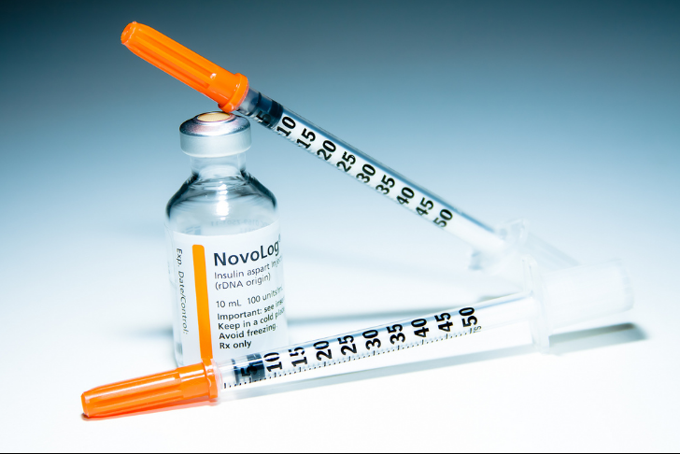
INSULIN
THERAPHY
Dilum Weliwita
B. Sc Nursing ( UK )

Slide 2
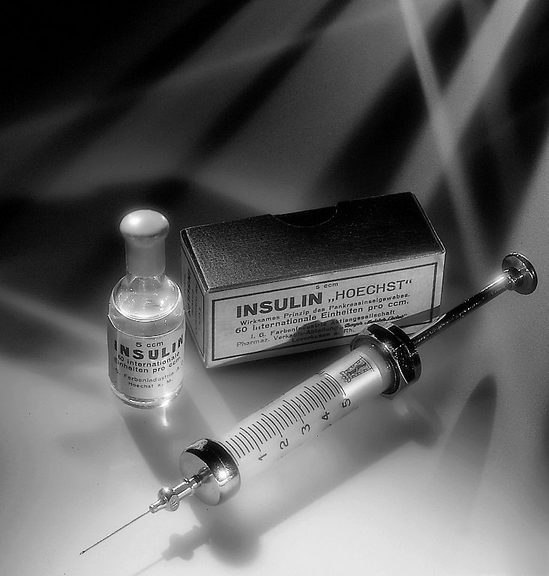

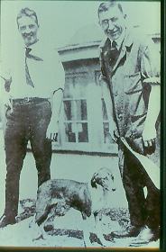


Slide 3
Objectives
Overview of Diabetes
Indications for Insulin in Diabetes
Goals for glycemic control
Fears and concern about Insulin
Type of insulin
Delivery option, storage
Complications

Slide 4
Type 1 Diabetes
Absent or impaired beta cell function
Insufficient insulin secretion
Increased insulin sensitivity
Type 2 Diabetes
Impaired beta cell function
Insufficient insulin secretion
Increased insulin resistance

Slide 5
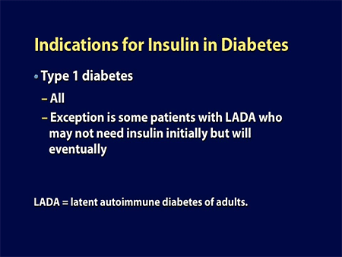
INSULIN THERAPHY

Slide 6
Indications for Insulin Use in Type 2 Diabetes
Pregnancy (preferably prior to pregnancy)
Acute illness requiring hospitalization
Perioperative/intensive care unit setting
Postmyocardial infarction
High-dose glucocorticoid therapy
Inability to tolerate or contraindication to oral antiglycemic agents
Newly diagnosed type 2 diabetes with significantly elevated blood glucose levels (pts with severe symptoms or DKA)
Patient no longer achieving therapeutic goals on combination antiglycemic therapy

Slide 7
Proposed Algorithm of therapy for Type 2 Diabetes
Inadequate
Non pharmacological
therapy
Severe symptoms
Severe hyperglycemia
Ketosis
pregnancy
2 oral
agents
3 oral
agents
1oral agent
Add Insulin Earlier in the Algorithm

Slide 8
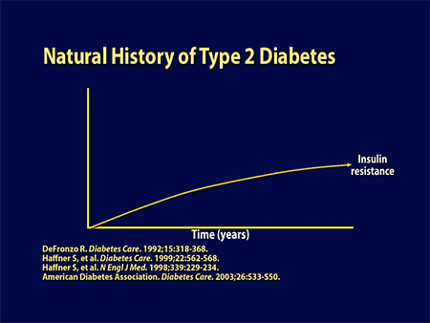

INSULIN THERAPHY

Slide 9
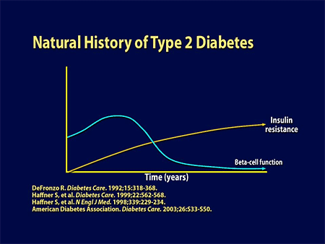
INSULIN THERAPHY

Slide 10
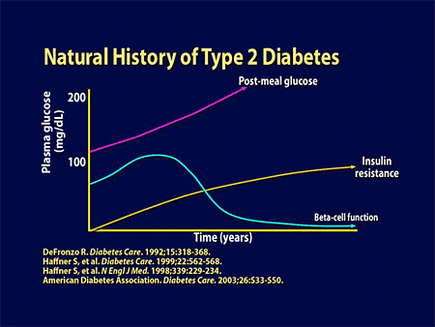
INSULIN THERAPHY

Slide 11
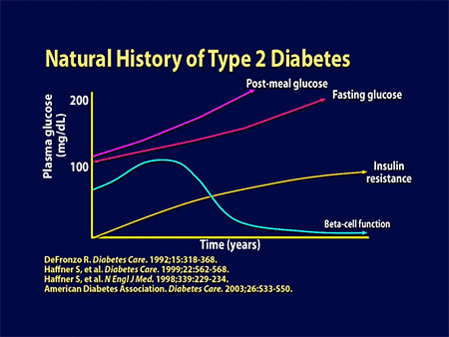
INSULIN THERAPHY

Slide 12
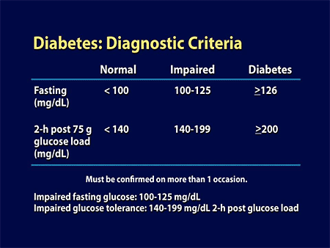
INSULIN THERAPHY

Slide 13
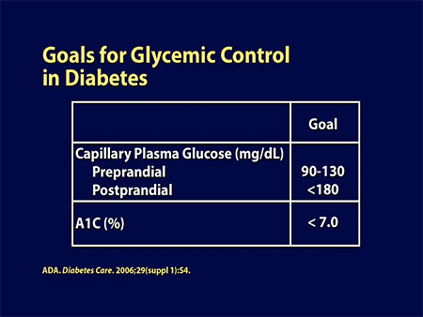
INSULIN THERAPHY

Slide 14
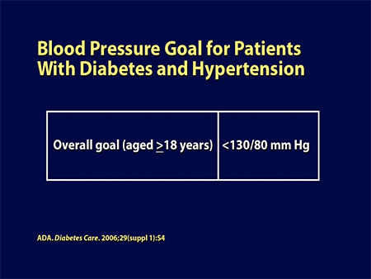
INSULIN THERAPHY

Slide 15
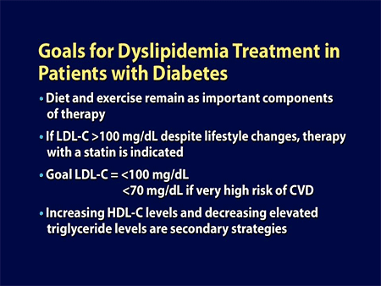

Slide 16
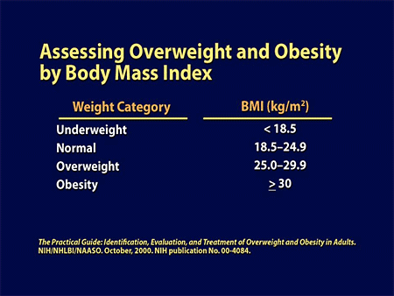

Slide 17

Fears & concerns
about insulin therapy
INSULIN THERAPHY

Slide 18
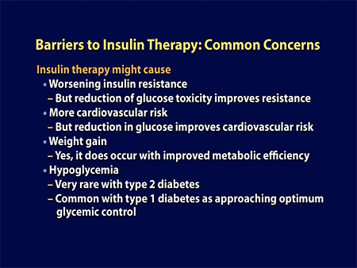
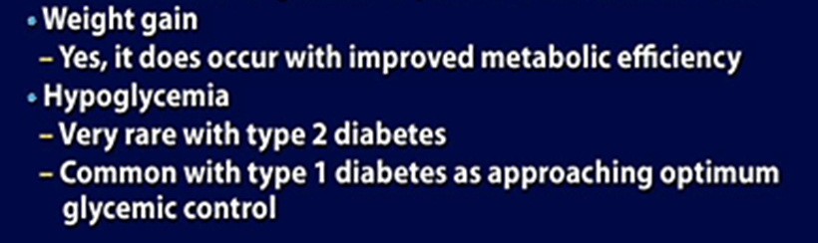
INSULIN THERAPHY

Slide 19
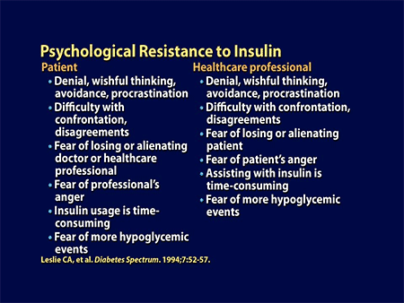

INSULIN THERAPHY

Slide 20
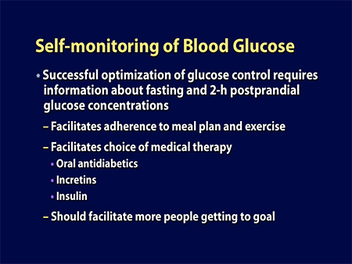
INSULIN THERAPHY

Slide 21
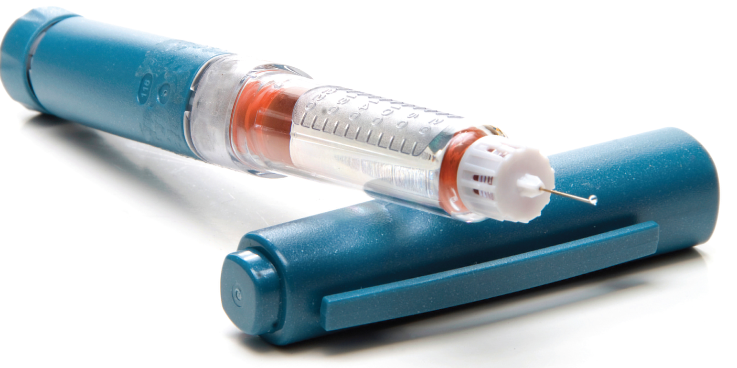
Normal physiologic patterns of glucose and insulin secretion in our body
INSULIN THERAPHY

Slide 22
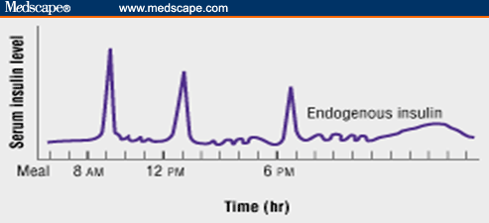
How Is Insulin Normally Secreted?
INSULIN THERAPHY
Notes:
Insulin is secreted continuously at low levels in a pulsatile fashion between meals and overnight to suppress hepatic glucose production (basal secretion). This is coupled with intense short bursts of secretion in response to meals and rising glucose concentrations to ensure that glucose concentrations remain within the normal range (prandial secretion) (Figure).^{[21]} The rapid early rise of insulin secretion in response to a meal is critical, because it ensures the prompt inhibition of endogenous glucose production by the liver and disposal of the mealtime carbohydrate load, thus limiting postprandial glucose excursions. Basal insulin secretion accounts for approximately 50% of total insulin secreted each day, whereas the remaining 50% of insulin is secreted in response to meals.^{[22]}

Slide 23
The rapid early rise of insulin secretion in response to a meal is critical . . .
because ;
it ensures the prompt inhibition of endogenous glucose production by the liver
disposal of the mealtime carbohydrate load, thus limiting postprandial glucose excursions.
INSULIN THERAPHY

Slide 24
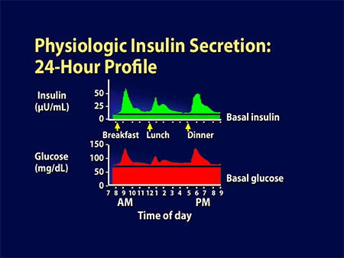
INSULIN THERAPHY
Notes:
When we wake up in the morning, our glucose level is not 0; there is continual basal glucose production by the liver overnight without a need to eat anything during the night. The extent of that basal glucose production is controlled by a certain amount of basal insulin secreted by the islet cells. Once we start to eat, we have increasing glucose absorption from the intestine so that glucose levels rise; almost immediately, there is a rise in islet cell insulin secretion, and this will then peak as the glucose levels peak. Then once the absorption of glucose from the intestine starts to fall, and glucose levels are starting to exit out of the bloodstream into the tissues as a result of adequate insulinization, then so does insulin secretion decrease from the pancreas, and levels come back down to baseline between meals. Again then it is time for lunch, insulin levels rise; again they fall between meals, only to rise again at dinner and with any snacks that we may eat during the day.

Slide 25
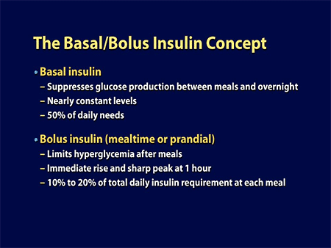

Slide 26
Source and Manufacturers
-In past from pancreas of pigs and cows
-Human insulin is widely used now which is produced by recombinant DNA technology
Eg: Humalog

Slide 27
Types of Insulin
1. Rapid-acting
2. Short-acting
3. Intermediate-acting
4. Premixed
5. Long-acting
6. Extended long-acting
(Analogs)
(Regular)
(NPH)
(70/30)
(Lantus)
INSULIN THERAPHY
Notes:
27
Key Point
There are six types of insulin available which differ in their time to onset of action and duration of action.

Slide 28
Time course | Agent | Onset | Peak | Duration | Indication
Rapid acting | Lispro-hum, Aspart-novo | 10-15 min 10-15 min | 1hr 40-50 min | 3hr 4-6hr | Rapid reduce of BG , prevent nocturnal hypoglycemia
Short acting | Regular -Humalog -novolin -iletin11 | ½ -1 hr | 2-3 hr | 4-6 hr | Prevent post parandal hyperglycemia, given 20-30 min before meal can given alone or combination with long acting insulin
Intermediate acting | NPH Humalin-N,Iletin -N,Novolin- N Lente Humalin-L, Iletn-L | 2-4 hr 3-4hr | 6-12hr 6-12hr | 16-20hr 16-20hr | Can take after meal, white and cloudy
Long acting | Ultra lente(UL) | 6-8hr | 12-16hr | 20-30hr | Used to control primarily fasting BGL
Very long acting | Glargine(lantus) | 1hr | No peak conti. | 24hr | Use as basal dose

Slide 29
Action Time
Includes onset ,peak and duration of action
human preparations have shorter action time than animal preparations ( Animal proteins triggers immune response)
Rapid acting insulin are BG lowering agents ( acting time <15 min)
This cannot use as basal insulin
When given as split doses intermediate acting insulin can be used as basal insulin
Normally, long acting insulin is basal insulin.

Slide 30
Methods of insulin delivery
-Insulin pen
-Insulin Injections
-Insulin pump
-Implantable & inhalant insulin therapy
-Transplantation of pancreatic cells- surgery
INSULIN THERAPHY

Slide 31
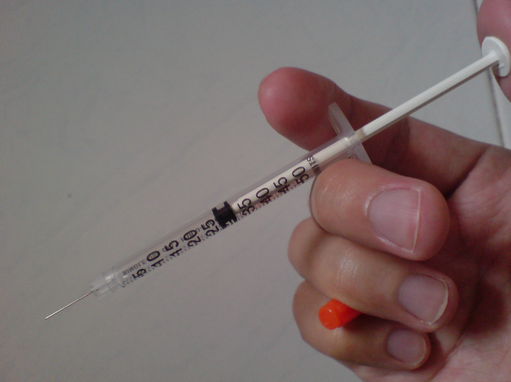
First step into
Insulin therapy

Slide 32
Remember
Insulin
  No miracle drug
  Has definite indications
  As delivery route follows reverse physiology:
  Good control is achieved only if residual pancreatic function is preserved to a certain extent i-e:
  Starting insulin on time is vital
  (Concept of early insulinization)
INSULIN THERAPHY

Slide 33
Pearls for practice
  Never try to control diabetes with oral hypoglycemic drugs / insulin without first ensuring strict diet control.
  Always bring fasting sugar to normal before trying to control post prandial / random blood sugar.
  Control any underlying infection/stressful condition vigorously.
  Keep meal timings regular with 6 hrs between the three meals.
  Do not inject NPH before 11 p.m.
  Keep number of calories during the meals same from day to day. The quantity and quality of diet should be same at same timings.
  Do not use sliding scale to calculate the dose of insulin.
  Use proper technique to inject s/c insulin.
  Ensure proper storage of insulin.
INSULIN THERAPHY

Slide 34
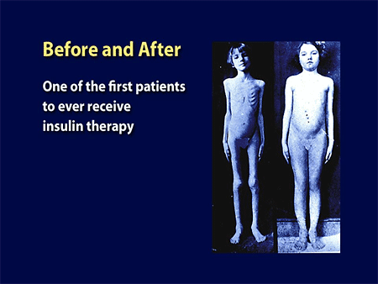
INSULIN THERAPHY

Slide 35

Common
Problems

Slide 36
Problems can be avoided
Adherence to time table is all that is required to avoid problems :
  Regular meals
  Regular injections
  Regular exercise
INSULIN THERAPHY

Slide 37
Choosing an Insulin with a Lower Risk of Hypoglycemia
Insulin analogues with longer, non-peaking profiles may decrease the risk of hypoglycemia . . .
INSULIN THERAPHY
Notes:
37
Key Point
An effective way of lowering the risk of hypoglycemia is to choose an insulin analogue with a longer, non-peaking profile.
Reference:
Nathan DM et al. Management of hyperglycemia in type 2 diabetes: a consensus
algorithm for the initiation and adjustment of therapy. Diabetes Care 2006;29(8):1963-72.

Slide 38
Complications of Insulin Therapy
-Local allergy reactions
-Systemic allergy reactions
-insulin lipodistropy (atrophy or hypertrophy)
-Insulin Resistance
-Morning hyperglycemias
-Weight gain

Slide 39
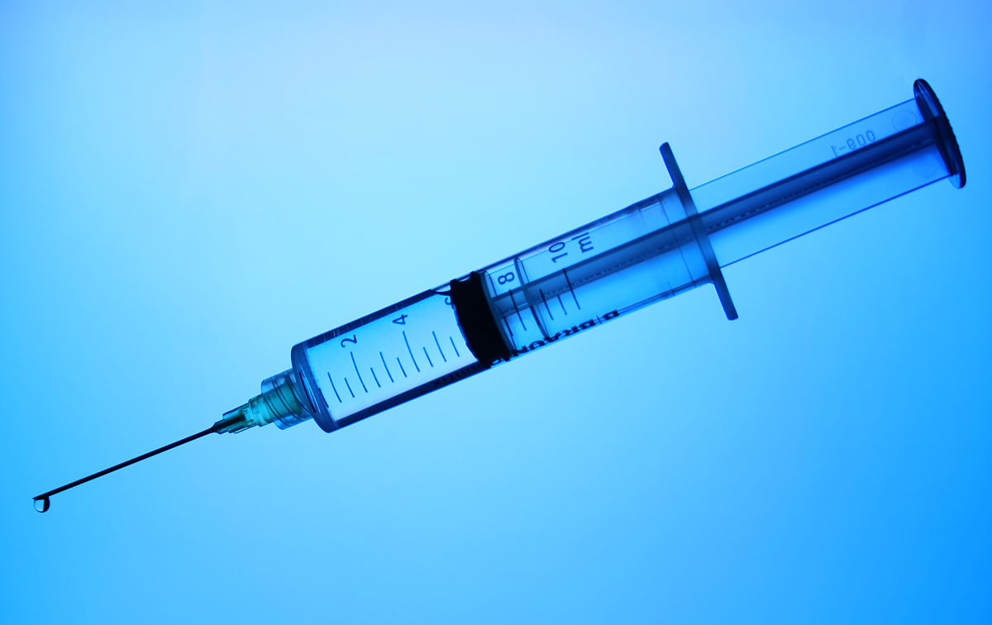
Injection
Techniques

Slide 40
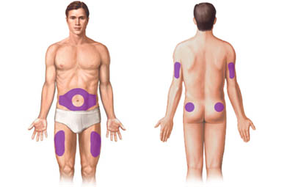
Sites of injection
Arms ☹
Legs ☹
Buttocks ☹
Abdomen ☺
INSULIN THERAPHY

Slide 41
Sites of injection
. . . contd
Preferred site of injection is the abdominal wall due to ;
Easy access
Ample subcutaneous tissue
Absorption is not affected by exercise.
INSULIN THERAPHY

Slide 42
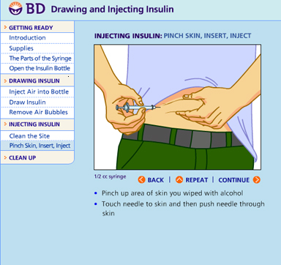
Injection technique

Slide 43
Injection technique
. . . contd
Tight skin fold
Spirit…. X
Appropriate needle size
90 degree angle
Change site to avoid lipodystrophy
INSULIN THERAPHY

Slide 44
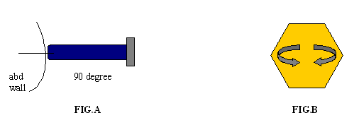
Injection technique
. . . contd
INSTRUCTIONS:
  Keep the needle perpendicular to skin in order to avoid variability in absorption (fig-A)
  Insert needle upto the hilt (fig-A)
  Distribute daily injections over a wide area to avoid lipodystrophy and other local complications (fig-B)

Slide 45
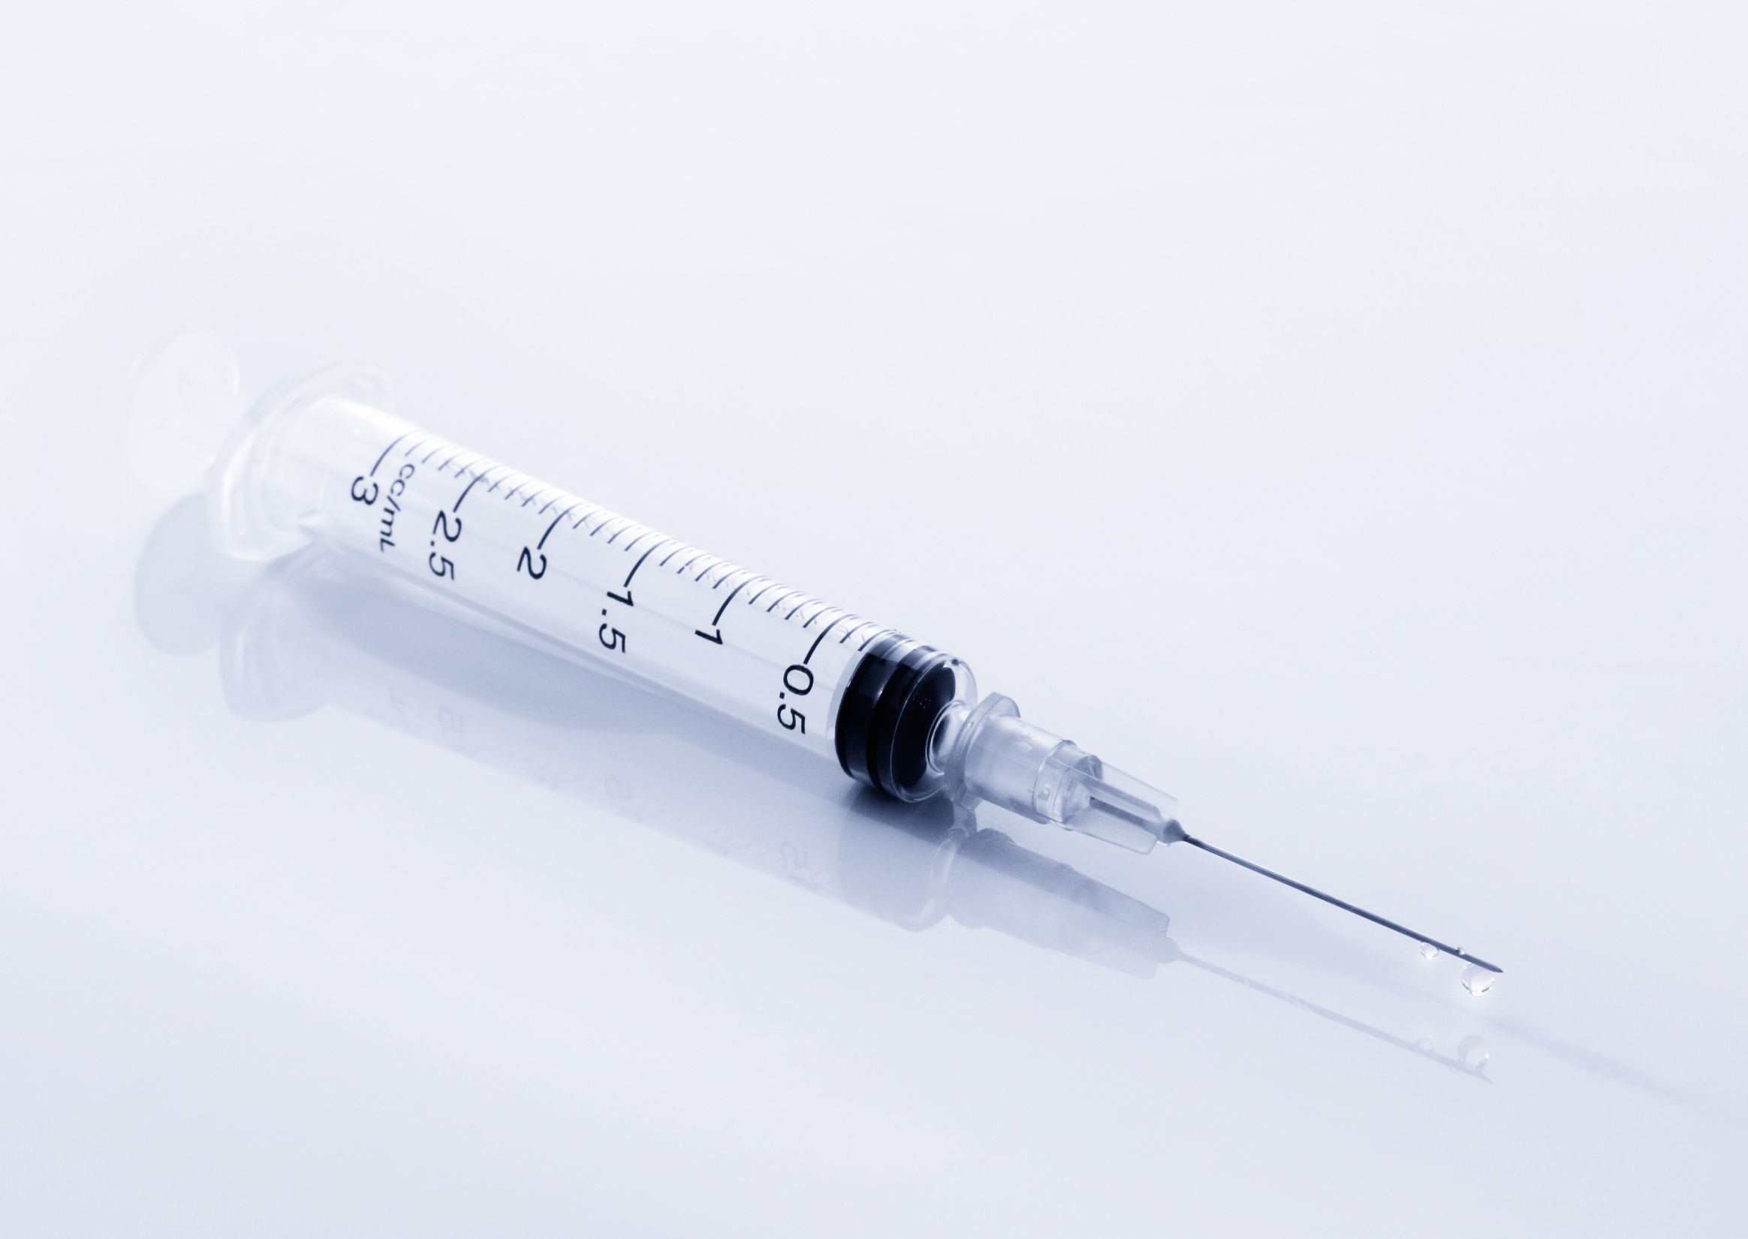
Storage
Injections : refrigerate
Pens : do not refrigerate

Slide 46

Shelf life
One month once opened
INSULIN THERAPHY

Slide 47

INSULIN THERAPHY

Slide 48
A usual starting dosage for patients with type 2 diabetes is 1 U of rapid-acting insulin for every 10 g of carbohydrate eaten plus an additional 1 U for every 30 mg/dL above the target self-monitoring blood glucose level of 100 mg/dL.
For example, a patient who had a premeal self-monitoring blood glucose level of 160 mg/dL, and was planning to eat a meal containing 30 g of carbohydrate, would take a prandial insulin dose of 5 U .

Slide 49

INSULIN THERAPHY

