Slide 1
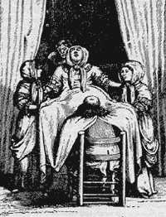
Labor & Delivery
Nirmala Priyadarshanie(B.Sc.N)
University of Peradeniya

Slide 2
What is Labor?
Onset of rhythmic contractions
Relaxation of the uterine smooth muscles
Effacement or progressive thinning of the cervix
dilation or widening of the cervix
Expulsion of the fetus and products of conception (placenta and membranes) from the uterus.

Slide 3
What causes Labor?
The process begins between 38 and 40th week.
The exact cause of onset is not understood.
There are several hypothesis: Progesterone withdrawal → relaxation of the myometrium, whereas estrogen stimulates myometrial contractions and production of prostaglandins.
Oxytocin, a hormone produced by the pituitary, stimulates the uterus to contract.

Slide 4
FACTORS THAT MAY EXTEND OR INFLUENCE THE DURATION OF LABOR - 4 Ps
Passage: Birth Passage: size and morphology of true pelvis, uterus, cervix, vagina, and perineum. Parity of woman.
The True Pelvis is primarily important when a vaginal delivery is expected.
Passenger: Presentation of the fetus “part of the fetus that enters the pelvis first” (breech, transverse). Size of the fetus, moldability of the fetal skull.
Powers: Quality, force and frequency of uterine contractions
Psyche: mother’s attitude toward labor and her preparation for labor. Culture, Anxiety/Fear

Slide 5
SIGNS OF IMPENDING LABOR
Lightening
Braxton Hicks contractions
Cervical changes: Effacement
Bloody show: labor 24-48 hrs
Rupture of membranes (ROM)
GI disturbance: N/V, diarrhea, weight loss
Sudden burst of energy (nesting)

Slide 6
MATERNAL SYSTEMIC RESPONSES TO LABOR
CV system–cardiac output increases.
Respiratory system–oxygen consumption during labor equals moderate to strenuous exercise.
Renal system–with engagement, bladder pushed forward and upward.
GI system–peristalsis and absorption decrease.
Fluid and Electrolyte balance–body temperature increases and client perspires profusely.
Immune system–white blood count increases
Integumentary system–vagina and perineum have great ability to stretch.
Musculoskeletal system–relaxation of pelvic joints, may result in backache.
Neurological system–endorphins increase pain threshold, sedative effect. Pains of labor individual, subjective

Slide 7
True Labor
Contractions produce progressive dilatation and enfacement of the cervix.
Occur regularly and increase in frequency, duration, and intensity.
The discomfort of true labor contractions usually starts in the back and radiates around to the abdomen
Not relieved by walking.

Slide 8
False Labor
Braxton Hicks contractions.
They do not produce progressive cervical effacement and dilatation.
They are irregular and do not increase in frequency, duration, and intensity.
Discomfort is located chiefly in the lower abdomen and groin area.
Walking often offers relief.

Slide 9
True Labor vs False Labor
Factor | True labor | False labor
Contractions | Progressive dilation & effacement of the cervix. Regular and increase in frequency Duration & Intensity | No progressive dilatation & effacement. Irregular. No increase in frequency, duration, intensity.
Show | YES | NO
Cervix | Becomes effaced and dilates progressively | Uneffaced and closed
Fetal movement | No significant change. | May intensify for a short period or it may remain the same.
.

Slide 10
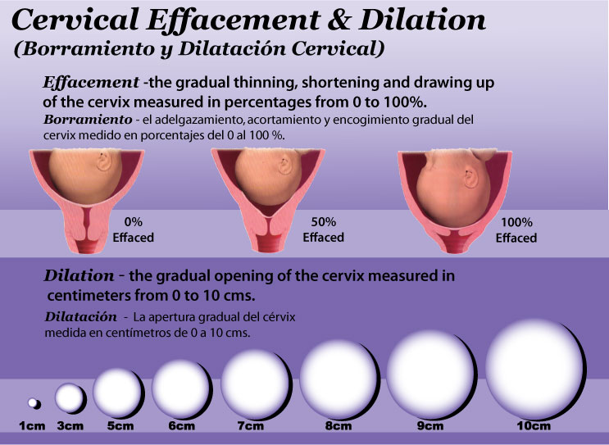

Slide 11
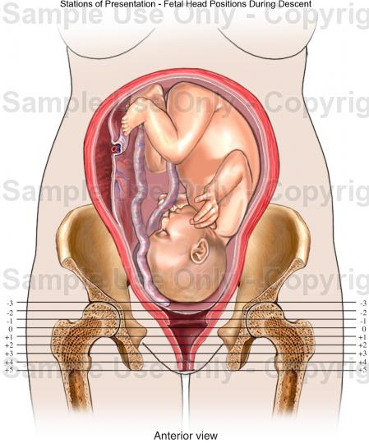
Fetal Descent Stations
How far the baby is "down" in the pelvis, measured by the relationship of the fetal head to the ischial spine .
Measured in neg. & pos. numbers. (Centimeters)
The ischial spine is in (0) Station
If the presenting part is higher than the ischial spine, the station has a (-) neg. #.
Positive #s = presenting part has passed the ischial spine.
Positive (+) 4 is at the outlet.

Slide 12
Passenger
Fetal Presentation – Referred to the fetal presenting part. Part of the fetus that enters the pelvis first:
  Cephalic
  Breech
  Shoulder.
Fetal attidude – Relationship of fetal parts to one another: all joints in flexion
Fetal lie – Relationship of cephalocaudal axis (spinal column) of fetus to the cephalocaudal axis of mother- transverse, parallel

Slide 13
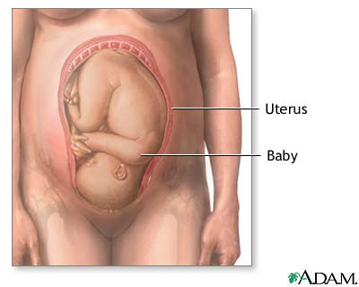
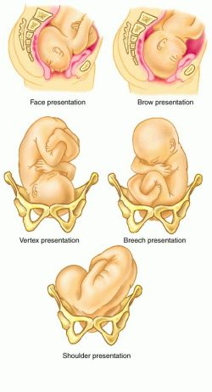
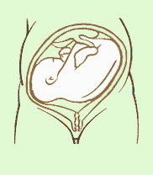

Slide 14
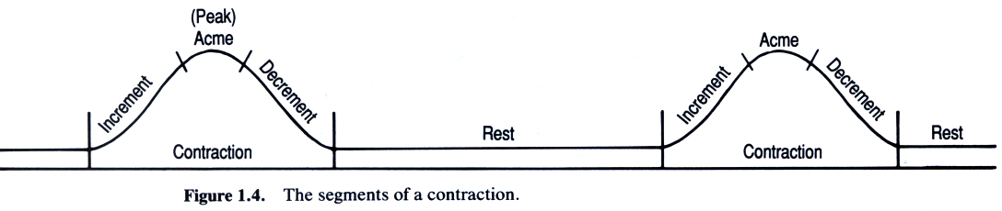
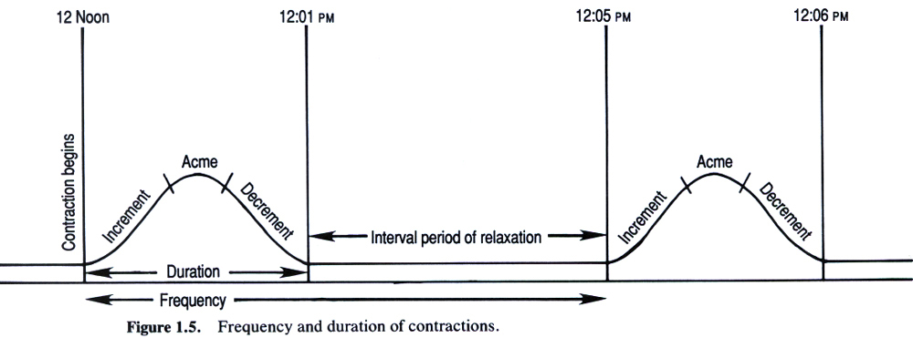
The POWERS: Uterine Contractions
Increment: Beginning, building of pressure
Acme: Most intense part of the contraction
Decrement: Diminishing of the contraction
Rest: Period of time between contractions

Slide 15
Characteristics of Contractions
Frequency: How often they occur?
  They are timed from the beginning of a contraction to the beginning of the next contraction.
Regularity: Is the pattern rhythmic?
Duration: From beginning to end - How long does each contraction last?
Intensity: By palpation mild, moderate, or strong.
10/1/2013
15

Slide 16
Assessment of Contractions
10/1/2013
16
Palpation: Use the fingertips to palpate the fundus of the uterus
  Mild: Uterus can be indented with gentle pressure at peak of contraction
  Moderate: Uterus can be indented with firm pressure at peak of contraction (feels like chin)
  Strong: Uterus feels firm and cannot be indented during peak of contraction

Slide 17
Monitor Vital Signs
Every hour during early labor.
Blood pressure (BP), pulse (P), and respiratory rate (R) every 30 minutes during active, transition, and the second stage of labor, to include the temperature every hour.
Blood pressure, P, and R every 15 minutes while on Pitocin®, to include the temperature every hour.
The FHTs should be checked and recorded on admission
Every 15 minutes during the first stage of labor
Every 5 minutes during the second stage of labor, and immediately after rupture of membranes.

Slide 18
Nursing interventions
Patient Given an Opportunity to Void every 2 hours
Full bladder may interfere with labor progress
Patient is NPO During Labor. Prolonged Gastric emptying.
Vomit
C/section
Ice chips okay

Slide 19
Positioning During Labor
Assist the patient in turning from side to side.
Elevate the head of the bed 30 degrees; this makes it easier for the patient to breathe.
Try to keep the patient off her back to prevent supine hypotensive syndrome.
May result in pressure of the enlarged uterus on the vena cava, reduces blood supply to the heart, decreases blood pressure, and reduces blood circulation to the uterus and across the placenta to the fetus.
The best position for the patient is on her left side since this increases fetal circulation.

Slide 20
Pain Medication
Nursing Interventions:
Assessment and management of respiratory depression
Assessment of motor and sensory blockade
Assessment and management of hypotension
Regional Blocks
  Epidural block
  Intrathecal block
  Local infiltration
  Pudendal block
General Anesthesia

Slide 21
The client has elected to have epidural anesthesia to relieve labor pain. If the client experiences hypotension, the nurse would:
PLACE HER IN TRENDELENBURG POSITION
DECREASE THE RATE OF IV INFUSION
ADMINISTER OXYGEN PER NASAL CANNULA
INCREASE THE RATE OF THE IV INFUSION

Slide 22
Answer is D
If the client experiences hypotension after an injection of epidural anesthetic, the nurse should turn her to the left side, apply oxygen by mask, and speed the IV infusion.
Placing the client in Trendelenburg position (head down) will allow the anesthesia to move up above the respiratory center, thereby decreasing the diaphragm’s ability to move up and down and ventilate the client.
Oxygen should be applied by mask, not cannula.

Slide 23
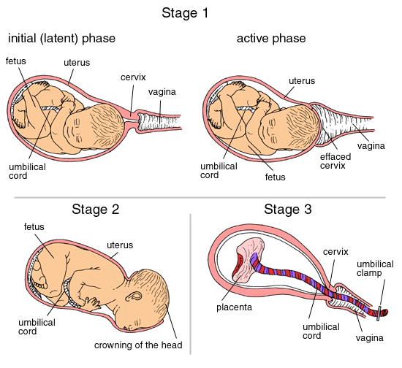
Stages of Labor

Slide 24
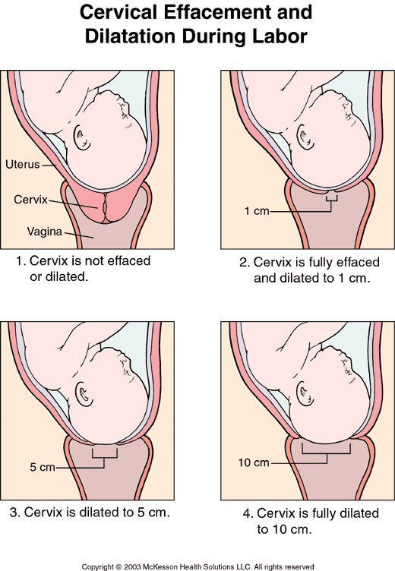
Cervical Effacement and Dilatation
Cervical Effacement: the progressive shortening and thinning of the cervix during labor. 0 – 100%
Cervical Dilatation: the increase in diameter of the cervical opening measured in centimeters. 0 – 10 cm.

Slide 25
A client is admitted to the labor and delivery unit. The nurse performs a vaginal exam and determines that the client's cervix is 5cm dilated with 75% effacement. Based on the nurse's assessment the client is in which phase of labor?
ACTIVE
LATENT
TRANSITION
EARLY
Active Labor

Slide 26
1st Stage of Labor: dilatation and effacement
The first stage of labor is referred to as the "dilating" stage.
It is the period from the first true labor contractions to complete dilatation of the cervix (10cm)
The forces involved are uterine contractions.
The first stage of labor is divided into three phases:
(1) Latent
(2) Active
(3) Transition

Slide 27
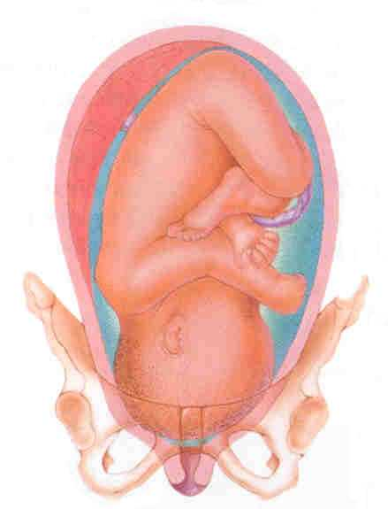
Latent Phase
Ends when cervix is dilated 4 cm.
Contractions more frequent.
The duration becomes longer.
Intensity - moderate.
Mother is usually alert and talkative, can walk
Contractions last from 30 to 45 seconds The frequency of contractions is from 5 to 20 minutes.
True labor is considered to be at 4 cm.
Duration varies, sometimes as long as 24 hours.

Slide 28
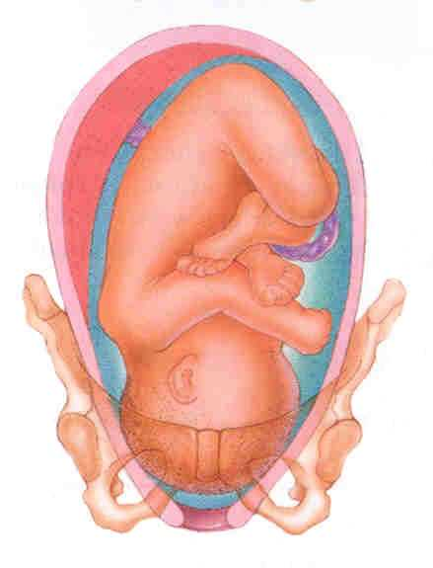
Active Phase
Begins when cervix is dilated 4 cm, ends when the cervix is dilated 8 cm.
Contractions occur every 3 to 5 minutes with a duration of 40 to 60 seconds.
Intensity progresses to strong.
The client focuses more on breathing techniques in contractions, less talkative.
Unable to walk
This phase is considered the onset of true labor.

Slide 29
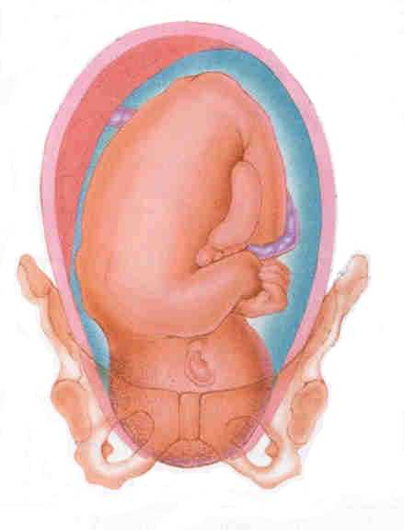
Transition Phase
Begins when cervix is dilated 8 cm, ends when cervix is dilated 10 cm.
Contractions occur every 2 to 3 minutes
Duration of 60 to 90 seconds.
The intensity of contractions is strong.
Completion of this phase marks the end of the first stage of labor.
Urge to push

Slide 30
CHARACTERISTICS OF
THE TRANSITION PHASE
Restlessness
Hyperventilation
Bewilderment and anger
Difficulty following directions
Focus on self
Irritability
Nausea, vomiting
Very warm feeling
Perspiration
Increasing rectal pressure

Slide 31
NURSING CARE DURING THE FIRST STAGE OF LABOR
Establish a rapport with the patient and significant others.
Explain all procedures or routines, which will be carried out prior to performing them. These include:
  NPO except ice chips while in labor.
  Use of fetal monitors.
  Progress reports.
  Visitation policies.
  Where patient's personal belongings will be maintained.

Slide 32
Question
Ms. L. is admitted to the hospital in labor. Vaginal examination reveals that she is 8 cm dilated. At this point in her labor, which of the following statements would the nurse expect her to make?
A) I can't decide what to name my baby.
B) It feels good to push with each contraction.
C) This isn't as bad as I expected.
D) Take your hand off my stomach when I have a contraction.

Slide 33
Answer is D
At 8 cm dilated the client is in the transition stage of her labor.
Many women experience hyperesthesia of the skin at this time and would not want to be touched during a contraction.
Transition is the most difficult stage of labor.
The client would not be trying to decide what to name the baby at this time.
The client would not be instructed to push until the cervix is fully dilated.

Slide 34
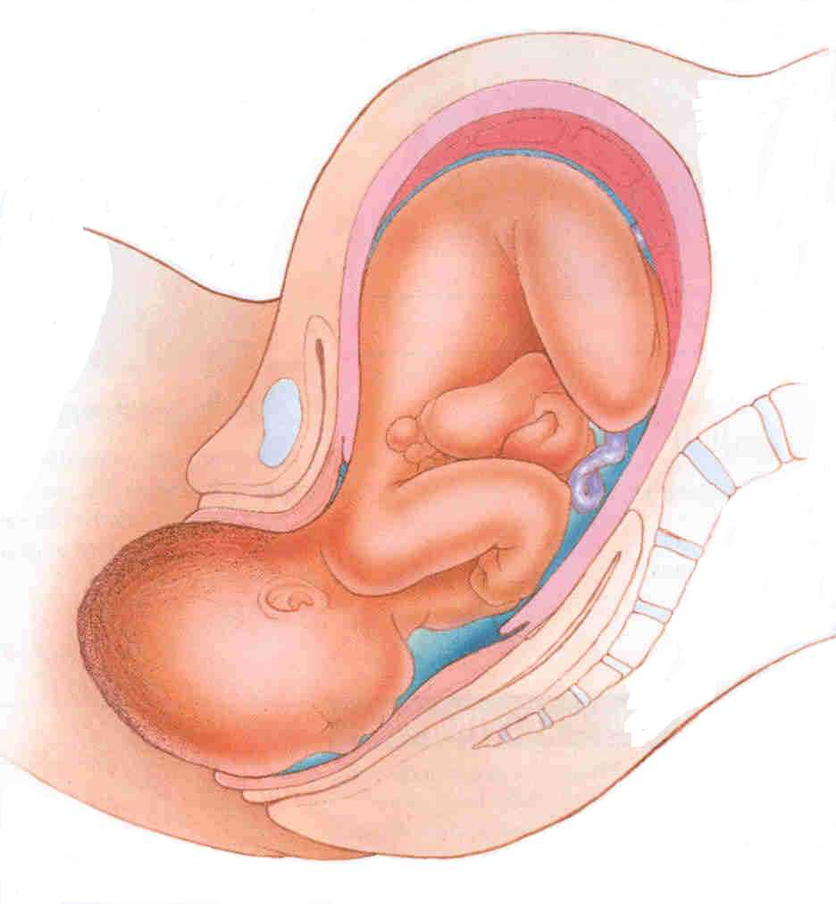
2nd Stage: Birth of the Baby
Begins when cervical dilatation is complete and ends with birth of the baby.
Impending Signs:
Bulging of the perineum.
Dilatation of the anal orifice.
Nausea, Irritability and uncooperativeness.
Complaints of severe discomfort.
Dilatation and effacement – complete - patient is instructed to push with each contraction to bring the presenting part down into the pelvis

Slide 35
Second stage of labor
Patient to rest between contractions
Push with contractions
One person should coach.
Verbal encouragement and physical contact help reassure and encourage the patient.
Monitor the patient's BP and the FHR every 5 minutes and after each contraction.

Slide 36
Third Stage of Labor
The period from birth of the baby through delivery of the placenta.
Dangerous time because of the possibility of hemorrhaging.
Signs of the placental separation
a. The uterus becomes globular in shape and firmer.
b. The uterus rises in the abdomen.
c. The umbilical cord descends three inches or more further out of the vagina.
d. Sudden gush of blood.

Slide 37
Nursing Care 3rd stage
Following delivery of the placenta:
Observation of the fundus.
Retention of the tissues in the uterus can lead to uterine atony and cause hemorrhage.
Massaging the fundus gently will ensure that it remains contracted.
Allow the mother to bond with the infant. Show the infant to the mother and allow her to hold the infant

Slide 38
4th stage
Period from the delivery of the placenta until the uterus remains firm on its own.
Uterus makes its initial readjustment to the non-pregnant state.
The primary goal is to prevent hemorrhage from the uterine atony and the cervical or vaginal lacerations.
Atony is the lack of normal muscle tone. Uterine atony is failure of the uterus to contract.

Slide 39
Nursing care 4th stage
An ice pack may be applied to the perineum to reduce swelling from episiotomy especially
Vital signs
Evaluated the fundal height and firmness
Evaluated the lochia.
Suction and oxygen in case patient becomes eclamptic.

Slide 40
Fourth Stage of Labor
Referred as the Recovery Stage
First 4 hours after the birth.
Blood loss is usually between 250 mL and 500 mL.
Uterus should remain contracted to control bleeding, positioned in the midline of the abdomen, level with the umbilicus.
Mother may experience shaking chills.

Slide 41
Assessing the Fundus
Massage the fundus every 15 minutes during the first hour, every 30 minutes during the next hour, and then, every hour until the patient is ready for transfer.
Evaluate from the umbilicus using fingerbreadths.
This is recorded as two fingers below the umbilicus (U/2), one finger above the umbilicus (1/U), and so forth.
The fundus should remain in the midline.
If it deviates from the middle, identify this and evaluate for distended bladder.
A boggy uterus many indicate uterine atony or retained placental fragments.

Slide 42
Assess Lochia
Lochia is the maternal discharge of blood, mucus and tissue from the uterus.
May last for several weeks after birth.
Record the number of pads soaked with lochia during recovery
Observe for constant trickle of bright red lochia. This may indicate lacerations.
Identify lochia amounts as small, moderate, or heavy (large)
Document lochia flow when the fundus is massaged.
Every fifteen (15) minutes times one hour.
Every thirty (30) minutes times one hour.
Every hour until ready for transfer.

Slide 43
Vital Signs
Take BP, P, and R every 15 minutes for an hour, then every 30 minutes for an hour, and then every hour.
Temperature every hour.
Observe for uterine atony or hemorrhage.
Observe for any untoward effects from anesthesia.
Allow the patient time to rest.
Encourage the patient to drink fluids.
Observe patient's urinary bladder for distention..
Characteristics of a full bladder.
Bulging of the lower abdomen.

Slide 44
Nursing Assessment/intervention
Spongy feeling mass between the fundus and the pubis.
Displaced uterus from the midline, usually to the right.
Increased lochia flow.
Full bladders may actually cause postpartum hemorrhage because it prevents the uterus from contracting appropriately
Urine output less than 300cc on initial void after delivery may suggest urinary retention.
Evaluate the perineal area for signs of developing edema and/or hematoma.
Apply an ice pack to the perineum as soon as possible to decrease the amount of developing edema.

Slide 45
Nursing Assessment Intervention
Vaginal or cervical lacerations.
Retained placental fragments.
Bladder distention.
Severe hematoma in vagina or surrounding perineum.
Assess for ambulatory stability.
The patient should be accompanied on the first ambulation and observed for stability.
The patient should be closely monitored while in the bathroom to prevent injury if fainting does occur.

Slide 46
NURSING DIAGNOSES
Impaired verbal communication
Pain
Fatigue
Anxiety
Fear
Deficient knowledge
Risk for infection
Risk for Injury
Risk for deficient fluid volume
Impaired urinary elimination
Impaired (fetal) gas exchange
Altered tissue perfusion (maternal)
Impaired physical mobility
Ineffective coping

Slide 47
PLANNING/OUTCOME IDENTIFICATION
Client:
Shows progress through labor.
Expresses satisfaction with assistance.
Maintains adequate hydration.
Voids at least every 2 hours.
Actively participates in labor process.
Does not experience any injury.

Slide 48
NURSING INTERVENTIONS
Assessment, timing contractions, and listening to FHR regularly
Comfort measures
Hygiene measures
Ambulation and position
Food and fluid intake
Elimination
Provide adequate oxygenation of mother and fetus.
Provide a focus of attention.
Decrease pain and anxiety.
Increase mental and physical relaxation.

Slide 49
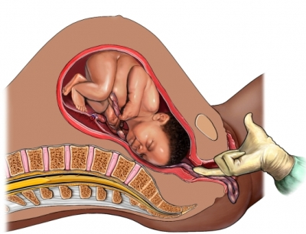
UMBILICAL PROLAPSE CORD
Cord is compressed by the fetus and not visible externally.
Cord may not be visual but lt in the vaginal canal.
Cord is protruding from the vagina.
Goal is prevention of fetal anoxia.
Management includes positioning the mother on the left side in trendelenberg or in a knee-chest position and administering 100% oxygen.
If the cord is exposed, cover it with saline moistened sterile gauze. STAT C-section is performed.
Insert 2 fingers into the vagina with sterile gloves, and put pressure on the presenting part to relieve the compression of the cord.

Slide 50
AUGMENTATION OF LABOR
augmentation–stimulation of contractions after spontaneously beginning, but with unsatisfactory progress.

Slide 51
Methods to augment labour?

Slide 52

Induction of Labor
Induction–stimulation of uterine contractions before they begin spontaneously.

Slide 53
Induction of Labor
Some common reasons for induction include:
Mother and/or fetus are at risk:
The mother has preeclampsia, eclampsia, or chronic hypertension
IUGR
ROM without spontaneous onset of labor
Nonreassuring fetal status
Postterm gestation
Elective induction for the convenience of mother or the practitioner is not recommended.

Slide 54
Induction
Some common techniques of induction include:
rupturing (artificially) the amniotic sac membranes.
Inserting vaginal suppositories that contain prostaglandin hormone to stimulate contractions.
Administering an intravenous infusion of oxytocin (a hormone produced by the pituitary gland that stimulates contractions)

Slide 55
Oxytocin contraindications
abnormal fetal presentations
marked uterine over distension
Six or more previous pregnancies
Previous uterine scar and a live fetus
CPD

Slide 56
Induction contraindications
Uterine surgery
Placenta previa
Macrosomia, hydrocephalus
Mal presentations
Non reassuring fetal status
Cephalo Pelvic Disproportion
Maternal active genital herpes

Slide 57

Amniotomy
Artificial rupture of membranes performed at or beyond 3 cm dilation.
The technique involves perforation of the fetal membranes with a sterile plastic instrument (amnihook).
May cause changes in the FHR ( accelerations or bradycardia).
Normal amniotic fluid is straw-colored and odorless.

Slide 58
A gravida III para 0 is admitted to the labor and delivery unit. The doctor performs an amniotomy. Which observation would the nurse be expected to make after the amniotomy?
FETAL HEART TONES 160BPM
A MODERATE AMOUNT OF STRAW-COLORED FLUID
A SMALL AMOUNT OF GREENISH FLUID
A SMALL SEGMENT OF THE UMBILICAL CORD

Slide 59
Answer is B
An amniotomy is an artificial rupture of membranes and normal amniotic fluid is straw-colored and odorless.
FHTs 160 indicate tachycardia, and greenish fluid is indicative of meconium.
If the nurse notes the umbilical cord, the client is experiencing a prolapsed cord, so answer D is incorrect and would need to be reported immediately.

Slide 60
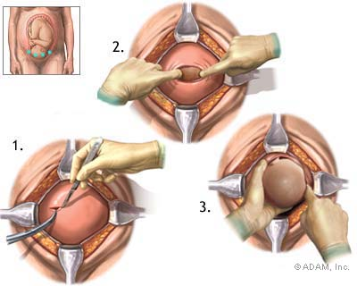
CESAREAN BIRTH
Birth of an infant through an incision in the abdomen and uterus.
Scheduled or unscheduled.
When C/Section is unscheduled: the nurse needs to review with the client events before the C/Section to ensure the client understands what happened

Slide 61
Breech Presentation Incidence
Breech presentation occurs in 3-4% of all deliveries.
25% of births prior to 28 weeks' gestation
7% of births at 32 weeks' gestation
Fetus to AF ratio (prematurity, polyhydramnios)
Intrauterine space (uterine malformations or fibroids, placenta previa, multiple gestation)
Fetal abnormalities (CNS malformations, neck masses, aneuploidy

Slide 62
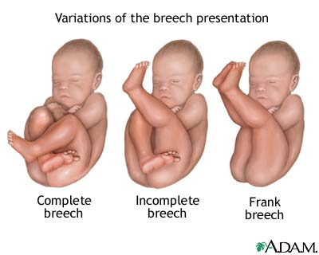
Types
Complete breech - Hips flexed, knees flexed (cannonball position)
Footling or incomplete - One or both hips extended, foot presenting
Frank breech - Hips flexed, knees extended (pike position)

Slide 63
The term for a breech presentation in which the fetal hips and thighs are flexed and the buttocks presents toward the maternal pelvis is:
Frank breech
Complete breech
Footling breech
Kneeling breech
Answer is Frank Breech

Slide 64
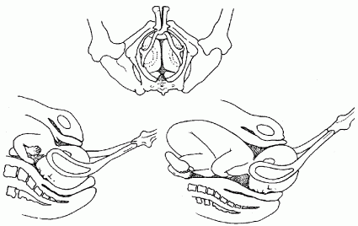
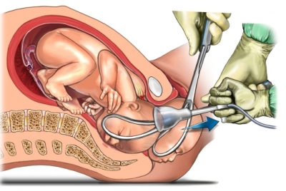
FORCEPS-ASSISTED BIRTH
Forceps are metal instruments used on fetal head to assist in delivery.
Cervix must be completely dilated and membranes must be ruptured.
Position and station of fetal head must be known.
Newborn possible facial bruising, edema.

Slide 65
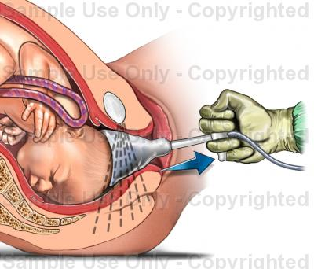
VACUUM-ASSISTED BIRTH
Indications are same as for forceps-assisted birth.
Maternal risks include vaginal and rectal lacerations.
Fetal risks: cephalhematoma, brachial plexus palsy, retinal and intracranial hemorrhage.

Slide 66
Indication for forceps or vacuum delivery
Maternal:
Heart/Lung disease
Intrapartum infection
Exhaustion
Prolonged 2nd stage labor
Fetal:
Cord Prolapse
Abruptio placenta
Non-reassuring FHR

Slide 67
Classification of forceps or vacuum
Outlet: scalp is visible at the introitus without separating the labia
Low: leading point of fetal skull is at station=>+2cm and not on the pelvic floor
Mid forceps: station above +2cm but head is
engaged.

Slide 68
Contraindication for vacuum & forceps delivery
Nonvertex presentations
Extreme prematurity
known macrosomia
Above zero stations

Slide 69
Forceps Complications
FETAL COMPLICATIONS:
Injury to facial nerves requires observation.
Injury may be self-limiting.
Lacerations of the face and scalp may occur.
Clean and examine lacerations to determine if sutures are necessary.
Fractures of the face and skull require observation.
MATERNAL COMPLICATIONS:
Tears of the genital tract may occur. Examine the woman carefully and repair any tears to the cervix or vagina or repair episiotomy
Uterine Rupture

Slide 70
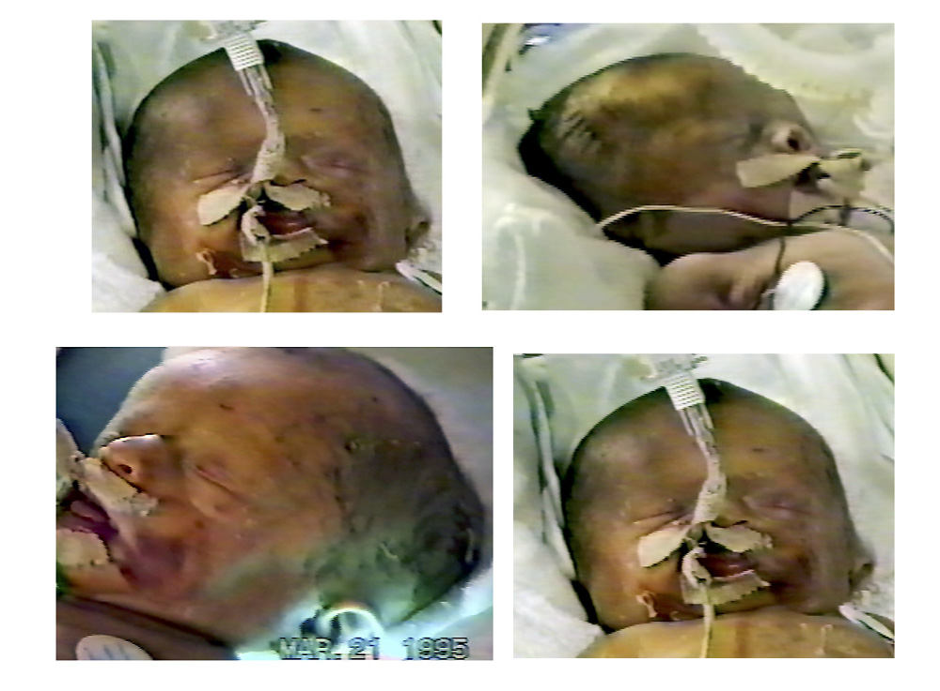
FORECEPS DELIVERY TRAUMA

Slide 71
What is Intrauterine Resuscitation?
Interventions to attempt to change the relationship of the uterus, placenta, cord, and fetus to improve placental and fetal oxygenation.
These are designed to overcome uteroplacental insufficiency or to decrease cord compromise.

Slide 72
Intrauterine Resuscitation
Positioning the mother to left side lying recumbent or knee-chest to improve blood flow to the uterus
Repositioning the mother to alleviate cord compression
Increasing IV fluids to enhance maternal blood flow volume
Administering oxygen to the mother in an effort to promote oxygen flow across the placental membrane

Slide 73
Which of the following is NOT one of the four stages of labor and delivery?
A: onset of labor through complete dilation of the cervix
B: cervical dilation through the delivery of the placenta
C: placenta delivery through complete stabilization of the mother
D: birth through the delivery of the placenta

Slide 74
Answer is B
The correct answer combines two of the four stages of labor and delivery.

Slide 75
A client telephones the ER stating that she thinks that she is in labor. The nurse should tell the client that labor has probably begun when:
HER CONTRACTIONS ARE 2 MINUTES APART.
SHE HAS BACK PAIN AND A BLOODY DISCHARGE.
SHE EXPERIENCES ABDOMINAL PAIN AND FREQUENT URINATION.
HER CONTRACTIONS ARE 5 MINUTES APART.

Slide 76
Answer is D
The client should be advised to come to the labor and delivery unit when the contractions are every 5 minutes and consistent.
She should also be told to report to the hospital if she experiences rupture of membranes or extreme bleeding.
She should not wait until the contractions are every 2 minutes or until she has bloody discharge.

