Slide 1
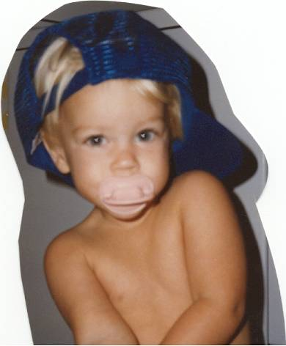
Infancy
Physical development
Dr Madhuranga Agampody

Slide 2
Development of infancy
Physical development
Cognitive development
Socioemotional development

Slide 3
Stages of Growth and Development
Infancy
Neonate
Birth to 1 month
Infancy
1 month to 1 year
Early Childhood
Toddler
1-3 years
Preschool
3-6 years
Middle Childhood
School age
6 to 12 years
Late Childhood
Adolescent
13 years to approximately 18 years

Slide 4
Principles of Growth and Development
Growth is an orderly process, occurring in systematic fashion.
Rates and patterns of growth are specific to certain parts of the body.
Wide individual differences exist in growth rates.
Growth and development are influences by are influences by a multiple factors.

Slide 5
Principles Continued
Development proceeds from the simple to the complex and from the general to the specific.
Development occurs in a cephalocaudal and a proximodistal progression.
There are critical periods for growth and development.
Rates in development vary.
Development continues throughout the individual's life span.

Slide 6
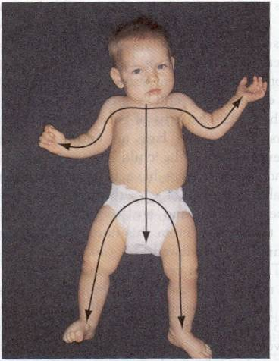
Growth Pattern

Slide 7
Growth Patterns
The child’s pattern of growth is in a head-to-toe direction, or cephalocaudal, (growth follows a pattern that begins with the head and upper body parts and then proceeds to the rest of the body. )
and in an inward to outward pattern called proximodistal.

Slide 8
Why developmental assessment?
Early detection of deviation in child’s pattern of development
Simple and time efficient mechanism to ensure adequate surveillance of developmental progress
Domains assessed: cognitive, gross motor, fine motor and vision, hearing and speech, language, social / behavioral.

Slide 10
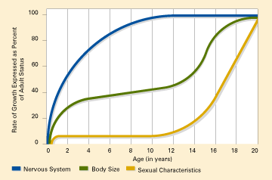
Maturation Rates
Different body systems mature at different rates.
For instance, the nervous system is highly developed during infancy.

Slide 11
Gross motor - Movement controlled by the large muscles or muscle groups (e.g. legs)
Fine motor - Movement controlled by the small muscles or muscle groups (e.g. hands)

Slide 12
Physical Growth
The average newborn weighs between 2.5kg to 3.5kg
By 5 months, the average infant’s birth weight has doubled
By the first birthday, the infant’s weight has tripled
By the end of the second year, the child’s weight has quadrupled since birth

Slide 14
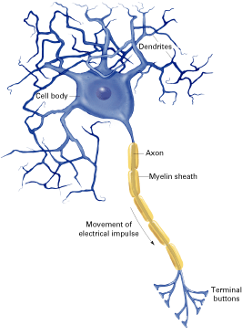
The nervous system comprises the brain and the nerves that extend throughout the body.
Infants are born with between 100 and 200 billion NEURONS!
As the infant's experience in the world increases, neurons that do not become interconnected become unnecessary and die off.

Slide 15
More About Neurons…
-- Neurons increase in size.
-- Neurons become coated with MYELIN, a fatty substance that helps insulate neurons and speeds transmission of nerve impulses.
-- The brain is made up of neurons, and triples its weight in the first two years of life.
The infant's brain is 3/4 its adult size by age two

Slide 17
More About Neurons…
As they grow, neurons become arranged by function.
Some move into the CEREBRAL CORTEX
Others move to subcortical levels, which regulate fundamental activities such as breathing and heart rate (and are below the cerebral cortex).
Networks of neurons become more complex over the first few years of life.

Slide 18
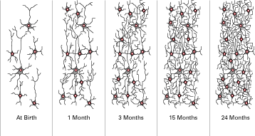
Neuron Networks

Slide 19
Brain development occurs because of genetic patterns and environmental influences.
PLASTICITY is the degree to which a developing structure (e.g., the brain) or behavior is susceptible to experience
The brain is relatively plastic
Infants who grow up in severely restricted environments are likely to show differences in brain structure and weight.

Slide 20
Primitive reflexes
Reflexes: built-in reactions to stimuli; generally carry survival mechanisms
Rooting Reflex: when the infant’s cheek is stroked, the infant will turn its head to the side that was touched
Moro Reflex: automatic arching of back and wrapping of arms to center of body when startled
Grasping Reflex: infant’s hands close around anything that touches the palms
Primitive reflexes disappear several months after birth ( 4 – 6 months )

Slide 21
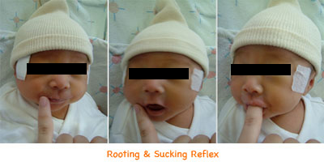
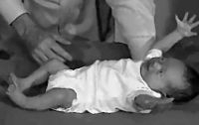
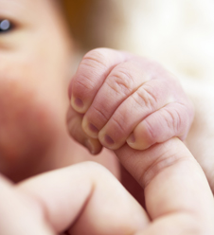

Slide 22
Gross Motor Skills
The acquisition of gross motor skill precedes the development of fine motor skills.
Both processes occur in a cephalocaudal fashion
Head control preceding arm and hand control
Followed by leg and foot control.

Slide 23
Gross Motor Development
Newborn: barely able to lift head
6 months: easily lifts head, chest and upper abdomen and can bear weight on arms

Slide 24
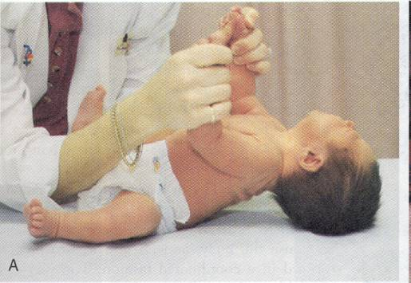
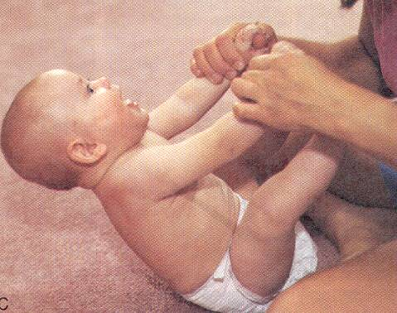
Head Control
Newborn
Age 6 months
Notes:
Newborn

Slide 25
Sitting up
2months old: needs assistance
6 months old: can sit alone in the tripod position
8 months old: can sit without support and engage in play

Slide 26
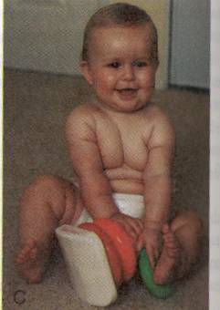
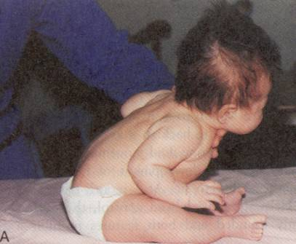
Sitting Up
Age 2 months
Age 8 months

Slide 27
Ambulation
9 month old: crawl
1 year: stand independently from a crawl position
13 month old: walk and toddle quickly
15 month old: can run

Slide 29
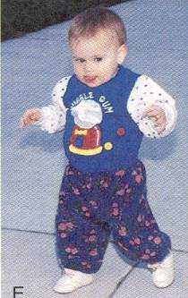
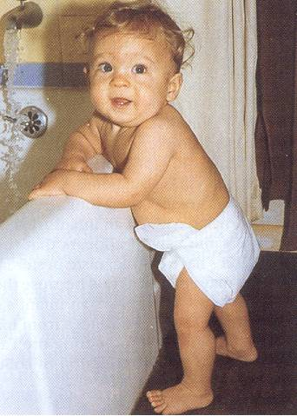
Ambulation
13 month old
Nine to 12-months
Notes:
N

Slide 32
Fine Motor - Infant
Newborn has very little control. Objects will be involuntarily grasped and dropped without notice.
6 month old: palmar grasp – uses entire hand to pick up an object
9 month old: pincer grasp – can grasp small objects using thumb and forefinger
Experienced infants look at objects longer, reach for them more, and are more likely to mouth the objects

Slide 33
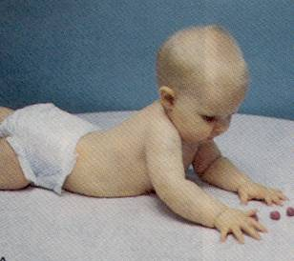
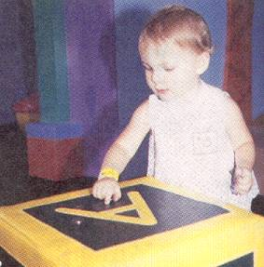
Fine Motor Development
6-month-old
12-month-old

Slide 34
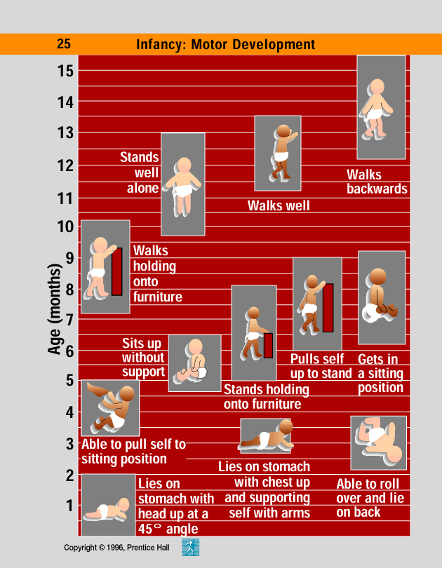

Slide 35
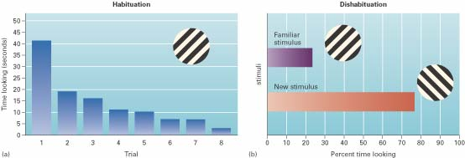
vision
Visual Preference Method: infants look at different things for different lengths of time
They look at preferred objects longer
Habituation: decreased responsiveness to a stimulus after repeated presentations
Dishabituation: recovery of a habituated response after a change in stimulation

Slide 36
vision
Newborn’s vision is about 6/182 (an object 6m away appears as if it were 182m away),(20/600 feet)
By the age of 6 months, vision is 6/6 or better
Vision approximates that of an adult by the infant’s first birthday
Infants show an interest in human faces soon after birth
The way they gather information about the visual world changes rapidly with age

Slide 37
Hearing
Fetuses can hear and learn sounds during the last two months of pregnancy and can recognize their mother’s voice at birth
Newborns:
Cannot hear soft sounds as well as adults
Are less sensitive to pitch
Are fairly good at determining the location of a sound

Slide 38
Hearing
Sound localization, the ability to determine where a sound is coming from, is at adult level by 1 year old
By four and a half months, infants can discriminate their own names

Slide 39
Speech Milestones
1-2 months: coos
2-6 months: laughs and squeals
8-9 months babbles: mama/dada as sounds
10-12 months: “mama/dada specific
18-20 months: 20 to 30 words – 50% understood by strangers
22-24 months: two word sentences, >50 words, 75% understood by strangers
30-36 months: almost all speech understood by strangers

Slide 41
Smell and Taste
Sense of smell is extremely well developed in infants. A 12-18 day old infant can distinguish the smell of the mother.
Taste is also well developed in infants who can distinguish disgust and bitter and show preference for sweet. Infants also develop taste preferences depending on what the mother drank while they were in the womb

Slide 42
Touch is one of the better-developed senses at birth, being one of the first to develop inside the womb. This is evidenced by the primitive reflexes described above, and the relatively advanced development of the somatosensory cortex.
Pain: Infants feel pain similarly, if not more strongly than older children but pain-relief in infants has not received so much attention as an area of research.

Slide 44
Development delay
Development delay is where a child has not learnt the skills that are expected at that time point. Development delay can occur in any of the below areas.
Gross motor skill Development
Fine motor skill Development
Speech and Language Development
Cognitive Development
Social and Emotional Development

Slide 45
Red Flags in infant development
Unable to sit alone by age 9 months
Unable to transfer objects from hand to hand by age 1 year
Abnormal pincer grip or grasp by age 15 months
Unable to walk alone by 18 months
Failure to speak recognizable words by 2 years.

Slide 46
Risk factors
Malnutrition
Iodine, Iron def.
Maternal depression.
IUGR
Lack of breast feeding
Maternal infection
Intestinal helminthes
HIV

Slide 47
Genotype and Maturation
Culture
Parenting/parenting styles
Approval/ interactions
Disability
Factors affecting development
BIOLOGICAL
SOCIAL
Education
Housing
Disease and illness
Social Class
NATURE/NURTURE DEBATE

Slide 48
Nutrition in Infancy Fuels Motor Development
Nutrition during infancy is extremely important! Without proper nutrition, infants cannot reach their physical potential and also may suffer cognitive and social consequences.

Slide 49
Underweight Children

Slide 50
Malnutrition & It’s Effects
Malnutrition, the condition of having an improper amount and balance of nutrients produces several results.
--slower growth
--susceptibility to disease
--lower IQ scores

Slide 51
Malnutrition & It’s Effects..
Malnutrition can also cause MARASMUS, a disease characterized by the cessation of growth in infants.
Older children are susceptible to KWASHIORKOR, a disease in which a child's stomach, limbs, and face swell with water.

Slide 52
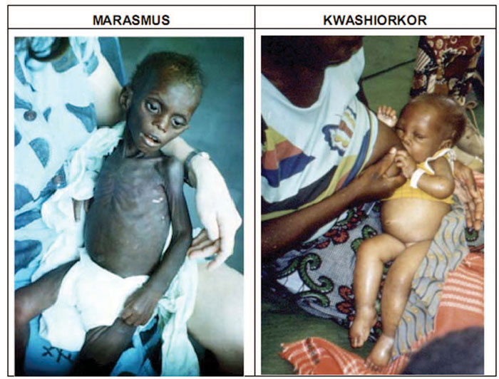

Slide 53
Nutrition as Fuel for Motor Development: Breast or Bottle??
For the first four to six months of life there is no better food for an infant than breast milk! Why?.
all essential nutrients
natural immunity to childhood diseases
more easily digested
health advantages for mother (lower cancer)
emotional advantages for both mother and child
bonding?

Slide 54
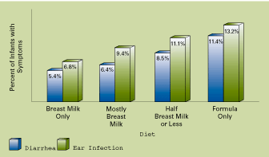
Breast Milk Advantages

Slide 55
THANK YOU…
drmadhuranga@iihsciences.com

Slide 56
Summery of Foetal development

Slide 57
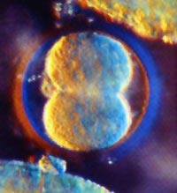
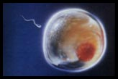
This is a fertilized egg only 30 hours after conception
Fertilization = the joining of the sperm and the egg in the fallopian tube to form a unique human being.
For the first 8 weeks it is known as an Embryo. After 8 weeks it is known as a Foetus.
an Embryo

Slide 58
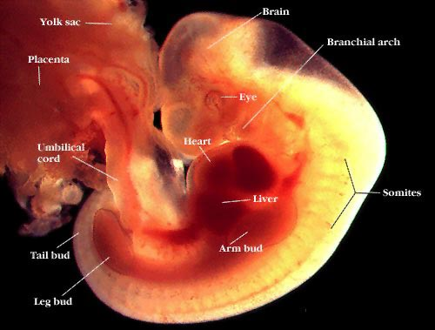
4 weeks
The Embryo is attached to the mother’s uterus.

Slide 59
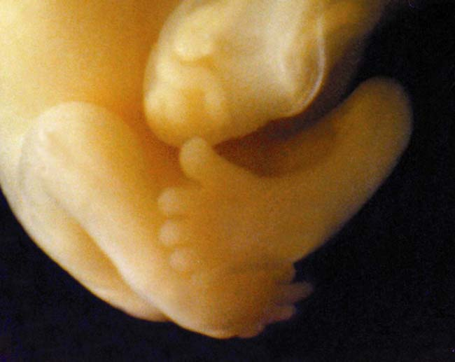
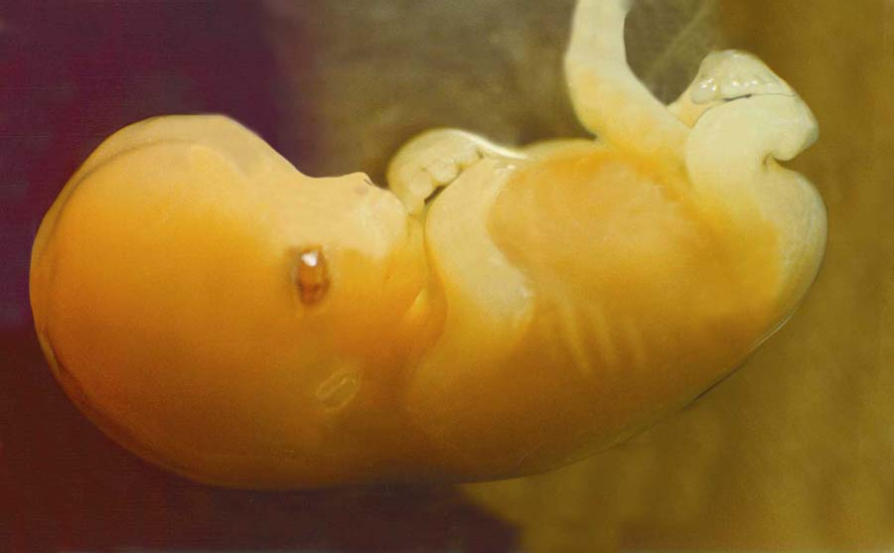
A foetus at 7 weeks in the womb

Slide 60
How do you think the foetus receives its nutrition?

Slide 61
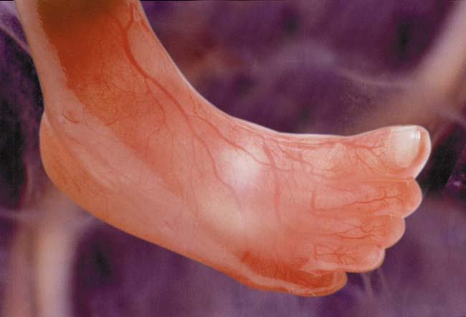
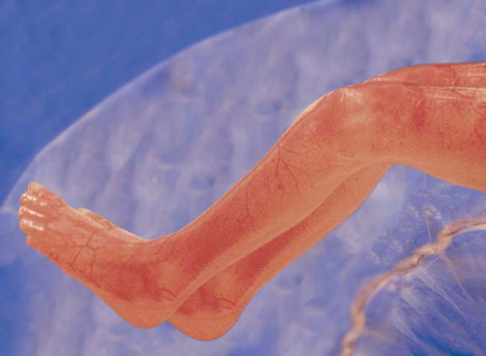
A foetus at 12 weeks

Slide 63
16 week foetus

Slide 64
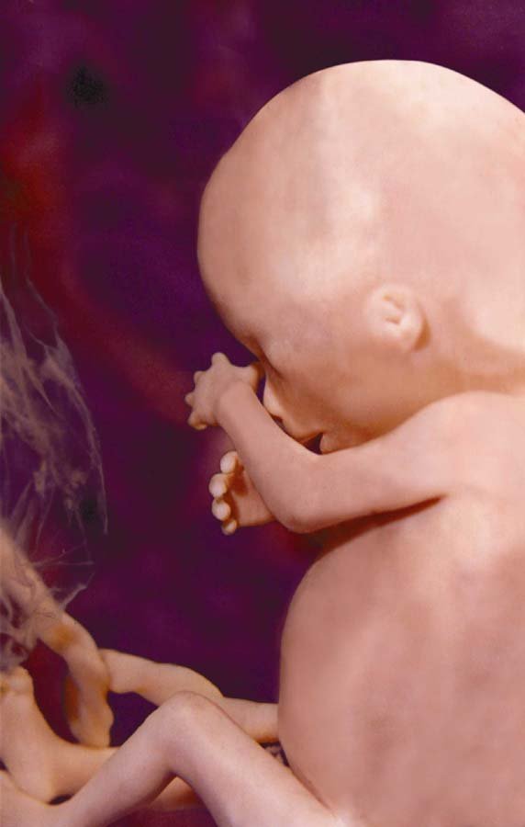
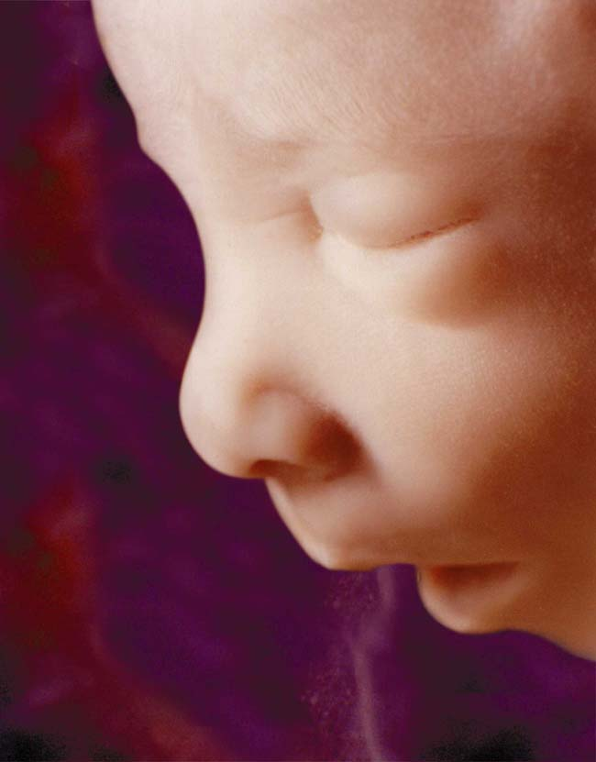
A foetus at 3 – 4 months

Slide 65
A foetus at 5 month

Slide 66
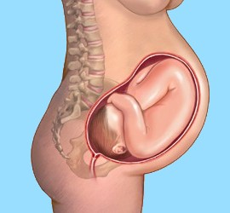
9 months – full term

Slide 67
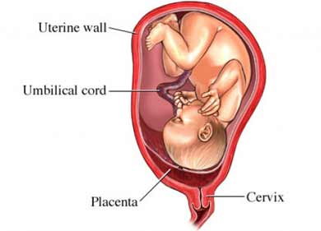
Week 4: The placenta develops
Week 6: Umbilical cord develops, first heart beat begins, buds for arms and legs form
Week 8: elbows and feet begin to grow, teeth develop under gums

Slide 68
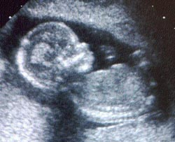
week 14
head-face, eyes, retina, eyelids and eyebrows, ears, bones in the middle ear, nostrils
vocal cords, intestines, pancreases, arms, hands, fingernails, hair, legs, toenails, fat, placenta, brain, muscles.

Slide 69
Week 24: eyes and ears develop and move to their proper position throughout the trimester
Week 26: brain waves for sight and sound
Week 27: eyes start opening and retinas start growing

Slide 70
A new born baby

Slide 71
Thank you…

