Slide 1
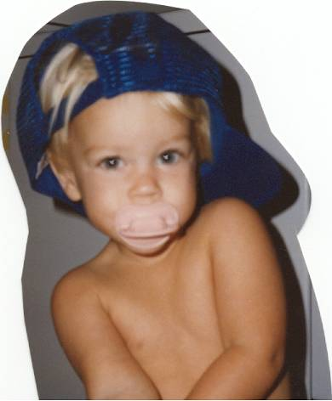
Infancy
Cognitive Development
Dr madhurangaAgampody

Slide 2
Cognitive Processes
Piaget proposed that we build mental structures that help us adapt to the world
Adaptation involves adjusting to new environmental demands
Piaget stressed that children actively construct their own cognitive worlds through interaction with the environment
Systematic changes in children’s thinking occur at different points in their development

Slide 3
Cognitive Processes
Schemes: actions or mental representations that organize knowledge
Behavioral schemes (physical activities) characterize infancy
Consist of simple actions that can be performed on objects
Mental schemes (cognitive activities) develop in childhood
Include strategies and plans for solving problems

Slide 4
Equilibration
According to Piaget, development is driven by the process of equilibration.
Equilibration encompasses assimilation (i.e., people transform incoming information so that it fits within their existing thinking) and accommodation (i.e, people adapt their thinking to incoming information).
Piaget suggested that equilibration takes place in three phases.

Slide 5
Cognitive Processes
First children are satisfied with their mode of thought and therefore are in a state of equilibrium.
Then, they become aware of the shortcomings in their existing thinking and are dissatisfied (i.e., are in a state of disequilibration and experience cognitive conflict).
Last, they adopt a more sophisticated mode of thought that eliminates the shortcomings of the old one (i.e., reach a more stable equilibrium).

Slide 6
Cognitive Processes
According to Piaget, individuals go through four stages of development
Cognition is qualitatively different from one stage to another
Sensorimotor Stage: infant cognitive development lasting from birth to 2 years
Infants understand the world through their sensory experiences

Slide 7
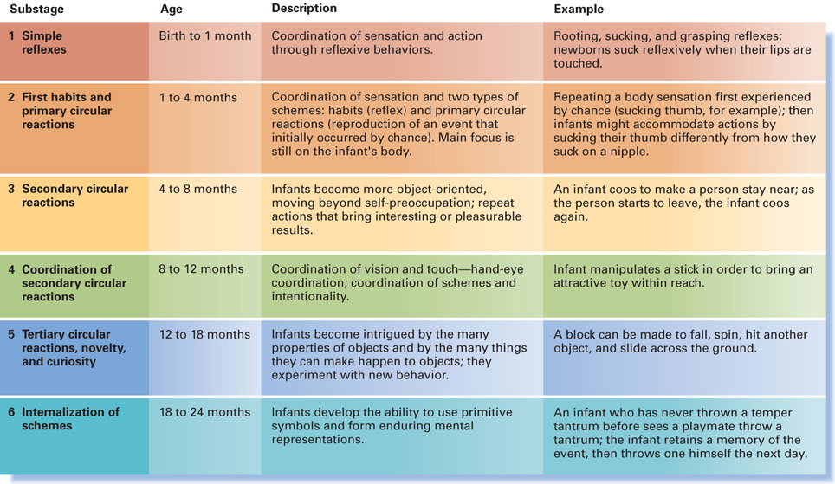
Sensorimotor Substages

Slide 8
Sensorimotor Substages
Reflexes--birth to one month
Primary circular reactions--1-4 months
Secondary circular reactions--4-8 months
Coordination of secondary circular reactions--8-12 months
Tertiary circular reactions--12-18 months
Representation--18-24 months

Slide 9
Reflexes
Child has an undifferentiated, stereotypical reaction to events/stimuli.
No connection is made between stimulation perceived through different senses.
No effort to grasp objects, but can visually track them.

Slide 10
Primary circular reactions
Primary because they involve the body
Circular because they are repeated
They first occur by chance
E.g., waving the hands in front of eyes, blowing bubbles with saliva
Goal-directed behavior begins here
Self-reinforcing: they don’t serve other drives, just prolong stimulation

Slide 11
Secondary circular reactions
Patterns repeated because of effect on environment
Objects involved now: e.g., shake a rattle
Initial awareness of effect on external world

Slide 12
Coordination of secondary circular reactions
Can attain goals now.
Now show intentional, goal-directed behavior, e.g., lift a cloth to reach a toy that was under it.
Scheme of picking up cloth is coordinated with scheme of reaching for toy

Slide 13
Tertiary circular reactions
Purposeful adaptations of established schemes to specific situations
Experimental quality to children’s actions
E.g., Jacqueline tried to pull a stick through the wooden bars of the playpen. Doesn’t fit sideways. After many days of trial and error, she discovers she can bring it through by turning it upright.

Slide 14
Representation
Invention of new means through mental combinations
Children can mentally represent a simple problem and solve it without trial and error
Now a child doesn’t have to experiment with angles to pull wooden stick through bars of playpen
Child can just turn the stick “automatically”
Use of words and definite object concept; beginnings of symbolic thought

Slide 15
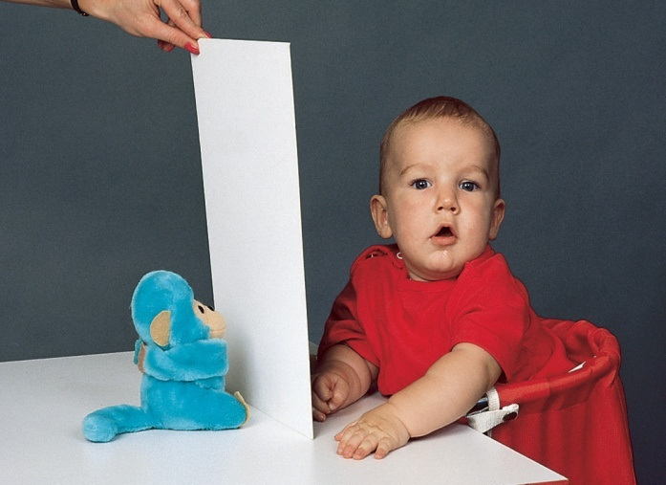
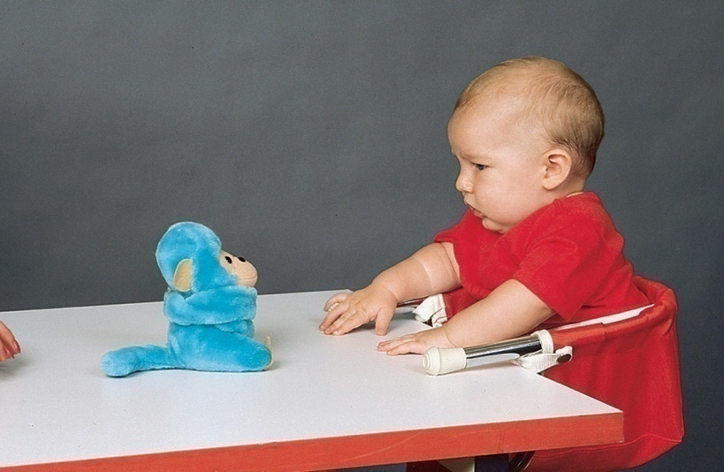
Cognitive Processes
Object Permanence:
The understanding that objects continue to exist even when they cannot be seen, heard, or touched
Developed by the end of the sensorimotor period
Studied by watching infant’s reaction when an interesting object disappears

Slide 16
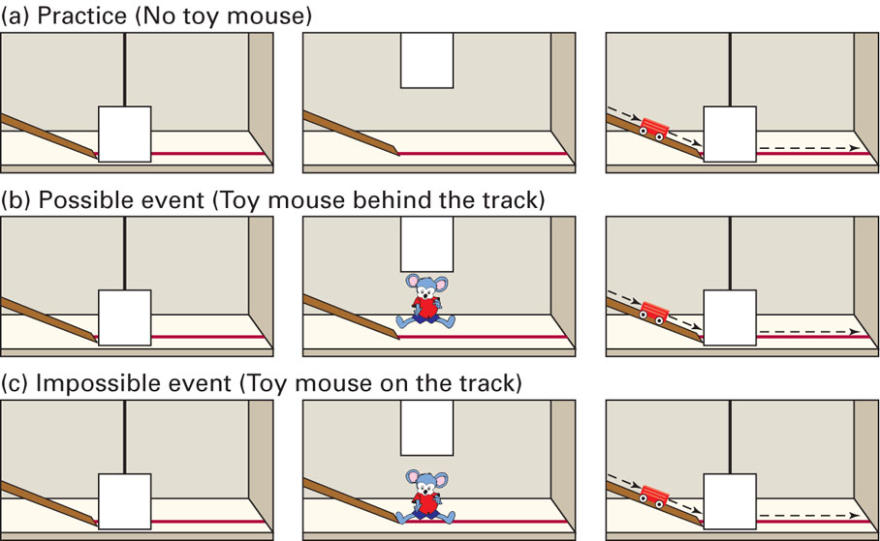
Object Permanence
Violation of Expectations method suggests that infants understand object permanence earlier than Piaget proposed

Slide 17
Cognitive Processes
Evaluating Piaget’s Sensorimotor Stage:
Piaget claimed that certain processes are crucial in transitions between stages; data do not always support this
Example: the A-not-B Error (infant selects familiar hiding place (A) rather than new hiding place (B))
Infant’s perceptual abilities may be much more developed than Piaget thought
Piaget was not specific enough about how infants learn about their world

Slide 18
Conditioning and Attention
Conditioning:
Infants can learn through classical (pairing of new stimulus to conditioned response) and operant conditioning(consequences of behavior affect probability of that behavior reoccurring)
Rovee-Collier (1997) demonstrated that infants can retain conditioning experiences

Slide 19
Conditioning and Attention
Infants’ attention is strongly governed by novelty and habituation
Habituation: decreased responsiveness to a stimulus after repeated presentations
Dishabituation: increased responsiveness after a change in stimulation
Habituation is studied to determine the extent to which infants can see, hear, smell, taste, and experience touch

Slide 20
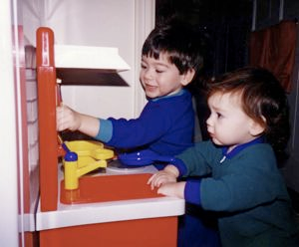
Conditioning and Attention
Joint Attention:
individuals focus on the same object or event
Requires an ability to track another’s behavior
One person directs another’s attention
Reciprocal interaction
Joint attention skills emerge by 7 to 8 months but are not frequently observed until the end of the 1st year
Plays a role in language development

Slide 21
Memory
Memory: retention of information over time
Encoding: the process by which information gets into memory
Implicit memory: memory without conscious recollection
Skills and routine procedures that are performed automatically
Explicit memory: conscious memory of facts and experiences
Occurs in infants after 6 months
Maturation of hippocampus and surrounding cerebral cortex
Infantile or childhood amnesia: inability to recall memories of events that occurred before 3 years of age
May be caused by immaturity of prefrontal lobes of the brain

Slide 22
Imitation
Meltzoff – Infant can imitate facial expression within a few days after birth; others disagree
Deferred imitation: imitate actions seen earlier; use of unusual gestures (extending arm, pointing index finger, etc.)
Piaget: begins about 18 months of age
Meltzoff: begins much earlier than 18 months
Mirror neurons play role in infant imitation

Slide 23
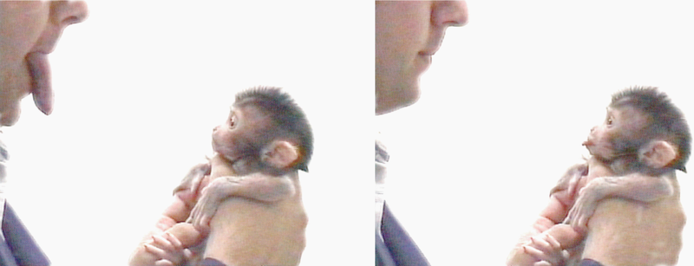
Imitation

Slide 24
Nutrition
Affects physical development
Malnutrition limits cognitive development
Early nutritional supplements, proteins and calories, have positive long-term effects
Many low-income parents cannot provide intellectually stimulating environment

Slide 25
Language Development
Language develops in infants throughout the world along a similar path and sequence
Recognizing language sounds
With age, infants get better at perceiving the sounds in their own language and worse at distinguishing sounds in other languages
Detecting boundaries between words
Occurs by about 8 months

Slide 26
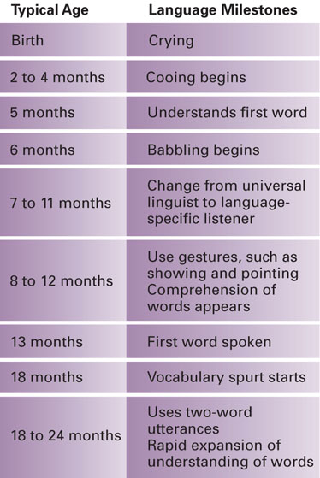
Language Milestones in Infancy
Babbling and other vocalizations
Crying
Cooing
Babbling
Gestures are used by about 8 to 12 months
Pointing, waving “bye-bye”
First words:
Children understand first words earlier than they speak them
On average, a child understands about 50 words at age 13 months but can’t speak 50 words until 18 months
Children typically speak their first word at 10–15 months
Two-word utterances occur at about 18–24 months
Telegraphic speech: use of short and precise words without grammatical markers

Slide 27
Language Development
Biological Influences:
Evolution of nervous system and vocal apparatus
Similarities in language development across the world suggest a biological basis
Particular brain regions used for language:
Broca’s area: language production
Wernicke’s area: language understanding

Slide 28
Language Development
Biological Influences (continued):
Language Acquisition Device (LAD; Noam Chomsky):
Theory that a biological endowment enables children to detect certain features and rules of language
Theoretical concept only
Critics argue that the LAD cannot explain all of language development
Theoretical; not physical part of brain

Slide 29
Language Development
Wild or feral children are raised in isolation and are unable to recapture normal language development despite intensive intervention later
Victor, Wild Boy of Aveyron
Genie: 13-year-old found in 1970 in Los Angeles
Both cases raise questions about biological and environmental determinants of language

Slide 30
Language Development
Language: a form of communication – whether spoken, written, or signed – that is based on a system of symbols
Infinite Generativity: the ability to produce an endless number of meaningful sentences using a finite set of words and rules

Slide 31
Language Development
Environmental Influences:
Behaviorists claim language is a complex learned skill acquired through responses and reinforcements
Interaction view (Tomasello): children learn language in specific contexts
Children’s vocabulary is linked to family socioeconomic status and the type of talk parents direct toward their children

Slide 32
Infancy
Socioemotional Development
Dr madhuranga Agampody

Slide 33
Emotions
Feeling, or affect,
That occurs when a person is in a state or an interaction that is important to him or her, especially to his or her well-being

Slide 34
Emotions
Biological and Environmental Influences:
Changes in baby’s emotional capacities with age
Development of certain brain regions plays a role in emotions
Emotions are the first language with which parents and infants communicate
Social relationships provide the setting for the development of a variety of emotions

Slide 35
Emotions
Early Emotions:
Primary Emotions: emotions that are present in humans and animals
Appear in the first 6 months
Self-Conscious Emotions: require self-awareness that involves consciousness and a sense of “me”
Appear between 6 months and 2 years of age
Ongoing debate about the onset of various complex emotions

Slide 36
Emotions
Fear is one of a baby’s earliest emotions
Appears at about 6 months; peaks at about 18 months
Stranger Anxiety:
occurs when an infant shows a fear and wariness of strangers
Emerges gradually, first appearing at about 6 months of age
Intensifies at about 9 months of age, increasing past the 1st birthday
Intensity of anxiety depends on:
Individual differences
Familiarity of the setting
Who the stranger is and how the stranger behaves

Slide 37
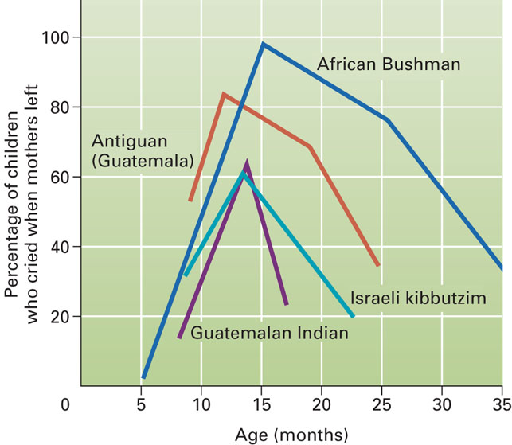
Emotions
Separation Protest: crying when the caregiver leaves
Due to anxiety about being separated from their caregivers
Typically peaks at about 15 months for U.S. infants
Cultural variations

Slide 38
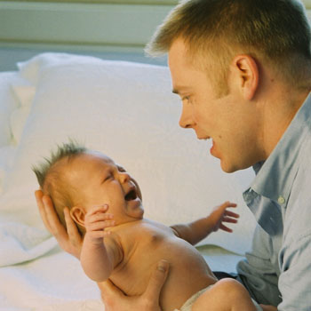
Emotions
Caregivers’ actions influence the infant’s neurobiological regulation of emotions
As caregivers soothe(calm), it reduces the level of stress hormones
Swaddling(wrap tightly with clothes.)
Infant gradually learns how to minimize the intensity of emotional reactions
Self-soothing
Self-distraction
Language (2nd year)
Context can influence emotional regulation
How should caregivers respond?

Slide 39
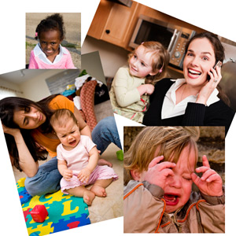
Temperament
An individual’s behavioral style and characteristic way of responding
Chess and Thomas’s Classification:
Easy child (40%)
Difficult child (10%)
Slow-to-warm-up child (15%)
Unclassified (35%)
Kagan classifies children based on inhibition to the unfamiliar
Shows stability from infancy to early childhood

Slide 40
Temperament
Kagan: children inherit a physiology that biases them to have a particular type of temperament, but this is modifiable through experience
Biological Influences:
Physiological characteristics have been linked with different temperaments
Heredity has a moderate influence on temperament differences
Contemporary view: temperament is a biologically based but evolving aspect of behavior
Goodness of Fit: the match between a child’s temperament and the environmental demands the child must cope with

Slide 41
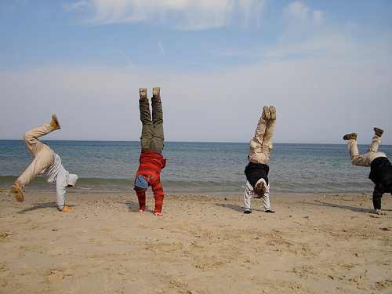
Personality Development
Three central characteristics:
Trust: Erikson believed the 1st year is characterized by trust vs. mistrust
Not completely resolved in the first year of life
Arises again at each successive stage of development
Development of a sense of self
Occurs at approximately 18 months
Independence through separation and individuation
Erikson: autonomy vs. shame and doubt

Slide 42
Social Orientation
Face-to-face play begins to characterize interactions at 2 to 3 months of age
Infants begin to respond more positively to people than objects
Still-face paradigm (http://www.youtube.com/watch?v=apzXGEbZht0)
Frequency of face-to-face play decreases after 7 months of age

Slide 43
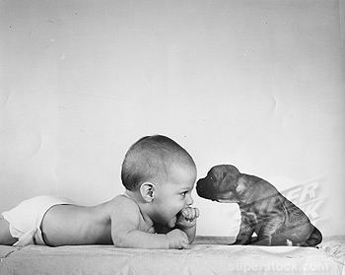
Social Orientation
Peer interactions increase considerably between 18 to 24 months of age
Increased locomotion skills allow infants to explore and expand their social world

Slide 44
Social Orientation
Perceiving people as engaging in intentional and goal-directed behavior occurs toward the end of the 1st year
Joint attention and gaze following
Social Referencing:
“reading” emotional cues in others to determine how to act in a particular situation
Emerges by the end of the 1st year; improves during the 2nd year

Slide 45
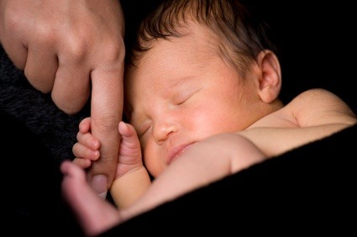
Attachment
A close emotional bond between two people
Theories of Attachment:
Freud: infants become attached to the person that provides oral satisfaction
Erikson: trust arises from physical comfort and sensitive care
Bowlby: newborns are biologically equipped to elicit attachment behavior from caregivers

Slide 46
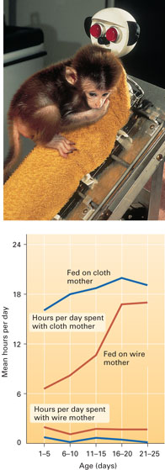
Attachment
Harlow: contact comfort vs. food
http://www.youtube.com/watch?v=hsA5Sec6dAI&feature=related
http://www.youtube.com/watch?v=02r3u59FRPU&feature=related
http://www.youtube.com/watch?v=OrNBEhzjg8I&feature=related

Slide 47
Attachment
Four Phases:
Phase 1 (birth to 2 months): infants direct their attention to human figures
Phase 2 (2 to 7 months): attachment becomes focused on one figure
Phase 3 (7 to 24 months): specific attachments develop
Phase 4 (24 months on): children become aware of others’ feelings and goals, and begin to take these into account in forming their own actions
Infants develop an internal working model of attachment

Slide 48
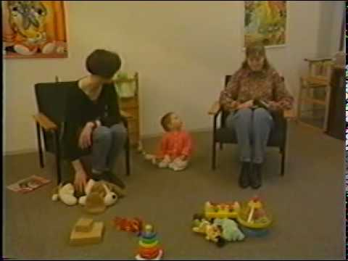
Attachment
Strange Situation is an observational measure of infant attachment http://www.youtube.com/watch?v=QTsewNrHUHU
Attachment Classifications:
Securely attached: explores environment while using caregiver as a secure base; displays mild discomfort when caregiver leaves
Insecure avoidant: avoids caregiver; shows no distress/crying when caregiver leaves
Insecure resistant: clings to caregiver and protests loudly and actively if caregiver leaves
Insecure disorganized: disorientation; extreme fearfulness may be shown even with caregiver
Ainsworth’s research is criticized for being culturally biased

Slide 49
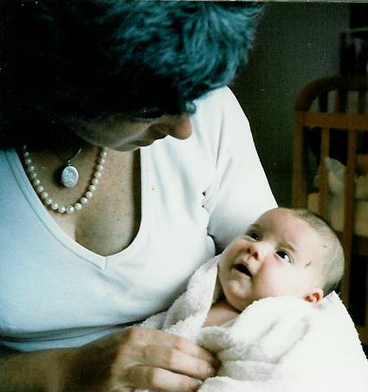
Attachment
Interpreting Differences in Attachment:
Attachment is an important foundation for later psychological development
Early attachment can foreshadow later social behavior
Early secure attachment is not the only path to success because children are flexible and adaptive
Later experiences also play an important role
Genetics and temperament play a role in attachment differences
Attachment varies among different cultures of the world

Slide 50
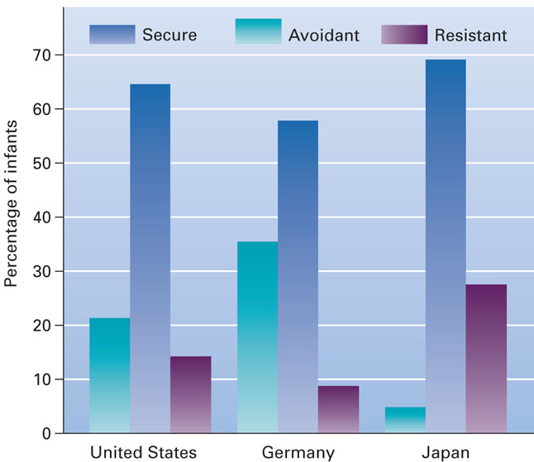
Social Contexts
Cross-Cultural Comparison of Attachment:
Ainsworth’s Strange Situation applied to infants in three countries in 1988

Slide 51
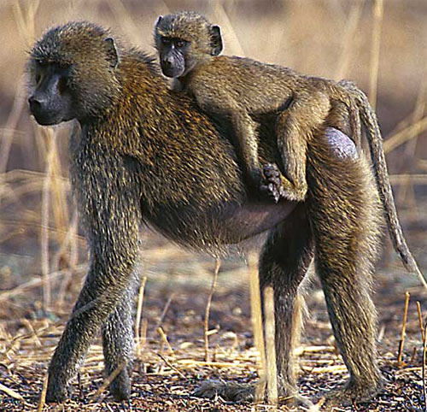
Social Contexts
The Family:
Family is a constellation of subsystems
Each subsystem has a reciprocal influence on the other
Adjustment of parents during infant’s first years
Infant care competes with parents’ other interests
Marital satisfaction and relationship dynamics may change

Slide 52
Social Contexts
Reciprocal socialization: two-way interaction process whereby parents socialize children and children socialize parents
Parent–infant synchrony: temporal coordination of social behavior
Scaffolding (Vygotsky): parental behavior that supports children’s efforts through turn-taking sequences
http://www.youtube.com/watch?v=Z1aEqmC3Sq8&feature=PlayList&p=A9AE2347493C9968&playnext=1&playnext_from=PL&index=2

Slide 53
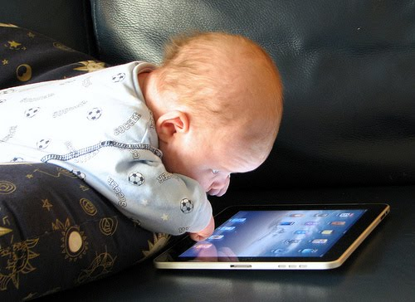

Slide 54
THANK YOU…
drmadhuranga@iihsciences.com

