Slide 1
Physical Development in Early Childhood
Dr. Madhuranga Agampody

Slide 2
Physical Development in Early Childhood
How Does a Young Child’s Body and Brain Grow and Change?
How Do Young Children’s Motor Skills Develop?
What Are Some Important Aspects of Young Children’s Health?

Slide 3
Body Growth and Change
Height and Weight:
Average child grows 6 – 7 cm and gains between 2.2 and 3.2 kgs a year during early childhood
Growth patterns affected by genetics, growth hormones, environmental factors
Boys gain muscle; girls gain fatty tissue
Growth Hormone Deficiency

Slide 4
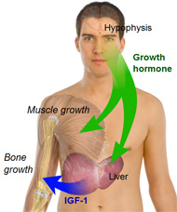
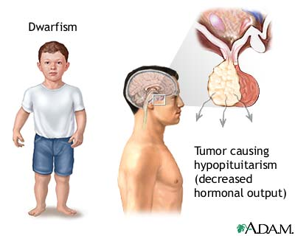
Growth Hormone Deficiency

Slide 5
The Brain
Brain and head: fastest growth in body
75% of adult size by age 3
90% of adult size by age 5
Neuronal Changes
Myelination: nerve cells insulated
3–6 age period: dopamine increase

Slide 6
The Brain
Structural Changes
Brain undergoes dramatic anatomical changes between ages of 3 and 15
Some areas almost double in size, purge of unneeded cells follows (up to age 4)
Frontal lobe growth (3–6 years of age)
Temporal and parietal lobes (6–puberty)

Slide 7
The Brain
The Brain and Cognitive Development
Neural networks: visual input is coded; output is language
Prefrontal cortex
Dopamine: key to information transmission
Important in self-control and other skills
Functioning mapped by diffusion tension imaging (DTI) – a variation of MRI

Slide 8
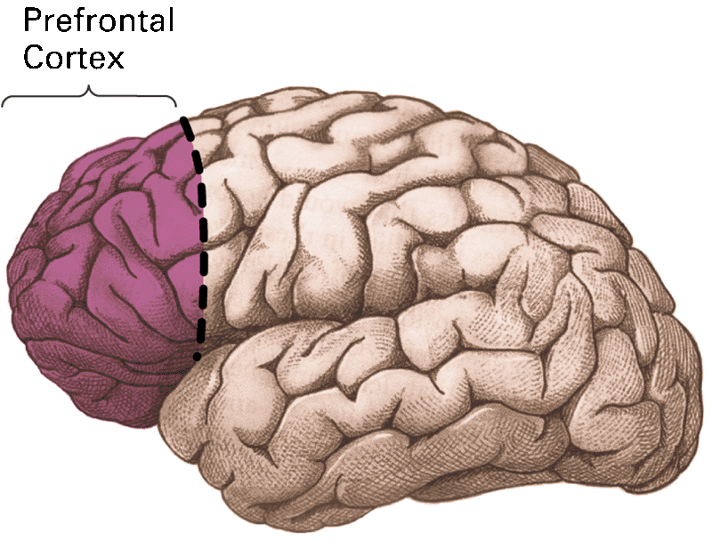
The Prefrontal Cortex
Prefrontal Cortex

Slide 9
Vision
Increases during early childhood years
Preschoolers are often far-sighted
Most can focus eyes by 1st grade
Vision problem signs
Appearance of eyes (redness, sores, tearing, drooping lids, etc.)
Should be screened, examined by age 3
Treatment before age 6 prevents loss

Slide 10
Gross and Fine Motor Skills
Preschooler: highest activity level of any age in the life span
Need daily exercise; good programs with creativity and free movement
Exercise increases physical and visual awareness

Slide 11
Gross Motor Skills
Age 3: Enjoys simple movements such as hopping, jumping, and running
Age 4: Becomes more adventurous and climbs
Age 5: Runs hard, is adventurous, tries hair-raising stunts in climbing

Slide 12
Fine Motor Skills
Age 3: Still emerging from infant ability to place and handle things
Age 4: Coordination improved and more precise
Age 5: Hand, arm, and body move together under better eye command

Slide 13
Development of Fine Motor Skills in Early Childhood
37 to 48 mos | 49 to 60 mos | 61 to 72 mos
Approximates a circle in drawing Cuts paper Pastes using pointer finger Builds 3-block bridge Builds 8-block tower Draws 0 and + Dresses and undresses doll Pours from pitcher without spilling | Strings and laces shoelace Cuts following a line Strings 10 beads Copies figure X Opens and places clothespins (one- handed) Builds a 5-block bridge Pours from various containers Prints first name | Folds paper in halves and quarters Traces around hand Draws rectangle, circle, square, triangle Cuts interior piece from paper Uses crayons appropriately Makes clay object with 2 small parts Reproduces letters Copies 2 short words

Slide 14
Assessing Motor Skills
Denver Developmental Screening Test
Used to diagnose developmental delay in children from birth to 6 years of age
Simple, inexpensive, fast
Includes gross and fine motor skills, language, and personal-social ability

Slide 15
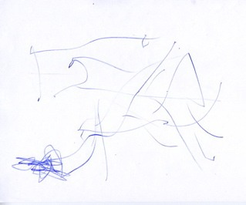
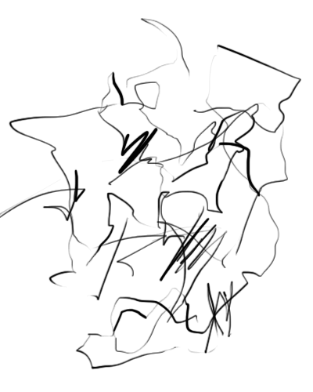
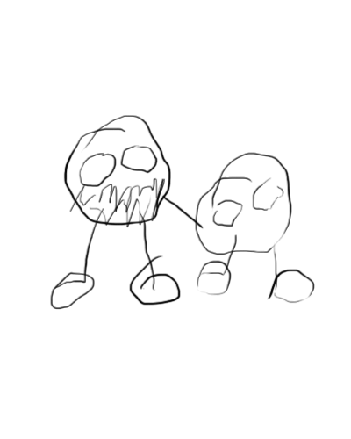
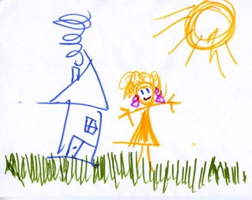
Stages of Young Children’s Artistic Development
Stage | Age | Progress
Placement Stage | 2–3 | Placement patterns
Shape Stage | 3 | Diagrams of 6 different shapes
Design Stage | 3–4 | Mix 2 basic shapes into more complex design
Pictorial Stage | 4–5 | Objects that adults recognize

Slide 16
Child Art in Context
Child art
Reflects inventive problem solving
Developmental changes depend on
Talent
Motivation
Familial support
Cultural values

Slide 17
Handedness
Origin and Development of Handedness
Genetic inheritance
Right-handedness dominant in all cultures
Hand preference may occur in womb
Many preschoolers use both hands; preference develops later

Slide 18
Handedness
Handedness, the Brain, and Language
Approximately 95% of right-handed individuals process speech primarily in left hemisphere
Left-handed individuals
Show more variation in processing
More likely to have reading problems

Slide 19
Handedness
Handedness and Other Abilities
Left-handers more common among
Mathematicians
Musicians
Architects
Artists

Slide 20
Sleep and Sleep Problems
Most young children sleep through night and have daytime nap
Transitional objects (bedtime companions)
Link between sleep and behavioral problems
Nightmares: frightening dreams
Night terrors: sudden arousal, intense
Somnambulism: sleep walking; most outgrow

Slide 21
Nutrition
Energy needs
Calorie needs increase with age
Needs vary by age, sex, and size
Dieting and eating behavior
Diets worsen as children age
Children need healthy, balanced diets
Fat and sugar consumption
Avoid excessive fat, sugars, fast foods

Slide 22
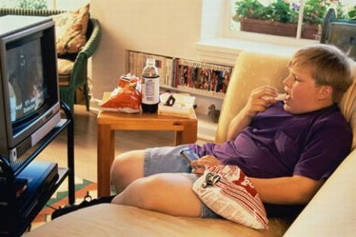
Nutrition
Allow child to develop tastes in food
Expose child to healthy food; limit sugar-based foods
Preschoolers
Healthy mid-morning snack recommended; avoid giving sweets for snacks

Slide 23
Nutrition
Overweight young children
Currently a serious health problem
Body mass index (BMI)
Increased dramatically in recent decades
Rates vary among ethnic groups
Prevention
Avoid using food as symbol of love or reward
Routine daily physical activity necessary

Slide 24
Nutrition
Malnutrition in Young Children from Low-Income Families
Poor nutrition linked to development
Nutritional supplement programs
May be linked to cognitive deficits
Underfed children tend to receive less supervision, stimulation, education
Linked to aggressive, hyperactive behavior

Slide 25
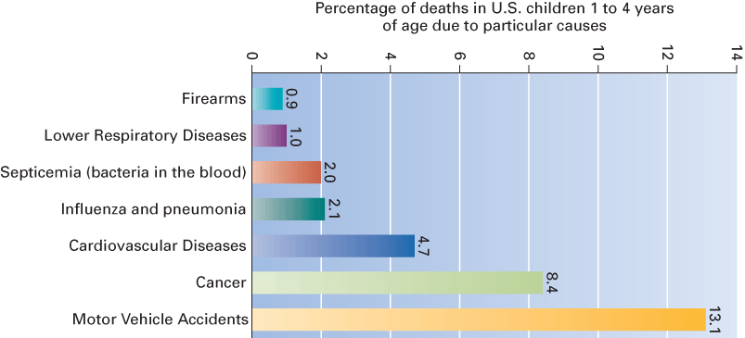
Main Causes of death in children 1-4 years of age

Slide 26
Illness and Death
Poverty and ethnicity
Poverty linked to health of young children
Many health problems begin before birth
Unsanitary conditions, crowded housing, inadequate supervision
Higher risk of exposure to lead poisoning
Inadequate medical insurance and care

Slide 27
Illness and Death
Safety at home and in child care
Caregivers have important role here
Vehicle safety
Tobacco use; Close monitoring of children
Keeping harmful products out of reach
Effective communication with child
Emotional support for children’s concerns
Use of effective parenting strategies

Slide 28
Illness and Death
The best parenting strategies with a chronically ill child
Balance illness with other family needs
Maintain clear family boundaries
Develop communication competence
Attribute positive meanings to situation
Engage in effective coping efforts

Slide 29
The State of Illness and Health of the World’s Children
UNICEF: Under-5 mortality rate causes
Nutritional health and health knowledge of mothers
Level of immunization
Dehydration
Availability of maternal and child health services
Income and food availability
Availability of clean water and safe sanitation
Overall safety of the child’s environment
Increase in HIV/AIDS

Slide 30
Cognitive Development in Early Childhood

Slide 31
Cognitive Development in Early Childhood
What Are the Three Views of the Cognitive Changes That Occur in Early Childhood?
How Do Young Children Develop Language?
What Are Some Important Features of Early Childhood Education?

Slide 32
Cognitive Changes
Piaget’s Preoperational Stage (2-7):
Children begin to represent the world with words, images, and drawings
Children form stable concepts and begin to reason
Cognitions are dominated by egocentrism and magical beliefs
Preoperational: child does not yet perform operations, or reversible mental actions
Children can only do mentally what they can do physically
Operations: internalized set of actions
Contains 2 substages: symbolic function and intuitive

Slide 33
Symbolic Function Stage
First sub stage of preoperational thought
Occurs about ages 2 to 4
Child gains ability to mentally represent an object not present
Drawings are imaginative
Thought still imperfect, not well organized

Slide 34
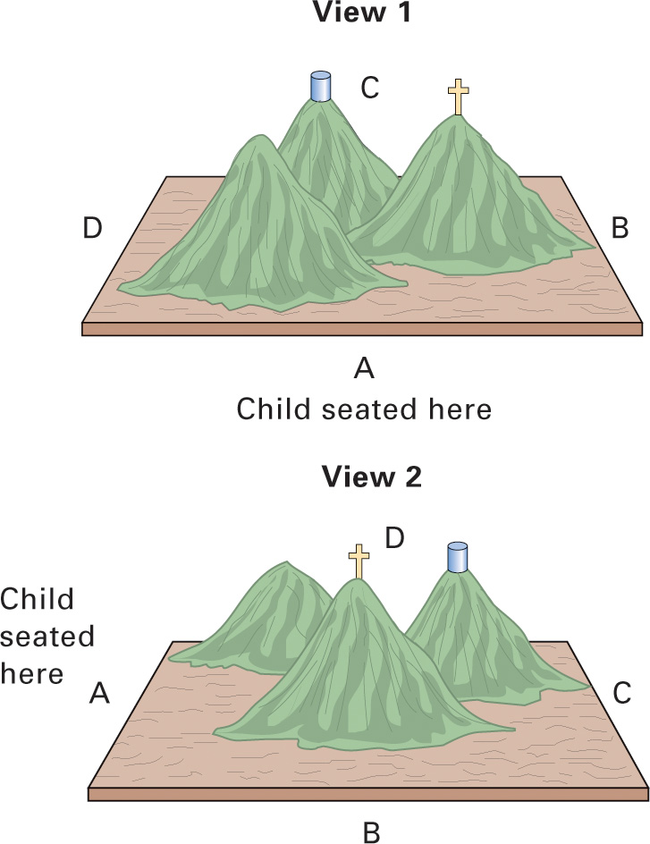
Two limitations on preoperational thought
Egocentrism: inability to distinguish between one’s own perspective and someone else’s (having or regarding the self or the individual as the center of all things)

Slide 35
Animism: belief that inanimate objects have lifelike qualities and are capable of action (the belief that natural objects have souls that may exist apart from their material bodies.)

Slide 36
Intuitive Thought Substage
Children begin to use primitive reasoning, seek answers to all sorts of questions
Occurs about 4 to 7 years of age
Limits of preoperational thought
Centration: focusing attention on one characteristic to the exclusion of all others
Conservation: realizes altering object’s substance does not change it quantitatively
Children may be able to conserve in one area but not another
Conservation may appear earlier than Piaget originally thought

Slide 37
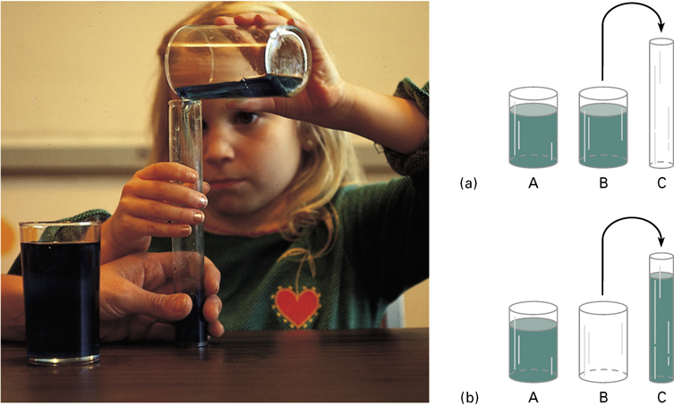

Slide 38
Some Dimensions of Conservation: Number, Matter, and Length
Type of conservation | Number | Matter | Length
Initial presentation | Two identical rows of objects shown to child | Two identical balls of clay shown to child | Two sticks are aligned in front of child
Manipulation | Child is asked which row has more objects | Experimenter changes shape of one ball | Experimenter moves one stick to right
Preoperational child’s answer | “Yes, the longer row” | “No, the longer one has more” | “No, the one on top is longer”

Slide 39
Vygotsky’s Theory of Development
Social constructionist approach
Children actively construct their knowledge and understanding
Ways of thinking, understanding develop primarily through social interaction
Cognitive development depends on tools provided by society
Minds shaped by cultural context

Slide 40
The Zone of Proximal Development (ZPD)
Range of tasks that are too difficult for the child alone but that can be learned with guidance
Lower limit: what child can achieve independently
Upper limit: what can be achieved with guidance and assistance of adults or more skilled children.
Captures child’s cognitive skills in process of maturing

Slide 41
Scaffolding and Dialogue
Scaffolding: changing level of support over course of teaching session to fit child’s current performance level
Dialogue
Guided participation: extend and support children’s understanding of skills

Slide 42
Language and Thought
Children use language to plan, guide, and monitor their behavior
All mental functions have social origins
Private speech (self-talk): early transition to be more socially communicative; used more when tasks are difficult

Slide 43
Teaching Strategies
Use child’s ZPD
Use more-skilled peers as teachers
Monitor and encourage private speech
Effectively assess the child’s ZPD
Place instruction in meaningful context
Transform classroom

Slide 45
Evaluating and Comparing Piaget’s and Vygotsky’s Theories
Both theories are constructivist
Vygotsky: emphasizes social opportunities for learning that Piaget ignores
Piaget: children construct knowledge by transforming, organizing, and reorganizing
Vygotsky overemphasized language; guidance has pitfalls
Both theories: teachers are facilitators

Slide 46
Information Processing
Emphasizes how individuals:
Manipulate information
Monitor information
Strategize about information

Slide 47
Attention
Attention ability
Greatly improves during preschool years
Deficits of child’s control of attention
Salient versus relevant (young children will pay attention to flashy, attractive stimuli even when it is not relevant)
Planfulness (young children do not tend to engage in systematic plans for analysis)
Child’s ability related to achievement-related skills and social skills

Slide 48
J
J
(a)
(b)

Slide 49
The Planfulness of Attention
J
J
(a)
(b)
In three pairs of houses, all windows were identical.
In three pairs of houses, the windows were different.
By filming the reflection in children’s eyes, one could determine what they looked at, how long they looked, and the sequence of their eye movements. Children under 6 were different from older children in this study.

Slide 50
Memory
Memory: retention of information over time
Implicit memory
allows people to remember how to tie their shoes or ride a bicycle without consciously thinking about these activities
Explicit memory comes in many forms
remembering the time of an appointment or recollecting an event from years ago
Short-term
Long term

Slide 51
Short-term memory
Up to 30 seconds without rehearsal
Span increases during early childhood
2 digits at ages 2 to 3
5 digits at age 7
Individual differences at different ages
Speed of repetition is powerful predictor of memory span

Slide 52
Developmental Changes in Memory Span
8
7
In one study: memory span increased from 3 digits at age 2 to 5 digits at age 7
6
5
Digit Span
4
3
2
1
0
2
4
6
8
10
12
Adults
Age (years)

Slide 53
How Accurate Are Young Children’s Long-Term Memories?
Young children remember large amount of information with appropriate cues and prompts
Age and individual differences linked to susceptibility
Children as eyewitnesses in court: accuracy affected by number of factors
There are individual differences in susceptibility
Low self-concept, low support from parents, and mothers’ insecure attachment in romantic relationships leads to increased suggestibility

Slide 54
Strategies and Problem Solving
Strategies – deliberate mental activities to improve processing information
Toddlers can learn a strategy
Early childhood: stimulus-driven changes to goal-directed problem solving
Some cognitive inflexibility in ages 3 to 4 due to lack of understanding

Slide 55
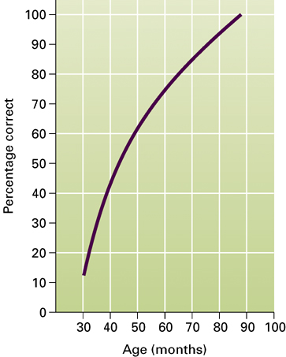
Theory of mind
Theory of Mind: awareness of one’s own mental process and the mental processes of others
Age 18 months – 3 years: children begin to understand three mental states — perceptions, desires, and emotions

Slide 56
Age 3 to 5: children understand false beliefs, and that people can be mistaken
Children demonstrate an inability to “think about thinking”
Potential problems with false belief studies

Slide 57
Theory of mind
Only beyond preschool years (5 to 7 years of age) do children have a deepening appreciation of the mind itself
In middle and late childhood
children understand beliefs are interpretive and that the mind is an active constructor of knowledge

Slide 58
In early adolescence
children begin to understand that people can have ambivalent feelings or experience conflicting feelings at the same time

Slide 59
Theory of mind
Gender Differences in Theory of Mind:
Some research suggests that girls understand false beliefs earlier than boys
Parents tend to discuss emotions more with daughters than with sons
Girls tend to have better overall language ability

Slide 60
Theory of Mind And Autism
Autism
Can be detected before age 3
Linked to genetics, brain abnormalities
Individual differences vary greatly
Autistic children have
Social interaction, communication problems
Difficulty developing theory of mind

Slide 61
Early Childhood Education
Child-centered kindergarten: focus on whole child; concern for child’s physical, cognitive, socioemotional development
Considers needs, interests, learning styles
Play is very important to total development
Montessori: cognitive skill emphasis
Considerable freedom and spontaneity to choose activities
Encourages self-regulation
Criticisms:
Deemphasizes verbal interaction
Restricts imaginative play

Slide 62
Developmentally Appropriate Practice
Focuses on typical child development within age span and uniqueness of each child
Age appropriateness
Individual appropriateness

Slide 63
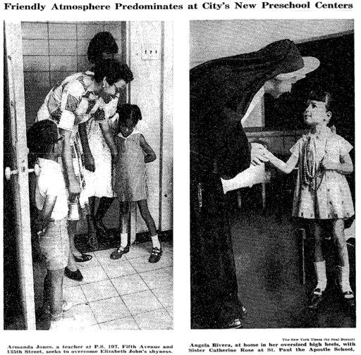
Diversity in Children’s Development
Japan
Some kindergartens attached to universities that have elementary, secondary schools
Culture: being a group member, not an individual
Teacher-centered education:
China, Thailand, Jamaica, Kenya, Turkey
Child-centered education:
Mexico, U.S., Singapore, Korea, Hong Kong

Slide 64
Socioemotional Development in Early Childhood

Slide 65
Socioemotional Development in Early Childhood
What Characterizes Young Children’s Socioemotional Development?
What Roles Do Families Play in Young Children’s Development?
How Are Peer Relations, Play, and Television Involved in Young Children’s Development?

Slide 66
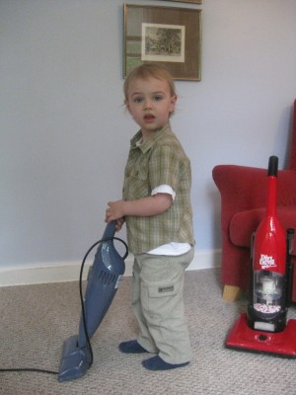
The Self
Initiative versus guilt
Third of Erikson’s eight stages ( others)
Initiative: enthusiasm for new activities; governed by conscience
Guilt: results when children’s efforts result in failure or criticism; lowers self-esteem
During early childhood, children must discover who they are
They often identify strongly with their parents
Children use their perceptual, motor, cognitive, and language skills to make things happen
Guilt can lower self-esteem

Slide 67
Self-Understanding
Child’s representation of self; substance and content of child’s self-conceptions
Self-recognition begins about 18 months
Young children view self in physical terms
Active dimension is central part of the self
Traits and emotions included by age 4 to 5

Slide 68
Emotional Development
Self-conscious (evaluative) emotions
Pride, shame, guilt, and embarrassment
First appear at about 2½ years
Pride and guilt more common
Heavily influenced by parents’ responses
Influenced by gender differences

Slide 69
Emotional Development
Parents play an important role in child’s emotional regulation
Emotion-coaching: parents monitor their child’s emotions, view them as opportunities for teaching, and coach them in how to deal with emotions effectively
Emotion-dismissing: parents view their role as to deny(to refuse to agree), ignore, or change negative emotions
Ability to manage one’s emotions is important in determining the success of a child’s peer relationships

Slide 70
Moral Development
Moral Development:
The development of thoughts, feelings, and behaviors regarding rules and conventions about what people should do in their interactions with other people

Slide 71
Moral Development
Moral Feelings:
Psychoanalytic theory emphasizes feelings of anxiety and guilt
Children identify with parents to reduce anxiety and avoid punishment
Other, more positive emotions contribute to child’s moral development
Example: empathy, which involves perspective-taking

Slide 72
Moral Development
Moral Reasoning (Piaget):
4 to 7: heteronomous morality
Justice and rules are unchangeable properties of the world
Behavior is judged based on its consequences only
Immanent justice: if a rule is broken, punishment will be given immediately
7 to 10: transitional phase
10 and older: autonomous morality
Rules and laws are created by people
Actions and intentions should be judged

Slide 73
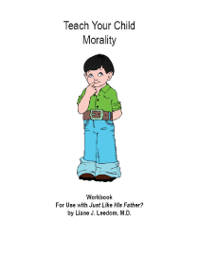
Moral Development
Parenting and Moral Development:
Research suggests that both parents and peers contribute to child’s moral maturity
Relational quality, parental discipline, proactive strategies, and conversational dialogue are particularly important
Parents should proactively avert potential misbehavior before it takes place
Use of diversions
Conversations about values and beliefs

Slide 74
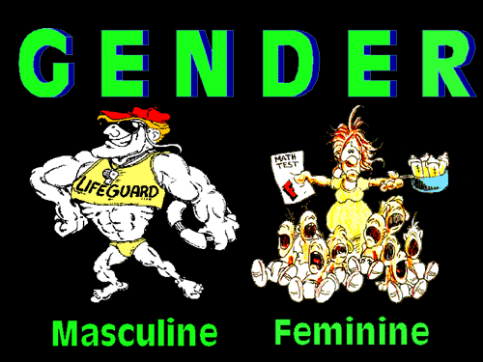

Slide 75
Gender
Social Theories of Gender:
Social Role Theory: gender differences result from the contrasting roles of women and men
Psychoanalytic Theory: the preschool child develops a sexual attraction to the opposite-sex parent

Slide 76
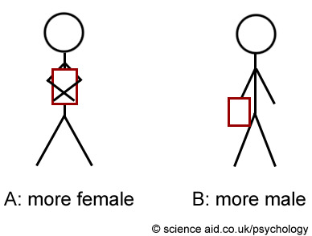
Gender
Social Cognitive Theory: gender development occurs through observing and imitating what other people say and do
Reward and punishment for gender-appropriate and gender-inappropriate behavior

Slide 77
Gender
Parental Influences:
Mother’s Socialization Strategies:
Mothers socialize daughters to be more obedient and responsible than sons
Mothers place more restrictions on daughters’ autonomy
Father’s Socialization Strategies:
Fathers show more attention to sons than daughters, engage in more activities with sons, and put more effort into promoting sons’ intellectual development

Slide 78
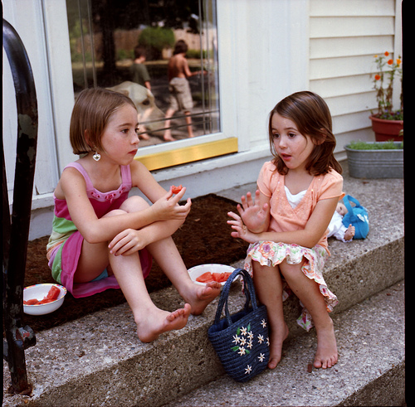
Gender
Peer Influences:
Peers extensively reward and punish gender behavior
Greater pressure for boys to conform to traditional gender roles
Children’s Groups:
Children show preference toward same-sex playmates by age 3
From age 5 onward, boys are more likely than girls to form large groups and participate in organized group games
Boys engage in rough play, competition, conflict, etc.
Girls engage in “collaborative discourse”(conversation)

Slide 79
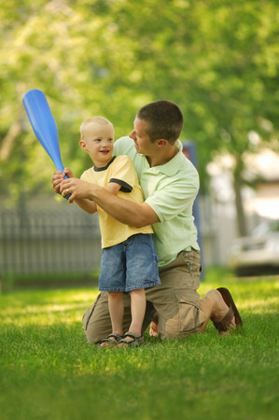
Gender
Cognitive Influences:
Social cognitive theory: gender develops through observation, imitation, rewards, and punishment
Gender schema theory: gender typing emerges as children develop gender schemas of appropriate and inappropriate behavior within their culture
Schema: network of associations that guide an individual’s perceptions
Gender schema: organizes the world in terms of male and female

Slide 80
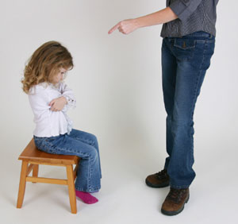
Parenting
Baumrind’s Parenting Styles:
Authoritarian: restrictive style in which parents demand obedience and respect
Parent places firm limits and does not allow discussion
Parent rigidly enforces rules but rarely explains them
Children are often unhappy, fearful, and anxious

Slide 81
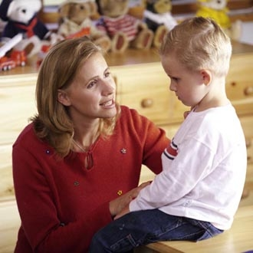
Authoritative: encourages children to be independent while placing limits and controls on actions
Extensive verbal give-and-take
Parents expect mature, independent, age-appropriate behavior
Children are often cheerful, self-controlled, and self-reliant

Slide 82
Parenting
Baumrind’s Parenting Styles (continued):
Neglectful: parent is very uninvolved in child’s life
Children feel that other aspects of the parent’s life are more important than they are
Children tend to be socially incompetent, immature, and have low self-esteem
Indulgent: parents are highly involved but place few demands or controls on the child
Children never learn to control their own behavior and always expect to get their way

Slide 83
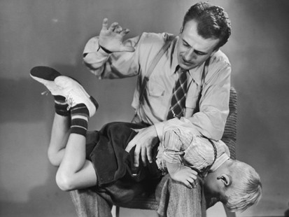
Parenting
Corporal Punishment:
Cross-culturally, U.S. and Canada are among those most favoring corporal punishment
Correlational research shows use of corporal punishment is:
Associated with higher levels of immediate compliance, aggression, and antisocial behavior in children
Associated with lower levels of moral internalization and mental health
Alternatives include use of time-outs, reasoning with child, positive reinforcement, loss of privileges

Slide 84
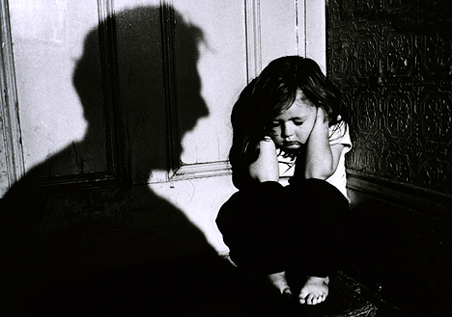
Child Maltreatment
Types of Child Maltreatment:
Physical abuse: infliction of physical injury
Child neglect: failure to provide for the child’s basic needs
Can be physical, educational, or emotional
Sexual abuse: fondling, rape, incest, intercourse, sodomy, exhibitionism, commercial exploitation
Emotional abuse: acts or omissions by caregivers that have caused, or could cause, serious behavioral, cognitive, or emotional problems

Slide 85
Child Maltreatment
Contributing factors:
Culture
Family
Developmental characteristics of child

Slide 86
Child Maltreatment
Developmental consequences of abuse:
Poor emotional regulation
Attachment problems
Difficulty in school and peer relations
Other psychological problems, such as depression and delinquency
Child victims show difficulty in establishing and maintaining healthy intimate relationships
Also display increased violence in adult relationships

Slide 87
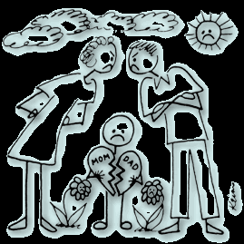
The Changing Family
Divorced Families:
Children from divorced families generally show poorer adjustment than children from intact families
Divorce can be advantageous if marital problems are affecting the well-being of the children
Conflict in non-divorced families is associated with emotional problems in children
Adjustment for children improves when parents’ relationship is harmonious and when they use authoritative parenting

Slide 88
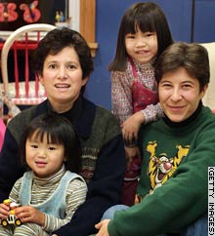
Child Risk and Vulnerability Factors:
Child’s adjustment prior to divorce
Child’s personality, temperament, and gender
Custody situation

Slide 89
The Changing Family
Gay Male and Lesbian Parents:
20% of lesbians and 10% of gay men are parents
Children may have born to their natural parents, now divorced (and with a gay partner), some through donor insemination and surrogates; some are adopted
Research has found no evidence that children growing up with lesbian mothers or gay fathers are any different from those living with heterosexual parents

Slide 90
The Changing Family
Cultural Variations:
Important cross-cultural variations in parenting
Many cultures are changing due to increased globalization
Trend toward greater distances between family members
Ethnic Variations:
Families within different ethnic groups differ in size, structure, composition, reliance on kinship networks, and levels of income and education
Large and extended families are more common among minority groups than among Whites
Single-parent families are more common among Blacks and Latinos than among Whites
Ethnic minority parents tend to be less educated and are more likely than Whites to live in low-income circumstances

Slide 91
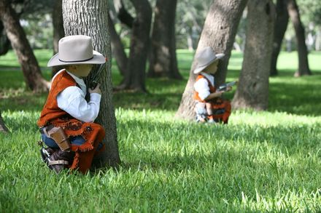
Play
Play: a pleasurable activity that is engaged in for its own sake
Theorists have focused on different aspects of play:
Freud and Erikson: play helps child master anxieties and conflicts
Play therapy
Piaget: play advances cognitive development; children’s cognitive development constrains the way they play
Vygotsky: play is an excellent setting for cognitive development

Slide 92
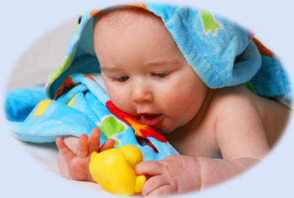
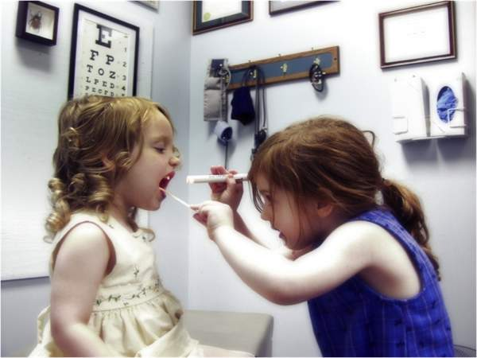
Play
Types of Play:
Sensorimotor play:
Behavior by infants to derive pleasure from exercising their sensorimotor schemes
Practice play:
The repetition of behavior when new skills are being learned or mastered
Pretense/symbolic play:
Occurs when the child transforms the physical environment into a symbol

Slide 93
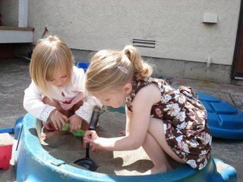
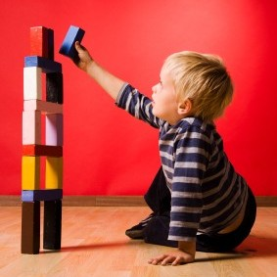
Play
Social play:
Play that involves interaction with peers
Constructive play:
Combines sensorimotor/practice play with symbolic representation
Games:
Activities that are engaged in for pleasure and have rules

Slide 94
Television
Children watch an average of 2–4 hours of television each day
Negative influence | Positive influence
Makes children passive learners | Presents motivating educational programs
Distracts them from homework | Increases information about the broader world
Teaches stereotypes | Provides models of prosocial behavior
Provides violent models of aggression
Presents an unrealistic view of the world

Slide 95
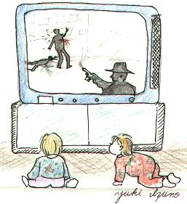
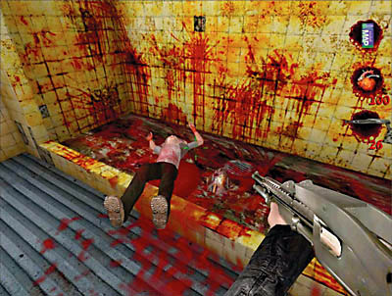
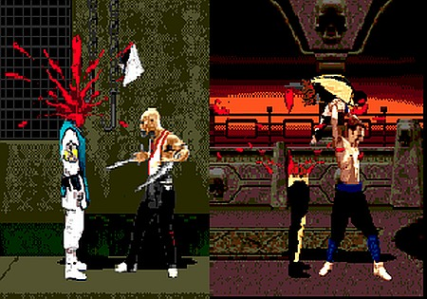
Television
Effects of Television on Children’s Aggression:
Research demonstrates that exposure to TV violence can cause increased aggression in children
Watching television violence as a child has been linked with aggression years later
Increased concern about realistic violent video games
Television can also teach children about positive, prosocial behavior

Slide 96
THANK YOU…
drmadhuranga@iihsciences.com

