Slide 1
Physical and Cognitive Development in Middle and Late Childhood

Slide 2
Body Growth and Change
Body Growth and Change:
Growth averages 5–7 cms per year
Weight gain averages 2.3–3.3 kgs each year
Muscle mass and strength gradually increase; baby fat decreases
Ossification of bones
Boys have a greater number of muscle cells and are typically stronger than girls

Slide 3
Body Growth and Change
The Brain:
Brain volume stabilizes
Significant changes in structures and regions occur, especially in the prefrontal cortex
Improved attention, reasoning, and cognitive control
Increases in cortical thickness
Activation of some brain areas increase while others decrease
Shift from larger areas to smaller, more focal areas
Due to synaptic pruning

Slide 4
Body Growth and Change
Motor Development:
Gross motor skills become smoother and more coordinated
Boys usually outperform girls on gross motor skills
Improvement of fine motor skills during middle and late childhood
Increased myelination of the central nervous system
Girls usually outperform boys on fine motor skills

Slide 5
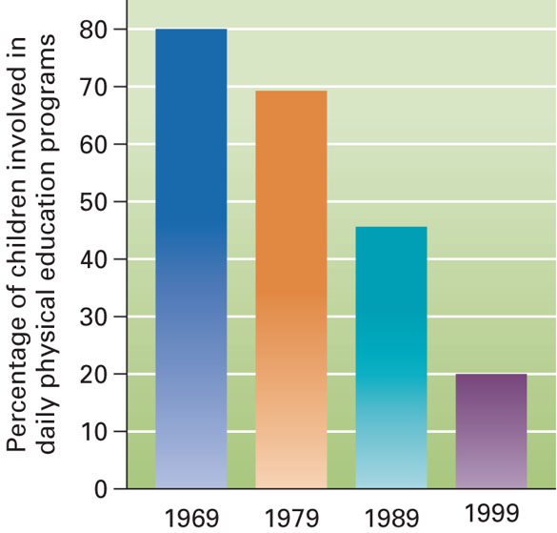
Exercise
Exercise plays an important role in children’s growth and development
Percentage of children involved in daily P.E. programs in schools decreased from 80% (1969) to 20% (1999)
Television watching is linked with low activity and obesity in children

Slide 6
Health, Illness, and Disease
Middle and late childhood is usually a time of excellent health
Injuries are the leading cause of death during middle and late childhood
Motor vehicle accidents are most common cause of severe injury
Cancer is the 2nd leading cause of death in children 5–14 years old
Most common child cancer is leukemia
Many elementary-school children already possess risk factors for cardiovascular disease

Slide 7
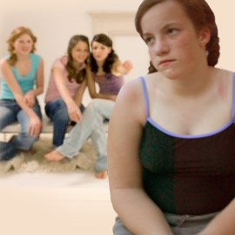
Health, Illness, and Disease
Overweight Children:
Being overweight as a child is a risk factor for being obese as an adult
Girls are more likely than boys to be overweight
Changes in diet and total caloric intake may be one reason for increasing obesity rates

Slide 8
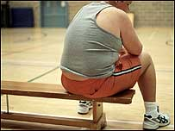
Raises risks for many medical and psychological problems
Pulmonary problems, diabetes, high blood pressure
Low self-esteem, depression, exclusion from peer groups

Slide 9
Learning Disabilities
Definition of learning disability includes three components:
Minimum IQ level
Significant difficulty in a school-related area
Exclusion of
Severe emotional disorders
Second-language background
Sensory disabilities
Specific neurological deficits

Slide 10
Boys are identified three times more frequently than girls
Most common form involves reading (i.e., dyslexia)

Slide 11
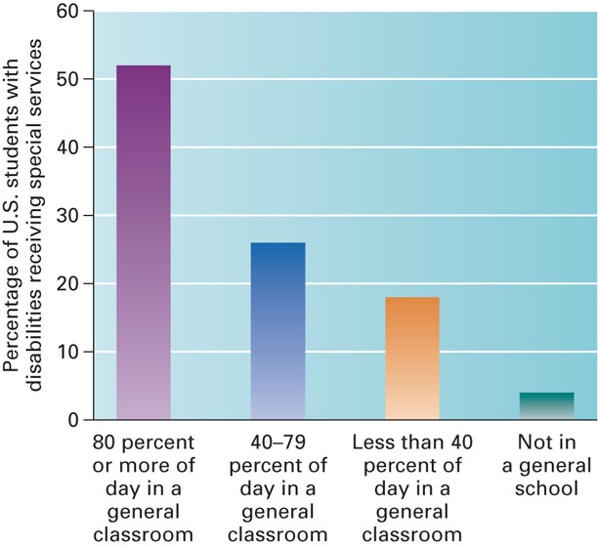

Slide 12
Learning Disabilities
Possible Causes:
Genetics (many tend to run in families)
Environmental influences
Problems in integrating information from multiple brain regions
Difficulties in brain structures and functions
Intervention:
Improving reading ability through intensive instruction

Slide 13
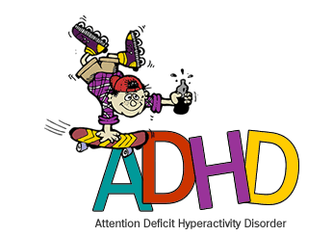
Learning Disabilities
ADHD
Characterized by
Inattention
Hyperactivity
Impulsivity
Number of children diagnosed has increased significantly

Slide 14
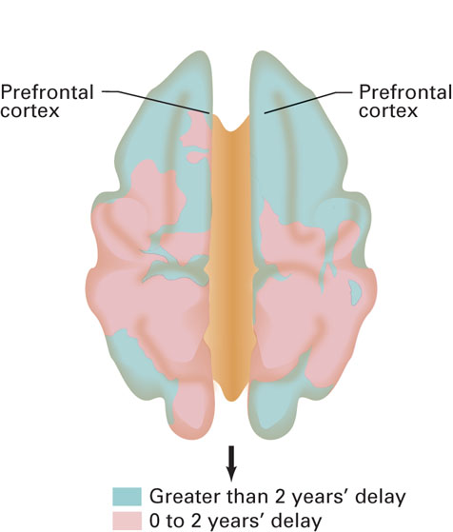
Possible Causes:
Genetics
Brain damage during prenatal or postnatal development
Cigarette and alcohol exposure during prenatal development
Later peak for cerebral cortex thickening

Slide 15
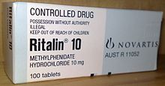
Learning Disabilities
ADHD Treatment:
Stimulant medication (Ritalin or Adderall) is helpful (methylphenidate)
Combination of medication and behavior management seems to work best
Exercise may reduce ADHD symptoms
Critics argue that physicians are too quick to prescribe medications

Slide 16
Learning Disabilities
Autism Spectrum Disorders
1 million American children
Ranging from
severe autistic disorder
milder Asperger syndrome
Detected as early as 1-3 years of age
Boys 4x likely to have the disorder
IQ range from MR to average and above average intelligence

Slide 17
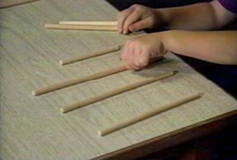
Cognitive Changes
Piaget’s Concrete Operational Stage:
Ages 7 to 11
Children can perform concrete operations and reason logically
Ability to classify things into different sets and consider their interrelationships

Slide 18
Concrete Operational Thought
Mental actions that allow the child to do mentally what was physically done before.
Concrete Operations are also mental actions that are reversible.
Example- The clay roll test

Slide 19
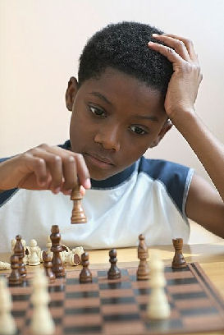
Memory
Memory:
Long-term memory increases with age during middle and late childhood
Influences how they organize, represent, and interpret information
Affects ability to remember, reason, and solve problems
Older children usually have more expertise about a subject than younger children do

Slide 20
Thinking
Critical Thinking:
Thinking reflectively and productively, and evaluating evidence
Is it functioning in the schools?
Open-mindedness
Intellectual curiosity
Planning and strategy
Intellectual carefulness

Slide 21
Creative Thinking:
The ability to think in novel and unusual ways, and to come up with unique solutions to problems
Convergent thinking: produces one correct answer
Divergent thinking: produces many different answers to the same question

Slide 22
Intelligence
Intelligence:
Intelligence is verble ability,
Problem-solving skills and the ability to learn from and adapt to life’s everyday experiences
Individual Differences:
Stable, consistent ways in which people are different from each other

Slide 23
Intelligence
Intelligence Tests:
Binet Tests: designed to identify children with difficulty learning in school
Mental age (MA): an individual’s level of mental development relative to others
Intelligence quotient (IQ): a person’s mental age divided by chronological age, multiplied by 100
Stanford-Binet Tests: revised version of the Binet test
Scores approximate a normal distribution—a bell-shaped curve
Wechsler Scales: give scores on several composite indices
Three versions for different age groups

Slide 24
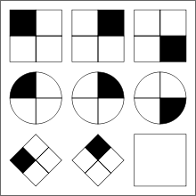
Intelligence quotient (IQ)

Slide 25
Intelligence quotient (IQ)
Binet Scale of Human Intelligence
IQ Score | Original Name | Modern Term
Over 140 | Genius or Near-Genius
120 - 139 | Very Superior
110 - 119 | Superior
90 - 109 | Average or Normal
80 - 89 | Dull | Dull Normal
70 - 79 | Borderline Deficiency | Mild
50 - 69 | Moron | Moderate
20 - 49 | Imbecile | Severe
Below 20 | Idiot | Profound

Slide 26
Intelligence
Types of Intelligence
Sternberg’s Triarchic Theory of Intelligence: intelligence comes in three forms:
Componential Intelligence:
Ability to analyze, judge, evaluate, compare, and contrast
Experiential intelligence:
Ability to create, design, invent, originate, and imagine
Contextual intelligence:
Ability to use, apply, implement, and put ideas into practice

Slide 27
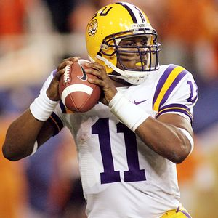
Intelligence
Types of Intelligence (continued):
Gardner’s Eight Frames of Mind:
Verbal: ability to think in words and use language to express meaning
Mathematical: ability to carry out mathematical operations
Spatial: ability to think three-dimensionally
Musical: sensitivity to pitch, melody, rhythm, and tone
Interpersonal: ability to understand and interact effectively with others
Intrapersonal: ability to understand oneself
Naturalist: ability to observe patterns in nature and understand natural and human-made systems

Slide 28
Differences in IQ Scores
Environmental Influences:
Communication of parents
Schooling
Flynn Effect: rapidly increasing IQ test scores around the world
Increasing levels of education attained by more people
Explosion of available information
Interventions designed to help children at risk for impoverished intelligence

Slide 29
Differences in IQ Scores
Group Differences:
On average, African American schoolchildren score 10 to 15 points lower on IQ tests than White American schoolchildren
Gap has begun to narrow as African Americans have gained social, economic, and educational opportunities

Slide 30
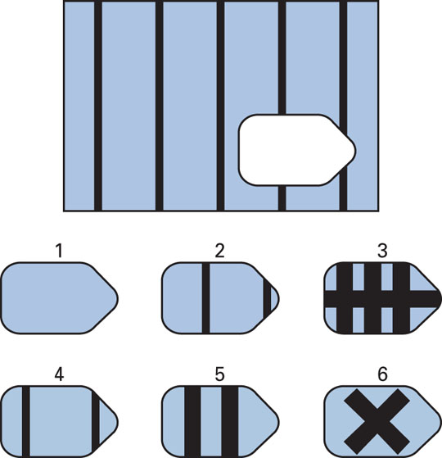
Differences in IQ Scores

Slide 31
Differences in IQ Scores
Extremes of Intelligence:
Mental Retardation:
A condition of limited mental ability in which an individual has a low IQ (typically below 70) and has difficulty adapting to everyday life
Can be mild, moderate, severe or profound
Mildly retarded makes up 85% of MR population
Can have an organic cause, or it can be social and cultural in origin

Slide 32
Intelligence (IQ) vs. Emotional Intelligence (EQ)
IQ is primarily used to measure one's cognitive abilities,
such as the ability to learn or understand new situations;
how to reason through a given problem/scenario;
the ability to apply knowledge to one's current situations.
It involves primarily the neo cortex or top portion of the brain.
EQ - A measure of one's emotional intelligence,
as defined by the ability to use both emotional and cognitive thought.
Emotional intelligence skills include but are not limited to empathy, intuition, creativity, flexibility, resilience, stress management, leadership, integrity, authenticity, intrapersonal skills and interpersonal skills.
It involves the lower and central sections of the brain, called the limbic system

Slide 33
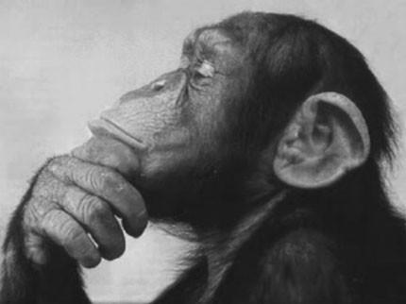
"It is not the strongest of the species that survives, nor the most intelligent, but the one most responsive to change." - Charles Darwin

Slide 34
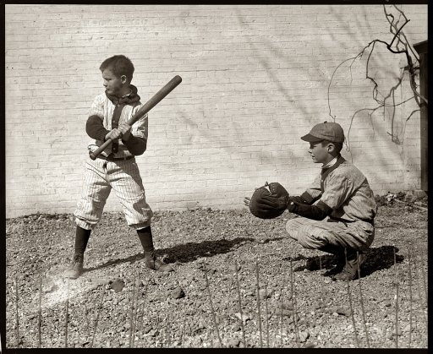
Socioemotional Development
in Middle and Late Childhood

Slide 35
The Self
Development of Self Understanding
During middle and late childhood:
Defining one’s “self” shifts from using external characteristics to using internal characteristics or personality traits.
Children recognize social aspects of the self.
Social comparison increases

Slide 36
The Self
Understanding Others
Children show an increase in perspective taking (ability to assume another persons point of view and understand their thoughts and feelings)
Especially important for the development of prosocial or antisocial attitudes and behavior
Children become increasingly skeptical of others’ claims ( having doubt)

Slide 37
The Self
Self Esteem:
Global evaluations of the self
Self Concept:
Domain-specific evaluations of the self
Beliefs about self esteem do not always match reality
Most studies about self esteem are correlation (cannot determine causation)

Slide 38
The Self
Children with high self esteem
Do not seem to perform better in school
Have greater initiative (can be positive or negative)
Are prone to both prosocial and antisocial actions

Slide 39
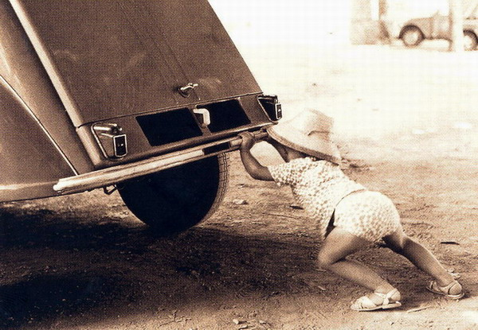
The Self
Four Ways to Improve Self Esteem
Identify causes of low self esteem
Provide emotional support and social approval
Help child achieve
Help child cope

Slide 40
The Self
Self Efficacy:
Belief that one can master a situation and produce favorable outcomes
Students with low self efficacy often avoid challenging
Self Regulation:
Increased capacity for self-regulation in middle and late childhood
Linked to development advances in the prefrontal cortex

Slide 41
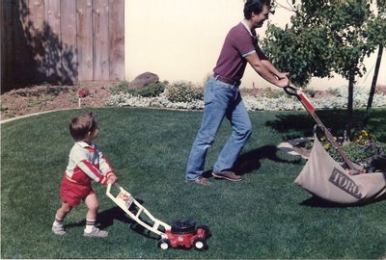
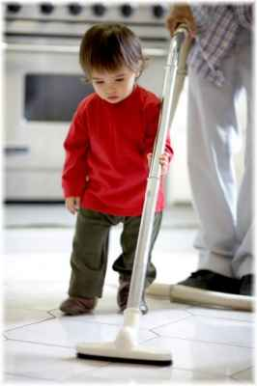
The Self
Industry vs. Inferiority (Erickson)
Industry:
Children become interested in how things work
Inferiority:
Parents who see their children’s efforts as mischief may encourage inferiority
School is very important in the development of a sense of industry

Slide 42
Emotional Development
Developmental Changes Include:
Improved emotional understanding
Increased understanding that more than one emotion can be experienced in a particular situation
Increased awareness of the events leading to emotional reactions
Ability to suppress or conceal negative emotional reactions
Use of self-initiated strategies for redirecting feelings
A capacity for genuine empathy

Slide 43
Emotional Development
Coping with Stress:
Older children utilize more coping strategies
Coping with stressful events:
Reassure children
Allow children to retell events
Encourage children to talk about feelings
Protect children from re-exposure
Help children make sense of what happened

Slide 44
Moral Development
Morality
The differentiation of
Intentions
Decisions, and
actions
between those that are good (or right) and those that are bad (or wrong).

Slide 45
Lawrence Kohlberg’s Theory
Punishment & obedience
Reward stage
Peer pressure stage
Law and Order by the legal order
People have own moral principles but willing to sit down and resolve discrepancies that other’s have
Dr. Martin Luther King, Jr. felt higher law than law of land, transcended higher law, willing to take risks because felt strong belief in ultimate moral principle

Slide 46
Moral Development
Lawrence Kohlberg’s Theory:
Extended Piaget’s basic theory
Proposed 6 universal states of moral development.
Developed stages based on interviews using moral dilemmas
Before age 9, most children use level 1
Most adolescents reason at stage 3
By early adulthood, a few use postconventional reasoning

Slide 47
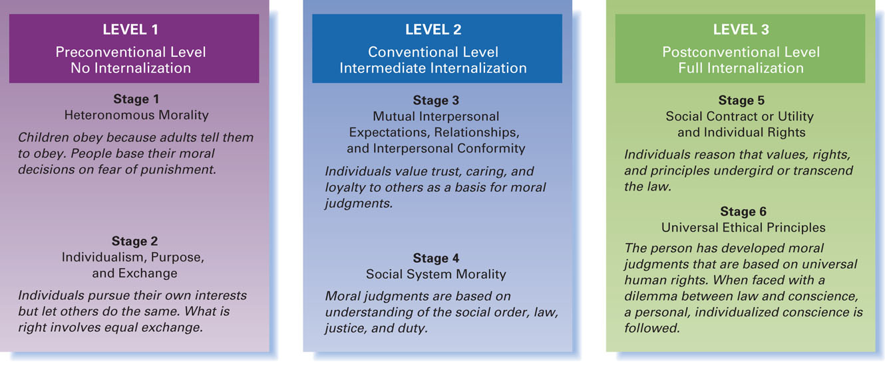
Moral Development
Notes:
Preconventional: immature stage
1 – punishment & obedience, difficult to reason with children & have to impose punishment for them to behave so they won’t do something detrimental – some adults stuck in this will behave when there’s a threat of punishment
2 - reward stage, children realize if they do something people will be good to them & kids will suck up to parents to get what they want, adults stuck in this stage will do what’s right if there’s something in it for them, not that it’s the right thing to do
3 – peer pressure stage, people concerned about instant gratification but by being accepted by social group or family, the in crowd, gang – people do what’s expected behavior deemed by the group as right or wrong (ex: manager skipped product testing even if it’s against the law)
4 – Law and Order by the legal order, if you behave according to law, your good, if not, you’re bad. I didn’t break the law, if I didn’t then I’m okay. Letting society at large deemed what’s good and bad.
5 – people have own moral principles but willing to sit down and resolve discrepancies that other’s have
6- Dr. Martin Luther King, Jr. felt higher law than law of land, transcended higher law, willing to take risks because felt strong belief in ultimate moral principle

Slide 48
Moral Development
Research on Kohlberg’s Theory:
Stage 1 and 2 use decrease with age
No 10 year olds (but 62% of 32 year olds) use level 4
Stage 5 did not appear until age 20 to 22
Stage 6 reasoning is very rare

Slide 49
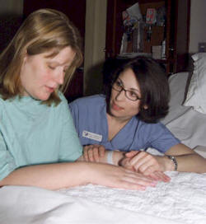
Criticisms of Kohlberg’s Theory
Kohlberg’s theory may reflect a gender bias (Carol Gilligan)
Kohlberg promotes a justice perspective
Gilligan argues for a caring perspective
Gilligan and colleagues found that women consistently interpret moral dilemmas differently than men
Experts now believe there is no evidence to support Gilligan’s claim

Slide 50
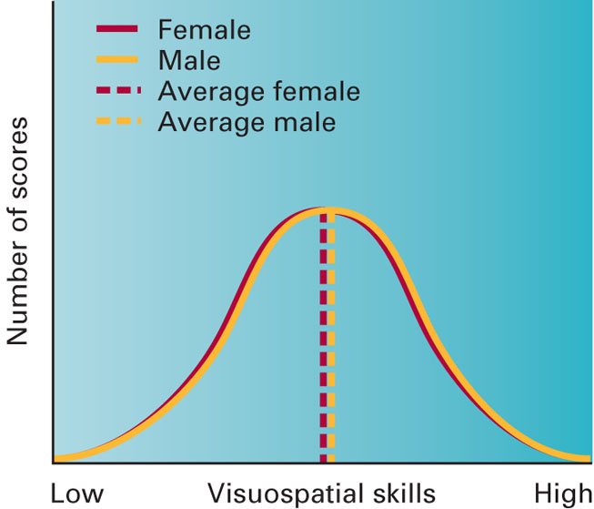
Gender - Cognitive Development
Men tend to have better math and visuospatial skills
(the ability to see and analyze objects in relation with their surroundings),
but difference are small
Females tend to perform better than males on reading and writings tasks

Slide 51
Gender - Socioemotional Development
Aggression:
Boys are more physically aggressive than girls
Girls show as much verbal aggression as boys
Girls engage in relational aggression
(harm is caused through damage to one’s relationships or social status) more often than physical aggression

Slide 52
Gender - Socioemotional Development
Emotion:
Girls admit to feeling
sadness
shame
guilt
boys tend to deny that they experience these emotions
Males show less emotional self-regulation
Prosocial Behavior:
Females engage in more prosocial behavior than males

Slide 53
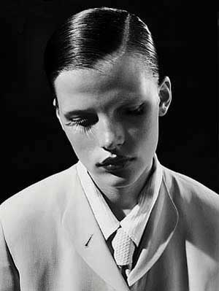
Gender Role Classification
Masculinity and femininity used to be described as a continuum
This view challenged by the concept of androgyny (presence of positive masculine and feminine traits in the same person)
Androgynous individuals are more
Flexible
Competent
mentally healthy

Slide 54
Peers
Positive relationships with peers are especially important in middle and late childhood
Developmental Changes:
Reciprocity (A mutual or cooperative interchange) becomes increasingly important in peer interchanges during elementary school
Size of peer group increases.
Peer interaction is less closely supervised by adults
Children’s preference for same-sex peer groups increases until about age 12

Slide 55
Peers
Popular Children:
Give out reinforcements
Listen carefully; maintain open lines of communication with peers
Are happy
Control their negative emotions
Show enthusiasm and concern for others
Are self confident without being conceited (Holding or characterized by an unduly high opinion of oneself)

Slide 56
Peers
Neglected Children:
Engage in low rates of peer interaction
Often described as shy

Slide 57
Rejected Children:
Often have more serious social adjustment problems than neglected children
Often find that rejection increases aggressive behavior over time
More impulsive
More emotionally reactive
Fewer social skills

Slide 58
Bullying
Aggressive behavior manifested by the use of force or coercion to affect others
Boys and younger middle school students are most likely to be affected
Child victims often tend to:
Be lonely and have difficulty making friends
Be anxious, socially withdrawn, aggressive
Child bullies often tend to:
Have low grades in school
Use alcohol and/or tobacco

Slide 59
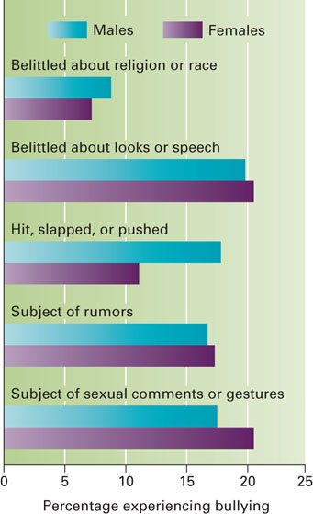
Bullying
Outcomes of bullying:
More likely to experience depression and attempt suicide
More health problems
Headaches
Dizziness
sleep problems
anxiety)

Slide 60
Friends
Children’s friendships are typically characterized by similarity
Six functions:
Companionship
Stimulation
Physical support
Ego support
Social comparison
Affection (love) and intimacy (involved in a sexual relationship

Slide 61
Schools
Constructivist Approach: learner-centered approach
emphasizes the importance of individuals actively constructing their own knowledge and understanding
Emphasis on collaboration and active learning
Direct-Instruction Approach: structured, teacher-centered approach
Teacher direction and control
High teacher expectations for students’ progress
Maximum time spent by students on academic tasks
Combination of both approaches may be best

Slide 62
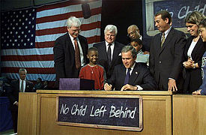
Schools
No Child Left Behind Legislation (2002):
That testing will:
Improve student performance
Encourage teachers to spend more time teaching the subjects that are tested
Raise expectations for students
Identify poorly performing schools, teachers, and administrators
Improve confidence in schools

Slide 63
QUESTIONS

Slide 64
Every forward step we take we leave some phantom of ourselves behind”
-JOHN LANCASTER SPALDING
American educator

Slide 65
THANK YOU…

