Slide 1
Mental Health Nursing
Introduction
Dr. Vidumini De Silva

Slide 2
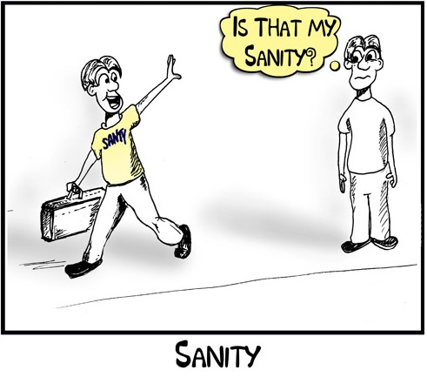

Slide 3
Objectives
What is mental health
Mental health problems
The role of the mental health nurse

Slide 4
Mental Health
The successful adaptation to stressors from the internal or external environment,
evidenced by thoughts, feelings, and behaviours that are age appropriate,
and congruent with local and cultural norms.

Slide 5
Mental Illness
Maladaptive responses to stressors from internal and external environment
evidenced by thoughts, feelings, and behaviours that are
incongruent with local and cultural norms and
Interfere with social, occupational, and/or physical functioning

Slide 6
Mental Health Problems

Slide 7
Mood disorders
Depressive disorder
Bipolar affective disorder

Slide 8
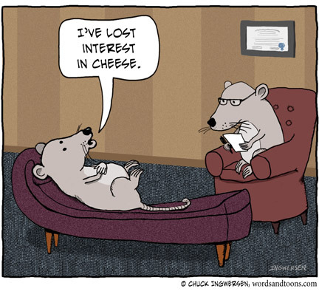
Depressive disorder

Slide 9
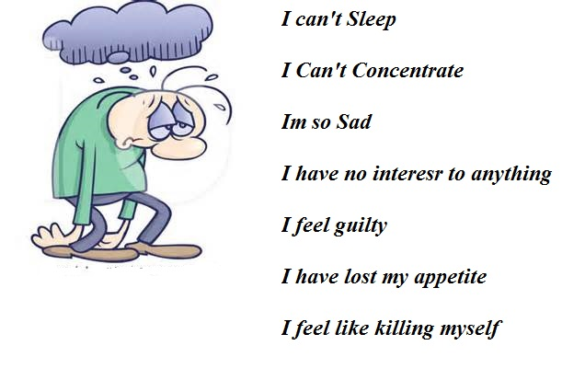

Slide 10
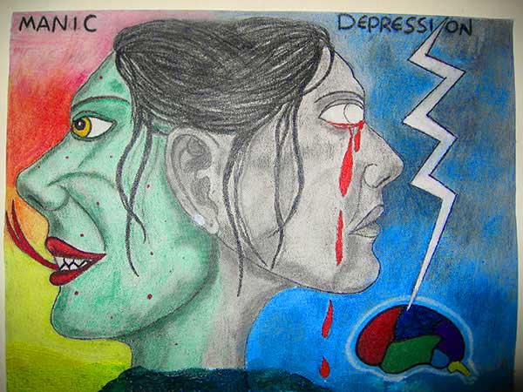
Bipolar affective disorder

Slide 11
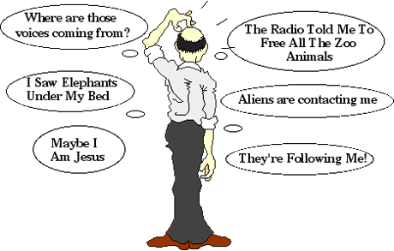
Schizophrenia

Slide 12
Deliberate self harm and suicide

Slide 13
Substance Abuse

Slide 14
Eating Disorders

Slide 15
Anxiety Disorders

Slide 16
Child psychiatry

Slide 17
Dementia

Slide 18
The role of the mental health nurse
Concentration
Identification
Confidentiality
Assist in ECT, and other procedures
Exercise : What else?

Slide 19
Assignment
21 yr old girl complaints of feeling sad and guilty, lack of interest and states that she will commit suicide.
What would you do?

Slide 20
Thank You!

