Slide 1
Mood Disorders
Dr. Vidumini De Silva

Slide 2
Depression - Lowering of mood
Mania - Heightening of mood

Slide 3
Bipolar Affective Disorder

Slide 4
About B.A.D.
1. Epidemiology
Lifetime risk 0.3% - 1.5%
2. Can be interpreted in various ways
Cultural beliefs
3. Serious consequences
STD
Unwanted pregnancy
Financial ruin
Substance misuse
4. Treatable

Slide 5
Psychological syndrome
Physical Diseases
Normal Experience

Slide 6
Exercise 03
Key terms
- mania
- depression
- neurotransmitters
- suicidal ideation
- cycling
- cyclothymia
- hypomania

Slide 7
Clinical features
Mania
Inattention
Risky behaviour
Impulsivity
Increased energy
Decreased sleep
Talkativeness
Racing thoughts
Grandiosity
Elated mood

Slide 9
Depression
Refer previous slides

Slide 12
MSE
Appearance and behaviour
Brightly coloured clothes
Severe – untidy
poor self care
dishevelled
Sexually inappropriate behaviour
Disinhibited
Reckless

Slide 13
MOOD
Elated
Cheerful
Optimistic
Irritable
Lability of mood

Slide 15
Speech
Increased rate and amount
Flight of ideas
Thought
Expansive ideas
Delusions - Grandiose
Persecutory

Slide 16
Hallucinations
Auditory
Visual
Insight
- impaired
- do not realize they have an illness
- therefore difficult to treat

Slide 17
Aetiology of mania
Genetic – 1st degree relatives risk of B.A.D. is 10%
Biochemical imbalances – excess serotonin
etc/increased intracellular Na+, Ca2+ / defective
feedback mechanism in limbic system
Precipitating factors - recent life events
eg: bereavement

Slide 18
Excersice 04
- List 12 Nursing Diagnoses for BAD

Slide 19
Course and Prognosis
Onset - commonly between 15 and 30 years but can occur at any age
Recurring course.

Slide 20
Average duration – 4 to 5 months
90% of patients experience a further affective episode

Slide 21
Therapeutic Nursing Management
Safe environment
Psychological treatment –
individual/group/family therapy
3. Pharmacological treatment
4. ECT
5. Assess improving of symptoms

Slide 22
Nursing Interventions
Discuss on below topics,
Assessing
Environmental wise
patient family education
With regard to drugs – administration etc
Monitoring
Risk assessment

Slide 23
MCQs
The nurse understands that the best explanation for involuntary admission for psychiatric treatment is that:
A psychiatrist has determined the client’s behavior is irrational
the client exhibits behaviour that is a threat to either the client or to society.
The client is unable to manage the affairs necessary for daily life
the client has broken a law

Slide 24
Depressive
Disorder

Slide 25
Overview
Introduction
Clinical Features
Aetiology
Course and prognosis
What’s your management

Slide 26
Depression
A persistent pervasive feeling of emptiness or hopelessness,
resulting in a loss of interest in every thing that once gave a person pleasure.
It is not the occasional low mood or sadness in response to a loss.

Slide 27
Aetiology

Slide 28
Genetic
- 15% more chance if a blood relation is affected
Environmental Factors
Childhood stressful events
Life events - 6x
Climate, decreased light

Slide 30
Personality
Eg Anxious, Obsessional
Vulnerability factors
No job
Having no one to confide with
having 3 or more children less than 14 years
loss of mother before the age of 11yrs

Slide 31
Other Psychological Causes
Schizophrenia, OCD, Substance Abuse
Low self esteem, unresolved grief

Slide 32
Illnesses associated with Depression
Thyroid disorder - esp. hypothyroidism
Diabetes mellitus
Addison’s disease, Renal Failure
Carcinoma
Systemic lupus erythematosus
Neurological disorders eg. Parkinsonism
Cushing’s disease
Infections
*post partum

Slide 33
Drugs
- beta blockers
- methyldopa
- calcium channel blockers
- cimetidine
- oral contraceptive pills
- corticosteroids
- L-dopa

Slide 34
Other Risk Factors
Gender – Females more
Age - <40yrs
Marital status – Single
Biochemical factors – deficiency of serotonin, Ach, norepinephrine

Slide 35
Specific Mental Illness
As an associated feature of psychological
Ill health
Part or a response to a physical illness
Part of day to day
Experience

Slide 36
Clinical features
1. Low mood:
- misery.
- It does not improve in pleasant company
or when hearing good news.
- hopelessness, helplessness
- tearful, crying
2. Lack of enjoyment:
No enthusiasm for activities and hobbies
that were normally enjoyed.

Slide 37
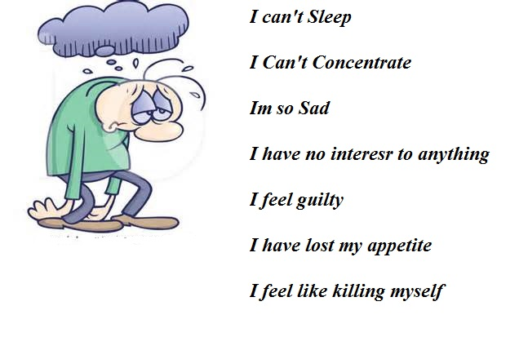

Slide 39
3. Reduced energy:
The person finds every thing an effort.
4. Pessimistic thinking:
Sees the unhappy side of every event.
The past - Guilt + Self blame
The present - a failure
The future - expects the worst.
Foresees the ruin of his finances and misfortune for his family.

Slide 40
Concentrating difficulties
Self destructive behaviour or harm others

Slide 41
Biological symptoms
Sleep disturbance - early morning awakening
- delay in falling asleep
Loss of appetite
Loss of weight
Constipation
Loss of libido
Amenorrhoea
Decreased personal hygiene

Slide 42
Psychiatric symptoms
Anxiety
Depersonalization
Obsessional symptoms
Phobias eg. Social
Dissociative state eg. Paralysis of a limb
Poor memory ( pseudo-dementia )

Slide 43
Assessment
Hx. MSE, physical Ex – Refer notes on Mental Health Assessment
Ix – Na+, K+, Mg+, TSH levels
Nutritional Assesment
Assess behaviour with regard to suicidal ideation

Slide 44
Exercise 01
List 25 Nursing diagnoses for depression

Slide 45
Therapeutic Nursing Management
Safe environment – specially in severe depression, suicidal ideation

Slide 46
2. Psychological environment
CBT
Individual psychotherapy
Behavioural therapy
Social skills training
Self monitoring
Behavioural contracts
Read
up

Slide 47
3. Social treatment
- Milieu therapy
- Family therapy
- Group therapy
What do you mean by these terms?

Slide 48
Treatment
Antidepressants
ECT
Psychosocial therapy ( family, marital therapies and supportive psychotherapy)
Cognitive therapy
Interpersonnal therapy

Slide 49
Exercise 02
List the nursing interventions with regard to a patient with depressive disorder.
Include complications, impact on others, outcome assessments, advices etc.

Slide 50
Thank You!

