Slide 1
Physical and Cognitive Development in Early Adulthood

Slide 2
Becoming an Adult
Emerging Adulthood: the transition from adolescence to adulthood
Occurs from approximately 18 to 25 years of age
Characterized by experimentation and exploration
Key Features:
Identity exploration, especially in love and work
Instability
Self-focused
Feeling isolated
The age of possibilities, a time when individuals have an opportunity to transform their lives

Slide 3
Becoming an Adult
Three Characteristics of “Late-Bloomers”:
A person whose talents or capabilities are not visible to others until later than usual
Support by adults
Being playful
Showing positive aspects of autonomy
Markers of Becoming an Adult:
Holding a more or less permanent, full-time job
Economic independence
Taking responsibility for oneself
Different criteria in other countries
Marriage
Notes:
Turning point for late bloomers: military service, marriage & romance, higher education, religion, work

Slide 4
Becoming an Adult
Assets linked to well-being during transition to adulthood:
Intellectual: academic success, ability to plan, good decision-making skills
Psychological: mental health, motivation, confidence, identity, values, community contributions
Social: connectedness to others through friendship and positive peer relations

Slide 5
Becoming an Adult
Negative aspects of high school to college transition:
Top-dog phenomenon
Movement to a larger, more unfriendly school structure
Increased focus on achievement and assessment

Slide 6
Positive aspects of transition:
More likely to feel grown up
More subjects from which to select
More time to spend with peers
More opportunities to explore different lifestyles and values
Greater independence from parental monitoring
Intellectual challenges

Slide 7
Physical Development
Physical Performance and Development:
Peak physical performance typically occurs before the age of 30
Different types of athletes reach their peak performances at different ages
Muscle tone and strength usually begin to show signs of decline around age 30

Slide 8
Health:
Young adults have more than twice the mortality rate of adolescents
Few chronic health problems (respiratory problems)
Most college students know what behaviors will prevent illness and promote health, but many of them do not apply this information

Slide 9
Eating and Weight
Obesity:
Prevalence of obesity in adults is increasing
Linked to increased risk of hypertension, diabetes, and cardiovascular disease
Factors Involved in Obesity:
Heredity
Leptin: a protein involved in feeling full, antiobesity hormone
Environmental factor: great availability of fatty food, physical activity
Dieting:
As obesity rises, dieting is an obsession for many
1/3 to 2/3 of dieters regain more weight than they lost on their diets
Most effective programs include exercise
Diets can place the dieter at risk for other health problems
Yo-yo dieting (a repeated cycle of weight loss followed by weight gain)

Slide 10
Substance Abuse
Individuals in college are less likely to use drugs
Exception: alcohol
Alcohol:
Binge drinking: http://www.youtube.com/watch?v=QwkL0tyeee4
A usually brief period or bout of excessive alcohol consumption.
Often increases in college
More common among men than women (125% increase in binge drinking)
Binge drinking peaks at about 21 to 22 years of age and then declines
Increases risk of having unprotected sex, falling behind in school, and driving drunk

Slide 11
Alcoholism
A disorder that involves long-term, repeated, uncontrolled, compulsive, and excessive use of alcoholic beverages
Impairs the drinker’s health and social relationships
One in nine of those who drink becomes an alcoholic
Family studies consistently reveal a high frequency of alcoholism in the first-degree relatives of alcoholics
Environmental factors play a role
By age 65: 1/3 rule
1/3 are dead or in terrible shape
1/3 have recovered
1/3 are still trying to beat their addiction

Slide 12
Sexuality
During emerging adulthood, most individuals are both sexually active and unmarried
Patterns of Heterosexual Behavior:
Males have more casual sex partners, while females report being more selective
60% have had sexual intercourse with only 1 individual in the last year
25% report having sexual intercourse only a couple of times a year or not at all
Casual sex is more common in emerging adulthood than in young adulthood
Notes:
Key Findings from 1994 Sex in America Survey:
Americans tend to fall into three categories:
1/3 have sex twice a week or more
1/3 a few times a month
1/3 a few times a year or not at all
Married (and cohabiting) couples have sex more often than non-cohabiting couples
Most Americans do not engage in kinky sexual acts
Adultery is the exception rather than the rule
Men think about sex far more often than women do

Slide 13
Sexuality
Sources of Sexual Orientation
Possible biological basis of same-sex relations:
Sexual orientation does not change when gay men are given male sex hormones (androgens)
Possible exposure to female hormones during 2nd to 5th month after conception
Area of hypothalamus that governs sexual behavior is twice as large in heterosexual males as in gay males
Most likely determined by a combination of genetic, hormonal, cognitive, and environmental factors
Notes:
Sources of Sexual Orientation
Many people view sexual orientation as a continuum from exclusive male–female relations to exclusive same-sex relations (with bisexuality in the middle)
All people have similar physiological responses during sexual arousal
Higher prevalence of mental disorders in lesbians, gay men, and bisexuals
Due to stress associated with stigma
Homosexuality was once considered a mental disorder, but the classification was discontinued in the 1970s

Slide 14
Sexuality
Sexually Transmitted Infections (STIs): diseases contracted primarily through sex
Affect about 1 of every 6 U.S. adults
AIDS has had a greater impact than any other:
HIV destroys the body’s immune system
Leads to AIDS (acquired immune deficiency syndrome)
Greatest concern is in Africa and Asia
Strategies to Protect Yourself:
Knowing your and your partner’s risk status
Obtaining medical examinations
Having protected, not unprotected, sex
Not having sex with multiple partners

Slide 15
Cognitive Development
Piaget’s View:
Adolescents and adults think qualitatively in the same way (formal operational stage)
Young adults are more quantitatively advanced because they have more knowledge than adolescents
Some developmentalists theorize that individuals strengthen their formal operational thinking during adulthood
Many adults do not think in formal operational ways at all
Realistic and Pragmatic (practical) Thinking:
Some believe that as adults face the constraints of reality, their impracticality decreases
Adults progress beyond adolescence in their use of intellect
Switch from acquiring knowledge to applying knowledge

Slide 16
Cognitive Development
Reflective(deep) and Relativistic Thinking:
Adults move away from absolutist (The acceptance of or belief in absolute principles in political, philosophical, ethical, or theological matters) dualistic thinking in favor of reflective, relativistic thinking
Key aspects of cognitive development in emerging adulthood include:
Deciding on a particular world view
Recognizing that the world view is subjective
Understanding that diverse world views should be acknowledged
Some theorists have proposed a fifth cognitive stage: Postformal Thought
Notes:
Adults view world less in terms of polarities, right/wrong, we/they, good/bad – as they become aware of diverse opinions of others
Some theorists have proposed a fifth cognitive stage: Postformal Thought
Involves understanding that the correct answer to a problem requires reflective thinking and can vary from one situation to another
The search for truth is often an ongoing, never-ending process
Solutions to problems need to be realistic
Emotion and subjective factors can influence thinking
Young adults are more likely to engage in this postformal thinking than adolescents are
Research has yet to document that postformal thought is a qualitatively more advanced stage than formal operational thought

Slide 17
Postformal Thought
Involves understanding that the correct answer to a problem requires reflective thinking and can vary from one situation to another
The search for truth is often an ongoing, never-ending process
Solutions to problems need to be realistic
Emotion and subjective factors can influence thinking
Young adults are more likely to engage in this postformal thinking than adolescents are
Research has yet to document that postformal thought is a qualitatively more advanced stage than formal operational thought

Slide 18
Careers and Work
From mid-twenties on, individuals often seek to establish their emerging career in a particular field
It is important to be knowledgeable about different fields and companies
80% of U.S. undergraduate college students worked during the 1999-2000 academic year
Notes:
http://www.acenet.edu/AM/Template.cfm?template=/CM/ContentDisplay.cfm&ContentFileID=1618

Slide 19
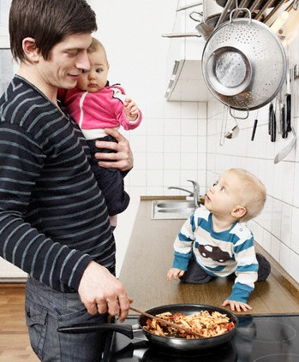
Careers and Work
Dual-Earner Couples:
Sometimes difficult to find a balance between work and the rest of life
Recent research suggests that:
U.S. husbands are taking increased responsibility for maintaining the home
U.S. women are taking increased responsibility for breadwinning
U.S. men are showing greater interest in their families and parenting

Slide 20
Socioemotional Development in Early Adulthood

Slide 21
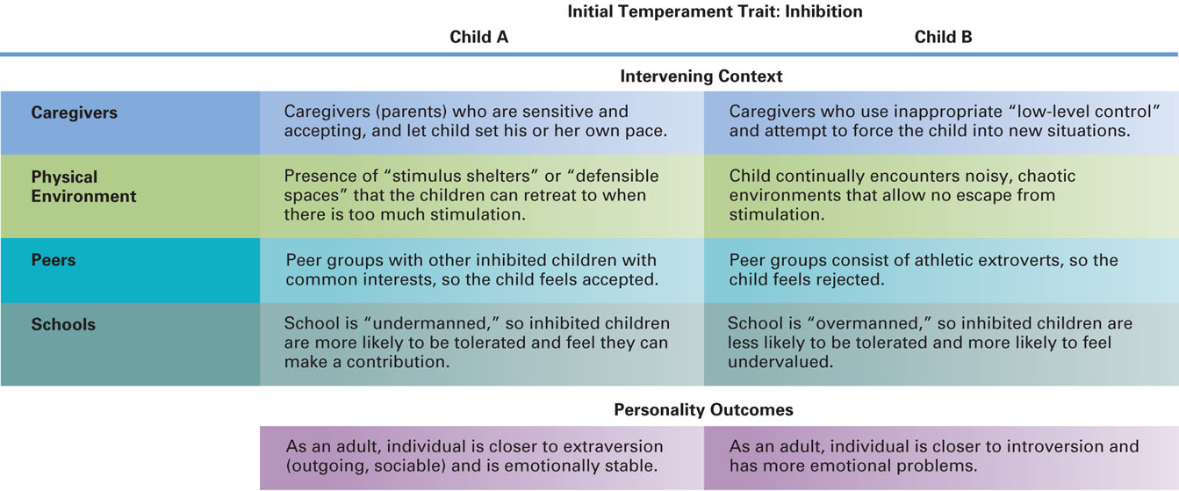
Temperament
Researchers have linked several dimensions of childhood temperament with characteristics of adult personality
Easy and difficult temperaments
Inhibition (embarresment)
Ability to control one’s emotions
Link between childhood & adult temperament may depend on the environment
Notes:
Boys with difficult temperament more likely to drop out of school, girls more likely to have marital conflict.

Slide 22
Attachment
long-term relationships between humans
Romantic partners fulfill some of the same needs for adults as parents do for children
Adults may count on their romantic partners to be a secure base
Childhood attachment is linked with adult attachment in romantic relationships
Link can be narrowed by stressful and disruptive experiences

Slide 23
Attachment
Adult Attachment Styles:
Secure Adults:
Have a positive view of relationships and find it easy to get close to others
Are not overly concerned with or stressed out about romantic relationships
Tend to enjoy sexuality in the context of a committed relationship
Avoidant Adults:
Are hesitant about getting involved in romantic relationships
Tend to distance themselves from their partner
Anxious Adults:
Demand closeness; are less trusting
Are more emotional, jealous, and selfish

Slide 24
Attachment
Benefits of Secure Attachment:
They have a well-integrated sense of self-acceptance, self-esteem, and self-efficacy
They have the ability to control their emotions, are optimistic, and are resilient
They activate cognitive representations of security, are mindful of what is happening around them, and mobilize effective coping strategies
Attachment insecurity places couples at risk for relationship problems

Slide 25
Attraction
What Motivates Attraction?
Familiarity is necessary for a close relationship
People seek others who are similar to themselves, but opposites do attract in certain instances
Consensual Validation: our own attitudes and values are supported when someone else’s are similar to ours
Physical attractiveness is important, but the link is not clear-cut
Standards of what is attractive change over time and across cultures
Matching Hypothesis: we tend to choose partners who match our own level of attractiveness
Notes:
Consensual validation: like to be around people whose attitudes we can predict, be around people who enjoy doing the same things as you.
Attraction: women look for traits like honesty, kindness, understanding, and earning prospects & men look prefer good looks, cooking skills & frugality
Matching hypothesis not applicable to couples once married. More attractive husbands were less satisfied, spouses were positive if wife was more attractive.

Slide 26
The Faces of Love
Intimacy:
Self-disclosure and the sharing of private thoughts are hallmarks of intimacy
Erikson: Intimacy vs. Isolation
Intimacy should occur after one is well into establishing a stable and successful identity
Failure to achieve intimacy results in social isolation
Intimacy and Independence:
Balance between intimacy and commitment, and independence and freedom
Young adults who have not sufficiently moved away from parental ties may have difficulty in interpersonal relationships and a career

Slide 27
Friendship
Gender Differences in Friendships:
Women have more friends than men; female friendships involve more self-disclosure and exchange of mutual support
Women’s relationships are characterized by depth and breadth
Men tend to engage in activities, especially outdoors
Men share useful information but keep a distance
Men are less likely to share weaknesses; they seek practical solutions to their problems rather than sympathy
Male relationships are more aggressive
Notes:
Friendship is important throughout the life span
Friendship provides people with:
Companionship
Intimacy/affection
Support
Source of self-esteem
Adult friends usually come from the same age group
Cross-gender friendships are more common among adults than among elementary school children
Can provide both opportunities and problems
Learning more about common feelings and interests
Acquiring knowledge and understanding of beliefs and activities of the other gender
Different expectations
Unclear sexual boundaries

Slide 28
Love
Types of Love
Romantic love: also called passionate love
Strong components of sexuality and passion
Different emotions: anger, fear, passion, sexual desire, joy, jealousy
Affectionate love: also called companionate love
Based on a deep and caring affection
Passion tends to give way to affection
Consummate love: the strongest form of love
Notes:
Affectionate Love: with time, sexual attraction lessens & lovers find themselves bored, disappointed, lonely, hostile or distressed. Pattern among people married for many years.

Slide 29
Sternberg’s Triangular Theory of Love:
Triangle with three main dimensions:
Passion: physical and sexual attraction to another
Intimacy: emotional feelings of warmth, closeness, and sharing
Commitment: cognitive appraisal of the relationship and the intent to maintain the relationship even in the face of problems
3 types of love combine to form these patterns of love

Slide 30
Adult Life Styles
Single Adults:
Dramatic rise in the last 30 years
Associated with many myths and stereotypes
“swinging single” to “desperately lonely, suicidal”
Common problems:
Forming close relationships with other adults
Confronting loneliness
Finding a place in a society that is marriage-oriented
Advantages:
Having time to make decisions about one’s life
Freedom to make autonomous decisions and pursue one’s own schedule and interests
Opportunities to explore new places and try out new things
Privacy

Slide 31
Adult Life Styles
Cohabiting Adults:
Live together and have a sexual relationship without being married.
Percentage has increased in recent years
Some couples choose to cohabit permanently, rather than get married
Relationships between cohabiting men and women tend to be more equal than those between husbands and wives
Problems:
Disapproval by parents and other family members
Difficulty with legal and financial issues
Notes:
Cohabiting Adults (continued):
Research suggests either no difference or worse outlook for couples who cohabit before marriage
Timing seems to be key: couples who cohabited only after being engaged had better marital outcomes
May be a selection effect: people who are likely to cohabit may be less conventional and may not believe in marriage in the first place
May be that cohabiting changes people’s attitudes and habits in ways that increase their likelihood of divorce

Slide 32
Adult Life Styles
Marital Trends:
Marriage rates have declined in recent years
Marriage in adolescence is more likely to end in divorce
Average duration of marriage in the U.S. is just over nine years
Percentage of married persons who said they were “very happy” declined from 1970s to 1990s, but recently began to increase
Men report being happier in marriage than women

Slide 33
Adult Life Styles
Contexts within a culture and across cultures are powerful influences on marriage
Communication is rated as a relatively severe problem in most marriages, but it is most severe in high-income households
Drugs and infidelity are more severe problems in low-income households
Cultural variations in ideal mates, role of religion, etc.
Notes:
Premarital Education:
Premarital education can improve the quality of marriage and reduce the chances of divorce
Recommended to begin 6 months to 1 year before marriage
Benefits of a Good Marriage:
Happily married people live longer, healthier lives
Less physical and emotional stress

Slide 34
Adult Life Styles
Divorce:
Divorce rates have increased dramatically in all socioeconomic groups, from 2% in 1950 to 10% in 2002
Some groups have a higher incidence of divorce:
Youthful marriage
Low educational level
Low income level
Not having a religious affiliation
Having divorced parents
Having a baby before marriage
Divorce typically occurs within the 5th to the 10th year of marriage
Divorced men and women complain of loneliness, lowered self-esteem, anxiety about unknowns, and difficulty forming new close relationships

Slide 35
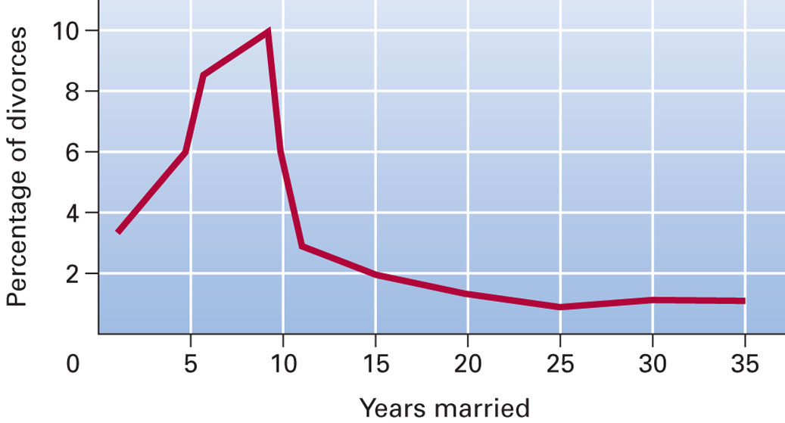
Dealing with Divorce
After a Divorce:
Difficulty in trusting someone else in a romantic relationship
Remarried Adults:
Most adults remarry within four years after divorce
Stepfamilies come in many sizes and forms
Remarried adults are more likely to have higher levels of depressive symptoms than adults in intact, never-divorced families
Many remarry not for love but for financial reasons, help in rearing children, and to reduce loneliness

Slide 36
Becoming a Parent
Parenting Myths and Reality:
Myths:
The birth of a child will save a failing marriage
The child will think, feel, and behave like the parents did in their childhood
Having a child gives the parents a “second chance” at achievement
Parenting is an nature and requires no training

Slide 37
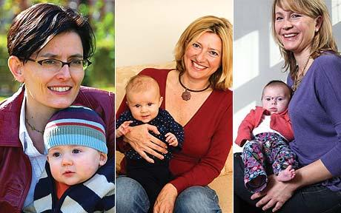
Becoming a Parent
Parenting Trends in the U.S. Today:
The age at which individuals have children is increasing
As birth control is common practice, many consciously choose when they will have children, and how many
The number of one-child families is increasing
Women are having fewer children and are working outside the home more
Fathers are increasing their participation in household tasks
There is widespread institutional childcare (day care)
Women are becoming mothers later life, a large number after they are 35 years of age

Slide 38
Becoming a Parent
Advantages of Having Children Early:
Parents are likely to have more physical energy
Mother is likely to have fewer medical problems with pregnancy and childbirth
Parents may be less likely to build up expectations for their children
Advantages of Having Children Later:
Parents will have had more time to consider life goals
Parents will be more mature and will benefit from their life experiences
Parents will be better established in their careers and typically have more income

Slide 39
Gender and Communication
Differences in Communication:
Problems come in part from differences in preferred ways of communicating
Research by Deborah Tannen:
Women prefer rapport talk: the language of conversation; a way of establishing connections and negotiating relationships
Men prefer report talk: designed to give information, which includes public speaking

Slide 40
Women’s Development
Women place high value on relationships and focus on nurturing connections with others
A large part of women’s lives is spent actively participating in the development of others
It is important for women to maintain their competency in relationships but to also be self-motivated
Critics argue that this view is too stereotypical

Slide 41
Men’s Development
Pleck’s role-strain view: male roles are opposing and unpredictable
Men experience stress when they violate men’s roles and when they act in accord with men’s roles
Men experience considerable stress in:
Health
Male-female relationships
Male-male relationships

Slide 42
Men’s Development
Involves becoming more “emotionally intelligent”
Becoming more emotionally self-aware
Managing emotions more effectively
Reading emotions better
Being motivated to improve close relationships

Slide 43
THANK YOU…

