Slide 1
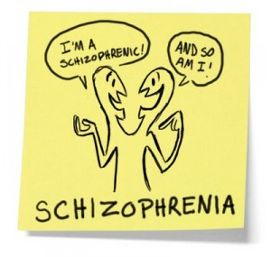
Dr. Vidumini De Silva

Slide 2
Objectives
What is schizophrenia
Clinical features
Nursing Management

Slide 3
Psychiatric disorders
Neurotic Disorders
Psychotic Disorders

Slide 4
Psychosis
Manic Depressive Psychosis
Dementia

Slide 5
Schizophrenia –
splitting of the mind

Slide 6
Epidemiology
1. Incidence : 0.1 – 0.5 per 1000
2. Life time risk : 7 – 9 per 1000
3. Male = females

Slide 7
Aetiology
Congenital
Gestational damage
Hypoxia
Exposure to viruses
Prenatal malnutrition
Problems during birth

Slide 8
Genetic
10 percent of people have a first-degree relative with the disorder, such as a parent, brother, or sister.
Dopamine activity peaks in teen to 20’s
Increased stress levels stimulate cortisol secretion which increase excessive dopamine release → schizophrenia

Slide 9
Problems during brain development before birth may lead to faulty connections
Problem may not show up in a person until puberty
The brain undergoes major changes during puberty, and these changes could trigger psychotic symptoms.

Slide 10
Clinical Features
Major symptoms
1. Delusions
2. Hallucination
3. Interference with thinking

Slide 11
What is a delusion ?
A belief that is,
- firmly held on inadequate grounds,
- is not affected by rational arguments and evidence to the contrary,
- and is not explained by the patient’s educational and cultural background.

Slide 12
Suspicious
Everybody is working
against me
There is a plot to kill me !
There are international
spies following me !
Persecutory delusion

Slide 13
Types of delusions seen in Schizophrenia
Persecutory delusions
Delusions of reference
Delusions of control - passivity
Delusions about the possession of thought
Thought insertion
Thought withdrawal
Thought broadcasting

Slide 14
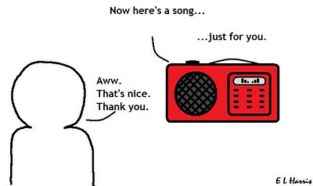
Delusion of reference

Slide 15
Delusions of control - passivity

Slide 16
What is a hallucination ?
A percept without an external stimulus to the sense organs
and with a similar quality to a true percept.
Hallucinations can occur in any sensory modality.

Slide 17
hallucinations
I WILL KILL YOU !
You are a fool !!

Slide 18
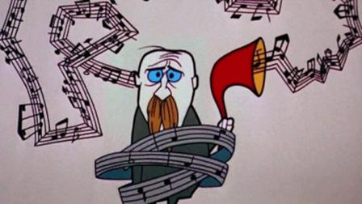
Types of hallucinations in Schizophrenia
Auditory Hallucinations

Slide 19
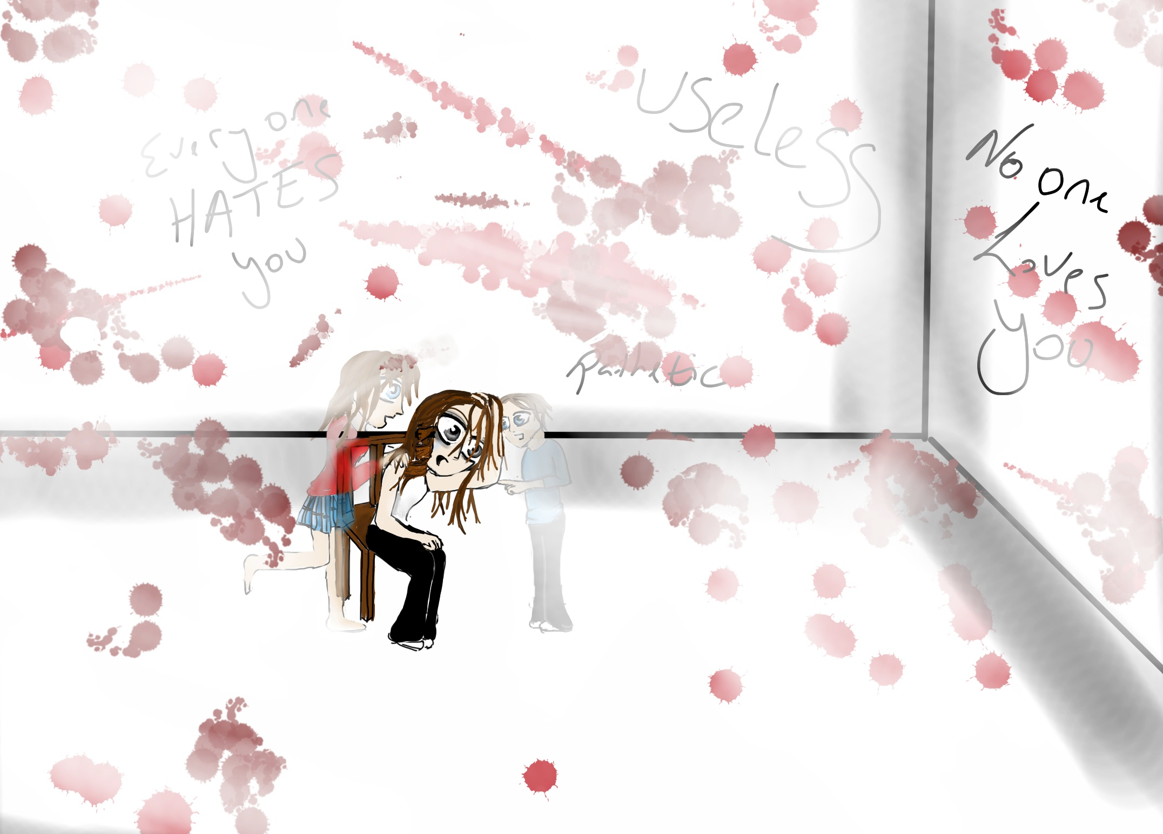
2. Visual hallucinations

Slide 20
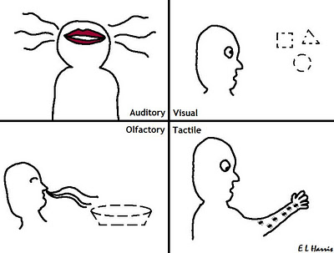
3. Gustatory hallucinations
4. Olfactory hallucinations
5. Tactile and Somatic hallucinations

Slide 21
Interference with thinking
Loosening of association
Poverty of thought
Thought blocking
Concrete thinking

Slide 22
Other features..
Impairment in social and occupational functioning
Poor self care
Harming behaviour – to themselves/others
Impaired communication –
- loosening of associations
- neologisms
- tangentiality

Slide 23
5. Disturbances in emotion – apathy
6. Depression too can oocur
7. Echolalia
8. Echopraxia
9. Flight of ideas

Slide 25
10. Positive symptoms – appear 1st. Symptoms are,
Anxiety
Bizzare behaviour
Delusions and hallucinations
Aggressiveness
Somatic complaints
Suspiciousness
Incoherence, word salad, pressured and poverty of speech

Slide 26
11. Negative symptoms
- motor retardation
- anhedonia – absence of pleasure
- cognitive defects
- social withdrawal/isolalation
- lack of thoughts
- blunted affect

Slide 27
Abnormalities of the mood
Blunting of affect
Incongruity of affect
Insight : impaired

Slide 29
Assessment of the patient
Hx. MSE, physical Ex – Refer notes on Mental Health Assessment
Ix – Na+, K+, Mg+, TSH levels
Nutritional Assessment – sp. in (-) symptoms
Assess behaviour with regard to suicidal ideation

Slide 30
Assessment guidelines
Good rapport
Do when patient is after medication, rest
Don’t directly confront

Slide 31
Exercise 01
List 10 nursing diagnoses for schizophrenia

Slide 32
Therapeutic Nursing Management
Safe environment – specially in severe depression, suicidal ideation
Limiting stimuli – calm environment

Slide 33
3. Psychological environment
Individual psychotherapy
Behavioural therapy
Social skills training
Self monitoring
Behavioural contracts
Read
up

Slide 34
3. Social treatment
- Milieu therapy
- Family therapy
- Group therapy
What do you mean by these terms?

Slide 35
Treatment
Antipsychotics – S/E -> parkinsonism
ECT
Psychosocial therapy ( family, marital therapies and supportive psychotherapy)

Slide 36
What is the prognosis of schizophrenia ?
1/5 – acute illness with complete recovery
1/5 – recurrent acute episodes
3/5 – chronic illness with acute episodes
1/10 commit suicide

Slide 37
Exercise 02
List the nursing interventions with regard to a patient with Schizophrenia.
Include complications, impact on others, patient and family education, outcome assessments, etc.
Types of schizophrenia

Slide 38
Delusional disorder
A single delusion or an encapsulated delusional system
No impairment of other mental functions
Can go on working
Maintain normal social life

Slide 39
Delusions can be persecutory
grandiose
hypochondriachal
erotic
concerned with jealousy
appearance

Slide 40
Pathological Jealousy ( Morbid jealousy )
Delusion regarding infidelity of spouse
Commoner in males

Slide 41
Clinical Features
Delusion about partner’s fidelity
Maybe accompanied by the belief that the wife is plotting against him
to poison him
to take away sexual capacities
to infect him with a STD
Intense seeking for evidence

Slide 42
Repeated cross questioning
Violent quarrelling
False confessions
Worsens the condition

Slide 43
Risk of violence !
Homicide
Suicide

Slide 44
Aetiology
- Can be associated with a primary disorder
schizophrenia
depressive disorder
personality disorder
alcoholism
organic disorders – infection
neoplasm
metabolic
endocrine
- Low self esteem
- Sexual disorders / erectile dysfunction

Slide 45
Management
Treat underlying psychiatric illness
Psychotherapy - allow ventilation
Behaviour modification
Admit if risk of violence
Geographical separation

Slide 46
Erotic delusions ( De Clerambault’s syndrome )

Slide 47
Usually seen in females - usually single
Firmly believes that a famous person is in love with her
Can be associated with schizophrenia

Slide 48
Treatment
Antipsychotic medication

Slide 49
Thank you !

