Slide 1
Perioperative Nursing
NADEEKA JAYASINGHE (ccrn, Aust).
MEDICAL AND NURSING iv, nur 124.
Session 1.

Slide 2
Housekeeping
Breaks
Mobile phones
Contact
Email: najaysinghe311@gmail.com
Please provide your email address on the paper provided. All communication will be done via email and VLE.

Slide 3
Session Content
Types of surgery
Types of incisions
Informed consent
Surgical risk factors and preventative strategies
Instruments in an operating room

Slide 4
Types Of Surgery
Diagnostic: To determine cause of symptoms
(Biopsy, exploratory laparotomy)
Curative / Ablative : To remove diseased tissue
(Appendectomy)
Restorative: To restore function of organ
To strengthen weakened areas (Hernioraphy)

Slide 5
Types Of Surgery
To correct deformities (repair of cleft lips and palate
To rejoin a separate part (bone pinning)
Palliative : To relieve symptoms without curing the disease
(Sympathectomy)
Cosmetic: To improve appearance
(Rhinplasty)

Slide 6
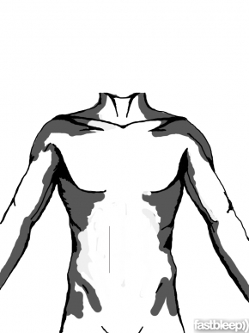
Types Of Incisions (refer to handout)
VERTICAL INCISION 1: Midline Incision
VERTICAL INCISION 2: Paramedian Incision
VERTICAL INCISION 3: Mayo Robson Incision

Slide 7
Types Of Incisions
4. TRANSVERSE INCISION 1: Transverse Incision
5. TRANSEVERSE INCISION 2: Subcostal incision
6. TRANSVERSE INCISION 3: McBurney’s incision and the Lanz Incision
7. TRANSVERSE INCISION 4: Pfannensteil Incision

Slide 8
Types of Incisions
8. Oblique Incision
9. Laparoscopic Incision

Slide 9
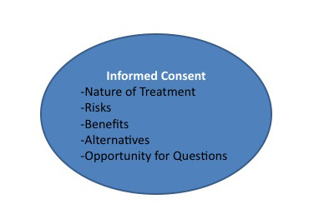
Informed Consent

Slide 10
Informed Consent
Legal document – signifies that the client is giving consent for the procedure
Guards the client against unwanted invasive procedures
Protects the health care facility and health care professionals

Slide 11
Informed Consent
The client requires a full explanation of the operation and must understand the procedure before signing the document.
Potential risks, complications and disfigurements, anesthesia should be discussed.
Ensure the patient receives an honest, accurate, fair statement of what to expect during and after surgery.
Adults can sign their permit unless they are unconscious or mentally incompetent. In such cases, a relative or guardian can sign it.
A child’s parent or legal guardian must sign for children under the age.

Slide 12
Informed Consent
Once the record is signed it becomes a permanent part of the client’s record. Make sure it accompanies the patient to the operating room.

Slide 13
SURGICAL RISK FACTORS
SYSTEMIC FACTORS
Hypovolemia, Dehydration, electrolyte imbalances, Nutritional deficits, Extremes of age and weight, Infection and sepsis, Toxic Condition, Immunological abnormalities, Pulmonary disease, Renal disease, Pregnancy, Diminshed maternal physiological reserve,
SYSTEMIC FACTORS

Slide 14
SURGICAL RISK FACTORS
Coronary artery disease, heart failure failure, dysarrhythmias, hypertension, prosthetic heart valve, thromboembolism, hemorrhagic disorders, cerebrovascular disease
CARDIOVASCULAR DISEASE

Slide 15
SURGICAL RISK FACTORS
ENDOCRINE DYSFUNCTION
Diabetes Mellitus, Adrenal Conditions, Thyroid Malfunction

Slide 16
SURGICAL RISK FACTORS
Hepatic Disease, Cirrhosis
Hepatic Disease

Slide 17
Group Task
List diagnostics and preventative strategies that can be used to mitigate the risk factors for surgery.

Slide 18
Instruments Used In OT
Watch video: NURSES ROCK: OPERATING ROOM BASIC INSTRUMENTS
https://www.youtube.com/watch?v=jTSHmcme7yM

Slide 19
SESSION SUMMARY
You are now able to:
List types of surgeries
Identify and differentiate different incision sites
Discuss what points must be highlighted when a patient consents to a procedure
Discuss the risk factors and relating preventative strategies that is common to all surgical procedures
Identify the basic instruments found in an operating room

Slide 20
ACTIVITY FOR HOME
Name the types of nurses that are found in an operating room and list their responsibilities.
Please bring your completed activity to class on the 14th of January 2015.
Need help? Email me or see me in office ☺

Slide 21
REFERENCES
Gowda, Nanjunde. “Foundations of Nursing”. 1st ed. New Delhi: Jaypee Brothers Medical Publishers. , 2010.
Hanna, Lydia. “Common Incisions”. Available from http://www.fastbleep.com/biology-notes/8/8/37

Slide 22
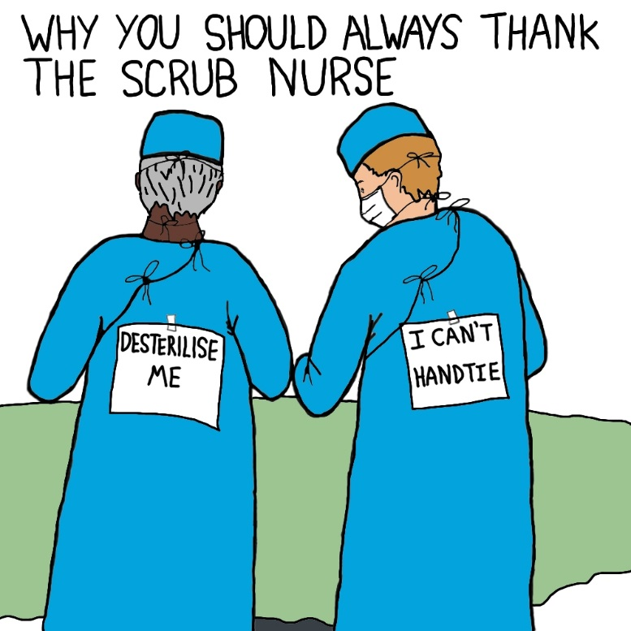
THANK YOU ☺
Nadeeka jayasinghe.

