Slide 1
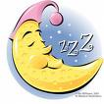
Sleep Disorders

Slide 2
Sleep
A regular , recurrent, easily reversible state , characterized by increase in threshold of response to external stimuli relative to waking state
Made up of two physiological states
NREM sleep- Non Rapid Eye Movement sleep
REM sleep - Rapid Eye Movement sleep

Slide 3
Sleep disorders
Common in the general population
Upto 30% of adults complain of insomnia
5% have excessive sleepiness
Problems with sleep
may be due to a primary sleep disorder
May be a cause of psychological symptoms
Maybe a feature of mental illness
Maybe mistaken for a psychological disorder

Slide 4
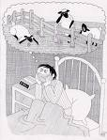
Insomnia
Difficulty initiating and maintaining sleep
Common
Transient or persistent
Transient episodes of insomnia may be associated with anxiety
grief / loss
any kind of life change or stress
No specific treatment needed
If hypnotics are given should be short term

Slide 5
secondary to ,
painful physical conditions
depressive disorders
anxiety disorders
May be associated with the use of alcohol, caffeine or prescribed medication
No cause may be found in 15% - primary insomnia

Slide 6
Management
Treating the primary cause
General measure to promote good sleep
Avoiding disruption to sleep
Short term hypnotics

Slide 7
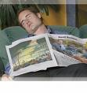

Slide 8
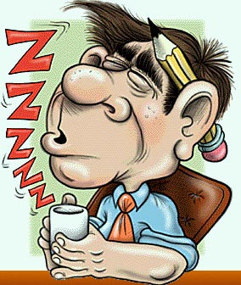
Hypersomnias
Excessive daytime sleepiness
Causes –
Insufficient night time sleep
Pathological sleep

Slide 9
Obstructive sleep apnoea
Excessive daytime drowsiness with excessive snoring at night
Associated with upper airway obstruction
Management
relieve cause of obstruction
encourage weight loss

Slide 10
Narcolepsy
Irresistible attacks of refreshing daytime sleep
Along with brief episodes of
bilateral loss of muscle tone – catalepsy
Hypnogogic / hypnopompic hallucinations (auditory or visual )
Sleep paralysis
Lasting 10 to 20 minutes

Slide 11
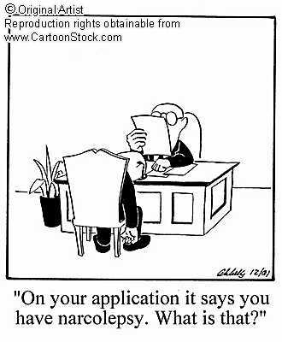

Slide 12
Begins between 10 and 20 years of age
More frequently seen in males
Could be familial
Management
Regular routine of well planned short naps during the day
Avoiding precipitants
Medication

Slide 13
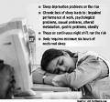
Circadian rhythm sleep disorders (sleep wake cycle disorders )
Jet lag
Shift work

Slide 14
Parasomnias
Nightmares
Night terrors
Sleep walking

Slide 15
Nightmares
Long frightening dreams from which people are awaken suddenly
Detailed dream recall present
Occurs in REM sleep
May be lifelong for some
During periods of stress / anxiety for some
Precipitated by frightening experiences during the day

Slide 16
Other causes – PTSD
fever
psychotropic drugs
alcohol detoxification
No specific treatment needed

Slide 17
Night terror disorder
Less common than nightmares
Sometimes familial
Begins in childhood
May persist into adult life
In NREM sleep

Slide 18
Suddenly gets up and appears terrified, confused, may scream
Slowly settles after a few minutes and then goes back to sleep
Little or no dream recall
Can be managed with regular bedtime routine and good sleep hygiene

Slide 19
Sleep walking (somnambulism)
Happens during NREM sleep
Usually in the early parts of the night
Common during 5 to 12 years of age
Some persist into adult life
Commoner in boys
May be familial

Slide 20
Most children do not walk but sit up and make repetitive movements
Some walk around usually with their eyes open, in a mechanical manner, but avoiding familiar objects
Most episodes last for a few seconds or minutes
Usually no recollection of what happened

Slide 21
Management
Can occasionally harm themselves
Management involves preventing injury
Should be given advice about safety, avoidance of precipitants
sleep deprivation
extreme tiredness
stress
alcohol before sleep

Slide 22
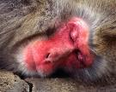
Thank you

